Slide 1




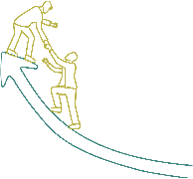






Inspire, Influence, and Innovate: Leadership Essentials

Slide 2







Sessions
Leadership Styles Overview
Effective Communication
Team Building and Collaboration
Time Management and Prioritization
Motivation and Inspiration
Adaptive Leadership
Emotional Intelligence

Slide 3
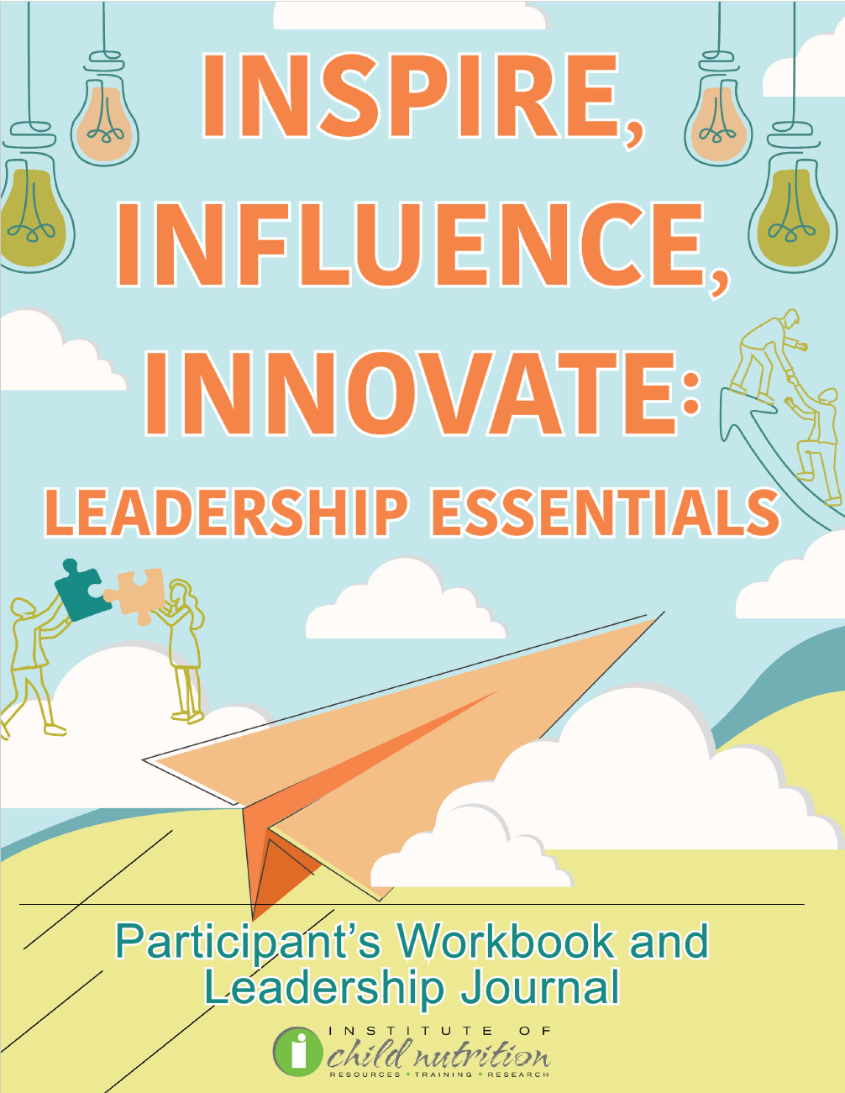
Participant’s Workbook
and Leadership Journal

Slide 4
Ground Rules
Show up on time.
Be present.
Let everyone participate.
Listen with an open mind.
Think before speaking.
Attack the problem, not the person.

Slide 5
EMOTIONAL INTELLIGENCE
EMOTIONAL INTELLIGENCE

Slide 6
Learning Objectives
Discuss the importance of self-awareness in leadership, such as its role in emotional intelligence, decision-making, and interpersonal relationships to improve leadership effectiveness.
Practice empathy techniques, including active listening to understand and share feelings, understanding different perspectives to manage diversity, and expressing empathy in interactions to build strong relationships. understood.
Explore relationship-building strategies, including building trust and loyalty to foster a reciprocal trusting environment, motivating teams by creating a culture of mutual respect and collaboration, and respecting diversity to foster an inclusive and supportive environment.

Slide 7

ACTIVITY: EMOTIONAL INTELLIGENCE DISCUSSION

Slide 8

Self-Awareness
Understanding one's character, feelings, motives
Conscious knowledge of oneself
Focusing on personal traits, behaviors, and feelings

Slide 9
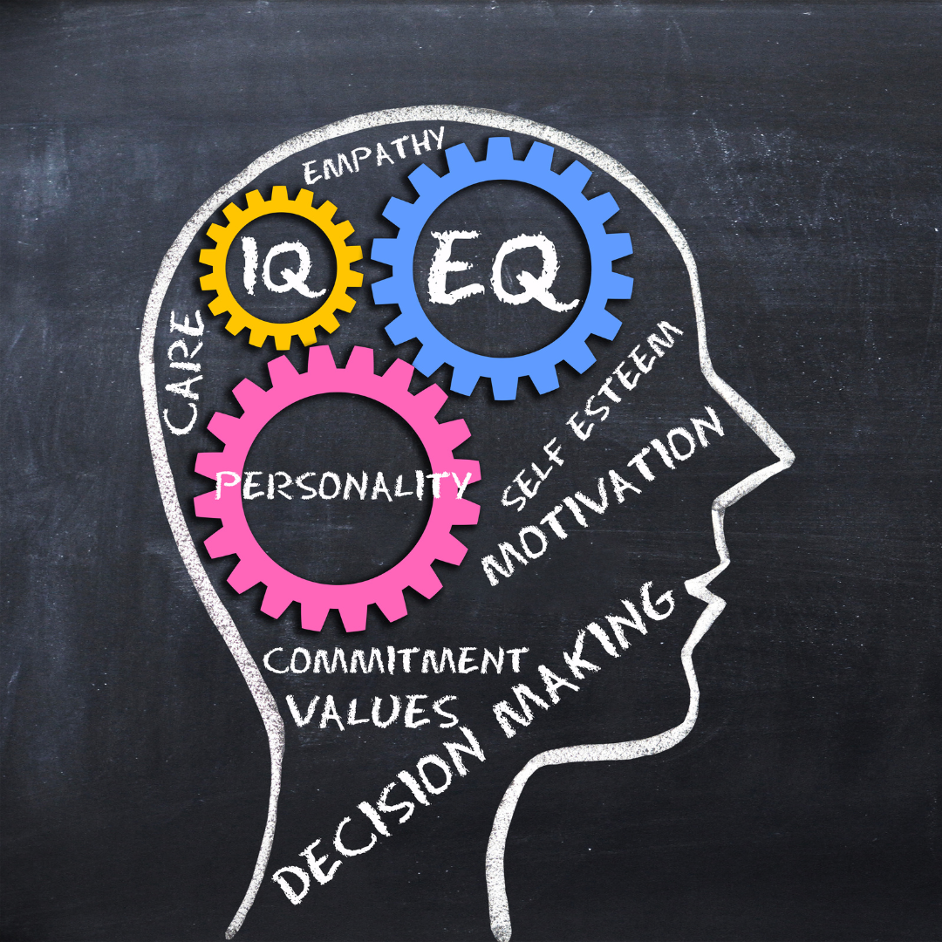
Importance of Self-Awareness in Leadership:
Emotional Intelligence
Self-awareness is key
Identify and manage emotions
Enables effective emotional management
Respond calmly and wisely

Slide 10

Importance of Self-Awareness in Leadership:
Decision Making
Aware of biases
Avoid emotional influence
Objectively evaluate options
Choose best for team

Slide 11

Importance of Self-Awareness in Leadership:
Interpersonal Relationships
Understand impact on others
Adjust behavior accordingly
Build positive relationships
Avoid conflicts

Slide 12

Importance of Self-Awareness in Leadership:
Receiving and Acting on Feedback
Open to feedback
Objectively analyze
Identify areas for improvement
Take appropriate actions

Slide 13

Importance of Self-Awareness in Leadership:
Continuous Improvement and Growth
Be aware of strengths
Acknowledge weaknesses
Work on improvement
Continuously grow as a leader

Slide 14

ACTIVITY: SELF-AWARENESS ROLE-PLAYING EXERCISE

Slide 15

Empathy
Enhances understanding
Builds strong connections
Fosters collaboration
Strengthens team morale

Slide 16

Importance of Empathy in Leadership:
Building Strong Relationships
Connect on a deeper level
Understand and share feelings
Foster trust and cooperation

Slide 17

Importance of Empathy in Leadership:
Conflict Resolution
Understand feelings and perspectives
Find resolutions that satisfy all
Foster harmonious and productive teams

Slide 18

Importance of Empathy in Leadership:
Managing Diversity
Understand and respect differences
Create an inclusive environment
Ensure everyone feels valued

Slide 19

Importance of Empathy in Leadership:
Fostering a Positive Environment
Understand and value others
Boosts satisfaction and productivity

Slide 20
ACTIVITY: EMPATHY ROLE-PLAYING EXERCISE

Slide 21

Relationship Building
Building Trust and Loyalty
Motivating Teams
Improving Teamwork
Creating a Positive Work Environment
Respecting Diversity

Slide 22
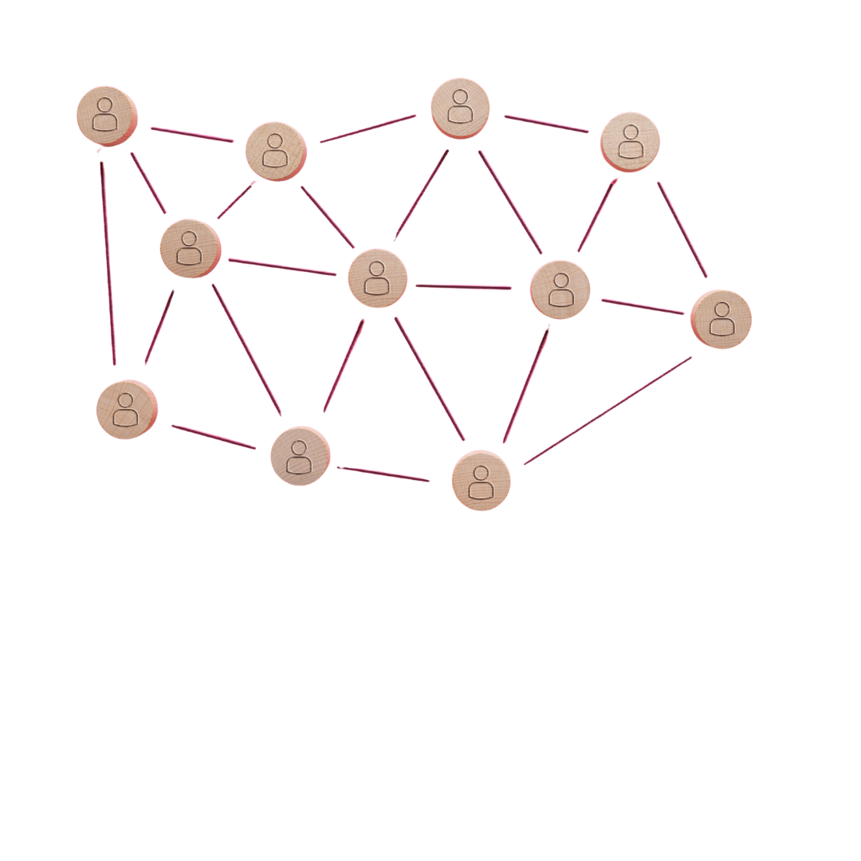
Relationship Building Strategies:
Building Trust and Loyalty
Trust is foundational
Reciprocal trust in roles
Loyalty from feeling valued

Slide 23

Relationship Building Strategies:
Motivating Teams
Enhance relationships
Value team members
Mutual respect culture

Slide 24

Relationship Building Strategies:
Improving Teamwork
Enhance relationships
Open communication
Contribute to success

Slide 25

Relationship Building Strategies:
Creating a Positive Work Environment
Genuine care and concern
Supportive atmosphere
Increased job satisfaction
Improved morale and productivity

Slide 26

Relationship Building Strategies:
Respecting Diversity
Understanding unique experiences
Valuing diverse perspectives
Fostering inclusivity
Encouraging creativity and innovation

Slide 27
ACTIVITY: RELATIONSHIP BUILDING ROLE-PLAYING EXERCISE

Slide 28

Wrap Up and Q&A
Self-Awareness
  Definition
  Characteristics
Empathy
  Characteristics
Building Relationships
  Strategies

Slide 29




Social Media Links
www.theicn.org 1-800-321-3054
Follow ICN on Social Media!
facebook.com/ichildnutrition
@ichildnutrition
instagram.com/theicn
linkedin.com/company/theicn

Slide 30
Disclosure
This training was developed by the
The University of Mississippi
School of Applied Sciences
www.theicn.org
1-800-321-3054

