Slide 1











Inspire, Influence, and Innovate: Leadership Essentials

Slide 2







Sessions
Leadership Styles Overview
Effective Communication
Team Building and Collaboration
Time Management and Prioritization
Motivation and Inspiration
Adaptive Leadership
Emotional Intelligence

Slide 3
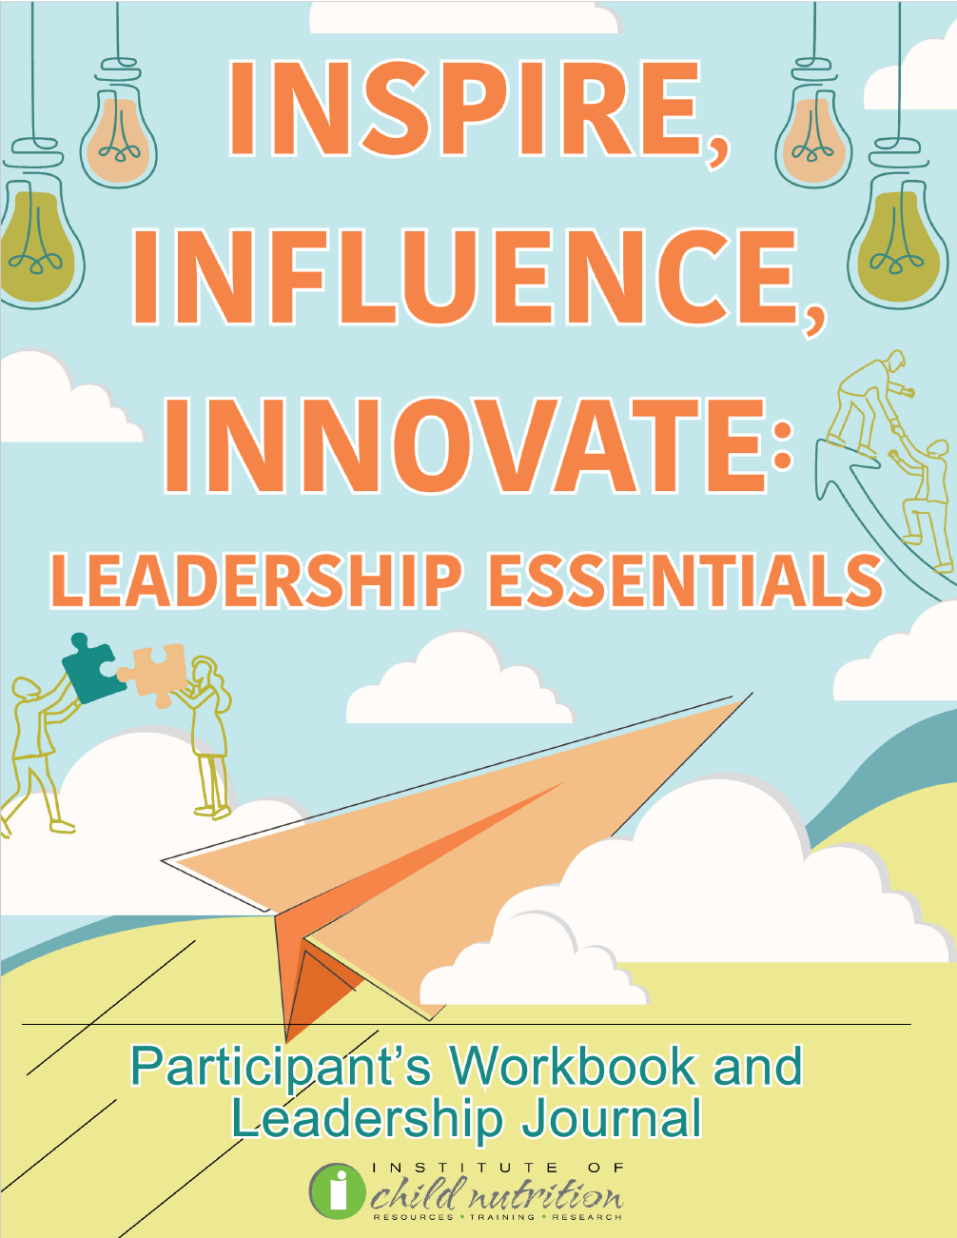
Participant’s Workbook
and Leadership Journal

Slide 4
Ground Rules
Show up on time.
Be present.
Let everyone participate.
Listen with an open mind.
Think before speaking.
Attack the problem, not the person.

Slide 5
MOTIVATION AND INSPIRATION
MOTIVATION AND INSPIRATION

Slide 6
Learning Objectives
Discuss strategies to motivate your team, including setting clear goals, providing feedback, and recognizing achievements to enhance team productivity, morale, and satisfaction in the school nutrition setting.
Practice wellness habits aimed at improving personal and professional life satisfaction, including educational initiatives, wellness programs, and leading by example.
Explore strategies to enhance leadership ethics and integrity, including self-reflection, seeking feedback, and continuous learning aimed at fostering a positive and inclusive work environment.
Explore networking and professional development, such as attending conferences, participating in online forums, and committing to continuous learning to enhance career growth, expand professional connections, and stay current with industry trends.

Slide 7

ACTIVITY: MOTIVATION AND INSPIRATION DISCUSSION

Slide 8

Motivating Your Team
Psychological force enabling action
Internal or external stimulus
Incites desire to persist, strive for goal
Involves biological, emotional, social, cognitive forces

Slide 9

Motivation and Engagement Techniques:
Set Clear Goals
Goals provide direction, purpose
Clarity and focus for team
Achievable goals as a roadmap

Slide 10

Motivation and Engagement Techniques:
Provide Feedback
Powerful motivational tool
Regular, constructive feedback
Understand performance, identify areas for improvement
Opportunity for learning, growth

Slide 11

Motivation and Engagement Techniques:
Recognize Achievements
Strong motivator
Celebrate achievements, big or small
Boosts morale, motivation
Appreciates hard work, fosters pride and satisfaction

Slide 12

ACTIVITY: MOTIVATING YOUR TEAM ROLE-PLAYING EXERCISE

Slide 13

Inspiring a Culture of Wellness
Frontline promoters of wellness
Provide nutritious meals
Educate students about healthy habits
Foster environment supporting overall wellness

Slide 14

Strategies for Encouraging Wellness:
Education Initiatives
Spearhead nutrition education
Workshops, cooking classes
Interactive nutrition games

Slide 15

Strategies for Encouraging Wellness:
Wellness Programs
Encourage physical activity
Stress management initiatives
Holistic approach to health
Fitness challenges, mindfulness sessions, health screenings

Slide 16

Strategies for Encouraging Wellness:
Leading by Example
Embody healthy habits
Consistently choose healthy meals
Stay active, maintain positive mindset
Powerful example for students, staff

Slide 17
ACTIVITY: WELLNESS ROLE-PLAYING EXERCISE

Slide 18

Leadership Ethics and Integrity
Ethics: Moral principles guiding decisions
Integrity: Being honest, strong moral principles
Inspires trust, loyalty, cooperation, productivity

Slide 19

Demonstrating Honesty and Transparency
Strive for honesty and transparency
Admit mistakes, provide clear information
Enhance trust, respect, openness, accountability

Slide 20

Creating an Inclusive Environment
Strive for inclusivity
Value and respect all team members
Respect diversity, promote equality, ensure fair treatment

Slide 21

Strategies for Making Moral and Ethical Choices:
Self-Reflection
Stay true to moral principles
Reflect on actions, consider impact
Ensure alignment with values

Slide 22

Strategies for Making Moral and Ethical Choices:
Seek Feedback
Gain insights from team members
Understand how actions are perceived
Align with team’s values

Slide 23

Strategies for Making Moral and Ethical Choices:
Continuous Learning
Stay informed about ethics
Update knowledge on ethical issues
Read, attend training, participate in discussions

Slide 24
ACTIVITY: LEADERSHIP ETHICS AND INTEGRITY ROLE-PLAYING EXERCISE

Slide 25

Networking and Professional Development
Process of interacting for information exchange
Develop professional and social contacts
Opportunities for collaboration, learning, and growth

Slide 26

Strategies for Networking and Professional Development:
Attend Conferences
Meet professionals, learn latest trends
Gain new insights and ideas

Slide 27

Strategies for Networking and Professional Development:
Online Forums
Share experiences, ask questions
Valuable source of information and support

Slide 28

Strategies for Networking and Professional Development:
Continuous Learning
Lifelong learning commitment
Stay current with industry trends
Enhance skills and knowledge
Read publications, attend webinars, take courses

Slide 29
ACTIVITY: NETWORK AND PROFESSIONAL DEVELOPMENT
ROLE-PLAYING EXERCISE

Slide 30

Wrap Up and Q&A
Motivating Your Team
  Strategies
Ethics and Integrity in Leadership
  Definitions
Networking and Professional Development
  Opportunities

Slide 31




Social Media Links
www.theicn.org 1-800-321-3054
Follow ICN on Social Media!
facebook.com/ichildnutrition
@ichildnutrition
instagram.com/theicn
linkedin.com/company/theicn

Slide 32
Disclosure
This training was developed by the
The University of Mississippi
School of Applied Sciences
www.theicn.org
1-800-321-3054

