Slide 1




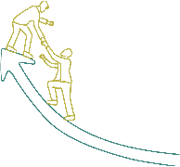






Inspire, Influence, and Innovate: Leadership Essentials

Slide 2
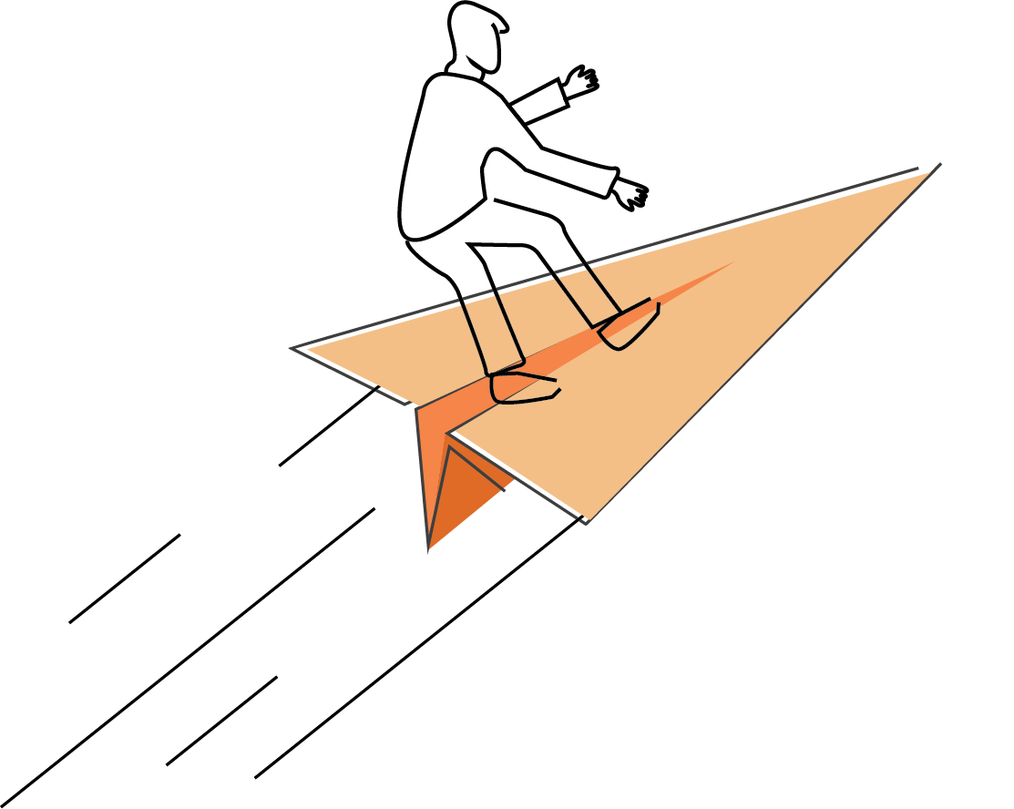






Sessions
Leadership Styles Overview
Effective Communication
Team Building and Collaboration
Time Management and Prioritization
Motivation and Inspiration
Adaptive Leadership
Emotional Intelligence

Slide 3
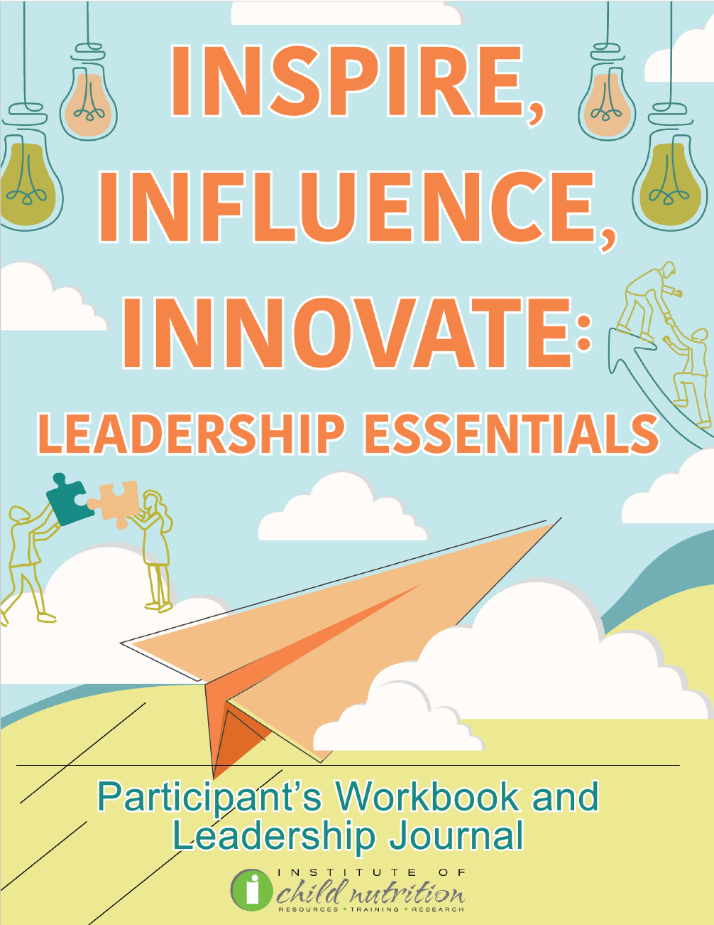
Participant’s Workbook
and Leadership Journal

Slide 4
Ground Rules
Show up on time.
Be present.
Let everyone participate.
Listen with an open mind.
Think before speaking.
Attack the problem, not the person.

Slide 5
TEAM BUILDING AND COLLABORATION
TEAM BUILDING AND COLLABORATION

Slide 6
Learning Objectives
Discuss strategies to build high-performing teams.
Practice conflict resolution techniques such as active listening, empathetic communication, focusing on the issue, not the person, and seeking win-win solutions in the context of school nutrition.
Employ strategies to collaborate across departments, such as establishing common goals, fostering open communication, respecting diverse perspectives, and sharing resources and best practices.

Slide 7

ACTIVITY: TEAM BUILDING AND COLLABORATION DISCUSSION

Slide 8

Building High-Performing Teams
Share common vision, goals
Collaboration, challenge, hold accountable
Commitment to growth, success

Slide 9

Characteristics of High-Performing Teams
Clear roles and responsibilities
Effective communication
Mutual trust
Shared vision and goals

Slide 10

Strategies for Building High-Performing Teams:
Setting Clear Expectations
Define roles, standards, deadlines
Ensure performance clarity

Slide 11

Strategies for Building High-Performing Teams:
Foster Open Communication
Encourage expression of thoughts
Create safe speaking environment
Regular team meetings

Slide 12

Strategies for Building High-Performing Teams:
Promoting Diversity & Inclusion
Bring varied perspectives
Ensure all feel valued

Slide 13

Strategies for Building High-Performing Teams:
Providing Constructive Feedback
Crucial for improvement
Acknowledge strengths, suggest improvements

Slide 14

Strategies for Building High-Performing Teams:
Recognizing and Rewarding Performance
Define roles, standards, deadlines
Ensure performance clarity

Slide 15

ACTIVITY: HIGH-PERFORMING TEAMS ROLE-PLAYING EXERCISE

Slide 16

Conflict Resolution
Natural part of teams
Arises from differences
Managed effectively, leads to:
  Creative solutions
  Improved team dynamics
  Stronger relationships
Stimulates critical thinking

Slide 17

Conflict Resolution Techniques:
Active Listening
Fully focus on speaker
Avoid interruptions
Respond thoughtfully
Shows respect, aids understanding

Slide 18
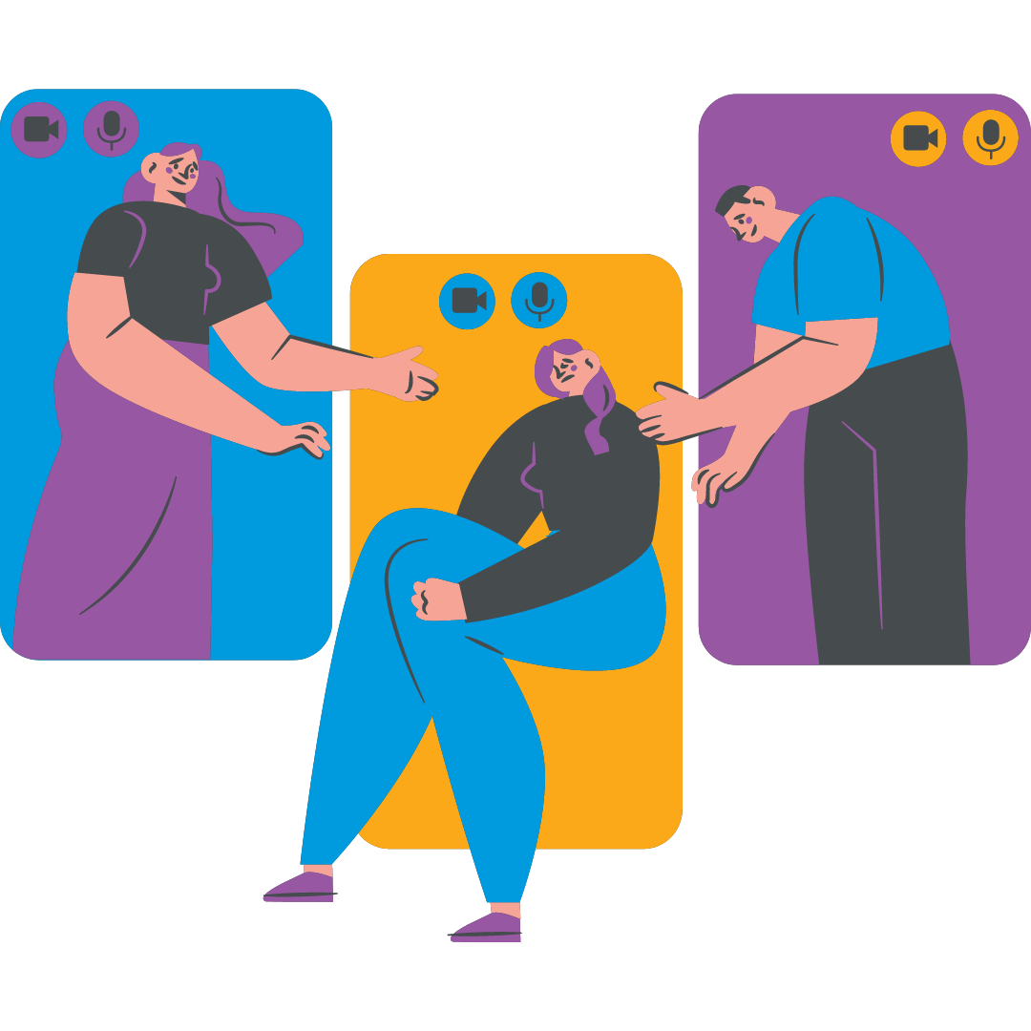
Conflict Resolution Techniques:
Empathetic Communication
Understand, share feelings
Better grasp of needs
Effective resolution strategies

Slide 19

Conflict Resolution Techniques:
Focus on the Issue, Not the Person
Avoid personal attacks
Keep discussion objective
Reduce defensiveness

Slide 20

Conflict Resolution Techniques:
Seek Win-Win Solutions
Aim for satisfying resolution
Involves compromise
Creative solutions for everyone's needs

Slide 21
ACTIVITY: CONFLICT RESOLUTION ROLE-PLAYING EXERCISE

Slide 22

Collaboration Across Departments
Crucial for promoting nutrition
Work with educators, administrators, parents
Align policies with educational goals
Ensure nutrition programs meet student needs
Leads to improved student health, academic performance

Slide 23

Effective Collaboration Strategies:
Establish Common Goals
Identify shared objectives
Define specific, measurable goals
Encourage collaborative goal-setting

Slide 24

Effective Collaboration Strategies:
Foster Open Communication
Regular communication channels
Meetings, newsletters, online platform
Keeps everyone informed
Facilitates problem-solving

Slide 25

Effective Collaboration Strategies:
Respect Diverse Perspectives
Each department unique
Respect diverse perspectives
Leads to innovative solutions
Strengthens collaboration

Slide 26

Effective Collaboration Strategies:
Share Resources and Best Practices
Help departments improve
Achieve goals effectively
Enhance overall practices

Slide 27
ACTIVITY: COLLABORATION ROLE-PLAYING EXERCISE

Slide 28

Wrap Up and Q&A
High-performing teams
  Characteristics
  Strategies
Conflict Resolution
  Techniques
Collaboration across departments
  Strategies

Slide 29




Social Media Links
www.theicn.org 1-800-321-3054
Follow ICN on Social Media!
facebook.com/ichildnutrition
@ichildnutrition
instagram.com/theicn
linkedin.com/company/theicn

Slide 30
Disclosure
This training was developed by the
The University of Mississippi
School of Applied Sciences
www.theicn.org
1-800-321-3054

