Slide 1




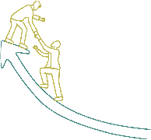






Inspire, Influence, and Innovate: Leadership Essentials

Slide 2
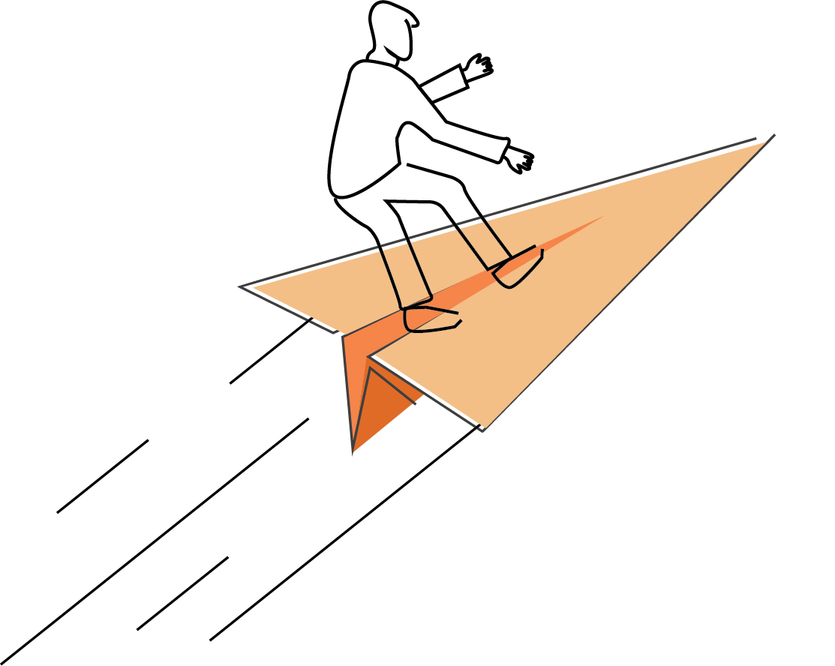






Sessions
Leadership Styles Overview
Effective Communication
Team Building and Collaboration
Time Management and Prioritization
Motivation and Inspiration
Adaptive Leadership
Emotional Intelligence

Slide 3

Participant’s Workbook
and Leadership Journal

Slide 4
Ground Rules
Show up on time.
Be present.
Let everyone participate.
Listen with an open mind.
Think before speaking.
Attack the problem, not the person.

Slide 5
TIME MANAGEMENT AND PRIORITIZATION
TIME MANAGEMENT AND PRIORITIZATION

Slide 6
Learning Objectives
Discuss strategies to effectively manage workload.
Practice delegation skills by clearly defining tasks and expectations, matching tasks with team members’ skills and interests, and providing feedback and recognition in the context of school nutrition
Employ strategies to successfully balance work and life, such as setting boundaries, taking breaks, practicing self-care, and seeking support.

Slide 7

ACTIVITY: TIME MANAGEMENT AND PRIORITIZATION DISCUSSION

Slide 8

Managing Workload
Amount of work
Maintain productivity
Prioritize tasks
Set realistic goals
Foster a healthy work-life balance

Slide 9
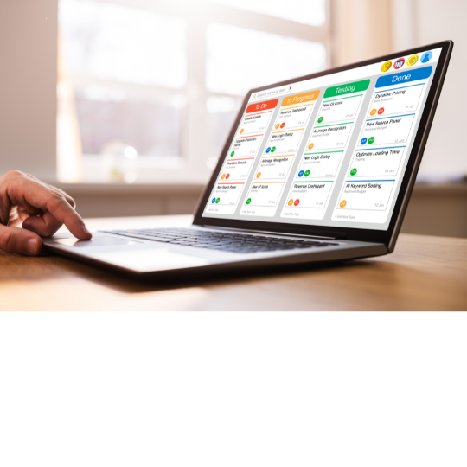
Workload Management Strategies:
Task Management Tools
Track tasks, deadlines, progress
Digital tools for organization
Set reminders, delegate tasks

Slide 10

Workload Management Strategies:
Create a Daily Schedule
Provide structure to the day
Allocate sufficient time
Avoid multitasking, reduce stress

Slide 11

Workload Management Strategies:
Prioritizing Tasks
Not all tasks are equal
Importance and urgency
Focus on what's crucial
Manage time effectively

Slide 12

ACTIVITY: WORKLOAD MANAGEMENT ROLE-PLAYING EXERCISE

Slide 13

Delegation Skills
Assigning responsibility, authority
Allows focusing on high-level tasks
Empower team members
Efficient task distribution

Slide 14

Benefits of Delegation
Empowering team members
Improving efficiency
Freeing up time for strategic planning

Slide 15
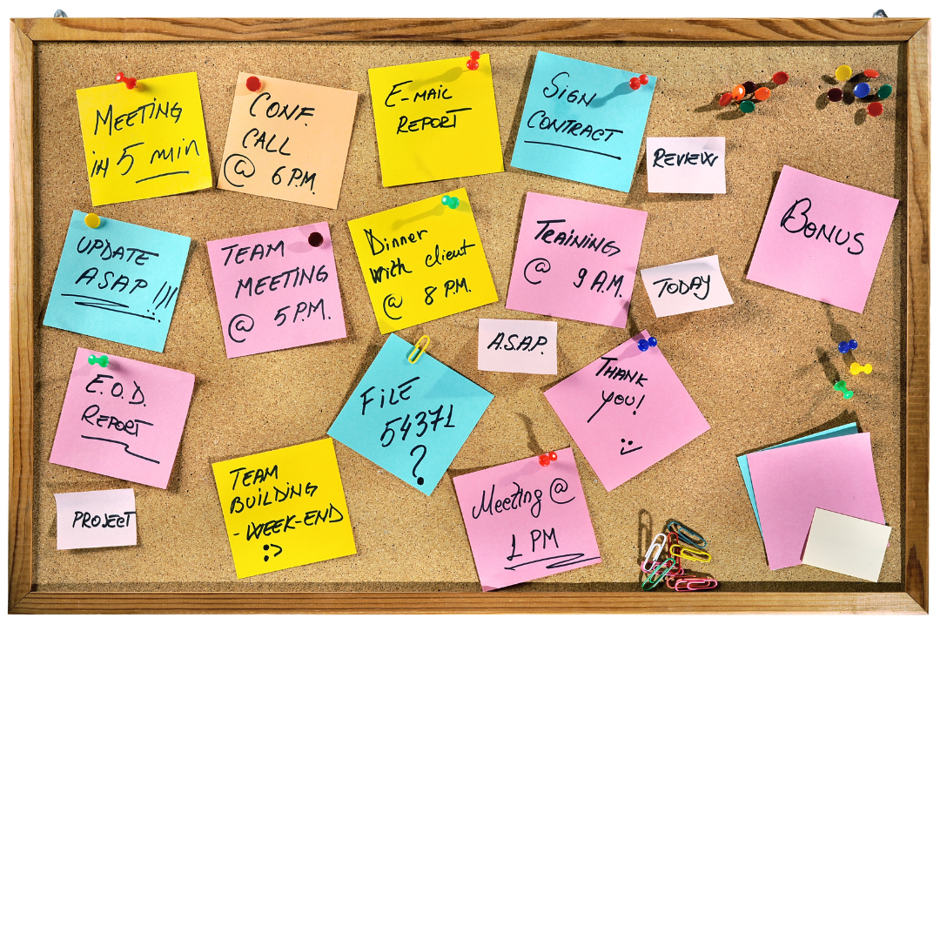
Delegation Strategies:
Clearly Define Tasks and Expectations
Define task, expectations clearly
What needs to be done
When it needs to be done
Guidelines, standards

Slide 16

Delegation Strategies:
Match Tasks with Skills and Interests
Match tasks with skills, interests
Ensures task success
Increases motivation, engagement

Slide 17

Delegation Strategies: Provide Feedback and Recognition
After task completion
Provide feedback
Recognize and appreciate
Encourage learning and growth

Slide 18
ACTIVITY: DELEGATION ROLE-PLAYING EXERCISE

Slide 19

Balancing Work and Life
Equilibrium between work and personal life
Sustainable harmony
Wellbeing, productivity, job satisfaction

Slide 20

Strategies for Work-Life Balance:
Set Boundaries
Define clear work, personal boundaries
Avoid work emails after a certain time
Ensure full lunch breaks

Slide 21

Strategies for Work-Life Balance:
Take Breaks
Prevent burnout, improve productivity
Short walks, mindfulness, breaks from workspace

Slide 22

Strategies for Work-Life Balance:
Practice Self-Care
Regular exercise
Healthy diet
Sufficient sleep
Relaxation techniques
Manage stress
Improve work-life balance

Slide 23

Strategies for Work-Life Balance:
Seek Support
Feeling overwhelmed
Seek support from colleagues, supervisor
Consider mental health professionals

Slide 24
ACTIVITY: WORK-LIFE BALANCE ROLE-PLAYING EXERCISE

Slide 25

Wrap Up and Q&A
Managing Workload
  Strategies
Delegation
  Techniques
Work-Life Balance
  Benefits
  Strategies

Slide 26




Social Media Links
www.theicn.org 1-800-321-3054
Follow ICN on Social Media!
facebook.com/ichildnutrition
@ichildnutrition
instagram.com/theicn
linkedin.com/company/theicn

Slide 27
Disclosure
This training was developed by the
The University of Mississippi
School of Applied Sciences
www.theicn.org
1-800-321-3054

