Slide 1
Culinary Institute Of Child Nutrition

Slide 2
SCHOOL MEAL RECIPE WORKSHOP:
From Concept to Standardization
Day 3

Slide 3
Schedule-at-a-Glance
Day Three
Time | Topic | Activities and Objectives
30 Minutes | Review Plan for the Day | Review how to conduct a yield test. Yield test activity Produce a small batch of the recipe and ask staff to informally evaluate the recipe.
As needed | Recipe | Make the small batch recipe Verify recipe yield Evaluate the recipe (staff) Make recipe adjustments
30-60 Minutes | End of the Day Meeting | Summarize day Answer questions Next Steps

Slide 4
Workshop Objectives
Review how to conduct a yield test.
Yield test activity
Produce a small batch of the recipe and ask staff to informally evaluate the recipe.

Slide 5





Yield Test
Nutritional Accuracy | Cost Effectiveness | Portion Control | Menu Planning | Waste Reduction

Slide 6
Scenario: Yield Test for Vegetable Soup
Your team is testing a new vegetable soup to add to next year’s menu. You are in the process of recipe testing and want to ensure an accurate yield.

Slide 7


Scenario: Yield Test for Vegetable Soup – Preparation
Gather ingredients and equipment
Weigh and measure raw ingredients

Slide 8


Scenario: Yield Test for
Vegetable Soup – Cooking Process
Prepare the ingredients
Cook the soup

Slide 9


Scenario: Yield Test for Vegetable Soup – Measuring Final Yield
Cool the soup slightly
Weigh the cooked soup
Calculate the yield

Slide 10



Scenario: Yield Test for Vegetable Soup – Analysis and Adjustment
Analyze the results
Adjust for consistency
Document the results

Slide 11
Scenario: Yield Test for Taco Meat
Participants will learn how to calculate and assess the yield of a recipe for taco meat intended to provide 25 servings, each serving being a 2 oz portion of cooked and seasoned ground beef.

Slide 12



Scenario: Yield Test for Taco Meat – Preparation
Gather ingredients and equipment
Understand the recipe yield
Calculate raw ground beef needed

Slide 13


Scenario: Yield Test for Taco Meat – Cooking Process
Cook the taco meat
Assess the yield

Slide 14



Scenario: Yield Test for Taco Meat – Measuring Final Yield
Identify yield accuracy
Corrective actions (if needed)
Documentation and adjustment

Slide 15
Recipe Review Checklist Guide
Review Step | Questions | Yes | No | N/A | Action Needed
Title | Is the recipe name descriptive of the dish, and is the dish appropriately named? |  |  |  | If yes, leave the title as listed, move to next title question. If no, consider new title.
 | Is the title appealing to customers? |  |  |  | If yes, leave title as listed, move to next review step. If no, consider alternate title to be used on menu.
Recipe category | Are recipes organized by category? |  |  |  | If yes, move to next review step. If no, identify recipe category on recipe.
Ingredients | Are all the ingredient names clear? |  |  |  | If yes, move to next ingredient question. If no, rewrite ingredient name.

Slide 16




Test the Recipe
Prepare the newly scaled recipe
Track time
Recipe Quality Score Card and informal evaluation
During preparation:
⬥ Make notes
⬥ Taste
⬥ Seasonings
TAKE PICTURES and/or VIDEOS ☺

Slide 17
Recipe Review Checklist Guide
Recipe Name:
Questions | Yes | No | Corrective Action
Is the visual appearance of the product acceptable?
Is the flavor of the product one that students might enjoy?
Are the ingredients in the recipe easily obtained?
Is the texture of the recipe correct?
Is the labor time to make the product within foodservice department guidelines?
Do employees possess the skills to prepare this item?
Is the recipe within nutrition guidelines/goals?
Is the equipment available to prepare this item?
Is the recipe acceptable enough to continue with more evaluation?

Slide 18
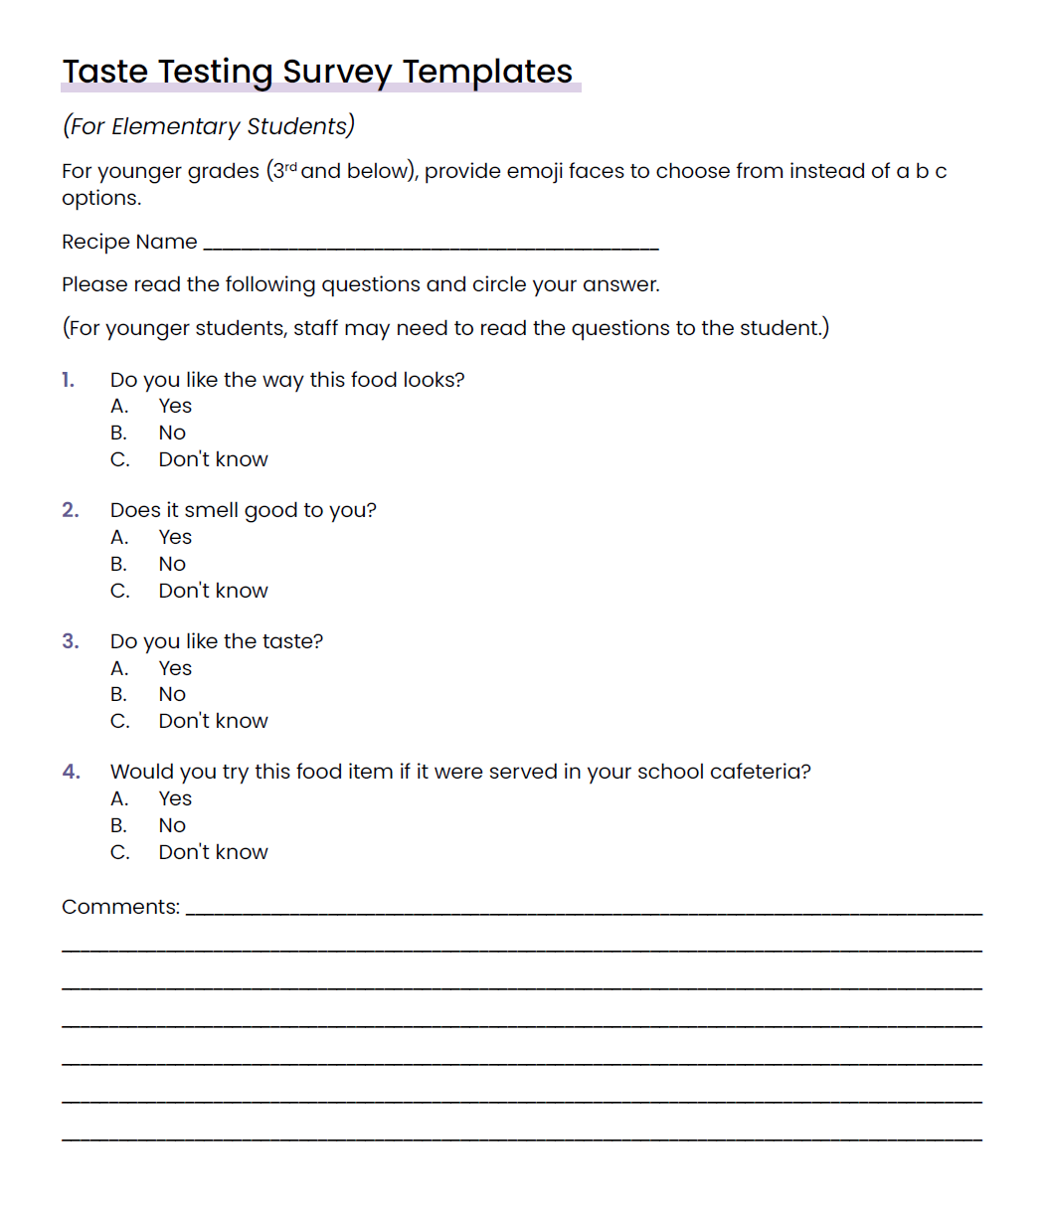
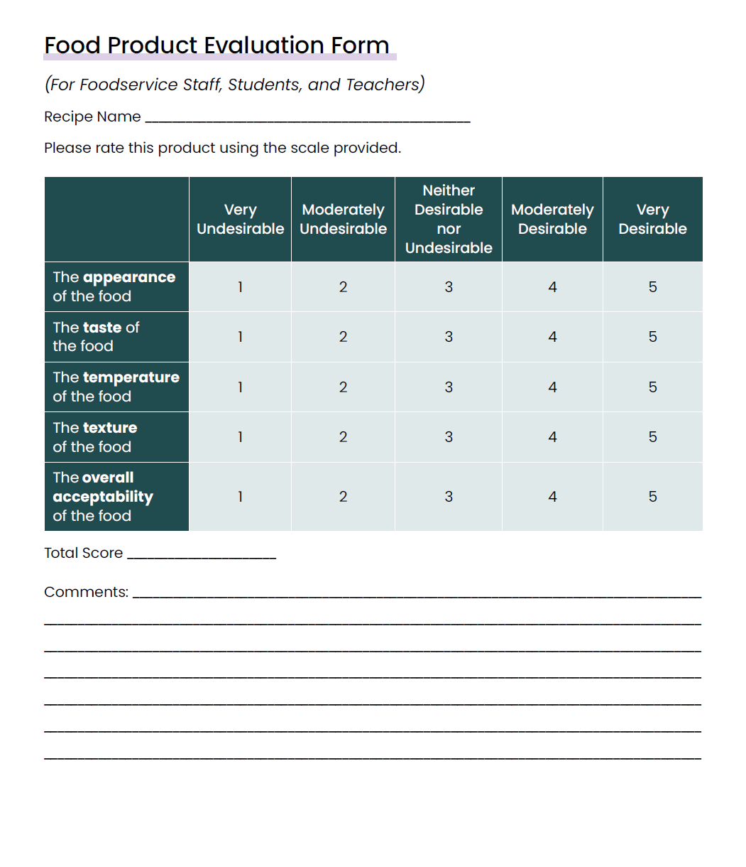
Culinary Institute Of Child Nutrition

Slide 19
REMEMBER!
Please take pictures and/or videos of the process
(I’ll send an email reminder or two during the recipe testing time to remind you to take pictures)

Slide 20
Activity: Small Batch Test & Student
Evaluation – Independent Work
Participants will produce a small batch of the recipe and ask staff to informally evaluate the recipe.
  Complete the Recipe Review Checklist and Recipe Review Checklist Decision Guide to ensure the recipe includes all the required information.
  Produce a small batch of the recipe.
  Verify the yield of the recipe.
  Conduct an informal evaluation of the recipe with staff.

Slide 21
Sharing Session

Slide 22
Key Takeaways and “Ah-Ha” moments

