Slide 1
Culinary Institute Of Child Nutrition

Slide 2
SCHOOL MEAL RECIPE WORKSHOP:
From Concept to Standardization
Day 4

Slide 3
Schedule-at-a-Glance
Day Four
Time | Topic | Activities and Objectives
20 Minutes | Review Plan for the Day | Produce a small batch of the recipe Staff and student evaluation
As needed | Recipe | Prepare small batch recipe Evaluate the recipe (staff and students) Make recipe adjustments
30-60 Minutes | End of the Day Meeting | Summarize day Answer questions Next Steps

Slide 4
Workshop Objectives
Produce a small batch of the recipe and conduct the evaluations.

Slide 5
Evaluation and Testing
Student evaluations
    Taste-Testing Survey Template
    Food Product Evaluation Form, or
    another age-appropriate evaluation method
    PLEASE take pictures and/or videos of your process
Recipe adjustments
Prepare for Day 5

Slide 6




Test the Recipe with Students
Prepare the scaled recipe for students, staff, and other community members
Formal evaluation
During preparation:
⬥ Make notes
⬥ Taste
TAKE PICTURES and/or VIDEOS ☺

Slide 7
Formal Evolution
Customers, Child Nutrition Manager, foodservice staff members, other members of your school community
Best practices
  a minimum of 50 students
  at least 85% of the student taste tests must approve the recipe
Reality

Slide 8




Places for student feedback
Incorporated into a nutrition education lesson
In conjunction with
a visit from a local farm/rancher/fisher highlighting an ingredient
Sample station in the cafeteria
Part of a student leadership group meeting
Work with school administration to make being a “taste-tester”
a reward

Slide 9
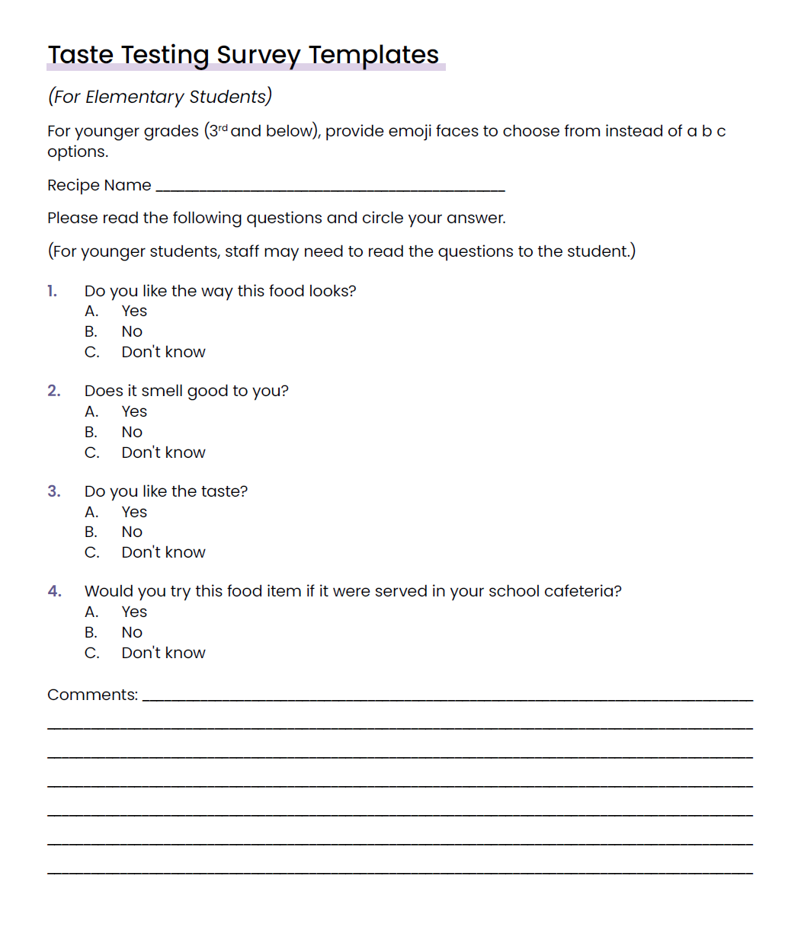
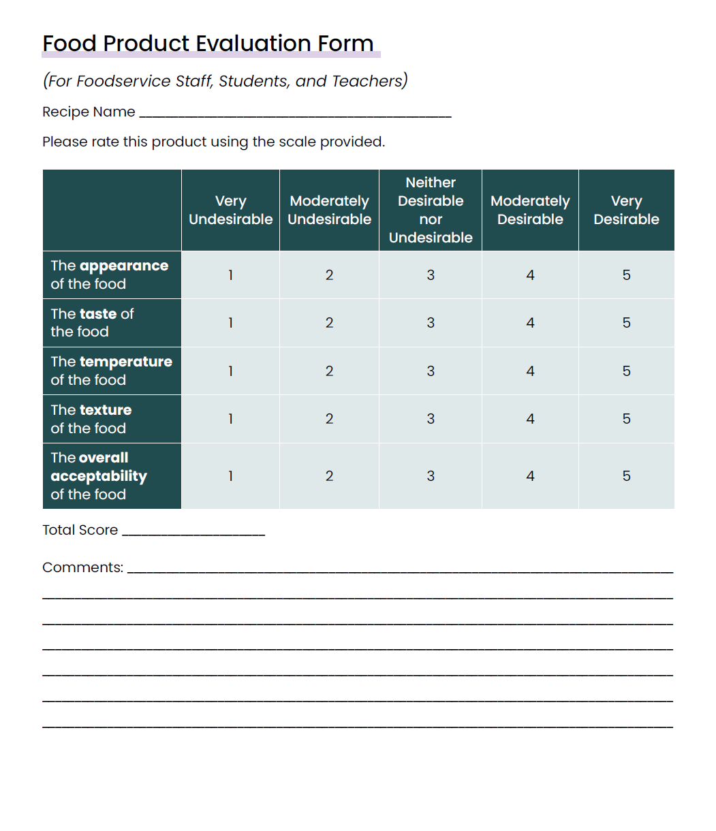
Templates and form

Slide 10

Test
TASTE TEST

Slide 11
REMEMBER!
Please take pictures and/or videos of the process
(I’ll send an email reminder or two during the recipe testing time to remind you to take pictures)

Slide 12
Activity: Small Batch Test & Student
Evaluation – Independent Work
Participants will produce a small batch of the recipe and ask staff to informally evaluate the recipe.
  Complete the Recipe Review Checklist and Recipe Review Checklist Decision Guide to ensure the recipe includes all the required information.
  Produce a small batch of the recipe.
  Verify the yield of the recipe.
  Conduct a small batch student evaluation of the recipe.

Slide 13
Sharing Session

Slide 14
Key Takeaways and “Ah-Ha” moments

