Slide 1
Culinary Institute Of Child Nutrition

Slide 2
SCHOOL MEAL RECIPE WORKSHOP:
From Concept to Standardization
Day 2

Slide 3
Schedule-at-a-Glance
Day Two
Time | Topic | Activities and Objectives
120 Minutes | Review Plan for the Day | Review the Food Buying Guide for Child Nutrition Programs (FBG) and Recipe Analysis Workbook (RAW). Discuss the recipes each participant will be developing. Draft the initial recipe using your nutrient analysis software and FBG.
As needed | Standardized Recipes | Draft recipe
30-60 Minutes | End of the Day Meeting | Summarize day Answer questions Next Steps

Slide 4
Review of Day 1
Examined the USDA Recipe Standardization Process
Reviewed the step for piloting a standardized recipe
  Recipe Verification Phase
  Product Evaluation Phase
    Informal evaluation
    Formal evaluation
  Quantity Adjustment Phase
Visited the online the Food Buying Guide for Child Nutrition Programs (FBG) and the Recipe Analysis Workbook (RAW)

Slide 5



Objectives for Day 2
Review the Food Buying Guide for Child Nutrition Programs (FBG) and Recipe Analysis Workbook (RAW).
Discuss the recipes each participant will be developing.
Draft the initial recipe using your nutrient analysis software and FBG.

Slide 6
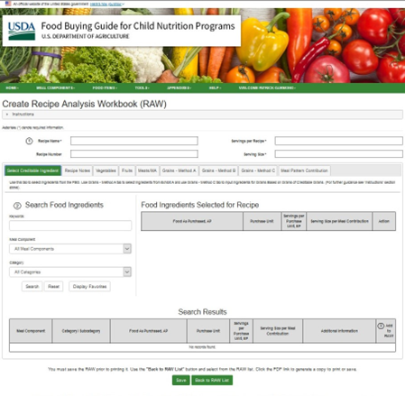
The USDA Food Buying Guide for Child Nutrition Programs and the Recipe Analysis Workbook
Training Learning Goal
Familiarize participants with the Food Buying Guide and Recipe Analysis Workbook.

Slide 7


Food Buying Guide for Child Nutrition Programs (FBG) Introduction
The Food Buying Guide for Child Nutrition Programs (FBG)
is a resource designed to help you:
Purchase the right amount of food in the most cost-effective way.
Determine the specific contribution each food makes toward the meal pattern requirements.

Slide 8

More about the Food Buying Guide
  First published in 1947
  Updated to reflect changes in meal pattern requirements, addition of new foods, changes
  in technology, and packaging yields
  Available in different formats:
    Interactive Web-Based Tool
    Mobile App (download from mobile device’s App Store)
    Downloadable, printable PDF

Slide 9
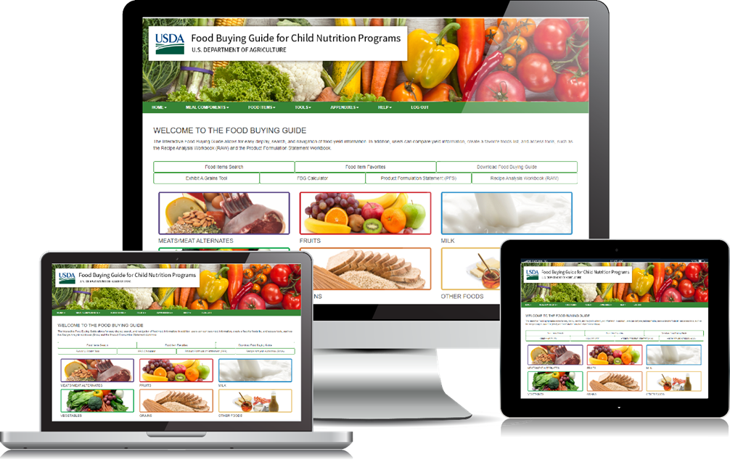
How to Access the Food Buying Guide

Slide 10
How to Access the Food Buying Guide
Access the Food Buying Guide for Child Nutrition Programs
Home Page
  To access the Food Buying Guide home page, navigate to
  https://www.fns.usda.gov/tn/food-buying-guide-for-child-nutrition-programs
Access the Interactive Web-Based Tool
  To access the Food Buying Guide Interactive Web-Based Tool, navigate to
  https://foodbuyingguide.fns.usda.gov
Access the Mobile App
  To access the Mobile App from iPhone or iPad, open the App Store, and download the Food Buying Guide for CNP.
  It is also available for Android platforms from Google Play.

Slide 11
Virtual Tour of FBG and RAW

Slide 12
Activity: Recipe Writing
Share the recipe details:
  Why (on how if applicable) the recipe was selected
  The primary ingredients that will be used
  The production process (hot, cold, complex food production, etc.)
  Any challenges they may perceive in developing the recipe
  Additional questions as the instructor(s) see as useful to enhance the learning

Slide 13
Activity: Recipe Writing –
Independent Work
Participants will write a first draft of a recipe using their site’s nutrient analysis software.
  Participants are encouraged to select a recipe that is planned to be used in the program on future menus.
  Instructors will be available to answer questions and provide technical assistance throughout the activity.
  Be prepared to share the recipe, via screen share on the Zoom Meeting application, with the workshop cohort.

Slide 14
Write the Recipe
Use the USDA Standardized Recipe
Template to write the recipe
Recipe Title and Recipe Description
(page 53 of your workbook)
Recipe Category
(page 59 of your workbook)
Ingredients and units of measure
(pages 60-66 of your workbook)
Preparation Directions
(page 67 of your workbook)
Cooking Temperature, Cooking Time,
and Preparation Time
(pages 69-71 of your workbook)
Serving Size and Yield
(page 72 of your workbook)
Equipment and Utensils Needed
(page 79 of your workbook)
Crediting Information
(page 81 of your workbook)
Marketing Guide
(page 88 of your workbook)
Food Safety Guidelines
(page 91 of your workbook)

Slide 15
Sharing Session

Slide 16
Key Takeaways and “Ah-Ha” moments

