Slide 1
Culinary Institute Of Child Nutrition

Slide 2
SCHOOL MEAL RECIPE WORKSHOP:
From Concept to Standardization
Day 1

Slide 3
Welcome and
Introductions

Slide 4
Schedule-at-a-Glance
Day One
Time | Topic | Activities and Objectives
30 Minutes | Introduction | Introduce Instructor Introduce ICN Staff Participant Introductions and Ice Breaker Activity Review Workshop Schedule and Topics Review ICN Ground Rules Pre-Workshop Assessment
300 Minutes | How to Identify, Prepare, and Standardize a Recipe | Participants will be able to describe how the recipes will be identified, prepared, and standardized in accordance with the USDA Recipe Standardization Process. USDA Recipe Standardization Process Recipe Verification Phase Product Evaluation Phase Quantity Adjustment Phase
5 Minutes | Wrap up | Summarize day Answer questions Next Steps

Slide 5
Key Areas and Professional Standards Codes
Key Area Code
1 – Nutrition
2 – Operations
4 – Communications and Marketing
USDA Professional Standards Codes
Menu Planning – 1100
Food Production – 2100
Communications and Marketing – 4100

Slide 6
Ground Rules
Show up on time and come prepared
Stay mentally and physically present
Let everyone participate
Listen with an open mind
Think before speaking
Attack the problem, not the person
Focus on safety
Maintain physical safety
Wear proper kitchen attire

Slide 7
Pre-Assessment
INSERT SPECIFIC QR CODE FOR EACH SESSION OFFERED

Slide 8
Day 1 Topic Overview
Standardized Recipes
Evaluation and Piloting
Student and Community Engagement
USDA Recipe Standardization Process
Tools for Analyzing Recipes

Slide 9
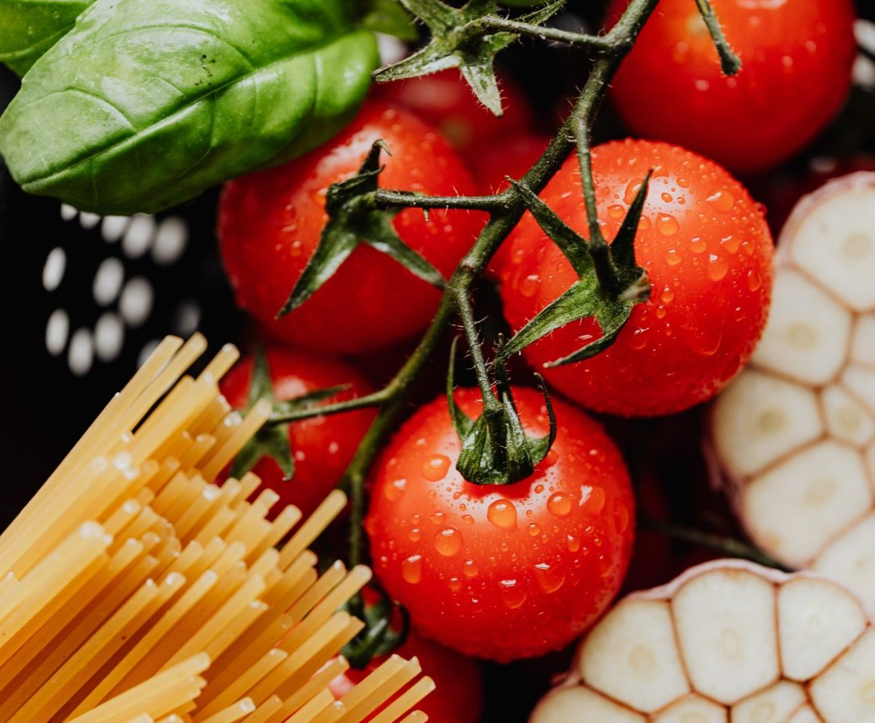
How to Identify, Prepare, and Standardize a Recipe
Day One Learning Goal
Participants will be able to describe how the recipes will be identified and prepared in accordance with the USDA Recipe Standardization Process.

Slide 10
Recipe Standardization Process Flow
Recipe verification
Product evaluation phase
Quantity adjustment phase

Slide 11
Introduction to Standardized Recipes
Learning Objectives
Define a standardized recipe.
Review the importance and benefits of using standardized recipes.

Slide 12
Recipe Verification Phase
Learning Objectives
Describe methods for soliciting recipes from the school community.
Discuss strategies for identifying locally sourced food items to be used in the recipe.
Recognize the anatomy of a standardized recipe.
Review the information to include in a standardized recipe.
Summarize the recipe verification phase.
Review the process of preparing, verifying the yield, completing the nutrient analyses and crediting information, and evaluating the usability of the recipe at the intended service site.

Slide 13

Product Evaluation Phase
Learning Objectives
Summarize the product evaluation phase.
Describe the informal evaluation process.
Describe the formal evaluation process.

Slide 14
Quantity Adjustment Phase Learning Objectives
Identify the methods for adjusting the quantity yields for recipes.
Discuss information for adjusting recipes.

Slide 15
After Recipe Standardization
Learning Objectives
Discuss how piloting your new recipe as part of a school meal service can help you get feedback on whether the recipe will work in a “real world” setting.
Review methods of training school nutrition staff on the preparation, serving, and marketing of the recipe.
Discuss strategies for implementing an evaluation process and collecting staff feedback.
Evaluate student acceptability and collect feedback on the recipe during the meal service.
Determine if the recipe needs to be modified and re-standardized based on the result of the pilot.

Slide 16


Introduction to Standardized Recipes
Benefits of
standardized recipes
Importance of standardized recipes

Slide 17
The U.S. Department of Agriculture (USDA) defines a standardized recipe as one that:
has been tried, adapted, and retried at least three times and has been found to produce the same good results and yield every time when the exact same procedures are used with the same type of equipment and the same quantity and quality of ingredients.

Slide 18
USDA Standardized Recipe Process
Required
Not required
New recipes
When a recipe requires significant changes
Ingredients, equipment, and scaling
Making minor adjustments to the recipe
Implementing a USDA Standardized Recipe
Prudent to pilot the recipe

Slide 19
Quantity Recipes vs.
Standardized Recipes
The terms “quantity recipes” and “standardized recipes” often are used interchangeably; however, they are not the same.
Many recipes are written to produce large quantities of food, but the recipe may or may not be standardized.
Any recipe that produces 25 servings or more is termed a quantity recipe.
Quantity recipes are not standardized until they have been prepared at least 3 times with consistent results.

Slide 20
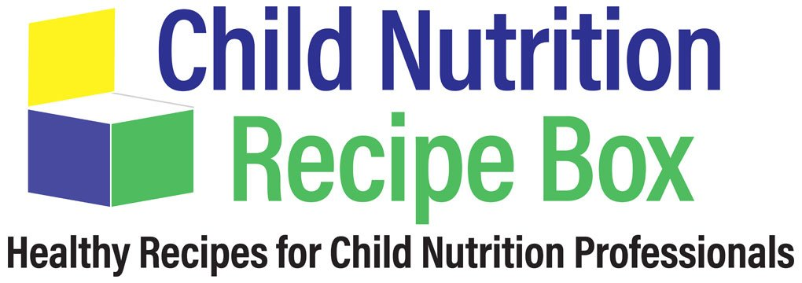
Child Nutrition Recipe Box
USDA Standardized Recipes

Slide 21
Brainstorm:
What are some of the benefits of using standardized recipes in your operation?

Slide 22
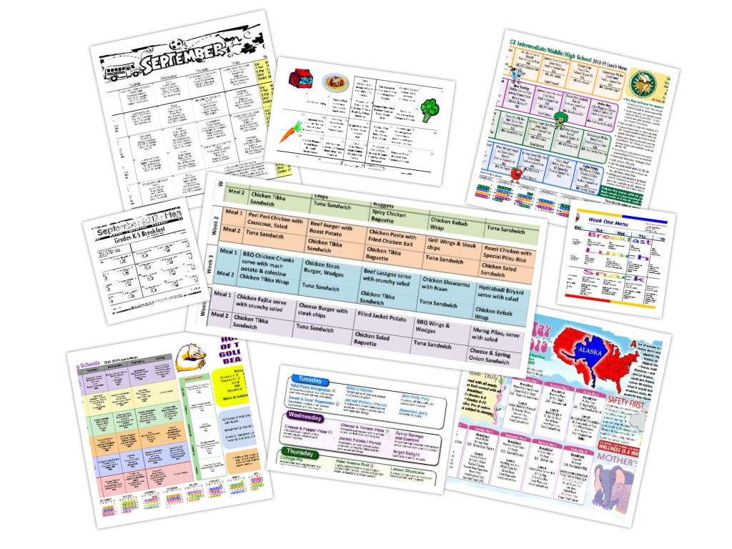
Benefits of Standardized Recipes
Inventory control
Labor cost control
Increased employee confidence
Successful completion of Administrative Reviews

Slide 23
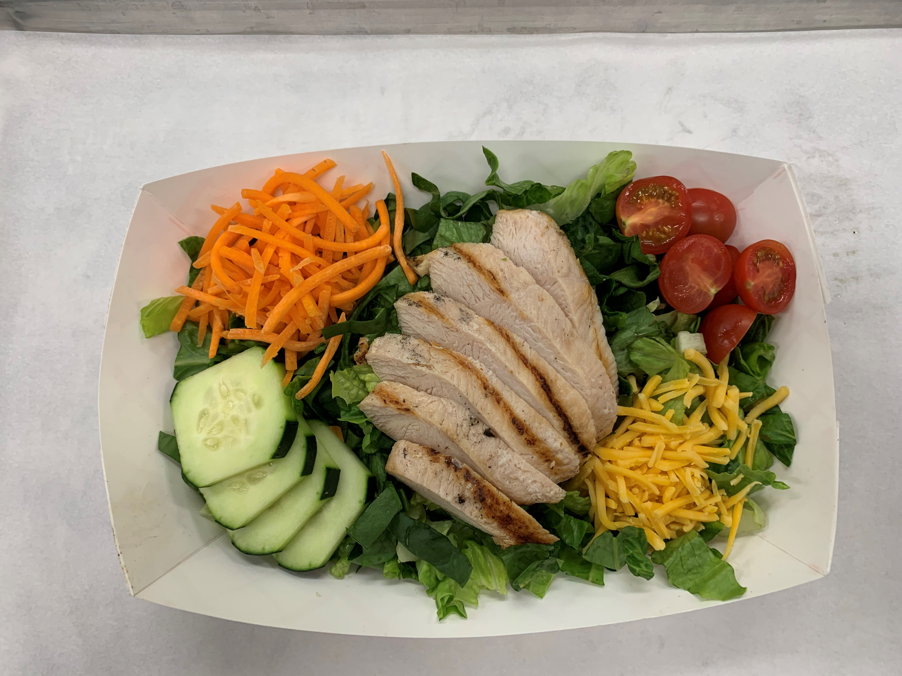
Benefits of Standardized Recipes
Consistent food quality
Predictable yield
Customer satisfaction
Consistent nutrient content
Food cost control
Efficient purchasing procedures

Slide 24
Discussion:
How many attendees use standardized recipes in your kitchens?
Where do you obtain the standardized recipes that you use in your kitchens?

Slide 25
Which of the following is not a benefit of standardizing recipes?
Cost control
Customer satisfaction
Over-purchasing food
Nutrient analysis
Predictable yield

Slide 26
Which of the following is not a benefit of standardizing recipes?
Cost control
Customer satisfaction
Over-purchasing food
Nutrient analysis
Predictable yield

Slide 27
Importance of Standardized Recipes
Four main areas positively impacted by routinely using standardized recipes.
  Cost control
  Customer satisfaction
  Nutrient analysis
  Predictable yield

Slide 28
Discussion:
How has the use of standardized recipes impacted the areas of cost control, nutrient analysis, predictable yield, and customer satisfaction in your program?
Have any of your programs had challenges implementing standardized recipes?
How have you been able to overcome
those challenges?

Slide 29
Recipe Verification Phase
Summarize the recipe verification phase to include identifying, reviewing, preparing, verifying the recipe yield, and recording changes to the recipe.

Slide 30
Breakout Rooms
How have you or how could you solicit recipes from the school community?

Slide 31
Soliciting Recipes from the School Community
Incorporate stakeholders from the school community
  Increase program buy-in
  Develop community partners

Slide 32
Recipe Solicitation Strategies
Recipe Dropbox
Student Cooking Competitions
Outreach to Parent Groups
Vendors

Slide 33
Recipe Solicitation Strategies
Recipe contests
Focus groups
Advisory groups
Surveys
Other ideas?

Slide 34
Recipe Solicitation Strategies
Focus groups
Surveys
Identify specific age groups, sites, or stakeholders.
Identify the group’s likes and dislikes, perception of the department, and other useful information.
Collect menu suggestions and ideas.

Slide 35
Recipe Solicitation Strategies
Outreach to Parent Groups
Present at PTA/PTO meetings.
Provide program overview and goals as well as project-specific goals.
Opportunity to solicit recipe ideas.
Provide updates on the status of
the project. Highlighting student engagement.
Provide testimonials of how PTA/PTO group input has improved the menu.
Include the Local Wellness (policy) Team.

Slide 36
Discussion:
What are some benefits of incorporating local recipes into the School Meal Programs?
How do you communicate with the local school community?

Slide 37

Strategies for Identifying Locally Sourced
Food Items
Discuss strategies for identifying locally sourced food items to be utilized in the recipe.

Slide 38
True or False?
Many ingredients can be sourced locally.

Slide 39
True
Many ingredients can be sourced locally.

Slide 40

How to Define Local
Defined at the district level
Crafted to meet the purchasing goals of the district

Slide 41
Benefits of Purchasing Locally Sourced Foods
Access to nutritious,
high-quality foods
Good stewardship
of SFA funds
Financial support of local food producers
Community engagement
Opportunities to increase food-related education of students
Positive environmental impacts
Learn about cultural impact of regional/ethnic food traditions and preparation methods

Slide 42
Models For Procuring Local Foods
Distributors
Food processors
Department of Defense Fresh Fruit and Vegetable Program (DoD Fresh)
Individual producers (direct from farmers, ranchers, and fishers)
Producer cooperatives and food hubs
School gardens

Slide 43
Discussion:
What are some positive impacts you have experienced from increasing the procurement
of local foods in your program/state?
What are some local food items you have had success purchasing and serving?
Does anyone want to share some unique food items that will be featured in your recipes? Can you also share why you selected the food item?

Slide 44
Strategies for Identifying Locally
Sourced Food Items
Local purchasing is not just about fresh fruits and vegetables, and it is not just about farmers.
Local and regional foods can also include:
Beans
Grains
Flour
Meat & Poultry
Fish
Condiments
Herbs
Eggs
Dairy

Slide 45
Strategies for Identifying Locally
Sourced Food Items
Many organizations are set up to help forge the relationship between schools and local food producers.
National Farm to School Network
  https://www.farmtoschool.org/
Cooperative Extension Programs
Food Hubs
Developing relationships between the school district and local producers and suppliers benefit everyone, from teachers and administrators to parents and producers, providing opportunities to build positive community outcomes.

Slide 46
Discussion:
How many attendees are already buying local products?
What resources are you using in your program to source local foods?
Looking at your recipe, are there any ingredients you could procure locally?

Slide 47
Recipe Review Process
Writing the recipe
Reviewing the recipe with your food production team
Allowing for input
Two-part process:
  Evaluation
  Staff Feedback

Slide 48
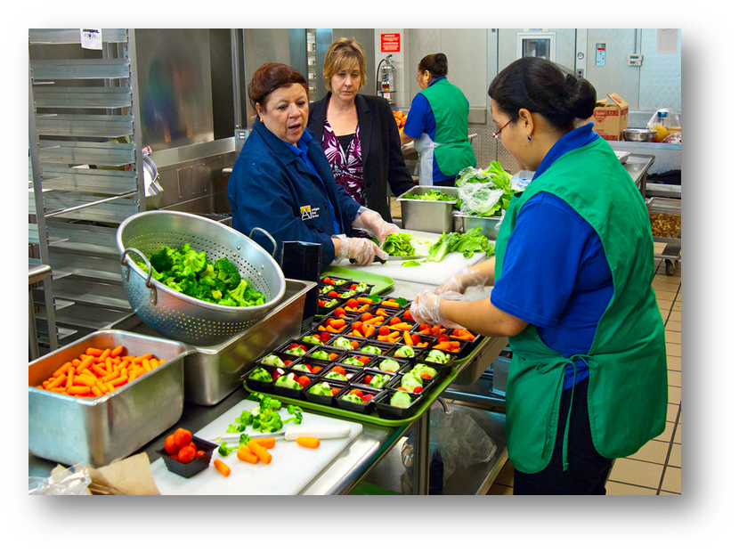
Recipe Verification Phase
Areas to Evaluate
Execution of the recipe
Ingredient sourcing
Production schedule
Menu mix
Likeability

Slide 49

Recipe Verification Phase
Staff Feedback
Review with production staff
Assess implementation at the production site
Develop staff buy-in

Slide 50
Discussion:
What are some factors to consider when assessing the feasibility of a recipe at a production site?
How have you created staff buy-in when introducing new recipes at the production site?

Slide 51
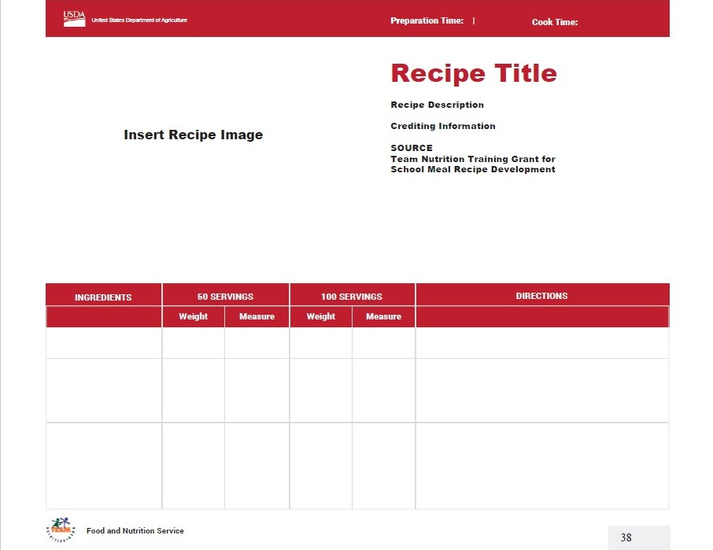
Brainstorm: What information should a standardized recipe include?

Slide 52
Anatomy of a Standardized Recipe
A standardized recipe has been tested for use in your kitchen(s). It produces consistently good results and yields when the preparer uses the same procedures, equipment, and quality and quantity of ingredients.

Slide 53
Anatomy of a Standardized Recipe
Recipe Title and Description
Recipe Category
Ingredients
Weight/Volume of Each Ingredient
Units of Measure for Each Ingredient
Preparation Directions
Cooking Time, Temperature, and Preparation Time
Serving Size
Yield

Slide 54
Anatomy of a Standardized Recipe
Equipment and Tools Needed
Crediting Information
Nutrient Analysis
Service Style
Marketing Guide
Food Safety Guidelines
Recipe Variations
Alternative Ingredients
Optional Ingredients
Notes Section

Slide 55
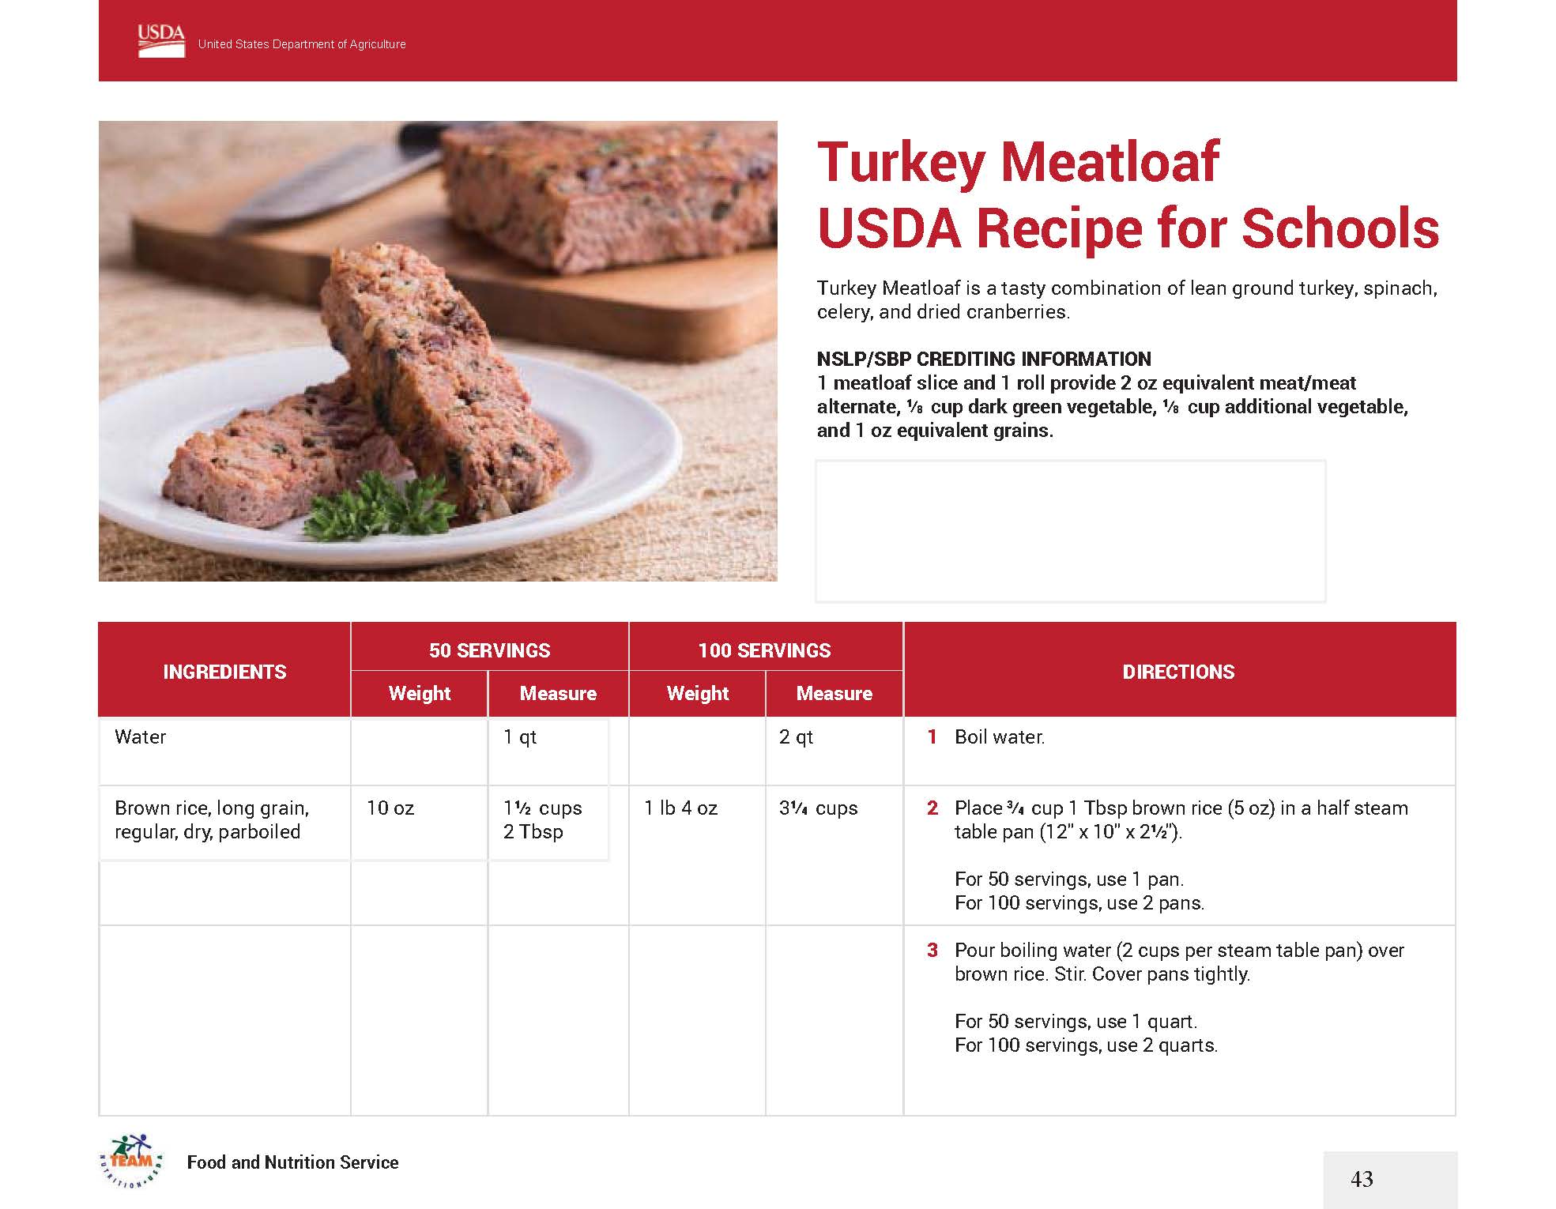
Turkey Meatloaf U S D A Recipe for Schools

Slide 56
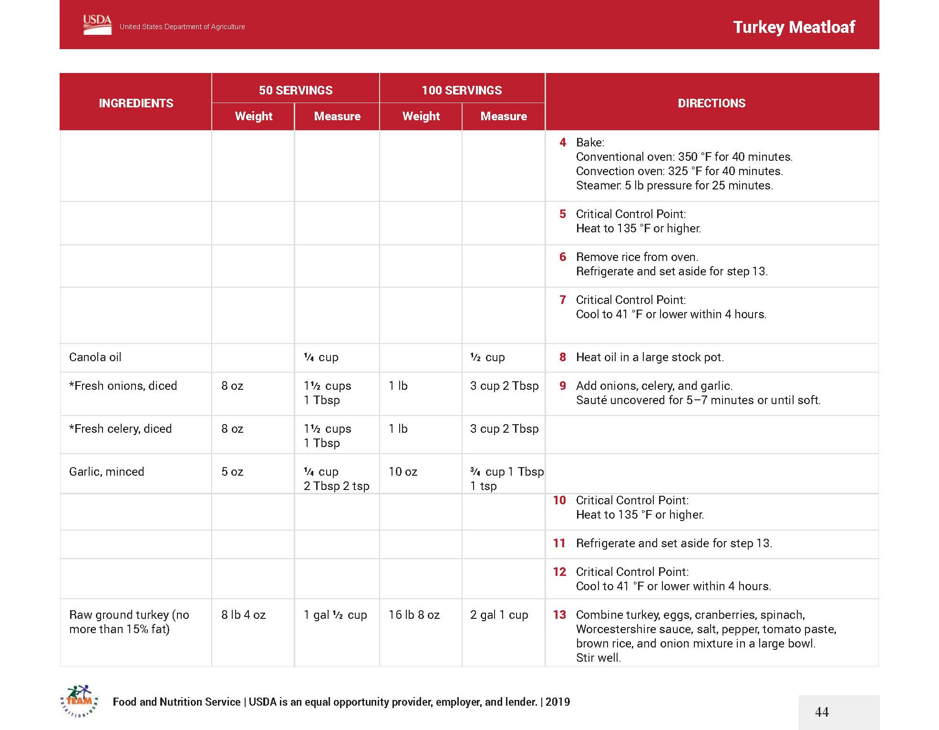
Turkey Meatloaf U S D A Recipe for Schools

Slide 57
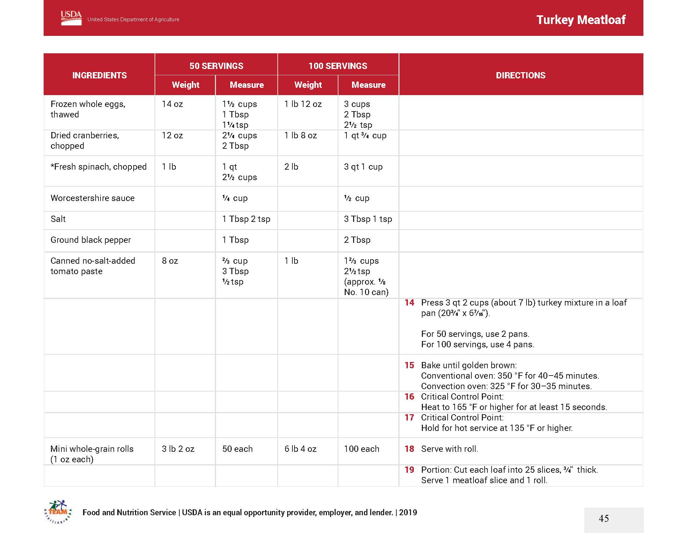
Turkey Meatloaf U S D A Recipe for Schools

Slide 58
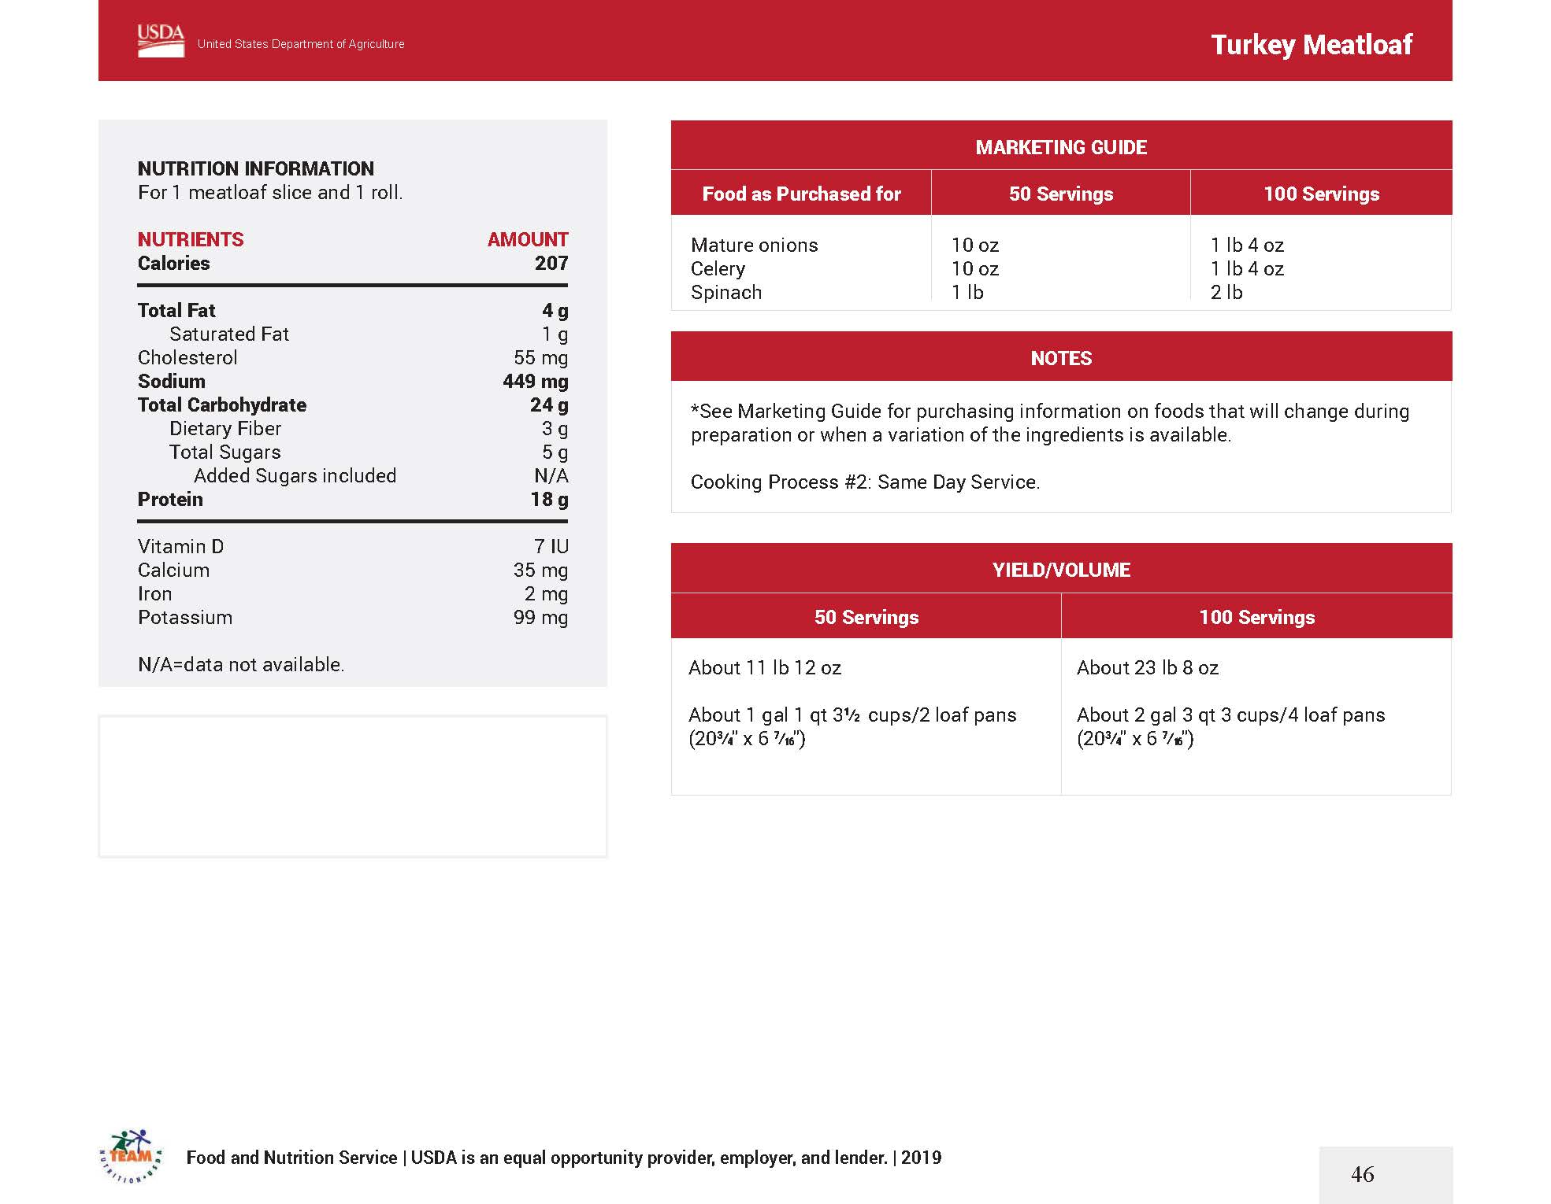
Turkey Meatloaf U S D A Recipe for Schools

Slide 59




Recipe Title and Description
The recipe title (name) and description should accurately describe the recipe.
Easily understood
Part of your marketing strategy
Focus on flavors and textures
Age-appropriate for grade level

Slide 60
Edgy Veggies Toolkit
The Edgy Veggies Toolkit teaches you how to reframe healthy food with indulgent and fun language to help people eat more healthy food and enjoy it more.
Developed at the Stanford Mind and Body Lab
http://sparqtools.org/edgyveggies/

Slide 61
Edgy Veggies Toolkit
You are …
Someone that influences
what others eat.
The Problem
People think healthy foods are depriving and bland, and so avoid them.
The Solution
Describing the tasty and enjoyable attributes of healthy foods makes people more likely to choose them.
The Result
People eat and enjoy more vegetables and plant-based foods, which help fight chronic disease and support sustainable planetary health.

Slide 62
Discussion: Recipe Title and Description
Roasted Brussels Sprouts
with Seasoning
OR
Tender Roasted Brussels Sprouts with Sweet Chili Glaze
Green Beans
with Cheese
OR
Sizzlin’ Garlic-Parmesan
Skillet Green Beans

Slide 63
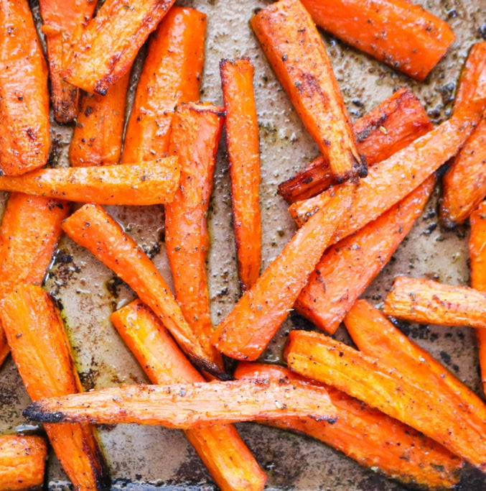
Practice:
Name That
Carrot Recipe

Slide 64
Breakout Room Activity:
Name Your Recipe
Share the name of the recipe you plan to standardize.
With your breakout room group brainstorm ideas for a more enticing name for each recipe.
Assign a spokesperson to report the results to the whole group.

Slide 65
Recipe Categories
Recipes should be categorized by type,
for example salad, sandwich, soup, etc.
When standardizing a recipe, a recipe category should be assigned to facilitate the organization of recipes.
Using recipe categories makes it easier to locate recipes in the kitchen site’s recipe file box or on the computer’s USDA-approved nutrient analysis software.

Slide 66
Recipe Categories
Main Dishes (Entrée) – an item that is served as the main dish and is either:
Combo of M/MA + Grain
Combo of M/MA + Veg/Fruit
Combo of M/MA + Grain + Veg/Fruit
A M/MA alone
Breakfast only: Grain served as the main

Slide 67
Recipe Categories
Side Dish is an accompanying item.
Side dishes can be a wide variety of fruits
and vegetables.
Grains may be side items, such as brown rice, whole grain-rich pastas, rolls, breadsticks,
or grain-based salads and side dishes.
A combination food of vegetables
and/or fruits and gains

Slide 68
Discussion:
Why is it useful to categorize recipes?
How do you categorize recipes in your kitchen?
How would you categorize the recipe
that you are going to standardize?
Could it fall into two categories?

Slide 69
Ingredients
The ingredient name should be exact so that the name of the product, product type/form (fresh, frozen, canned), and any preparation technique(s) (peeled, grated, minced, diced) are listed.

Slide 70
Tips for Listing Ingredients
Indicate size for preparation techniques
List in order of use
Include the proper unit of measurement
List as purchased (AP) or edible portion (EP) quantity
Account for loss in yield
For raw meats, the cooked EP amount is always less than the raw AP
Rice and pasta, the cooked quantity is more than the dry quantity
The USDA Food Buying Guide for Child Nutrition Programs provides yield information to assist with determining EP quantity.

Slide 71
Discussion:
When would you list the as purchased (AP) quantity versus the edible portion (EP) quantity for an ingredient?
What are the benefits of listing the preparation technique along with the product name?

Slide 72
Ingredient Units of Measure
It is important to list the correct units of measure for each ingredient to ensure accuracy.
Listing the ingredient in a unit of measure that is both easy to understand and appropriate is critical to ensure accuracy and ease of execution.

Slide 73
Ingredient Units of Measure
Weight
Volume
Used to determine the heaviness of a product
Weight is the unit of measure utilized to determine the amount of a dry or non-liquid ingredient
Weight is measured with the use of a scale
Refers to the amount of space or capacity; a product takes up in a three-dimensional space.
Volume is measured using a liquid measure

Slide 74
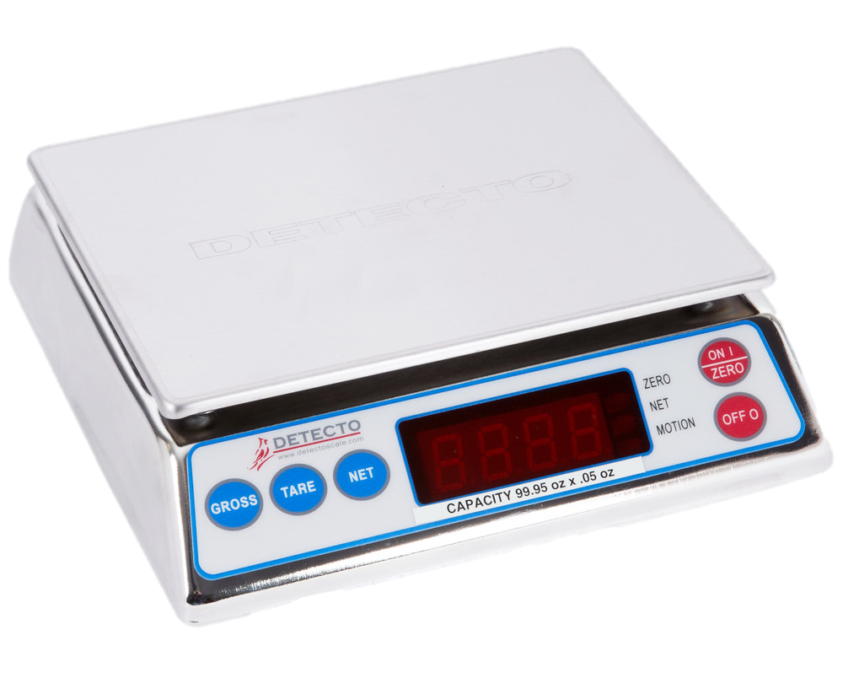
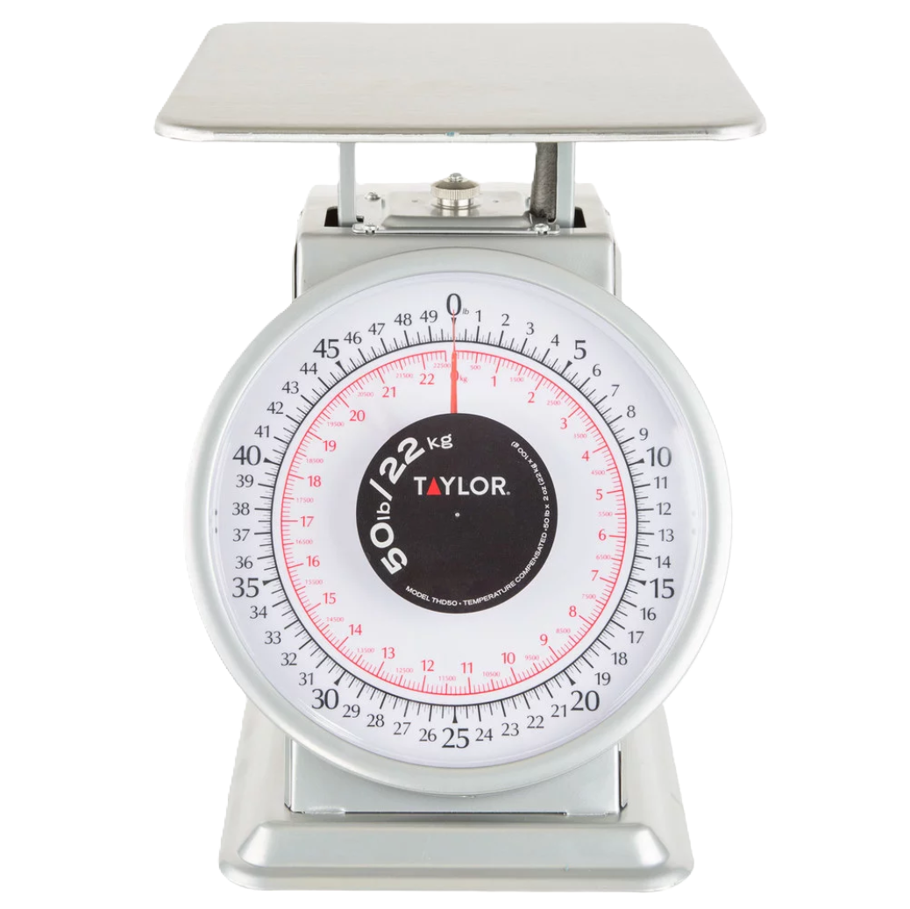
Examples — Measure by Weight
Flour
Lettuce
Tomato Paste
Honey
Pasta
Onions
Ground Beef

Slide 75
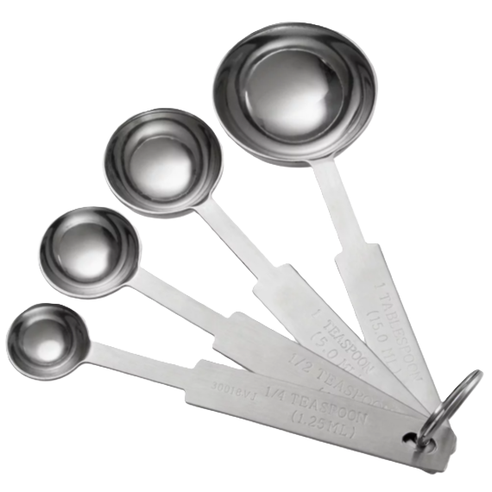
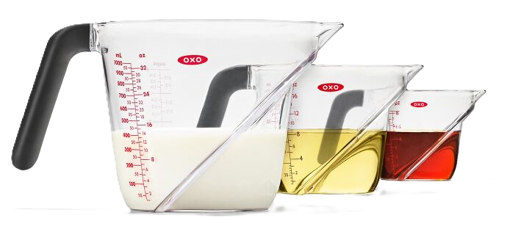
Examples — Measure by Volume
Oils
Water
Fluid Milk
Soy Sauce
Lemon Juice
Vanilla Extract
Vinegars

Slide 76
Ingredient Units of Measure
A best practice: list liquid ingredients by volume and all other ingredients by weight and measurement.
Quantities should be listed in the most manageable unit of measure.
  Examples:
    1 lb 4 oz instead of 20 oz
    ½ cup instead of 8 Tbsp
Listing the ingredient in a unit of measure that is both easy to understand and appropriate is critical to ensure accuracy and ease of execution.

Slide 77
Discussion:
What are some common measuring mistakes you have observed during production?

Slide 78
ACTIVITY: Manageable Units of Measure
Original Unit of Measure |  | Most Managable Unit of Measure
Ingredient | Unit of Measure | Ingredient | Unit of Measure
Flour | 40 oz | Flour
Vegetable Oil | 6 cups | Vegetable Oil
Ground Turkey | 8.75 lb | Ground Turkey
Black Pepper | 7 tsp | Black Pepper
Skim Milk | 50 fl oz | Skim Milk
Diced Celery | 74 oz | Diced Celery

Slide 79
ACTIVITY — KEY:
Manageable Units of Measure
Original Unit of Measure |  | Most Managable Unit of Measure
Ingredient | Unit of Measure | Ingredient | Unit of Measure
Flour | 40 oz | Flour | 2 lb + 8 oz
Vegetable Oil | 6 cups | Vegetable Oil | 1 qt + 2 cup
Ground Turkey | 8.75 lb | Ground Turkey | 8 lb + 12 oz
Black Pepper | 7 tsp | Black Pepper | ⅛ cup + 1 tsp
Skim Milk | 50 fl oz | Skim Milk | 1.5 qt + ¼ cup
Diced Celery | 74 oz | Diced Celery | 4 lb + 10 oz

Slide 80
Recipe Preparation Directions
Detailed directions should indicate how ingredients are to be combined.
Directions should list, in order, the steps to be followed in preparing the recipe.
Food safety guidelines must be included in the directions to help ensure that the final product will be safe to eat.
All preparation and cooking terms should be reviewed to make sure staff members understand exactly what each means.

Slide 81
Recipe Preparation Directions
Recipes can be perceived as complex the first time they are viewed (sometimes several times). This happens frequently with recipes that have a lot of ingredients or steps. It is critical to ensure clarity in the face of complexity to yield desired results.

Slide 82
Recipe Review
Look at the recipe you will be standardizing. Do you see any aspects of the directions that could be improved for quantity production?
Ingredient order
Logical directions
Clear language
Cooking tools/equipment?
Pre-prep or sub recipes?

Slide 83
Tips for Recipe Preparation Directions
Include detailed recipe directions indicating the combination of ingredients.
List steps in order to prepare the recipe.
Ensure clarity in directions and cooking terms for the food production team.
Include pre-preparation steps (e.g., defrosting,
pre-heating).
Incorporate Critical Control Points (CCP) in the production process.
Specify exact or approximate preparation and cooking times.

Slide 84
Tips for Recipe Preparation Directions
Break down recipes into sections by elements
(e.g., crust, filling).
Group ingredients by method of incorporation and list by weight or volume.
Include simple preparation methods directly in the ingredient list.
Specify the size and type of cookware and utensils needed.
Provide details on serving size, portioning utensils, service ware, and garnishes.
Include storage instructions for leftovers.
Use concise language, eliminating unnecessary words.

Slide 85
Discussion:
Has anyone had experience with poorly written recipe directions? What was the outcome?
What are some challenges you’ve experienced with recipe preparation directions?

Slide 86
Cooking Time and Temperature and Preparation Time
Preparation and cooking times help the food production team manage their time. They also help the menu planner in designing cycle menus.

Slide 87
Poultry should be cooked to:
135 ºF
145 ºF
155 ºF
165 ºF

Slide 88
Poultry should be cooked to:
135 ºF
145 ºF
155 ºF
165 ºF

Slide 89
Cooking Time and Temperature and Preparation Time
Cooking temperature and time should be identified on the recipe; additionally, the amount of time required to prepare the recipe should be specified.
This includes time for:
  Chopping or dicing ingredients
  Assembling the recipe
  Preparing individual servings
  Placing items on a baking sheet
  Etc.

Slide 90
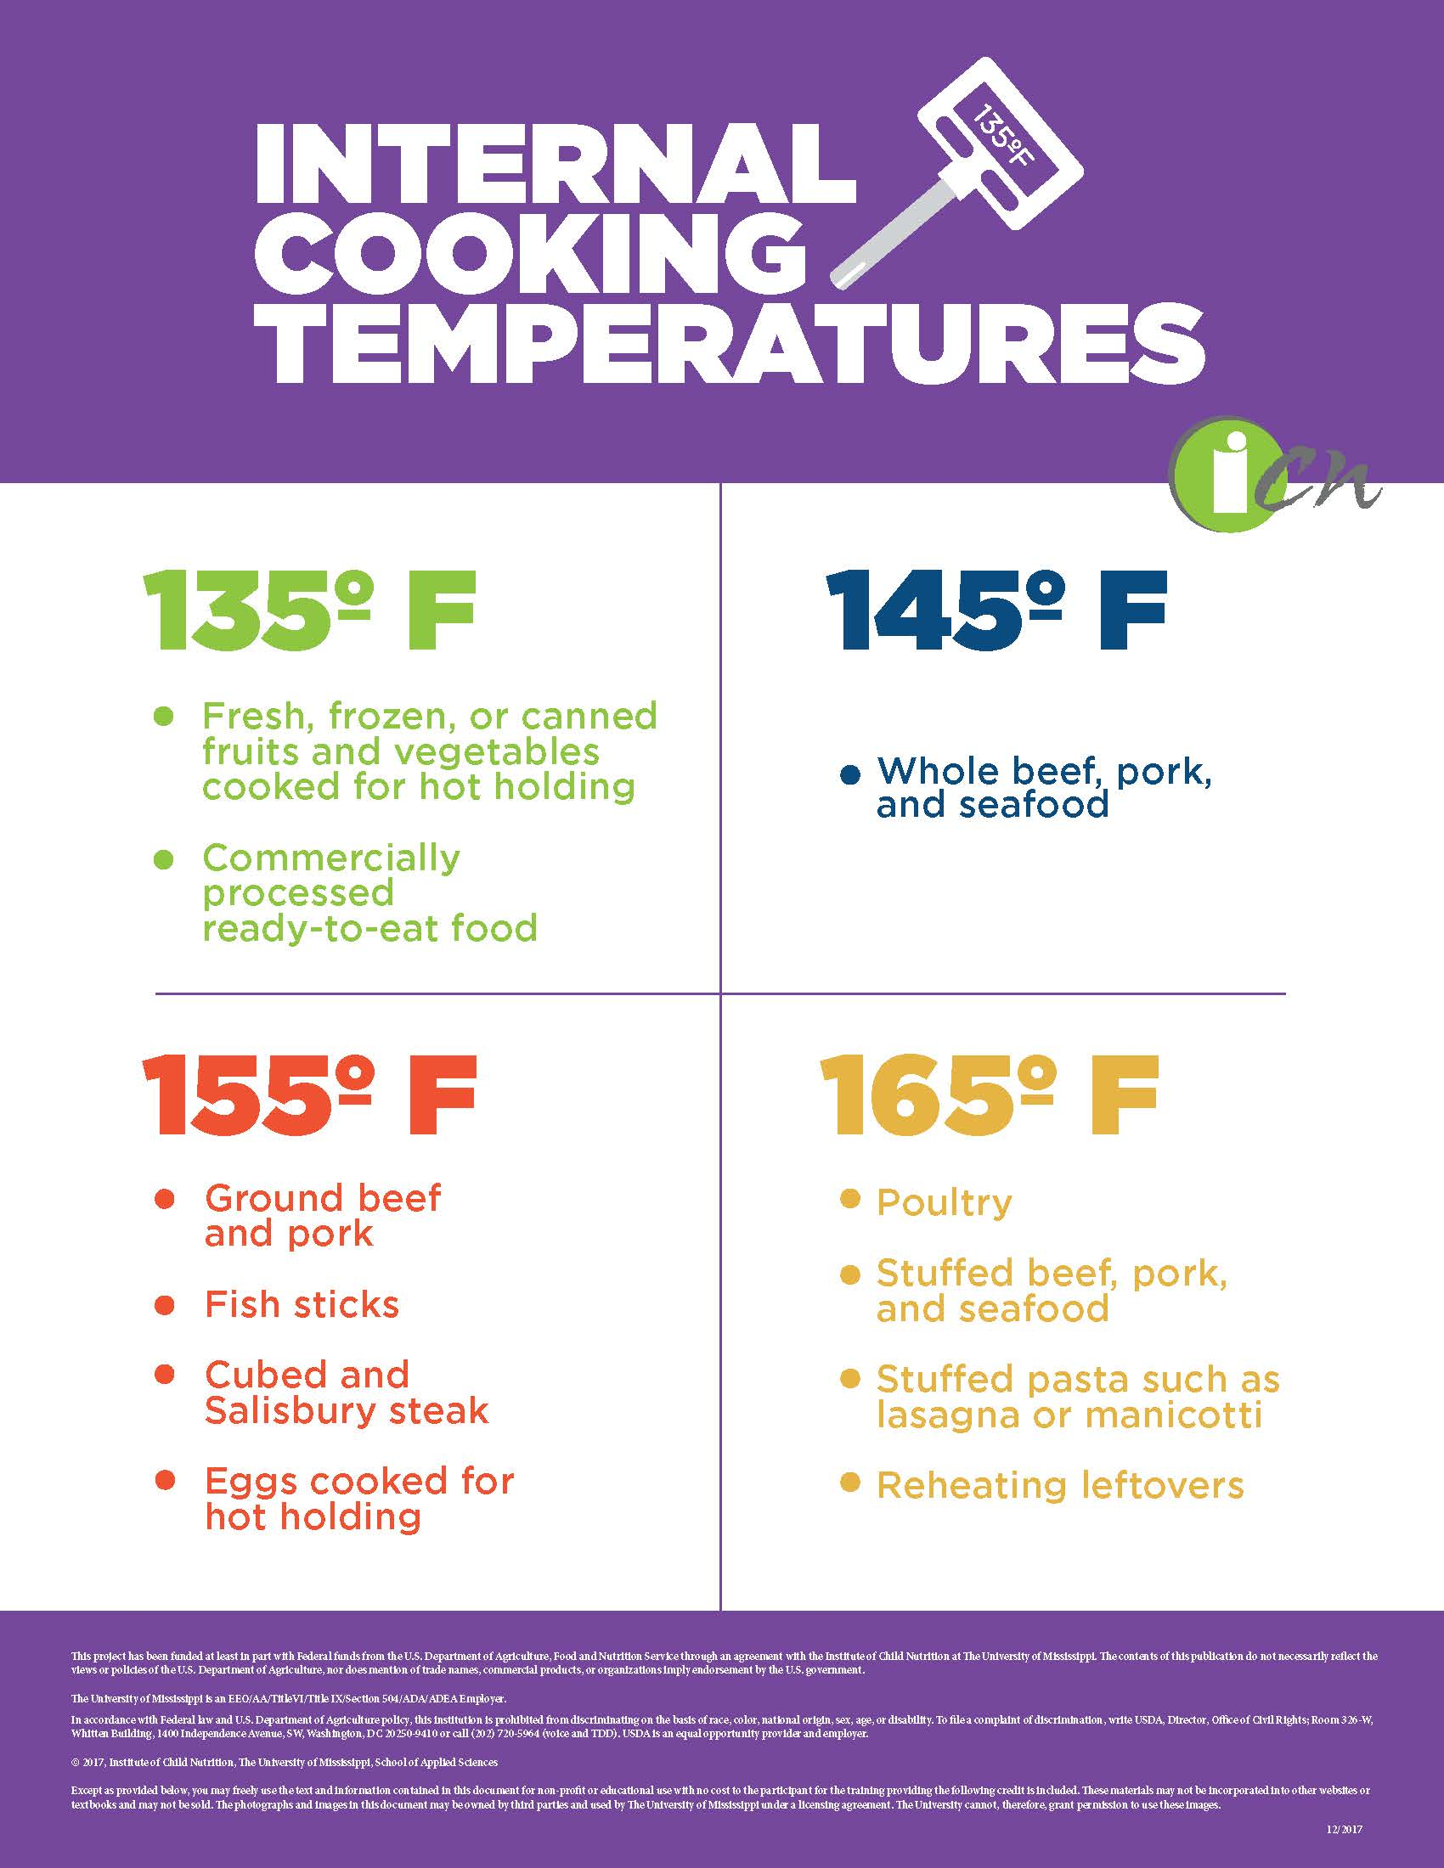
Cooking Time and Temperature and Preparation Time
The final internal temperature of the prepared foods should be identified.
  Specifying a final internal temperature ensure that products are cooked safely and properly.
  Please check with your state or local health authority for guidance related to safe internal cooking temperatures.
theicn.org/icn-resources-a-z/food-safety

Slide 91
Discussion:
One of the primary reasons standardized recipes need to be standardized to the site is variations between kitchens. What aspects of the kitchen do you think create variations between sites?

Slide 92
Serving Size and Yield
Serving the correct portion size is critical for maintaining the integrity of the recipe’s nutritional value.
Proper portion control ensures the recipe yields the correct number of servings.

Slide 93
Serving Size and Yield
The size of an individual serving should be listed on the recipe.
Assess the appropriateness of the serving size for each age group.
List the weight and volume of the serving.
Identify the weight of one serving and the general description of serving size.

Slide 94
Serving Size and Yield
Incorrect portioning can lead to a series of unfortunate situations:
Running out of food on the service line
Inaccurate nutritional makeup of the serving
Increase in food and labor costs
Unsatisfied customers

Slide 95
Yield
Yield refers to the amount of product that will be obtained when preparing a recipe.
Identify recipe yield in total weight and/or volume, as well as a more general description such as 50 servings or 8 (12” x 20” x 4”) pans.
Include the number of servings per pan. For example, each 2” full pan yields (50) servings.
Provide the amount of the finished or processed product (weight, volume, and number of servings) available at the completion of production.

Slide 96
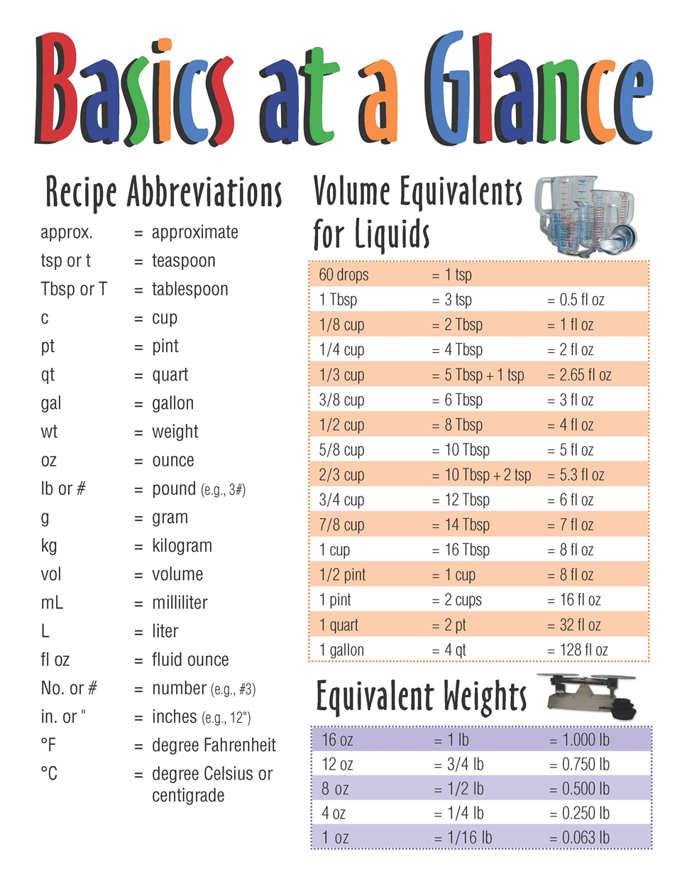
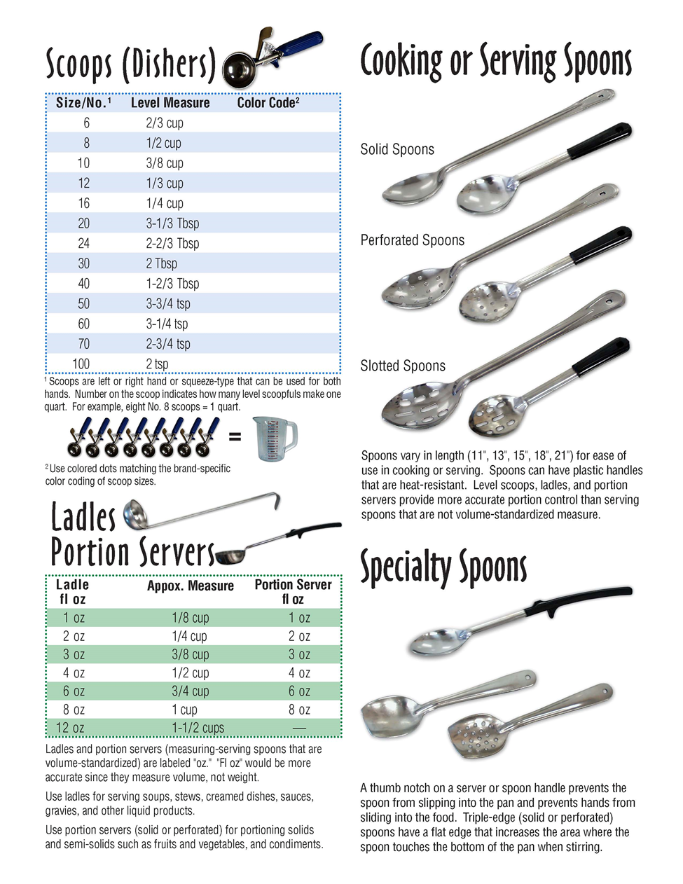
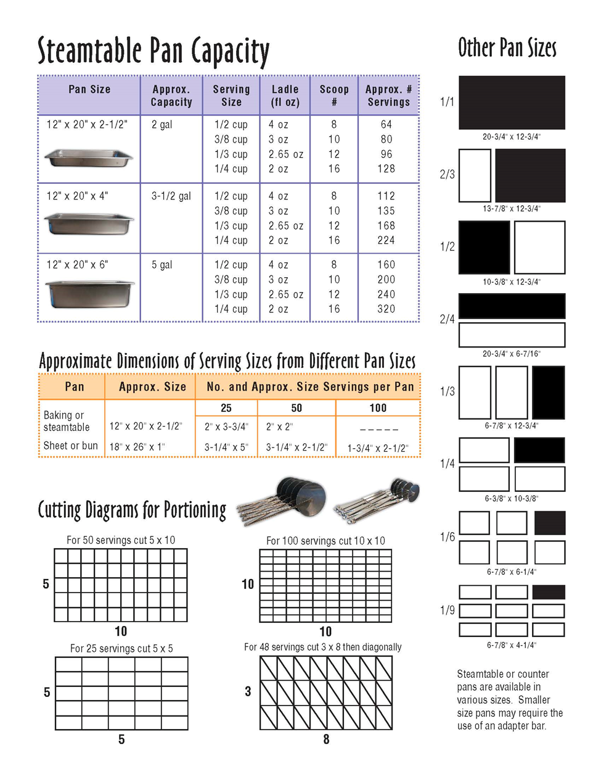
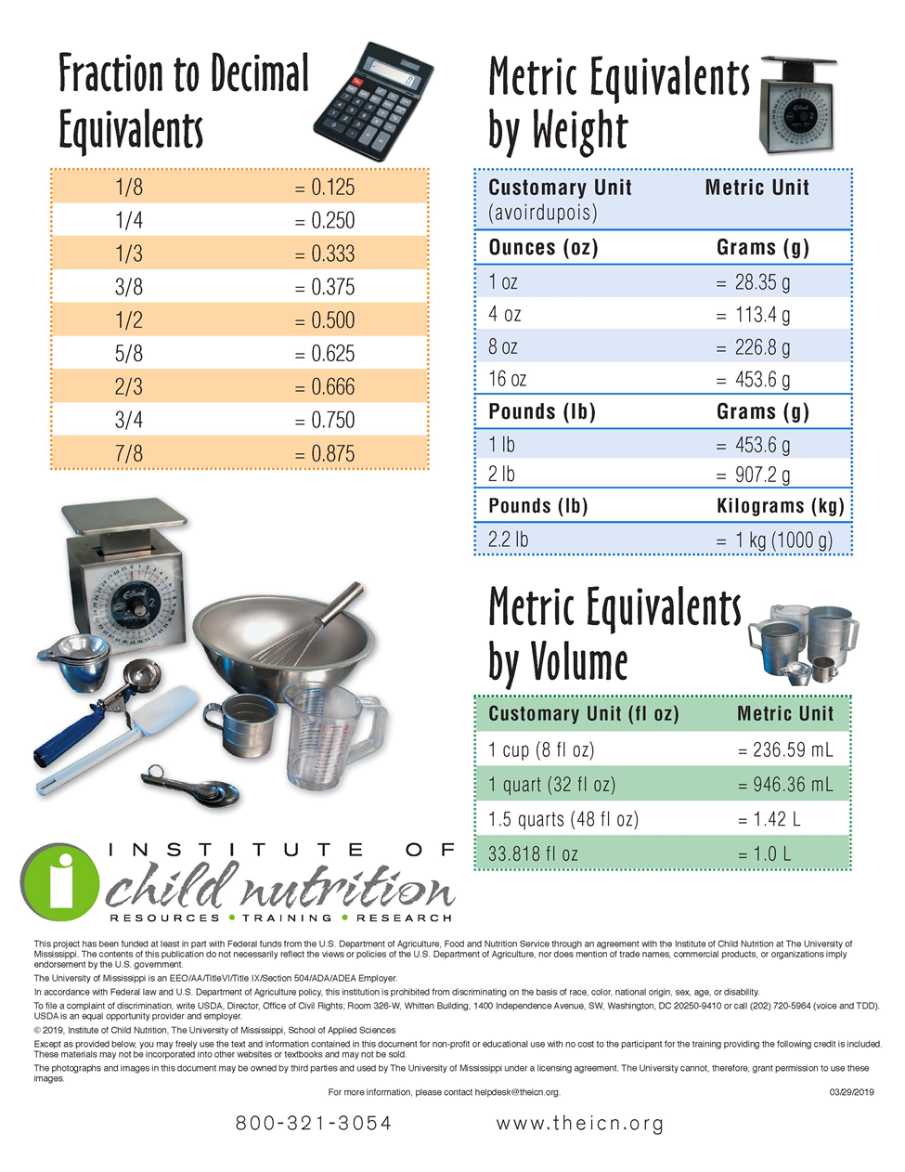
Basics at a Glance
theicn.org/icn-resources-a-z/basics-at-a-glance/

Slide 97
Discussion:
How can the Basics at a Glance tool help you and your staff ensure the proper portioning of foods?
Based on your own experience, what is the most common cause of incorrect portioning?
What is the proper portion size for the recipe you will standardize? What serving utensils will you use to ensure proper crediting? If you are unsure, let’s discuss.

Slide 98
Equipment and Tools
Recipes must be standardized to the production site and the specific equipment available at the site.
Recipes may include detailed alternative preparation methods highlighting the preparation steps, times, and equipment needed to produce the recipe in the alternative method accurately.

Slide 99
Which piece of equipment do you use most often?
Convection oven
Steam-jacked kettle
Tilt-skillet
Hotel pan
Mixer

Slide 100
Evaluating Equipment and Tools
School foodservice kitchens are equipped with a variety equipment. Evaluate the site’s capacity of the cooking equipment:
  List the cooking and serving equipment needed to prepare and serve the recipe.
  Determine cooking time and temperature based on the specific piece of equipment used to prepare the recipe
  Identify the pans needed to produce and serve the product
  List the utensil(s) for portioning and/or serving the product on the recipe

Slide 101
Discussion:
Why would a recipe need to include alternative preparation methods?
Does anyone have an example of a recipe they use at one of their sites that includes more than one production method?

Slide 102
Crediting Information
The Crediting Statement is a crucial component for identifying how the recipe contributes to the meal pattern.
Including the Crediting Statement on the recipe helps foodservice workers and menu planners assess how the recipe contributes to the daily menu’s meal pattern compliance.

Slide 103
Crediting Information
Each meal component has a minimum creditable amount.
The crediting statement identifies which NSLP/SBP food component(s) the ingredients in the recipe can count toward:
Meats/meat alternates
Vegetables (including subgroups)
Fruits
Grains
The Recipe Analysis Workbook (RAW) should be used to determine the crediting statement.
Available at https://foodbuyingguide.fns.usda.gov/

Slide 104
Crediting Information
The minimum creditable amount is the smallest portion of a food that counts toward meal component requirements, for example, ⅛ cup green beans.
Understanding minimum creditable amounts helps you plan reimbursable meals while considering
food costs.
If you serve food items in portions smaller than the minimum creditable amount, they cannot count toward reimbursement requirements.

Slide 105
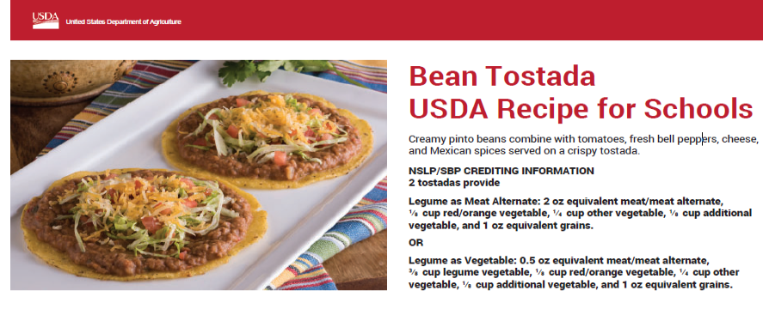
Crediting Information
When crediting beans, peas, and lentils toward more than one food component, include both the meat alternate and the vegetable credit in the crediting statement.

Slide 106
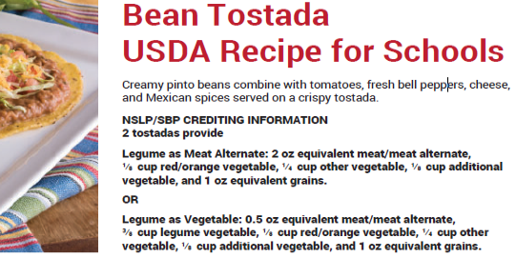
Crediting Information

Slide 107
Discussion:
How has including crediting statements on recipes helped you in your program?

Slide 108
Nutrient Analysis
Performing an accurate nutrient analysis is critical to the evaluation of menus and menu documentation.

Slide 109
Nutrient Analysis
Determine compliance with school meal regulatory requirements for:
Calories
Saturated fat
Sodium
Added Sugars
Each SFA should establish a nutrient threshold for each recipe category.
  Example: A side dish
  may contain no more than 200 mg of sodium and no more than 225 calories.

Slide 110
Service Style
How food items are presented is a critical component to engaging the customer.
Our customer’s first impression of the food items served is visual.
Instruction on how to serve the menu item, beyond portioning, is a key component to customer service.
Objective: Review the various types of service and how to indicate the service style in a recipe.

Slide 111
Brainstorm:
What are some unique service models you are currently using in your program or have considered implementing at your sites?

Slide 112
Service Style
Service Style
Include information such as:
Traditional cafeteria service
Grab-and-Go
Kiosks
Meals in the classroom
Self-service bars and stations
Made-to-order stations
Food trucks
Vending machines
Packing types and sizes
Serving pan types and sizes
Serving and portioning utensils
Garnishing information

Slide 113
Discussion:
What are some unique service models you are currently using in your program or have considered implementing at your sites?
How would including information about service style help your staff better deliver meals?

Slide 114
Marketing Guide
Marketing Guides help prevent under- and
over-purchasing.
Add a Marketing Guide to all of your school recipes.

Slide 115
True or False?
The marketing guide section of a recipe includes information for food as purchased (AP).

Slide 116
True
The marketing guide section of a recipe includes information for food as purchased (AP).

Slide 117
Marketing Guide
USDA recipes provide information to assist in purchasing necessary quantities of food for recipe production.
Recipes call for a specific amount of an ingredient.
The ingredient amount is seldom equal to the purchasing amount for many types of food.

Slide 118
Marketing Guide
The marketing guide section of each recipe provides purchasing information, including:
Food as Purchased (AP) – lists each food item to purchase
Food quantity to purchase for each recipe yield
Example: 50 servings or 100 servings

Slide 119





Places for student feedback
Incorporated into a nutrition education lesson
In conjunction with
a visit from a local farm/rancher/fisher highlighting an ingredient
Sample station in the cafeteria
Part of a student leadership group meeting
Work with school administration to make being a “taste-tester”
a reward

Slide 120
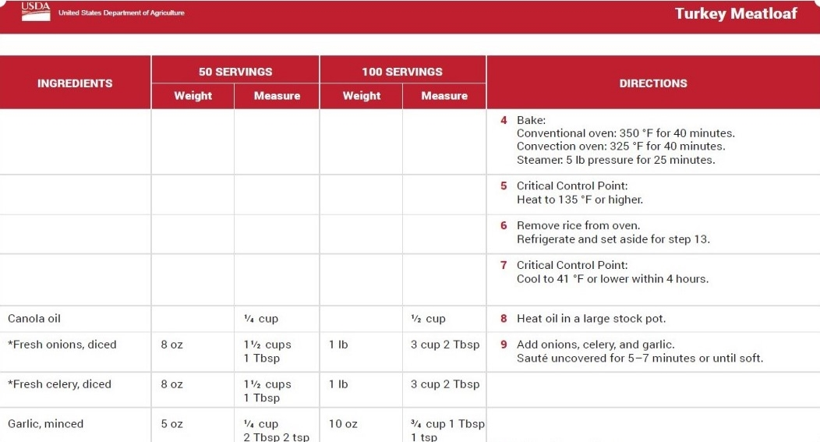
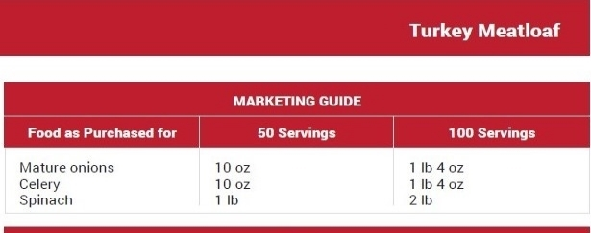
The recipe Marketing Guide shows the amount of each fresh vegetable (or fruit) to purchase that, when trimmed, provides the amount the recipe requires.

Slide 121
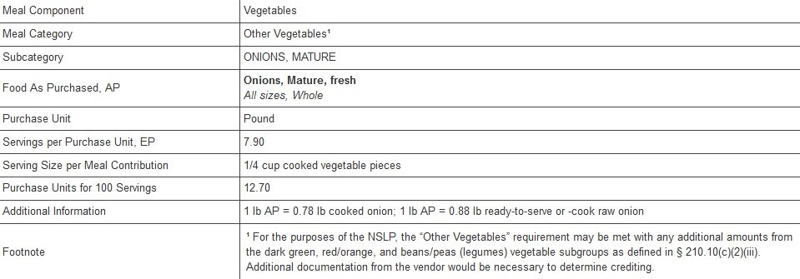
The Food Buying Guide for Child Nutrition Programs (FBG) shows how to determine marketing guide quantities. Use the FBG information under the Additional Information Column. Here you see that 1 lb fresh mature onions, when trimmed and cooked, yield about 0.78 lb of the finished product.

Slide 122
Discussion:
How many of you use a marketing guide when building your local recipes?
Has anybody ever had a situation where a site manager under-purchased a food item because they only looked at the ingredients listed in the recipe and did not account for the loss due to trim?

Slide 123
Food Safety Guidelines
Food safety must be at the forefront of all aspects of food production.
Including food safety information in the recipe helps ensure the production team understands and follows safe food handling practices.

Slide 124
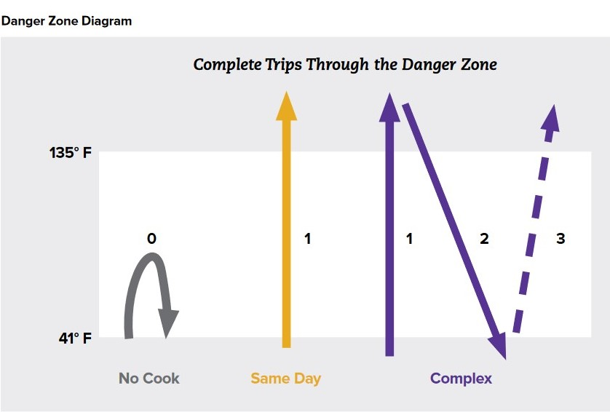
The Process Approach
Focuses on the number of
times a food moves through the temperature danger zone (41 °F to 135 °F). Foods are grouped into one of three process categories.
Process #1 – No Cook
Process #2 – Same Day Service
Process #3 – Complex Food Preparation

Slide 125
Important HACCP Terms
Hazard Analysis – review of operation to identify areas where food safety problems may occur
Control Measures – steps to reduce food contamination or bacterial growth
Critical Control Points (CCPs) – points in food preparation where process control (example – cooking) is essential to keep food safe
Critical Limits – time and temperature range for food preparation and service for keeping food safe (hot, 135 °F or higher; cold, 41 °F
or lower)

Slide 126
Discussion:
What are some common food safety issues you find when staff are preparing recipes? How have you overcome those issues?
What are some popular recipes that would require a Complex Food Preparation Process?
What CCPs will your recipe go through?

Slide 127
Small Batch Preparation
Staff buy-in is critical in the recipe development process; after all, the staff will be the people preparing the recipe.
Efficiently conduct small batch taste-testing to evaluate the feasibility and acceptability of a recipe.

Slide 128
Prepare and Evaluate
Create a small batch of the recipe.
25 serving batch
Taste as you go
Note any changes
Use the Recipe Review Checklist to verify all of the components have been included.

Slide 129
Small Batch Taste-Testing
Ask the staff to provide feedback regarding each of the areas:
Recipe title
Ingredients
Directions
Cooking and preparation times

Slide 130
Class Activity
Review the Recipe Review Checklist and the Informal Evaluation Checklist
Identify if there are any additions or changes that they would make to either checklist.
Do you think the checklists will be helpful in evaluating the recipe you have chosen for standardization?

Slide 131
Recipe Review Checklist
Review the Checklist in the Training Manual

Slide 132
Recipe Yield Verification
Yield accuracy is critical for ensuring that the nutritional composition and number of portions between the written and prepared recipes correspond.

Slide 133
Recipe Yield Verification
Verify the correct yield has been reached:
Includes verification that the ingredients, recipe, and serving yields are accurate
Determine the AP quantity needed to yield the necessary EP quantity of an ingredient
Occurs once all ingredients have been combined and recipe preparation is complete

Slide 134
Recipe Yield Verification
Weight and Volume
Determine Total Weight of Prepared Recipe
Convert total recipe weight to ounces (or grams).
Total Oz. ÷ Number of Desired Servings= weight of one serving
Find the correct serving utensil (spoodle, disher, or ladle) that is closest to providing that weight per serving
* Remember that the volume of the serving utensil is not necessarily the same as the weight it will hold *

Slide 135
Recipe Yield Verification
Example:
Total Recipe Weight: 9 lb. 7 oz.
9 x 16 = 144 + 7 = 151 oz.
151 oz. ÷ 38 servings = 3.98 oz. per serving
Test using different utensils to determine which one averages 3.98 oz. per serving.
This is your serving size to include on your recipe.

Slide 136
Recipe Yield Verification
Recipe yield should be specified in both the total quantity (weight and volume) and the number
of servings.
Recipe yield should be determined by weighing the final product and measuring its volume.
The weight of a serving is determined by taking the total final product's weight and dividing it by the number of servings the recipe makes.

Slide 137
Recipe Yield Verification
Guidelines for portioning the product into individual servings should be given on the recipe.
A serving utensil should be identified for each product.
Weights of these actual servings should be compared to the calculated serving weight to ensure portioning is being done correctly.
If the desired serving size is not achieved when verifying the yield, changes in the recipe, portioning, or ingredient amounts may be needed.

Slide 138
Discussion:
Where can yield verification go wrong?
What are some factors that can cause incorrect yields?

Slide 139
Nutrient Analysis
The purpose of the nutrient analysis is to determine compliance with school meal regulatory requirements for calories, saturated fat, sodium, and added sugars and to monitor these dietary components' levels in school meals.

Slide 140
Nutrient Analysis
Performing an accurate nutrient analysis is critical to evaluating menus and menu documentation.
Small changes to a recipe can have a massive impact on the overall contribution to pattern requirements and nutrition standards.
Changes to ingredient quantities can impact:
Meal pattern compliance
Nutritional values of the recipe
Utilize the Food Buying Guide and Recipe Analysis Workbook to verify the accuracy of meal pattern contribution.

Slide 141
Nutrient Analysis
Performing an accurate nutrient analysis is critical to evaluating menus and menu documentation.
Small changes to a recipe can have a massive impact on the overall contribution to pattern requirements and nutrition standards.
Changes to ingredient quantities can impact:
  Meal pattern compliance
  Nutritional values of the recipe

Slide 142
Nutrient Analysis
The nutrient content of foods may vary greatly depending on the method of preparation.
As foods cook, they may lose moisture
and nutrients.
All ingredients in recipes prepared “from scratch” must be entered into the software using the Yield Factor Method to account for nutrient value changes due to preparation and cooking.

Slide 143
Recipe Nutrient Analysis:
A Five-Step Process
Step 1 – Gathering Materials
Step 2 – Entering Food Items (Ingredients) into the Database
Step 3 – Adding the Recipe to the Local Database
Step 4 – Entering Specific Menu Planning Data
Step 5 – Evaluating the Recipe for Dietary Specifications Requirements

Slide 144
Product Evaluation Phase
Product evaluation follows the recipe verification phase and is an important part of the recipe standardization process.
Recipe evaluation should include the manager, foodservice staff members, and customers (can include students, teachers, administrators, and parents).
Two types of evaluation occur in the evaluation phase: informal and formal. The recipe needs to pass the informal evaluation before it goes on to the formal evaluation.

Slide 145
Informal Evaluation Process
Three decisions are possible as a result of the informal evaluation.
If the product was found to be unacceptable based on several of the informal evaluation criteria, the decision might be made to discontinue any further work on standardizing the recipe.
If most of the informal evaluation criteria were drafted as acceptable, the recipe might go back to the verification phase to allow for changes to be made to the recipe and a new version of the recipe prepared.
If all evaluation criteria were rated as acceptable in the informal evaluation, then the recipe may be prepared for formal evaluation.

Slide 146
Formal Evaluation Process
The formal evaluation occurs after successfully completing the informal evaluation process when the foodservice staff believes a recipe has potential for service in their operation.
Getting feedback from taste testers is key. If the taste testers do not like the recipe, it needs to be re-evaluated.

Slide 147

Formal Evaluation Process
Procedures for Conducting a Formal Evaluation
Select a group(s) of people to taste the sample recipe.
Choose an evaluation form.
When developing an evaluation form, consider:
What questions need to be answered?
Who will fill out the form?
How the results will be tallied?

Slide 148
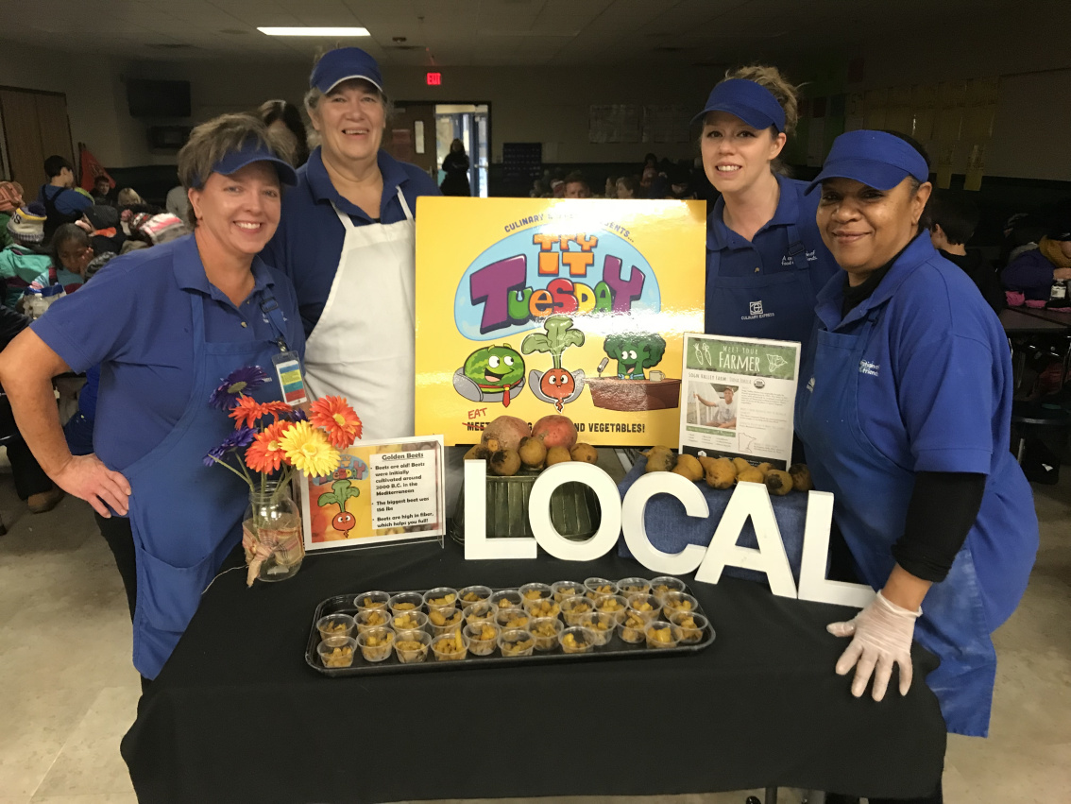
Formal Evaluation Process
Preparing the Sample Recipe Process
Prepared the recipe for evaluation
  Small batch- such as 25 servings
Set up sampling areas
  Drinking water
  Eating and serving utensils
  Napkins
  Evaluation forms
  Writing utensil
Seat evaluators apart

Slide 149

Formal Evaluation Process
Taste and Evaluate Process
Tasting procedures should be explained to those who will be evaluating the product
Remind evaluators of the importance of not making facial expressions or verbal comments about the food during the tasting
Explain what the evaluation terms mean

Slide 150
Formal Evaluation Process
Summarizing the Results Process
The evaluation form used will help determine the way results are summarized.
When evaluating a product, the total score, mean score, and individual attribute ratings should be reviewed.

Slide 151
Formal Evaluation Process
Determine if Recipe Is Acceptable
Based on the formal evaluation results, the recipe will be accepted as is, rejected, or changed.
If a different yield is needed, the recipe moves to the quantity adjustment phase of the recipe standardization process.

Slide 152
Evaluating Student Acceptability (Small Scale)
Students are the primary customer. Getting their feedback is key.
No matter how much the adults may like a recipe, if the students
do not care for it, the recipe needs to be re-evaluated.
Objective:
Review the process for gauging and evaluating student acceptability of the recipe.

Slide 153

Getting students’ feedback is the final step in the recipe standardization process
Gathering feedback may take on various forms:
Paper surveys
Posters with stickers – “Loved it,” “Liked it,” “Not really my thing.”
Facilitated questions with a show of hands
Online surveys
Ballots boxes

Slide 154
Getting students’ feedback is the final step in the recipe standardization process
When developing a survey, consider the following:
What questions need to be answered?
Who will fill out the form?
How will the results be tallied?

Slide 155
Getting students’ feedback is the final step in the recipe standardization process
Suggested methods for conducting a taste-test event include:
Sample station in the cafeteria
Incorporated into a nutrition education lesson
In conjunction with a visit from a local farm/rancher/fisher highlighting an ingredient
Part of a student leadership group (ASB) meeting
Work with school administration to make being a “taste-tester” a reward

Slide 156
Quantity Adjustment Phase
When a recipe has been evaluated positively but is not in the desired quantity, it moves to the quantity adjustment phase of recipe standardization.
Using the factor method, you can adjust the yield of a standardized recipe for your school nutrition program.
Always test and standardize recipes before including them in your school nutrition program menus.

Slide 157
Quantity Adjustment Phase
The factor method is often used in school nutrition programs during standardization.
Other methods include:
Direct reading tables method
Percentage method
Computerized recipe adjustments

Slide 158
Quantity Adjustment Phase
Factor Method of Recipe Adjustment
The factor method for adjusting recipes involves mathematical calculations and is the most commonly used manual adjustment method.
Determine the factor to be used
Multiply each ingredient quantity by the factor
Change the amounts into more common measurements

Slide 159
Quantity Adjustment Phase
Factor Method of Recipe Adjustment
Determine the factor to be used:
the desired yield ÷ current yield = factor.
Multiply each ingredient by the factor:
current measure x factor = new measure.
Change amounts into more common measurements: a new measure may not convert to a useful measure.

Slide 160
Quantity Adjustment Phase
Factor Method of Recipe Adjustment — INCREASE
Determine the factor to be used:
the desired yield ÷ current yield = factor.
Example of increasing a recipe for the first two steps:
Example: 250 (desired serving yield) ÷ 100 (current serving yield) = 2.5 (factor).
Multiply each ingredient by the factor: current measure x factor = new measure
Example: 5 pounds (current measure for 100 servings) x 2.5 (factor) = 12.5 pounds (measure for 250 servings).

Slide 161
Quantity Adjustment Phase
Factor Method of Recipe Adjustment — DECREASE
Determine the factor to be used:
the desired yield ÷ current yield = factor decreasing a recipe for the first two steps:
Example: 125 (desired serving yield) ÷ 250 (current serving yield) = 0.5 (factor).
Multiply each ingredient by the factor: current measure x factor = new measure
Example: 5 pounds (current measure for 250 servings) x 0.5 (factor) = 2.5 pounds (measure for 125 servings).

Slide 162
Quantity Adjustment Phase
Factor Method of Recipe Adjustment
Change amounts into more common measurements:
a new measure may not convert to a useful measure.
Example: A recipe for 50 servings calls for ⅔ cup (0.66 cups) shredded carrots; the amount for 300 servings is 3.96 cups of shredded carrots—convert to 1 quart.
Example: A recipe for 100 servings calls for 2 cups of diced onions; the amount for 60 servings is 1.2 cups—convert to 1¼ cups of diced onions.

Slide 163
Key Takeaways and “Ah-Ha” moments

Slide 164
ACTIVITY: Factor Method
Instructions:
Using the Factor Method, adjust the Broccoli Salad recipe below to determine the amount of each ingredient needed to make 225 servings.
The measure of some ingredients will need to be converted to simplify the math equation.
Ingredients | 100 Servings (Recipe Amount) | Converted Quantities | Factor | 225 Servings (Calculated Amount) | 225 Servings (Common Measure)
Broccoli, fresh | 13 lb 8 oz
Mayonnaise, low-fat | 2 qt
Sugar | 2 lb
White Vinegar | ½ cup
Milk, low-fat | ⅓ cup
Cranberry, dried | 1 qt + 3½ cups
Broccoli Salad Desired Yield: 225 Current Yield: 100 Factor: ______

Slide 165
ACTIVITY: Factor Method
Step 1: Determine the “factor” to be used
The factor is determined by dividing the desired yield in servings (225) by the current yield in servings (100).
225 ÷ 100 = 2.25
Ingredients | 100 Servings (Recipe Amount) | Converted Quantities | Factor | 225 Servings (Calculated Amount) | 225 Servings (Common Measure)
Broccoli, fresh | 13 lb 8 oz | 13.5 lb | 2.25 | 30.375 lb | 30 lb 6 oz
Mayonnaise, low-fat | 2 qt | 2 qt | 2.25 | 4.5 qt | 4 qt + 1 pt
Sugar | 2 lb | 2 lb | 2.25 | 4.5 lb | 4 lb 8oz
White Vinegar | ½ cup | 0.5 cup | 2.25 | 1.125 cups | 1 cup + 2 Tbsp
Milk, low-fat | ⅓ cup | 0.333 cup | 2.25 | 0.759 cup | ¾ cup
Cranberry, dried | 1 qt + 3½ cups | 7.5 cups | 2.25 | 16.875 cups | 4 qt + ⅞ cup
Broccoli Salad Desired Yield: 225 Current Yield: 100 Factor: ______

Slide 166
ACTIVITY: Factor Method
Step 2: Multiply each ingredient quantity
by the "factor."
Several conversions could be done before multiplying to simplify the math. For example, the 13 lb 8 oz of fresh broccoli could be converted to 13.5 lb;
the ½ cup of white vinegar could be converted to
0.5 cup.
Ingredients | 100 Servings (Recipe Amount) | Converted Quantities | Factor | 225 Servings (Calculated Amount) | 225 Servings (Common Measure)
Broccoli, fresh | 13 lb 8 oz | 13.5 lb | 2.25 | 30.375 lb | 30 lb 6 oz
Mayonnaise, low-fat | 2 qt | 2 qt | 2.25 | 4.5 qt | 4 qt + 1 pt
Sugar | 2 lb | 2 lb | 2.25 | 4.5 lb | 4 lb 8oz
White Vinegar | ½ cup | 0.5 cup | 2.25 | 1.125 cups | 1 cup + 2 Tbsp
Milk, low-fat | ⅓ cup | 0.333 cup | 2.25 | 0.759 cup | ¾ cup
Cranberry, dried | 1 qt + 3½ cups | 7.5 cups | 2.25 | 16.875 cups | 4 qt + ⅞ cup
Broccoli Salad Desired Yield: 225 Current Yield: 100 Factor: ______

Slide 167
ACTIVITY: Factor Method
Step 3: Change amounts
into more common measurements.
Once the new quantities have been calculated, conversion to more common measures may be needed. For example,
if an operation weighs ingredients in pounds and ounces, the 30.375 lb of fresh broccoli could be converted to 30 lb 6 oz.
Ingredients | 100 Servings (Recipe Amount) | Converted Quantities | Factor | 225 Servings (Calculated Amount) | 225 Servings (Common Measure)
Broccoli, fresh | 13 lb 8 oz | 13.5 lb | 2.25 | 30.375 lb | 30 lb 6 oz
Mayonnaise, low-fat | 2 qt | 2 qt | 2.25 | 4.5 qt | 4 qt + 1 pt
Sugar | 2 lb | 2 lb | 2.25 | 4.5 lb | 4 lb 8oz
White Vinegar | ½ cup | 0.5 cup | 2.25 | 1.125 cups | 1 cup + 2 Tbsp
Milk, low-fat | ⅓ cup | 0.333 cup | 2.25 | 0.759 cup | ¾ cup
Cranberry, dried | 1 qt + 3½ cups | 7.5 cups | 2.25 | 16.875 cups | 4 qt + ⅞ cup
Broccoli Salad Desired Yield: 225 Current Yield: 100 Factor: ______

Slide 168
Quantity Adjustment Phase
Factor Method of Recipe Adjustment
Some ingredients require special attention during recipe standardization. These ingredients do not increase or decrease proportionately:
Herbs and spices
Leavening agents – baking powder, soda,
and yeast
Thickening agents – flour, cornstarch,
and eggs
Liquids – water and juice.
The best method to determine the quantities of these specific ingredients is to prepare the recipe.

Slide 169
Comparison of Standardized Recipe Adjustment Methods
Method | Advantages | Disadvantages | Initial Recipe | Final Recipe
Factor Method | Can be used for most recipes Easy to use | Math skills required* | Can start with any recipe and desired yield | Final recipe can yield any number of servings desired
Direct Reading Tables Method | Minimal math skills required | Direct reading tables must be available Must know how to read tables Can only be used for yields in multiples of 25 | Must have yield of 25 servings or multiples of 25 servings | Yield of 25 servings or multiples of 25 servings (i.e.,200, 175, 500)
Percentage Method | Further adjustments to a single recipe are easy after initial ingredient percentages are calculated | Many steps in the process Math skills required Must use weights for all ingredients Must calculate and adjust for handling loss | Can start with any recipe and yield Initial recipe ingredients must be in weights | Yield can be any amount desired All final ingredients are in weights
Computerized Recipe Adjustment | Adjustments easy after recipe entered into system No math skills needed | Computer programs can be expensive Some programs require ingredients to be entered in weights only Ingredient quantities may be listed in decimals | Can start with any recipe and desired yield | Final recipe can yield any number of servings desired

Slide 170

ICN’s eLearning
Culinary Math Courses
Scaling Recipes
Conversions
Operations with Decimals
Operation with Fractions
Measurement
Calculating Food Cost
*Visit www.TheICN.org to enroll in the Basic Culinary Math eLearning series.

Slide 171
Formal Evaluation:
School Meal Service Pilot
Staff Training
Evaluating Student Acceptability (Large Scale)

Slide 172
School Meal Service Pilot
After standardizing your recipe, piloting the recipe as part of a school meal service will help you:
Get school nutrition staff feedback on whether the recipe will work as part of the school’s meal service.
Determining if the recipe directions are clear and appropriate for the environment in which it will be prepared.

Slide 173

Staff Training
Proper staff training is key to successfully implementing new menu items and recipes.

Slide 174
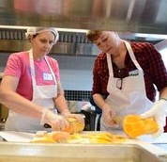
Staff Training
When reviewing the recipe with staff,
it is critical to evaluate their comfort with producing the recipe. Comfort levels often depend on effective training.
  Has the staff been provided with the training they need to produce the recipe?
  What level of training do they need to increase their skillset?
  Do they understand and know how to execute the recipe directions?

Slide 175
Staff Training
Presentation of the Food
  The term “we eat with our eyes first” is very accurate as we see our food before consuming it.
  A service line set up to draw the eye in by highlighting the colors, textures, freshness, and variety of food being offered is a free marketing tool at your disposal.
  A best practice to ensure your line setup is visually appealing is to view them from the customer’s perspective.
    Hold a pre-service meeting with staff and walk through the service line viewing it through the lens of a customer.

Slide 176
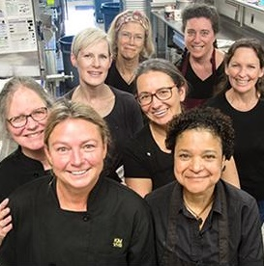
Staff Training
Appearance and Perception of the Staff
Students easily read verbal and nonverbal cues. Ensure the staff communication creates a positive message about the food item being served.
When the staff is invested in providing great customer service, they help market your program at the point of service, creating a pleasurable dining experience for your customer and elevating your business's overall perception.

Slide 177

Evaluating Student Acceptability (Large Scale)
Students are the primary customer.
Getting their feedback is key.

Slide 178
Evaluating Student Acceptability (Large Scale)
When evaluating the new recipe as part of the pilot meal service, consider a student survey or other way
to collect feedback:
  Paper surveys
  Posters with stickers – “Loved it,” “Liked it,” “Not really my thing”
  Facilitated questions with a show of hands
  Online surveys
  Ballots boxes

Slide 179
Evaluating Student Acceptability (Large Scale)
When developing a survey, consider the following:
  What questions need to be answered?
  Who will fill out the form?
  How will the results be tallied?

Slide 180
Preview Topics: Day 2
Food Buying Guide
FBG Calculator
Recipe Analysis Workbook
Nutrient Analysis

Slide 181
Lesson Conclusion
Summarize content
Review Day 2

