Slide 1

Food Allergies for the CACFP

Slide 2
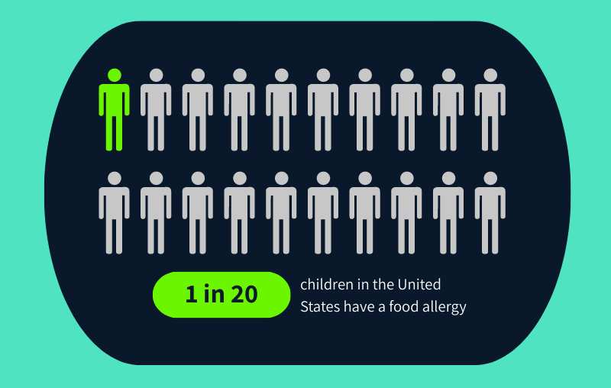
Food Allergies in Children

Slide 3
Logistics
Participant’s Workbook
Restrooms
Emergency Exits
Bike Rack
Ground Rules

Slide 4
Ground Rules
Show up on time and come prepared.
Stay mentally and physically present.
Let everyone participate.
Listen with an open mind.
Think before speaking.
Attack the problem, not the person.

Slide 5
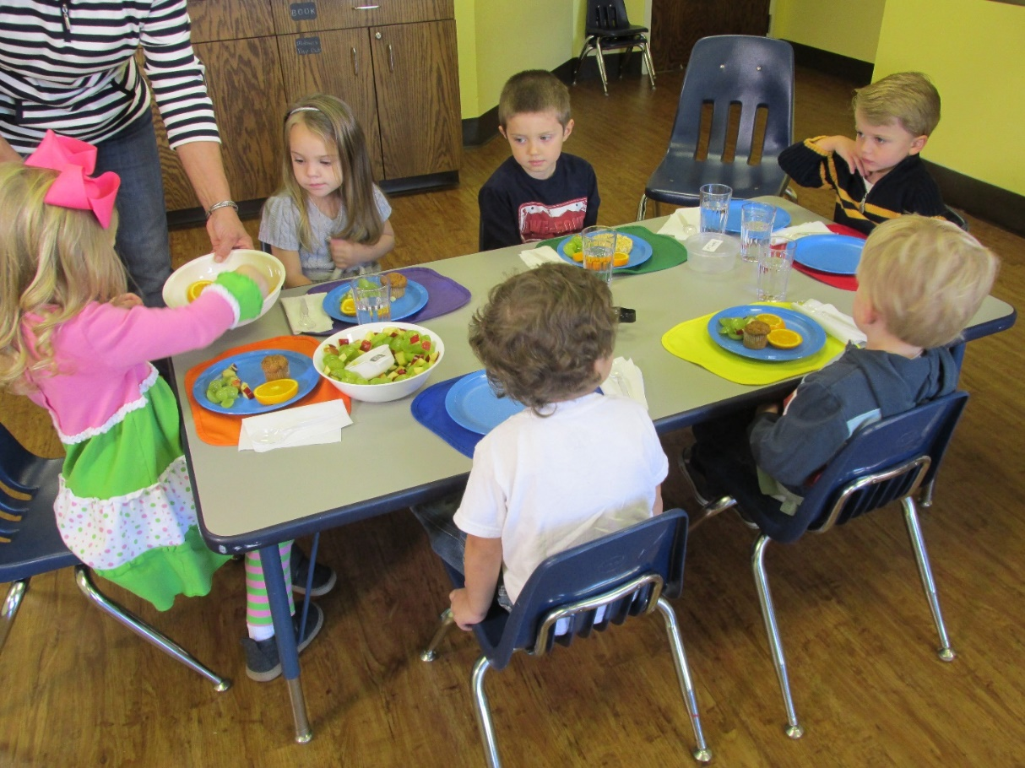
Warm-Up Activity
List 3 food allergies that children have in your program

Slide 6
Topics for Today
All About Food Allergies
Reading Labels for Allergens
Avoiding Cross-Contact
Accommodating Children With Food Allergies

Slide 7

Pre-Assessment
Test your food allergy knowledge
QR Code

Slide 8
Lesson 1: All About Food Allergies
Impact of an allergic reaction
Food allergies, symptoms, and treatments
Nine major food allergens
Food allergy vs. food intolerance

Slide 9

Notes:
The Caitlin Remembered video is not embedded into this slide deck due to it making the file too large to download. To get the video, go to www.theicn.org/foodsafety and download the Caitlin Remembered Video. To embed it, save the downloaded video to your computer. Then, go to the Insert tab, chose Video, and then Video on my PC. Choose the video from your files and embed.

Slide 10

The Power of a Story Activity
Personal reflection (How you felt)
Record feelings on the worksheet
Discuss as a class

Slide 11
What Is a Food Allergy?
Food Allergy
Body reacts to a food protein (allergen)
Body’s Immune System
Body thinks food protein is dangerous Creates antibodies against the allergen
EVEN A TRACE can result in an allergic reaction.

Slide 12
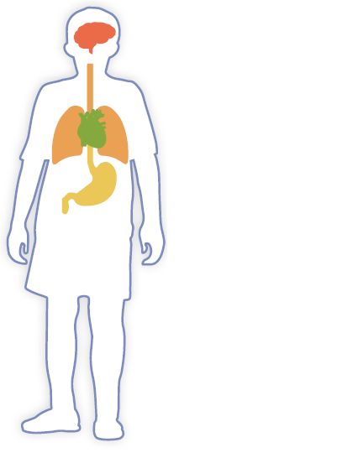
Allergic Reaction Symptoms
One or more symptoms can occur from minutes to a few hours
Can be MILD to SEVERE
Loss of consciousness
Trouble swallowing
Voice change
Drop in blood pressure
Shortness of breath
Repetitive coughing
Swelling
Hives
Eczema
Itchy, red rash
Nausea & vomiting
Diarrhea
Abdominal cramping
Notes:
*Animated Slide*

Slide 13

Treatment for Allergic Reaction
Determined by a State-licensed healthcare professional
Written in the emergency care section of the food allergy plan
Treatments for an allergic reaction may include:
  Epinephrine
  Antihistamine
  Inhaler

Slide 14
How a Child Might Describe Symptoms
This food is too spicy.
My tongue is hot (or burning).
It feels like something is poking my tongue.
My tongue (or mouth) is tingling.
My tongue (or mouth) itches.
My mouth feels funny.
There is a frog in my throat.
There’s something stuck in my throat.
My lips feel tight.
My throat feels thick.
It feels like there is a bump on the back of my tongue.

Slide 15

Nonverbal Signs of Allergic Reaction
Putting hands in mouth
Pulling or scratching at tongue
Slurring words
Voice may change (hoarse or squeaky)
Notes:
https://www.istockphoto.com/photo/asian-obese-boy-scratch-the-itch-with-hand-on-bed-gm810536608-131135529?phrase=food%2Ballergy
Stock photo ID:810536608

Slide 16
Anaphylaxis
Symptoms
Difficulty breathing
Drop in blood pressure
Feeling of doom
Gastrointestinal symptoms
Rapid pulse, cardiac arrest
Shock
Skin symptoms
Swollen lips
A serious allergic reaction
Rapid in onset
May cause death

Slide 17
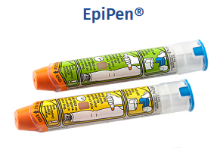
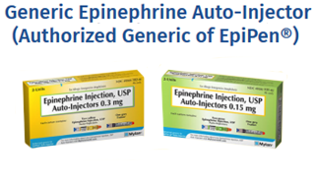
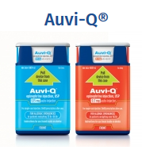
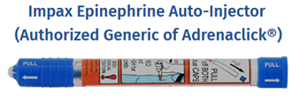
Epinephrine
Epinephrine auto-injectors treat anaphylaxis
Pictures from Food Allergy Research Education
Notes:
Trade names for this device include EpiPen®, Adrenaclick®, and Auvi-Q® (Allerject® in Canada). DEMONSTRATION

Slide 18
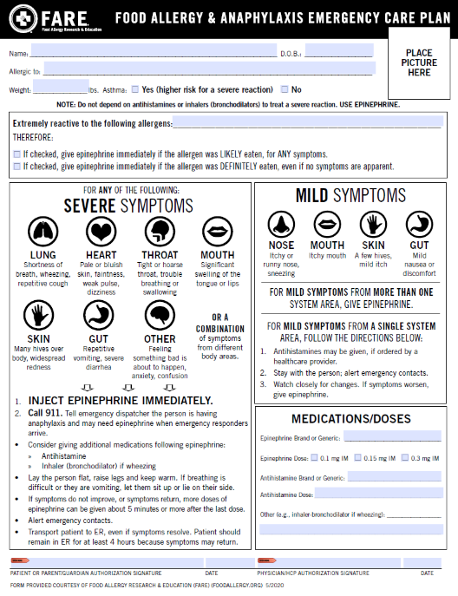
FARE Resources

Slide 19
Food Allergy Management Plan
Five Priority Areas
Ensure the daily management of food allergies in individual children.
Prepare for food allergy emergencies.
Provide professional development on food allergies for staff members.
Educate children and family members about food allergies.
Create and maintain a healthy and safe educational environment.
Notes:
*Animated slide*

Slide 20

Food Allergy Emergency Activity
Find Food Allergy Emergency worksheet
Answer questions, then discuss as a group

Slide 21
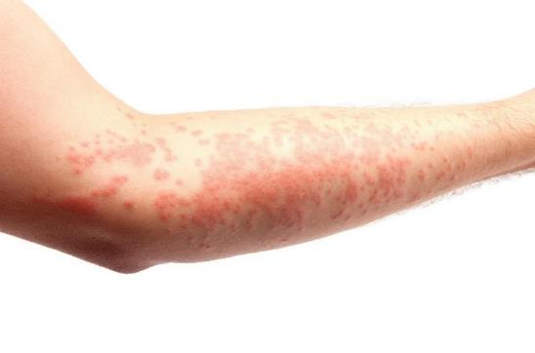
Emergency Reaction Questions
Child has reaction, what do you do first?
Who do you contact?
Who administers epinephrine?
Who is trained?

Slide 22

Response to Reaction
Quickly treat anaphylaxis with epinephrine
    Delay can be deadly
Serious food allergic reaction means an EMERGENCY
Call 911 or follow program’s food allergy emergency policy
Notify EMS that anaphylaxis is suspected and to bring epinephrine

Slide 23
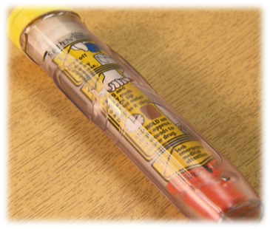
Auto-Injector Questions
Can a child carry an auto-injector?
Where is the auto-injector?
Is it secure and in an accessible location in case of a reaction?
Child without known food allergy has a reaction. Who do you contact?

Slide 24

Epinephrine Auto-Injector
Typically, only available by prescription
State laws may allow ‘stock’ auto-injectors
Children who receive an auto-injector need follow-up care and observation
Symptoms can improve or disappear, but child may have a 2nd reaction

Slide 25

Responding to an Emergency
Is staff trained? Substitutes? Volunteers?
Can your phone call 911?
Will EMS have epinephrine?

Slide 26
Preparation Is the Key to Success
Recognize
What are allergic reaction symptoms
React
Quickly administer medication or call 911
Review
After emergency:
Who may administer medication
Where the medication is stored
Delay could be deadly
What went well
What needs improvement

Slide 27
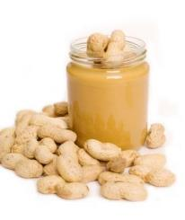
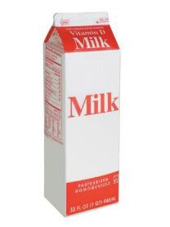

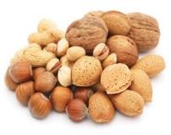
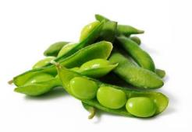
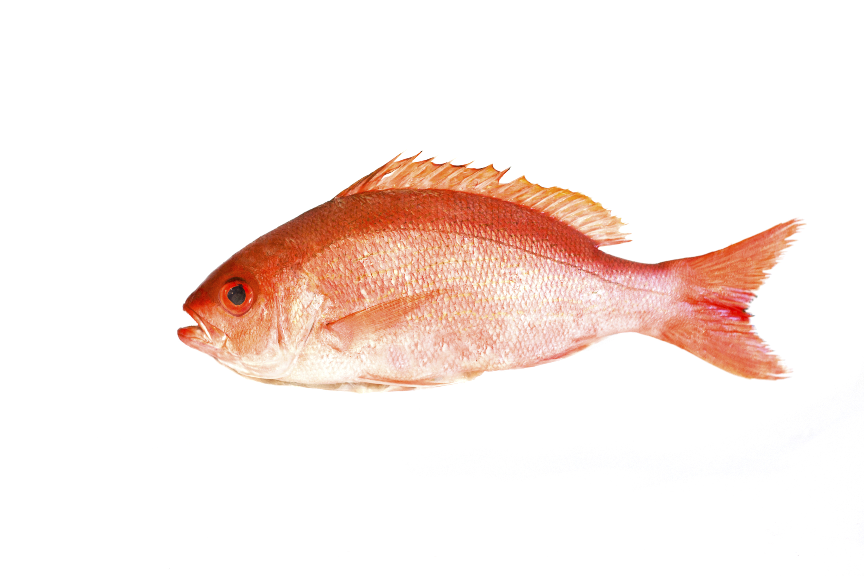
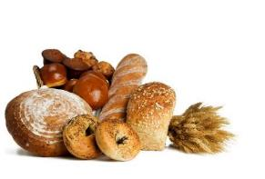
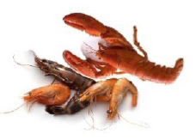
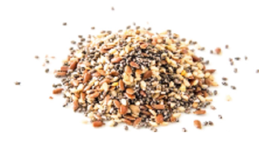
The Nine Major Food Allergens
Notes:
* Be aware that oysters, mussels, and clams do not fall under crustacean shellfish. Consideration must be taken with allergies related to them as they are not listed as one of the nine major allergens.

Slide 28

Only Way to Prevent an Allergic Reaction
Strict Avoidance of Known Food Allergens

Slide 29
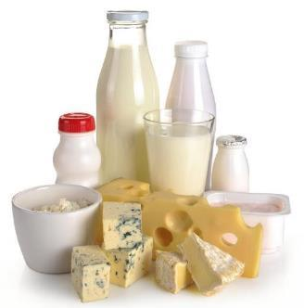
What Is a Food Intolerance?
Involves the Digestive System
Symptoms may:
Affect the skin, respiratory tract, and digestive tract—individually or combination
Can cause nausea, diarrhea, vomiting
Come on gradually
Not life-threatening
May be confused with food allergies

Slide 30

Food Allergy vs Food Intolerance Activity

Slide 31
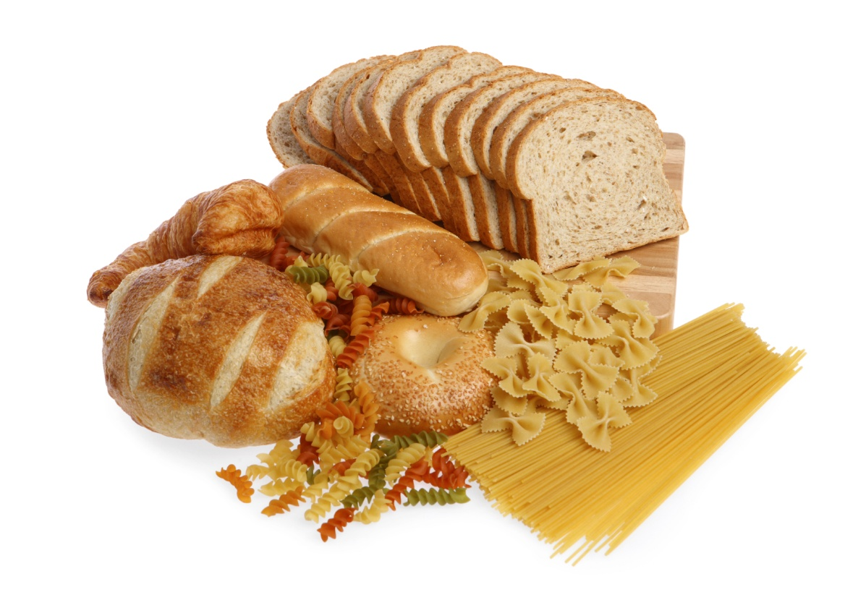
Celiac Disease
Autoimmune disorder involving the immune system in the small
intestine only
Reaction to eating gluten – protein in wheat, barley, and rye
Follow a strict gluten-free diet
Can have long-term health effects
Considered a disability

Slide 32
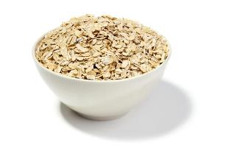
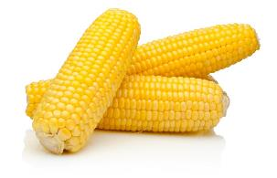
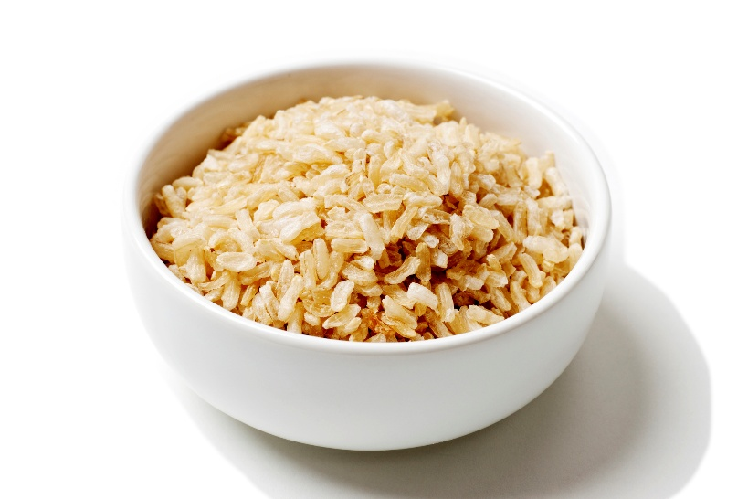
Gluten-Free Meals
Carefully read labels
Wheat-free ≠ Gluten-free
Be creative when planning menus
  Naturally gluten-free items

Slide 33
Lesson 1 Review
Impact of an allergic reaction
Food allergies, symptoms, and treatments
Nine major food allergens
Food allergy vs food intolerance

Slide 34
Lesson 2: Reading Food Labels for Allergens
Read food labels for nine major food allergens
Read food labels for allergens not among the nine major, in bulk, and in USDA Foods
Managing food labels

Slide 35
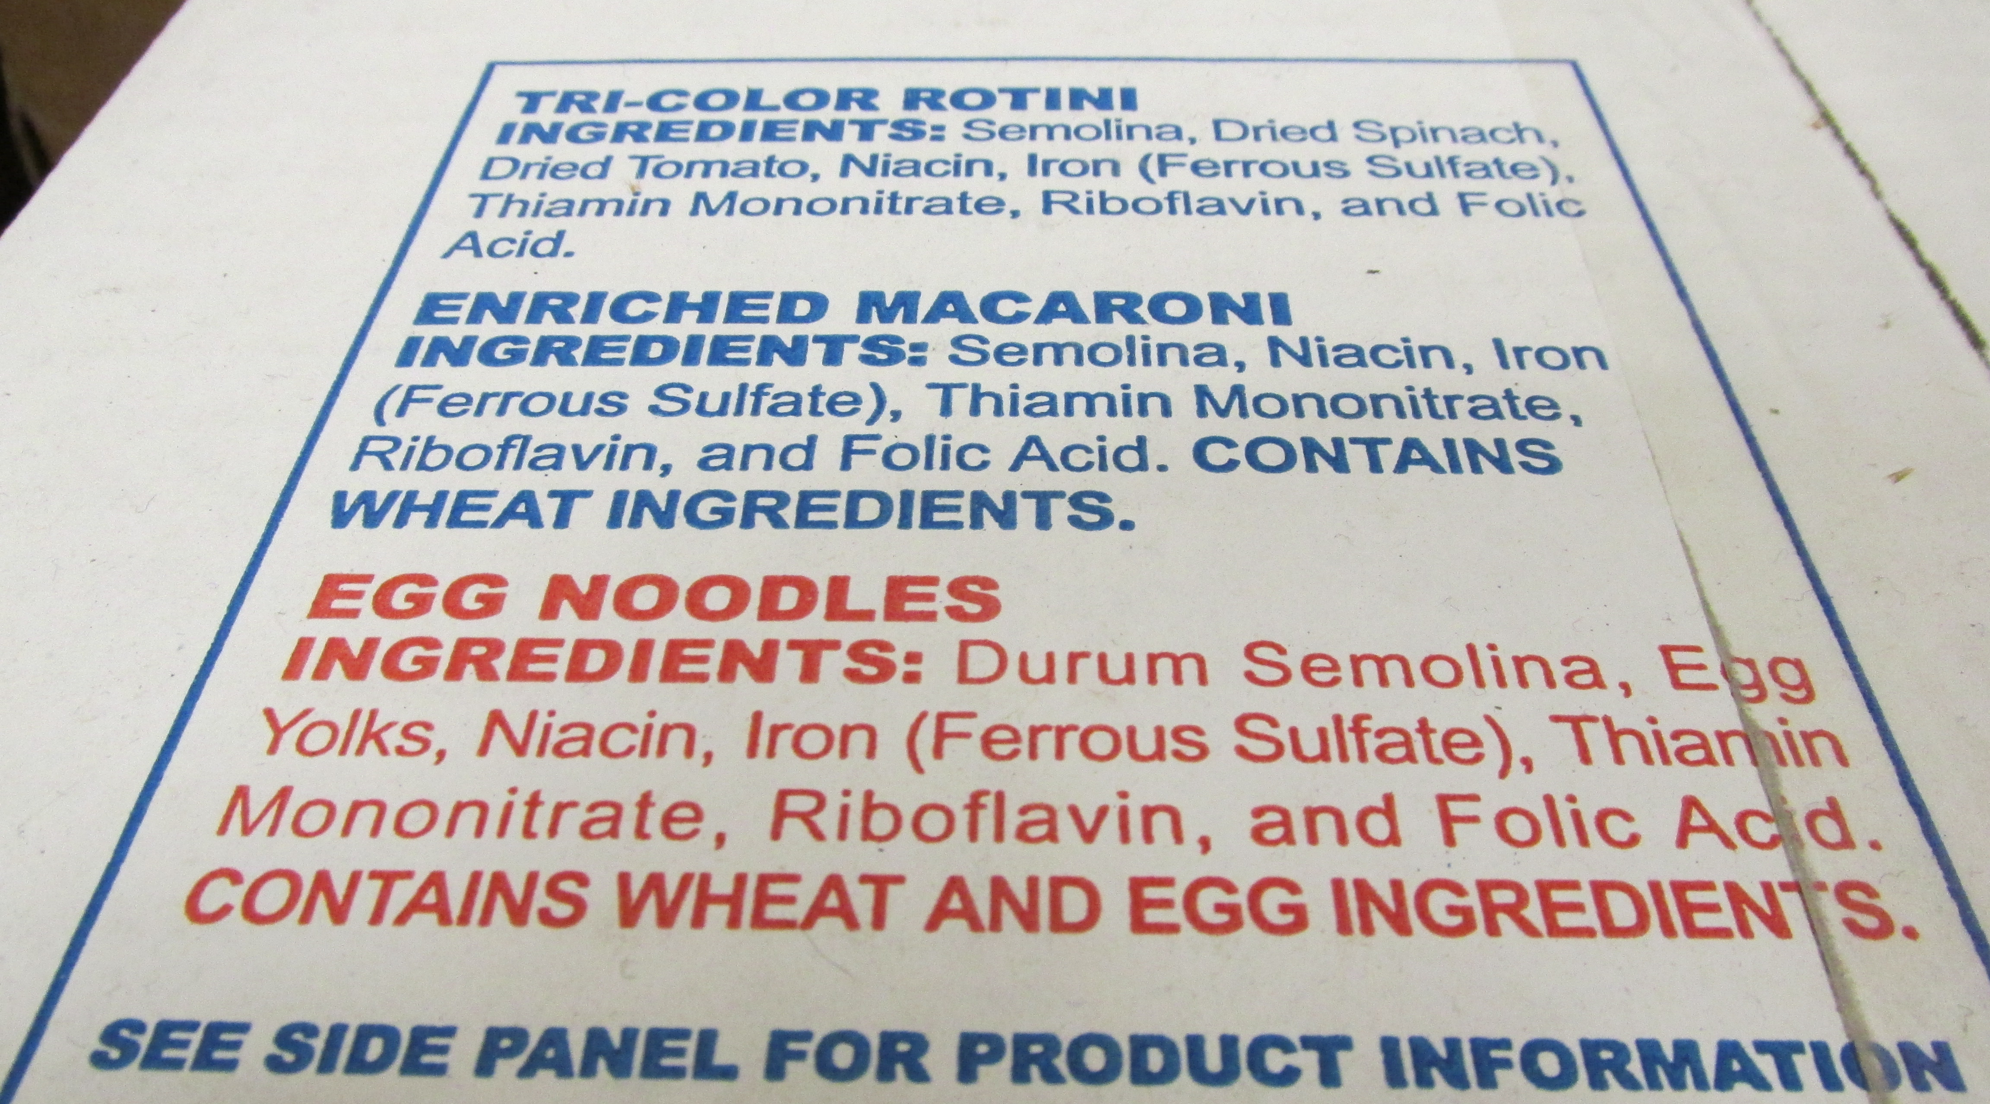
Reading Ingredient Statements

Slide 36
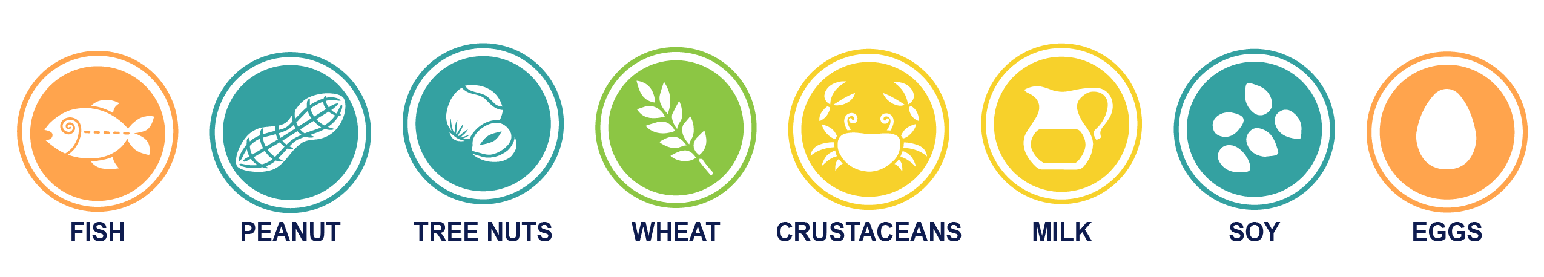
Food Allergen Labeling and Consumer Protection Act of 2004 (FALCPA)
Effective 2006
Food manufacturers must identify the major eight food allergens in plain language

Slide 37
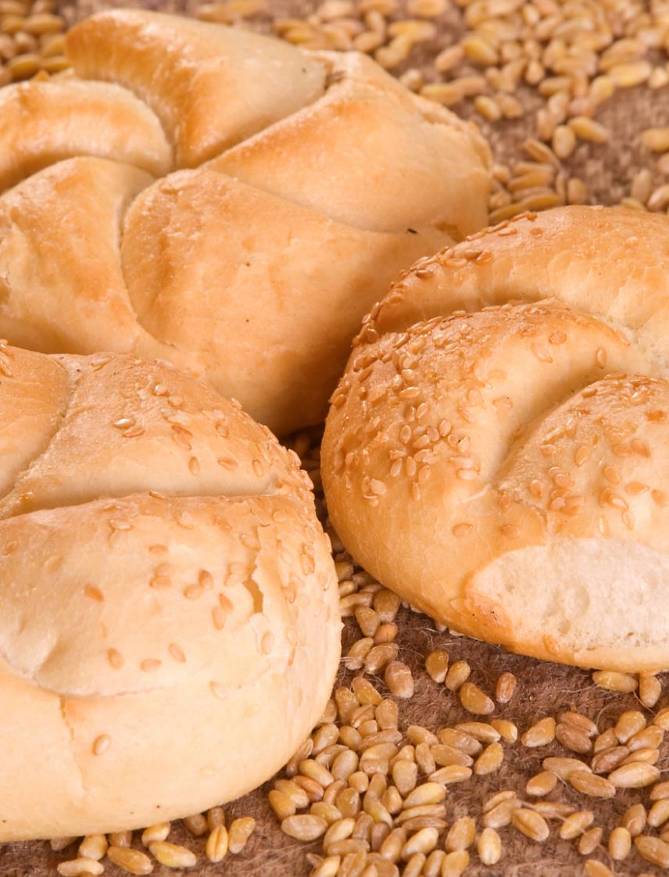

Food Allergy Safety, Treatment, Education, and Research Act (FASTER)
Passed in 2021
Effective January 2023
Added sesame as a major food allergen

Slide 38
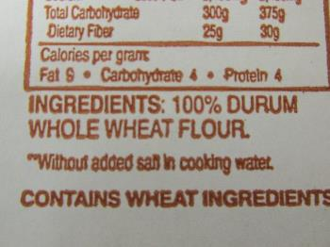
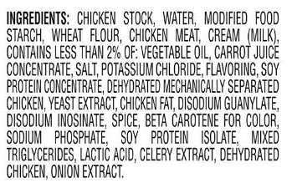
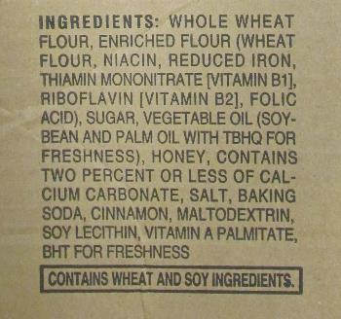
Label Samples
Written as the common or usual name of major food allergen
In parenthesis following, the ingredient that is not the common name
Listed after the ingredient list in a “Contains” statement
Notes:
*Animated Slide*

Slide 39
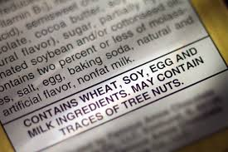
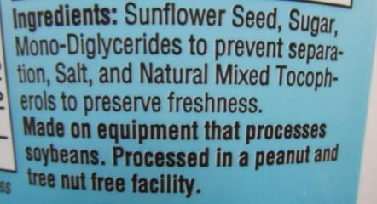
Advisory Statements
“May Contain”
“Made on equipment that also makes ...”
“Processed in facilities that also processes ...”
Not regulated
Not safe for food allergies
Notes:
*Animated Slide*

Slide 40

Other Food Labels
Regulated by FDA
Not Regulated by FDA
Gluten-free
  Gluten-free ≠ Wheat-free
Dairy-free
Egg-free
Peanut-free

Slide 41
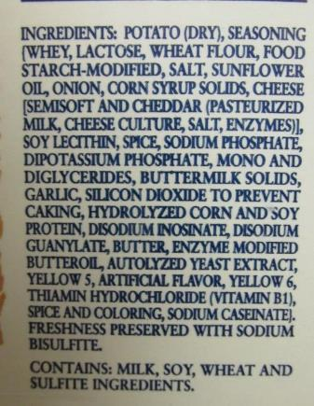
Hide and Seek Label Reading Activity
Work in groups
Read product label
Answer questions for label
Share answers with group

Slide 42

Recall Notifications
Coordinate with staff
49.2% of recalls due to undeclared food allergens
Recalls.gov
Notes:
Subscribe to food allergy recall notices, and a have system to take action if you serve a product being recalled.

Slide 43
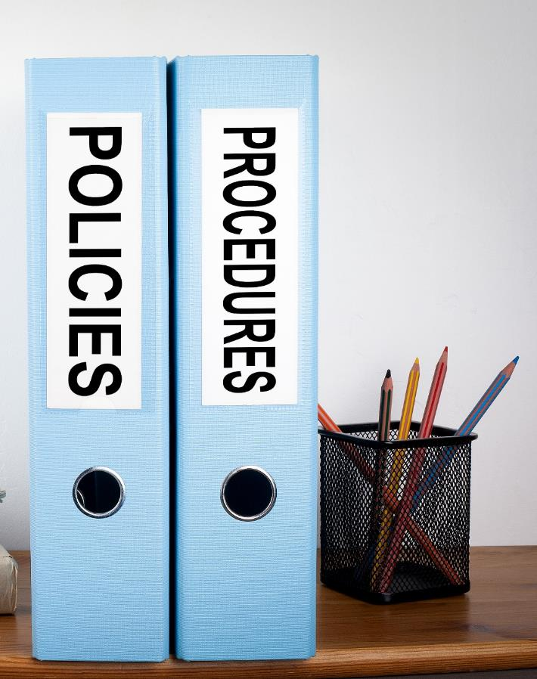
Recall Procedures
Follow program’s policies on handling recalls
Have and use SOPs
Serving Safe Food to Children With Food Allergies
Handling a Food Recall

Slide 44
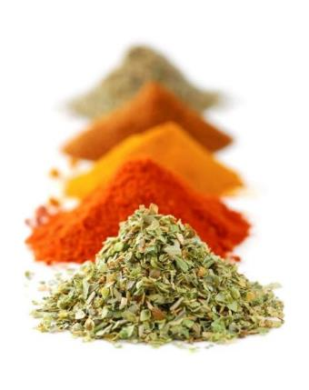
Reading Labels for Other Allergens
90% reactions = 9 Major
10% reactions = Not 9 Major
170 foods can cause allergic reactions
Read the entire ingredient statement
Work with parent or guardian
Be aware of “spices” in ingredient statement
Notes:
Remove borders

Slide 45
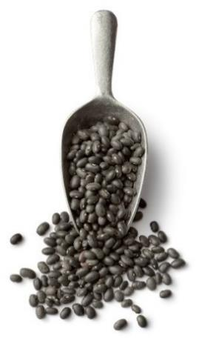
Recognizing Allergens in Bulk Items
Bulk Foods and USDA Foods
Read ingredient statements
SOP for handling bulk
    Mixing lots
    Scooping out of bulk
    Cleaning bulk containers
    Preventing cross-contact

Slide 46

Food Allergens in USDA Foods
Same labeling requirements
Read actual labels for food allergens
USDA Foods Database
Do not rely on USDA Foods Fact Sheets

Slide 47
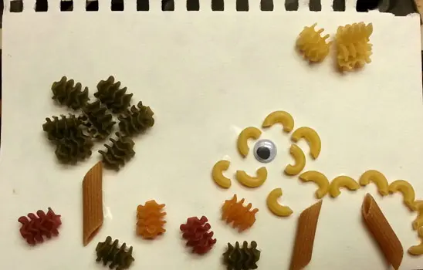
Food Allergens in Crafts and Supplies

Slide 48
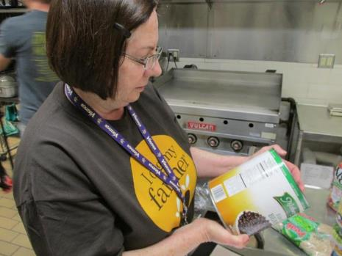
Procedures for Reading Food Labels
Build in time to read labels
Read all ingredient statements
Store labels according to program policy
Notes:
Reading food label pictures

Slide 49

Reading Food Labels Activity
Find Reading Food Labels worksheet
Write answers to questions
If unsure, check “Research”

Slide 50
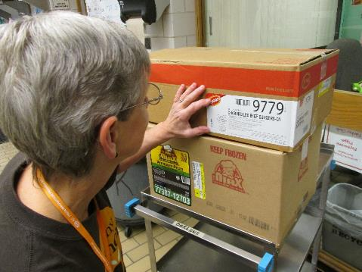
Procedures for Reading Food Labels
Who reads labels? If they are out, who is responsible?
Can subs read labels? Part-time staff? Volunteers?
How often are labels read?

Slide 51
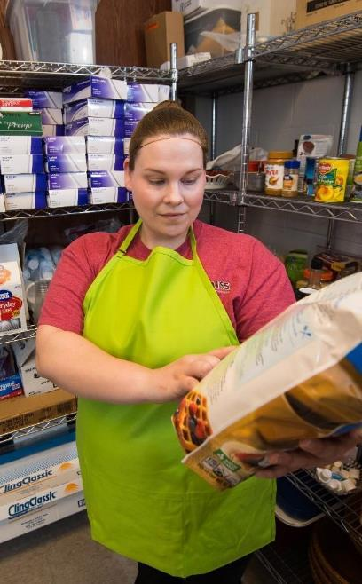
Reading Food Labels
Check all labels carefully every time
  When product is received
        Suppliers may make product substitutions
        Formulas may change
        Vendors could change
  Before using in cooking
Build time into the schedule for reading label

Slide 52
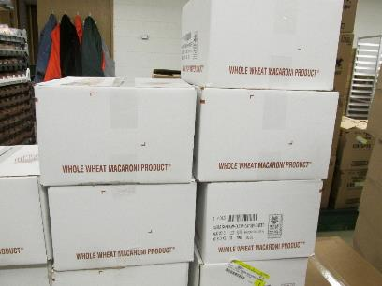
Storing Food Labels
Keep food labels? How long?
Cannot find label?
How to find label when case is thrown away?
Where are food labels stored?

Slide 53
Food Label Storage
CDC recommends keeping labels 24 hours
  Available in case of reaction
Keep label if food is used as leftover or reused in another recipe
Storing ideas
  Keep actual label
  Scan or take photo

Slide 54
Procedures for Changes in Food Labels
What do you do if a substitute product contains allergen?
    Recipe has changed?
    New advisory statement?
What is chain of command for communicating new allergen?
If misread label, what do you do?

Slide 55
Changes in Food Labels
Know chain of communication to report allergens in food
    Can prevent an allergic reaction
Food allergy management plan outlines:
    Chain of command
    Actions employees take if a food label is read incorrectly and contains a food allergen
        Do not serve the food to the child with the allergy
Train employees on plan

Slide 56

Communicating Food Allergy Information
How does your program share food allergy information?
Parent/guardian requests additional information?
Communicate with other employees?
If you cannot answer, who do you contact?

Slide 57
Communicating Food Allergies
Methods for sharing food allergy information
    Program website
    Prepare handouts
    Provide training for your staff and parents or guardians.
By communicating, families will understand how child is being protected:
    Priority of the child nutrition program
    Precautions taken
    Emergency action plan in place

Slide 58

Label Reading Role-Play Activity
Each group will be assigned a scenario.
Design skit to show solution.
Notes:
Add picture of a group discussion

Slide 59
Lesson 2 Review
Nine major food allergens in the ingredient statement on the food label
Allergens not among the nine major, in bulk, and in USDA Foods
Procedures for reading ingredient statements

Slide 60
Lesson 3: Avoiding Cross-Contact
Cross-contact definition
Ways cross-contact occurs
Strategies to avoid cross-contact

Slide 61
Cross-Contact | Cross-Contamination
Accidental transfer of allergens | Accidental transfer of microorganisms
Cooking does not reduce or eliminate allergens. | Cooking does reduce or eliminate microorganisms.
Example: Cutting PB&J and turkey sandwiches with same knife | Example: Raw meat stored above and dripping into fresh apple container

Slide 62
Cross-Contact or Cross-Contamination? Activity
Cross-Contact
Cross-Contamination
Both

Slide 63
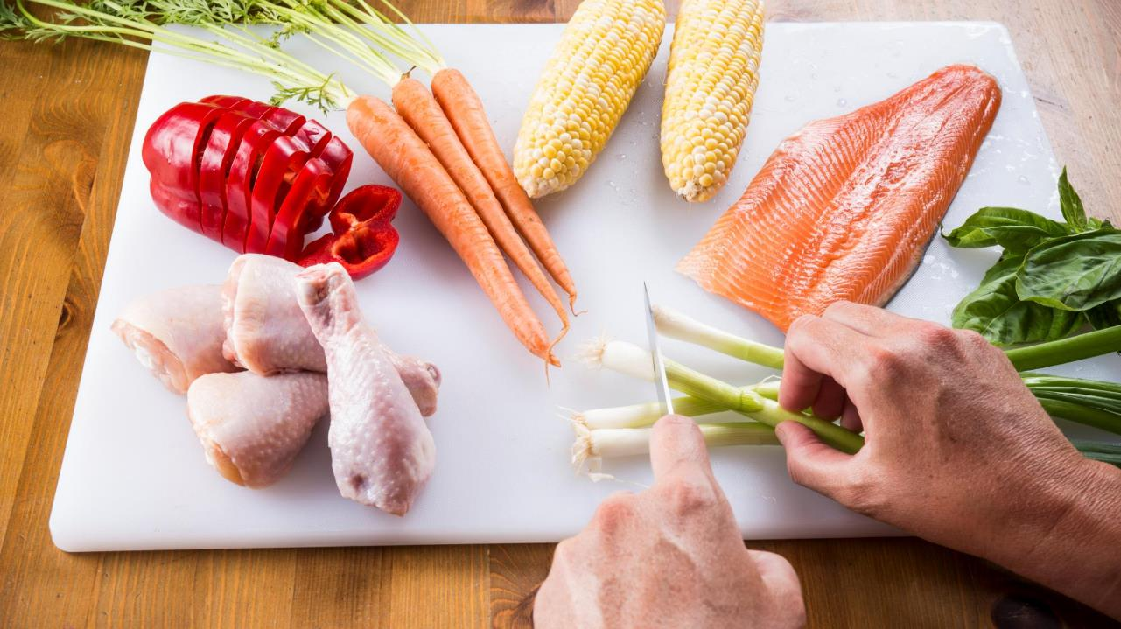
1. Cross-Contact or Cross-Contamination?

Slide 64
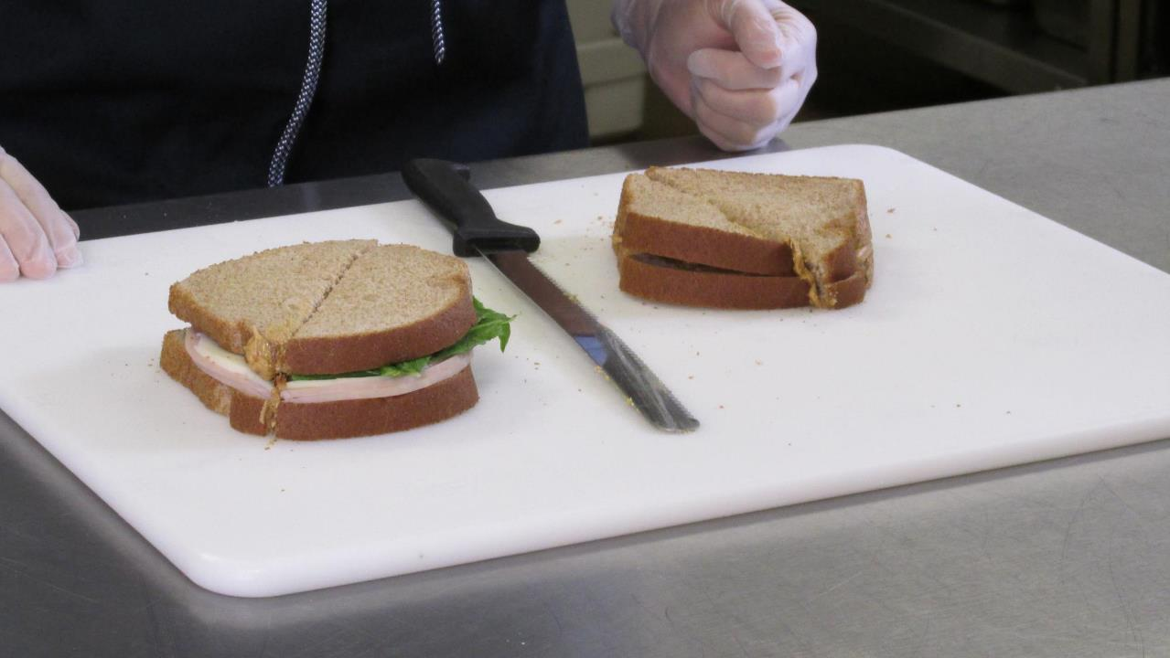
2. Cross-Contact or Cross-Contamination?

Slide 65
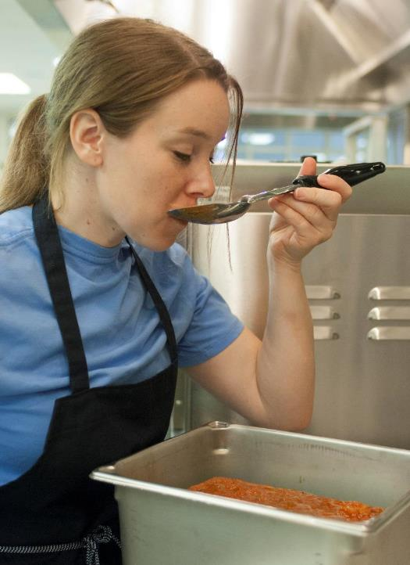
3. Cross-Contact or Cross-Contamination?
Notes:
Cross-Contamination: Person is tasting the food with the serving spoon over a pan of food.

Slide 66
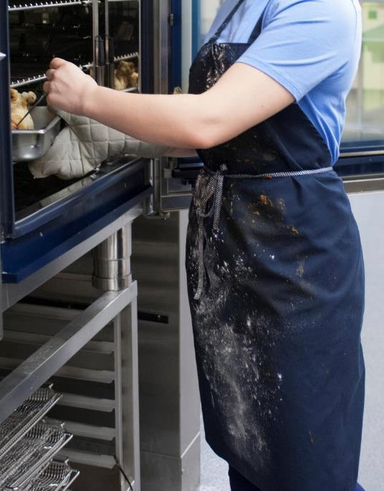
4. Cross-Contact or Cross-Contamination?
Notes:
Cross-Contact and Cross-Contamination: Cross-contact with the flour on the dirty apron allowing for wheat allergens to transfer. Cross-contamination as the spaghetti sauce and flour on the dirty apron can grow and transfer microorganisms.

Slide 67
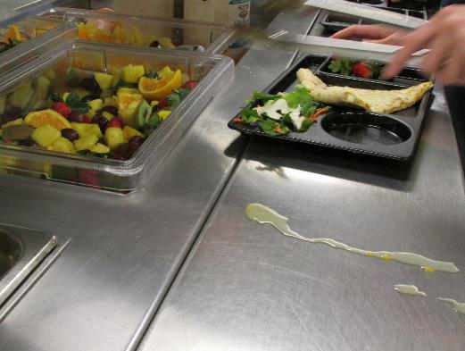
Potential Sources of Cross-Contact
Food handling and preparation
Insufficient handwashing
Insufficient cleaning
Shared equipment, utensils, cutting boards, counters
Splatter or steam

Slide 68
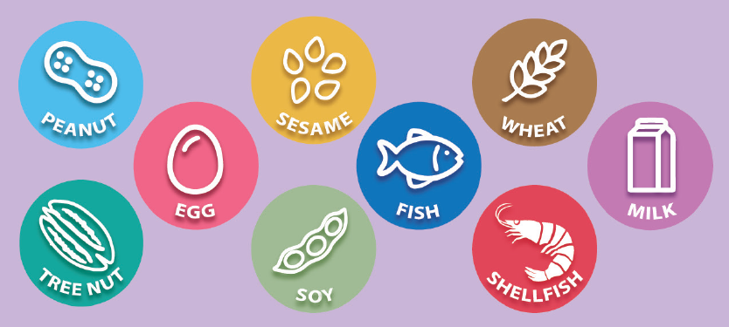
Where Are the Allergens? Activity

Slide 69
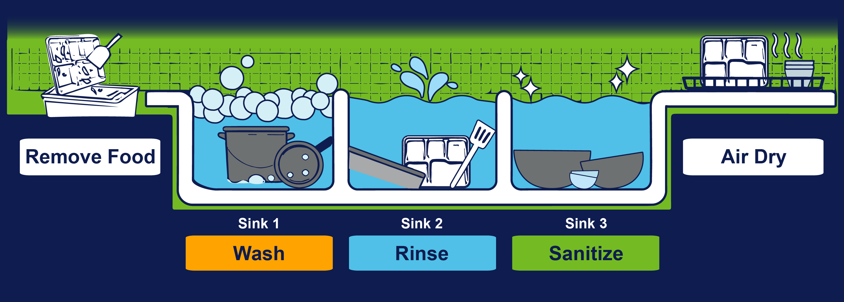
Cleaning and Sanitizing

Slide 70
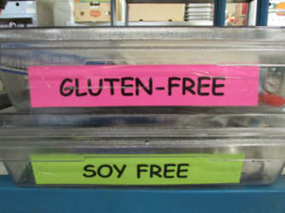

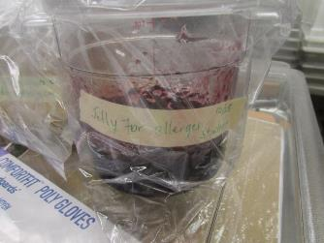
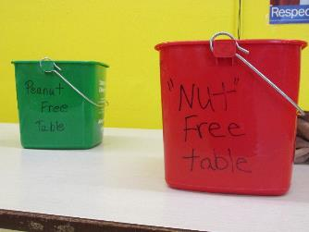
Preventing Cross-Contact

Slide 71

Avoiding Cross-Contact Case Studies Activity

Slide 72
HACCP-Based Food Safety Plan
HACCP
Control/prevent/minimize food safety hazards that may cause illness or injury
SOP
Step-by-step instructions for following your program’s food safety practices

Slide 73
Receiving Food
Storing Food
Preparing Food
Cooking Food
Holding Food
Serving Food
Handling Leftovers
Preventing Cross-Contact Plan Activity
Find the Avoiding Cross-Contact Plan worksheet.
Think about your kitchen.
Write where cross-contact could occur during these food processes.
Write procedures your program uses to avoid cross-contact.

Slide 74

Avoiding Cross-Contact Scenario Activity
Each group will be assigned a scenario
Come up with solution(s)
Report out
Notes:
Add picture of a group discussion

Slide 75
Lesson 3 Review
Cross-contact definition
Ways cross-contact occurs
Strategies to avoid cross-contact

Slide 76
Lesson 4: Accommodating Children With Food Allergies
Role of child nutrition staff in supporting children with food allergies
Manage food outside of the child nutrition program

Slide 77

Respect Children With Food Allergies
Civil rights and privacy must not be violated
Do not single out child with food allergies

Slide 78

Protect Children With Food Allergies
Be alert to prevent bullying from other children and/or adults
Encourage them to notify an adult, parent, or guardian if they are being harassed or threatened

Slide 79

Federal Disability Laws
Laws that cover the treatment of those with disabilities
  Rehabilitation Act of 1973
  Individuals with Disabilities Education Act (IDEA)
  Americans with Disabilities Act (ADA)
Notes:
gavel

Slide 80

Federal Privacy Laws
Laws that protect the privacy of children with disabilities
  Health Insurance Portability and Accountability Act of 1996 (HIPAA)
  Family Educational Rights and Privacy Act of 1974 (FERPA)

Slide 81
Strategies to Accommodate Children With Food Allergies
Step 1
  Be aware of the food allergies of children in your program.
Step 2
  Develop a partnership with all those involved with the child’s care.
Step 3
  Know requirements for serving food to children with food-related disabilities.
Step 4
  Implement the instructions of the State-licensed healthcare professional or registered dietitian.

Slide 82

Written Plans for Food Allergies
504 Plan
Individualized Education Plan (IEP)
Individualized Family Services Plan (IFSP)
Individualized Healthcare Plan (IHP)
Notes:
Remove border

Slide 83

Child Nutrition Meal Requirements
Must make substitutions when disability prevents children from eating/drinking the meal as prepared
Possible modifications:
  Allergen-free meal
  Safe environment to eat meal
Notes:
83

Slide 84
Medical Statement Requirement for Federal Reimbursement
Federal reimbursement:
    Outside of the meal pattern → medical statement required
    Inside of the meal pattern → medical statement not required
May still be required by:
    Local health authority
    State agency

Slide 85

Medical Statement
Medical statement should include:
  Information about how the child’s physical or mental impairment restricts the child’s diet
  Meal modifications for the child’s disability
  Food(s) to be omitted and recommended alternatives for a modified meal

Slide 86


Menu Planning Tips
Allergen-free options in menu cycle
Reimbursable meal with existing allergen-free options
Minimizes need for special recipes or menu substitutions
Offer Versus Serve for specific programs

Slide 87
Modifications for Food Allergens Activity
Menu for 3–5-year-olds
Meal Component | Breakfast | Lunch | Snack
Grain | WW Cinnamon Toast | WW macaroni and cheese | WGR pita
Meat/Meat Alternate | Spinach egg bake* | Grilled chicken drumsticks | HM Hummus
Fruit | Strawberries | Apples
Vegetable | *Spinach | Carrots and peas | Cucumbers
Milk | 1% or fat-free milk | 1% or fat-free milk
Food Allergens: Milk, Eggs, Strawberries, Cinnamon, Sesame

Slide 88
The Team
Child’s Safety
Director
Parents or Guardians
Child Nutrition Staff
Communication
Communication
Communication

Slide 89
Accommodating Children With Other Food-Related Disabilities
Food Related Disabilities
Other Accommodations
Diabetes
Phenylketonuria (PKU)
Celiac disease
Texture
IV
Tube feeding

Slide 90
Strategies to Manage Outside Food
Outside food prepared and served in the program | Program food served outside the kitchen/cafeteria | Outside food sources served at the site
Restaurants Caterers Vended meals | Food served in the classroom Field trip Playground Afterschool Snack Program | Potlucks Classroom projects Parent provided Donations

Slide 91
Reduce the Risk Activity
Work in groups.
Each group has a scenario of a child with a known life-threatening food allergy.
On the chart paper, record the actions you would take to safely provide food for the child.
Select a spokesperson; share your group’s scenario and the actions.

Slide 92
Lesson 4 Review
Accommodate children with food allergies.
Manage food outside of the child nutrition program.

Slide 93


Make It Stick

Slide 94

Post-Assessment
QR Code

Slide 95
Training Wrap Up
What questions may I answer for you?
ICN Evaluation
Make sure you sign the class roster.

Slide 96





www.theicn.org 800-321-3054
Email: helpdesk@theicn.org
Notes:
DO: Keep this slide visible as participants sign off. Encourage them to note the contact details and reach out to ICN for any follow-up questions or support.
SAY (Optional): If you have questions or need resources after today, don’t hesitate to contact ICN using the information on this slide. You can also stay connected by following us on your favorite social media platforms.

