Slide 1









An Introduction to
Farm to School
Maggie Gosselin, M.S.
Orientation
March 13, 2013
United States Department of Agriculture
Food and Nutrition Service

Slide 2
Overview
What is farm to school and what are its benefits?
Federal, state, and nonprofit support
Sourcing locally, and correctly!
Incorporating local foods into school meals: an example
Resources
Questions

Slide 3
What is farm to school and what are its benefits?

Slide 4


Farm to school defined
Local Food
Food Education

Slide 5

Local sourcing
Vegetables
Meat, Poultry and Fish
Beans, Grains, and Flour
Eggs
Fruits
Dairy

Slide 6

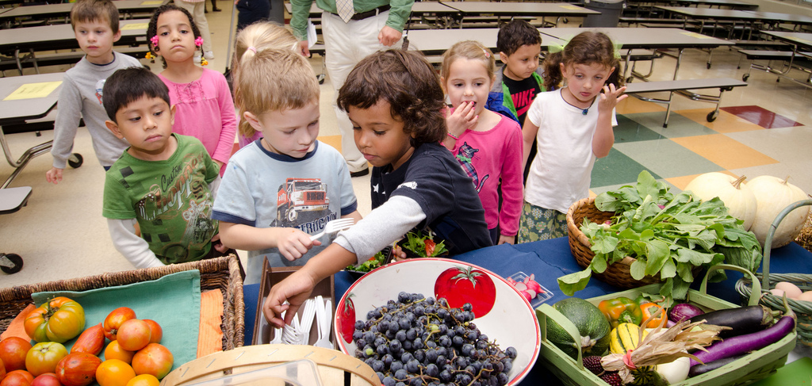
Food, nutrition, and ag education
Farm to school programs can also include food, agriculture and nutrition-based educational efforts that span a host of activities.

Slide 7
Farm to school is growing!
The National Farm to School Network estimates that in SY 2011 - 2012:
2,338 districts were involved
12,429 schools were involved
5,746,400 students were reached
$13,000,000 was spent

Slide 8
Why farm to school?
Farm to school programs are believed to:
  Improve knowledge and attitudes toward food, agriculture, nutrition, and environment.
  Increase fruit and vegetable consumption.
  Increase market opportunities for producers.
  Support economic development.

Slide 9
State, federal, and nonprofit support

Slide 10
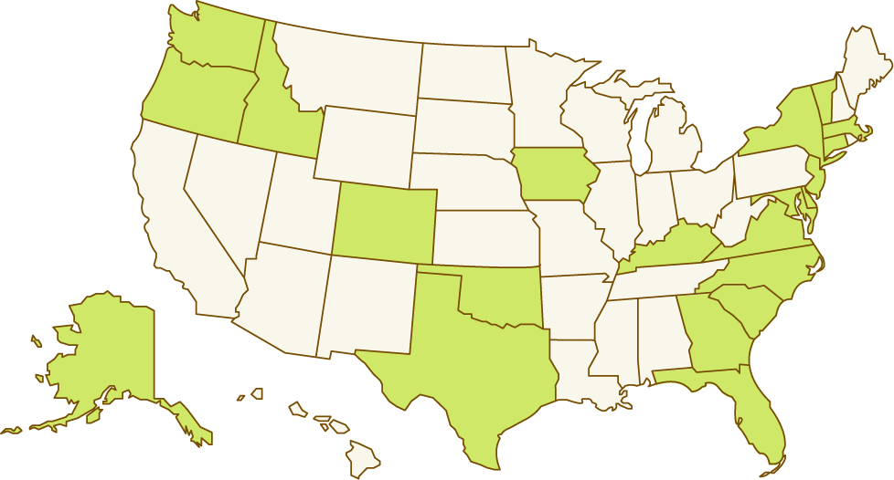
F2S Coordinators, Depts of Ag

Slide 11
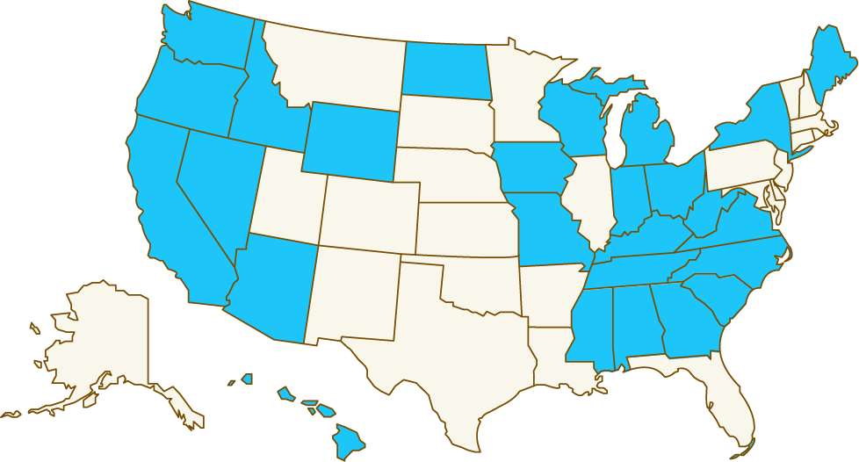
F2S Coordinators, Depts of Ed

Slide 12
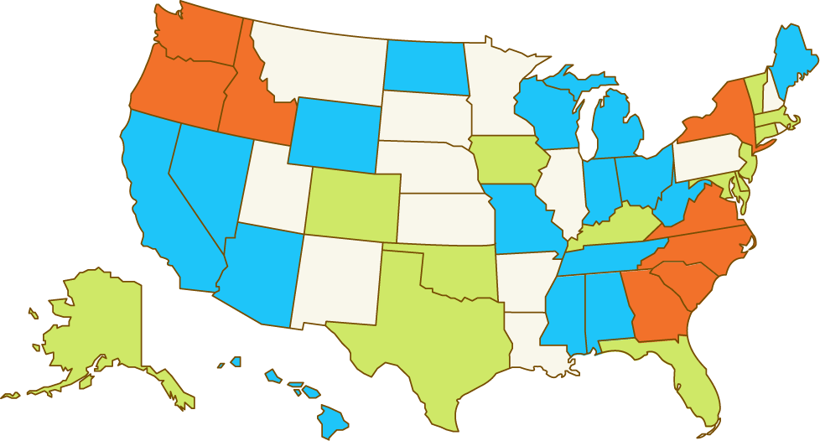
F2S Coordinators, Depts of Ag & Ed

Slide 13
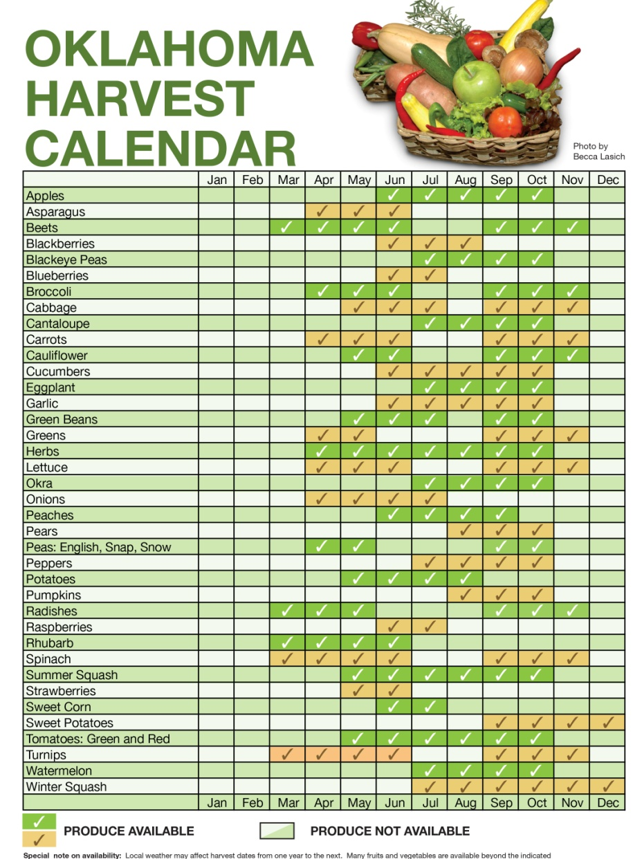


State spotlight: Oklahoma

Slide 14
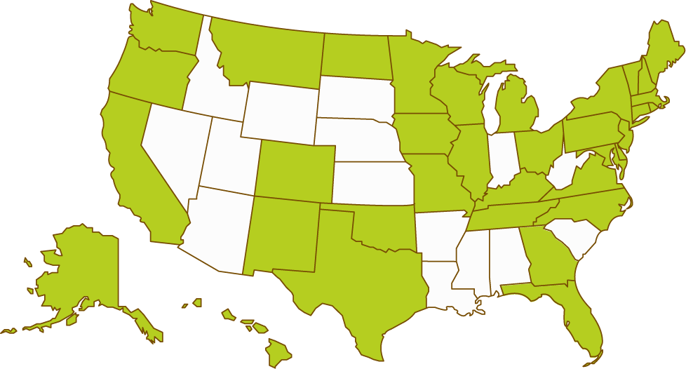
States with farm to school legislation

Slide 15








Nonprofit organizations

Slide 16


Slide 17
How is USDA involved?
The Food and Nutrition Service (FNS) works with State, territorial, and Indian tribal governments to implement child nutrition programs including:
The National School Lunch Program
The School Breakfast Program
The Summer Food Service Program
The Fresh Fruit and Vegetable Program
The Afterschool Snack Program

Slide 18
USDA’s legislative mandate
Section 243 of the Healthy Hunger-Free Kids Act of 2010 directed the Secretary of Agriculture to “improve access to local foods in (eligible) schools” by providing farm to school grants, training, and technical assistance.

Slide 19
Grants and technical assistance
  Planning grants are schools just beginning farm to school activities.
  Implementation grants are for schools to further develop existing farm to school initiatives.
  Support Service grants are intended for entities working with schools to further develop and provide broad reaching support services to farm to school initiatives.

Slide 20
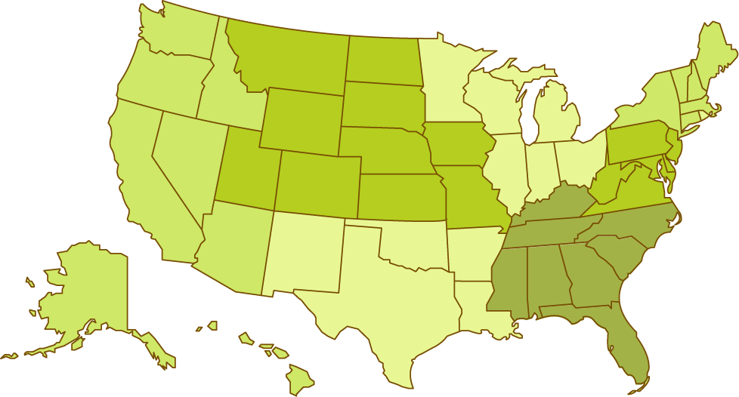
FNS staffing and offices
NERO
MWRO
MPRO
MARO
WRO
SERO
National Office
SWRO

Slide 21
Group discussion: What’s your experience with local food?

Slide 22


Slide 23
Sourcing locally, and correctly!

Slide 24
The Procurement Process
The procurement process involves:
Planning
Drafting Specifications
Awarding a Contract
Managing the Contract
Advertising the Procurement
Procurement
Principles

Slide 25
Federal procurement principles
The most important principle of a sound procurement is that it is competitive.
Open and free competition means that all suppliers are on a level playing field and have the same opportunity to compete.
Competition is essential to ensure low cost and good quality of goods and services.

Slide 26


Where to get local foods
Through distributors
Through the DoD Fresh Program
Through food service management companies
From food processors
From individual producers
From producer co-ops/food hubs
From school gardens

Slide 27
Methods for Local Sourcing
What are the ways that an SFA can source local foods and be in full compliance with federal procurement regulations?
By applying a geographic preference.
Unintentionally. (Because local products happen to be cheaper.)
By including related characteristics in specifications.
By approaching only local sources under an informal procurement.
By specifying your desire for local foods in contracts with food service management companies, distributors, or DoD Fresh

Slide 28
Procuring local foods without even trying
Some local products, because of their nature, are likely to be cheaper than non-local competitors.
SFAs in some areas are more likely than SFA in other areas to end up “accidentally” procuring local foods.
Ask your providers where your food is coming from—you might be surprised!

Slide 29
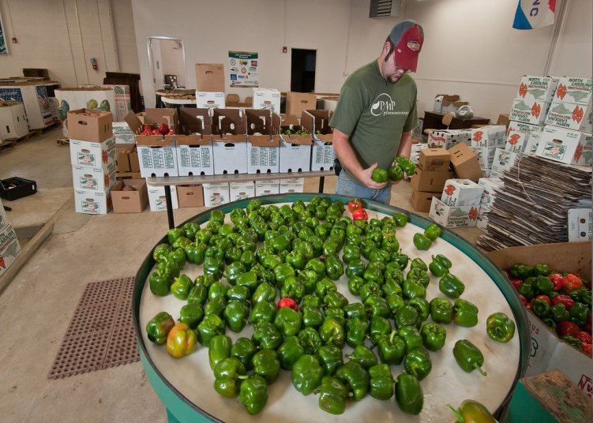
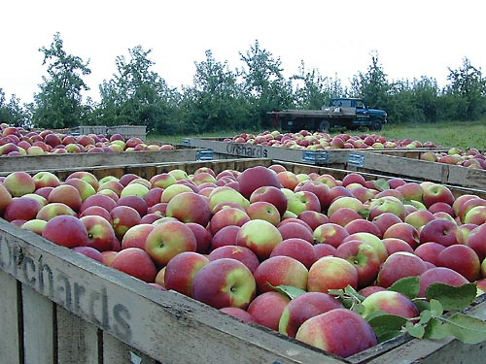
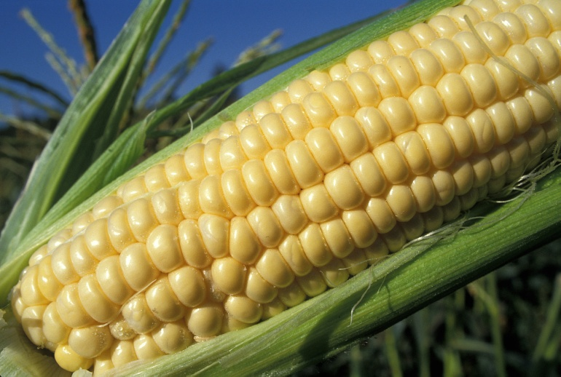
Specifications related to local foods
You can include specifications such as “harvested within 48 hours of delivery” that will increase the chances that a local vendor will win the contract.

Slide 30
Approaching only local vendors
If you’re making a purchase that falls under your small purchase threshold, you can get quotes from 3 (or more) local farms or vendors.
But remember, you can’t arbitrarily split up a procurement to come in under the small purchase threshold, and you have to put your specifications in writing.

Slide 31
Including your desire for local in solicitations
To purchase local foods through a distributor or food service management company, you must specify your desire for local products, including as much detail as possible.
Food service management companies must follow Federal procurement regulations, too; therefore, they can source local foods using the same methods you can.

Slide 32
Working with DoD Fresh
DoD Fresh offers an opportunity to use USDA Foods entitlement dollars on fresh produce
  DoD contracts with produce vendors across the country
  Many of these vendors purchase regionally grown produce
  Contact your produce vendor for more information on local products and work to connect the vendor with other producers in your area

Slide 33


Slide 34


The geographic preference option
Institutions that receive funds through USDA Child Nutrition Programs are allowed to apply an optional geographic preference in the procurement of unprocessed locally grown or locally raised agricultural products.

Slide 35
What is “unprocessed”?
“Unprocessed” agricultural products retain their inherent character. These are the allowed food handling and preservation techniques:
  Cooling, refrigerating, and freezing
  Peeling, slicing, dicing, cutting, chopping, shucking, and grinding
  Forming ground products into patties
  Drying and dehydrating
  Washing, packaging, vacuum packing, and bagging
  Adding preservatives to prevent oxidation
  Butchering livestock or poultry
  Pasteurizing milk

Slide 36
Incorporating a geographic preference
Define local.
Decide how much “preference” local products will receive.
Determine what type of procurement method to use.
Be sure your solicitation makes perfectly clear how the preference will be applied.

Slide 37
Geographic preference: An example
 | Bidder 1 | Bidder 2 | Bidder 3
Price | $1.97 | $2.05 | $2.03
Meets geographic preference? | No | Yes (- ¢10) | No
Price with preference points | $1.97 | $1.95 | $2.03

Slide 38
Bringing local into the cafeteria
Geographic preference can be applied to most school food purchases for unprocessed locally grown or raised agricultural products.
Local sourcing is possible through DOD Fresh.
USDA Foods save money and can be part of healthful, local meals.

Slide 39
Quality standards
When purchasing local foods, consider including specifications related to:
  Degree of ripeness or maturity
  Freshness (age)
  Condition upon receipt of product
  Temperature
  Size uniformity
  Other quality standards (such as “organic,” “no-till,” “no-spray,” etc.)

Slide 40
Farm to school and food safety
Farm to school operators must ensure the safety of all foods served to kids. Consider developing food safety protocol for:
  The school garden
  The school kitchen
  The production and transport of foods

Slide 41
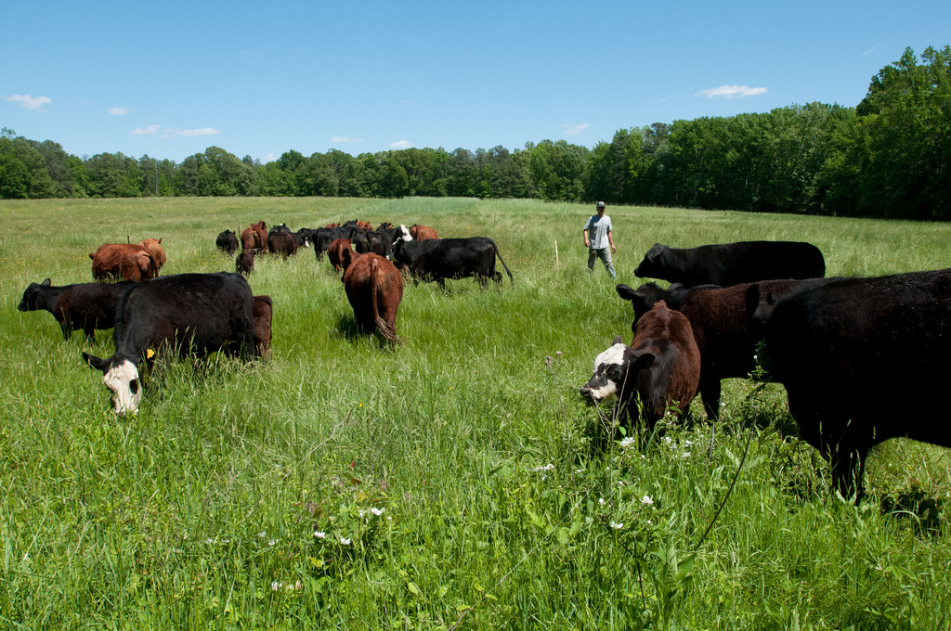

Slide 42
Incorporating local foods into school meals: an example

Slide 43
Monday | Tuesday | Wednesday | Thursday | Friday
Submarine Sandwich on Whole Wheat Roll Refried Beans Jicama Green Pepper Strips Cantaloupe wedges Skim Milk | Whole Wheat Spaghetti with Meat Sauce Whole Wheat Roll Green Beans Broccoli & Cauliflower Kiwi Halves Low-fat Milk | Chef Salad Whole Wheat Soft Pretzel Corn Baby Carrots Banana Skim Milk | Oven-Baked Fish nuggets Whole Wheat Roll Mashed Potatoes Steamed Broccoli Canned Peaches Skim Milk | Whole Wheat Cheese Pizza Baked Sweet Potato Fries Grape tomatoes Applesauce Low-fat Milk
Evolution of a local menu

Slide 44
Monday | Tuesday | Wednesday | Thursday | Friday
Submarine Sandwich on Whole Wheat Roll Refried Beans Jicama Green Pepper Strips Cantaloupe wedges Skim Milk | Whole Wheat Spaghetti with Meat Sauce Whole Wheat Roll Green Beans Broccoli & Cauliflower Kiwi Halves Low-fat Milk | Chef Salad Whole Wheat Soft Pretzel Corn Baby Carrots Banana Skim Milk | Oven-Baked Fish nuggets Whole Wheat Roll Mashed Potatoes Steamed Broccoli Canned Peaches Skim Milk | Whole Wheat Cheese Pizza Baked Sweet Potato Fries Grape tomatoes Strawberries Low-fat Milk Harvest of the month: Strawberries from Seascape Farm.
Evolution of a Local Menu

Slide 45
Monday | Tuesday | Wednesday | Thursday | Friday
Submarine Sandwich on Whole Wheat Roll Refried Beans Jicama Green Pepper Strips Cantaloupe wedges Skim Milk | Whole Wheat Spaghetti with Meat Sauce Whole Wheat Roll Green Beans Broccoli & Cauliflower Kiwi Halves Low-fat Milk | Chef Salad Whole Wheat Soft Pretzel Corn Baby Carrots Banana Skim Milk | Oven-Baked Fish nuggets Whole Wheat Roll Mashed Potatoes Steamed Broccoli Canned Peaches Skim Milk | Whole Wheat Cheese Pizza Baked Sweet Potato Fries Grape tomatoes Strawberries Low-fat Milk
Evolution of a local menu

Slide 46
Monday | Tuesday | Wednesday | Thursday | Friday
Submarine Sandwich on Whole Wheat Roll Refried Beans Jicama Green Pepper Strips Cantaloupe wedges Skim Milk | Whole Wheat Spaghetti with Meat Sauce Whole Wheat Roll Green Beans Broccoli & Cauliflower Kiwi Halves Low-fat Milk | Chef Salad Whole Wheat Soft Pretzel Corn Carrots Banana Skim Milk | Oven-Baked Fish nuggets Whole Wheat Roll Mashed Potatoes Steamed Broccoli Canned Peaches Skim Milk | Whole Wheat Cheese Pizza Baked Sweet Potato Fries Grape tomatoes Strawberries Low-fat Milk
Evolution of a local menu

Slide 47

Monday | Tuesday | Wednesday | Thursday | Friday
Submarine Sandwich on Whole Wheat Roll Refried Beans Jicama Green Pepper Strips Cantaloupe wedges Skim Milk | Whole Wheat Spaghetti with Meat Sauce Whole Wheat Roll Green Beans Broccoli & Cauliflower Kiwi Halves Low-fat Milk | Chef Salad Whole Wheat Soft Pretzel Corn Carrots Banana Skim Milk | Oven-Baked Fish nuggets Whole Wheat Roll Mashed Potatoes Steamed Broccoli Canned Peaches Skim Milk | Whole Wheat Cheese Pizza Baked Sweet Potato Fries Grape tomatoes Strawberries Low-fat Milk
Evolution of a local menu

Slide 48
Monday | Tuesday | Wednesday | Thursday | Friday
Submarine Sandwich on Whole Grain Roll Refried Beans Jicama Green Pepper Strips Cantaloupe wedges Skim Milk | Whole Wheat Spaghetti with Meat Sauce Whole Wheat Roll Green Beans Broccoli & Cauliflower Kiwi Halves Low-fat Milk | Chef Salad Whole Wheat Soft Pretzel Corn Carrots Banana Skim Milk | Oven-Baked Fish nuggets Whole Grain Roll Mashed Potatoes Steamed Broccoli Canned Peaches Skim Milk | Whole Wheat Cheese Pizza Baked Sweet Potato Fries Grape tomatoes Strawberries Low-fat Milk
Evolution of a Local Menu

Slide 49
Monday | Tuesday | Wednesday | Thursday | Friday
Submarine Sandwich on Whole Grain Roll Refried Beans Jicama Fresh Peas Cantaloupe wedges Skim Milk | Whole Wheat Spaghetti with Meat Sauce Whole Wheat Roll Green Beans Broccoli & Cauliflower Kiwi Halves Low-fat Milk | Chef Salad Whole Wheat Soft Pretzel Corn Carrots Banana Skim Milk | Oven-Baked Fish nuggets Whole Grain Roll Mashed Potatoes Steamed Broccoli Canned Pears Skim Milk | Whole Wheat Cheese Pizza Baked Sweet Potato Fries Grape tomatoes Strawberries Low-fat Milk
Evolution of a local menu

Slide 50
Monday | Tuesday | Wednesday | Thursday | Friday
Local Lentil Patty Whole Grain Roll Refried Beans Jicama Fresh Peas Cantaloupe wedges Skim Milk | Whole Wheat Spaghetti with Meat Sauce Whole Wheat Roll Green Beans Broccoli & Cauliflower Kiwi Halves Low-fat Milk | Chef Salad Local Spanish Rice with corn Carrots Banana Skim Milk | Oven-Baked Local Fish Sandwich on a Whole Grain Roll Mashed Potatoes Steamed Broccoli Canned Pears Skim Milk | Whole Wheat Cheese Pizza Baked Sweet Potato Fries Grape tomatoes Strawberries Low-fat Milk
Evolution of a Local Menu

Slide 51


Slide 52
Farm to school resources

Slide 53

Marketing and promotions
Potential audiences:
  Students
  Teachers and administrators
  Parents and community members
  Farmers
  The media

Slide 54
Resources
At www.fns.usda.gov/cnd/f2s:
  Sign up for the USDA Farm to School E-letter
  Learn more about USDA Farm to School Grants
  Find arm to school related policies and policy guidance
  Find contact information state farm to school coordinator and USDA staff
www.farmtoschool.org
www.schoolfoodfocus.org
www.ecoliteracy.org

Slide 55
Farm to School Myths, Busted
It’s mainly for farmers.
It’s mainly about fresh produce.
There is a set definition for local.
It’s dependent on direct deliveries from farmers.
It’s just about organic or sustainable products.
USDA requires local farmers to be GAP/GHP certified before they sell to schools.

Slide 56

Thank you! Questions?

