Slide 1
Federal child nutrition programs
January 2021
U.S. Department of Agriculture Food and Nutrition Service
Child Nutrition Division

Slide 2
Objectives
Provide an overview of the Federal Child Nutrition Programs, their administration, and structure
Clarify what is expected of those operating the Child Nutrition Programs
Introduce key policies of the Child Nutrition Programs
Answer questions about the operation of the Child Nutrition Programs
Provide a tutorial on how to access online information resources
Notes:
We know some of you are very familiar with the operation of these programs, while others may be familiar with only some aspects of the programs. This presentation is designed to:
Give you an overview of the programs administered by USDA Food and Nutrition Service in cooperation with you at the SAs
Help you understand the role that you and your State Agency play in a very large and important nationwide program
Provide information sources to help you understand program requirements. In many cases, the information you need is available to you through resources we will discuss today.

Slide 3
Structure and Administration of
Child Nutrition Programs

Slide 4
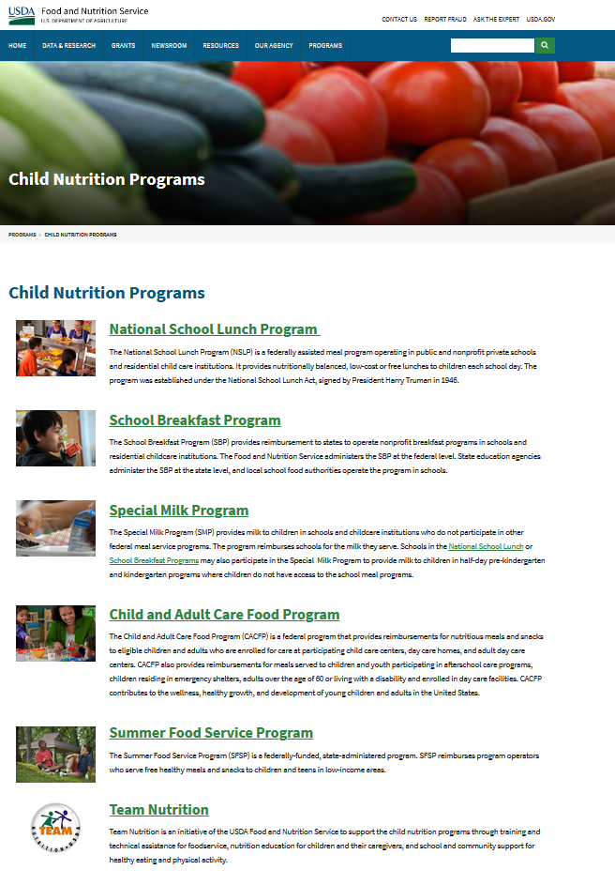
www.fns.usda.gov/cnd
Notes:
Here is the School Programs website where you can find the policies and resources that we are discussing today.

Slide 5
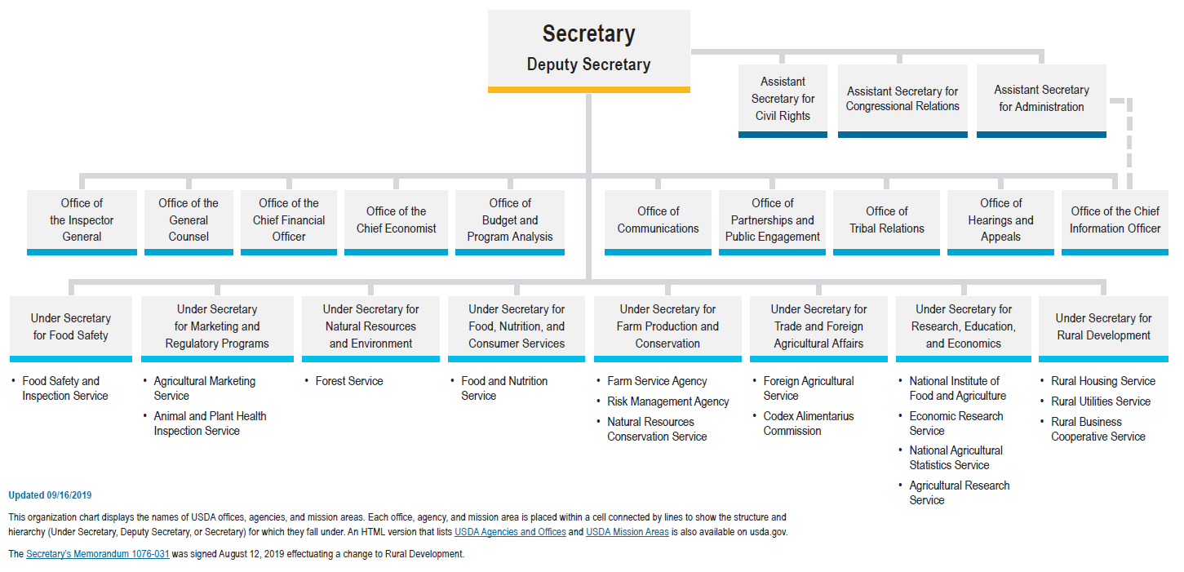
Organizational Structure
Notes:
The Under Secretary is responsible for Food and Nutrition Service (FNS)
Within USDA, CNPP is where scientific research is linked with the nutritional needs of the public. CNPP develops The Dietary Guidelines for Americans (with HHS) which is the nutrition foundation for the school meal programs and all government nutrition policy.
CNPP is also responsible for Choose MyPlate.gov
FNS increases food security and reduces hunger in partnership with cooperating organizations.
FNS program areas include:
Child Nutrition (CN)
Supplemental Nutrition Assistance Program (SNAP)
Special Supplemental Nutrition Program for Women, Infants, and Children (WIC)
Center for Nutrition Policy and Promotion (CNPP)
USDA Foods Programs (TEFAP, CSFP, FDPIR, and USDA Foods)

Slide 6
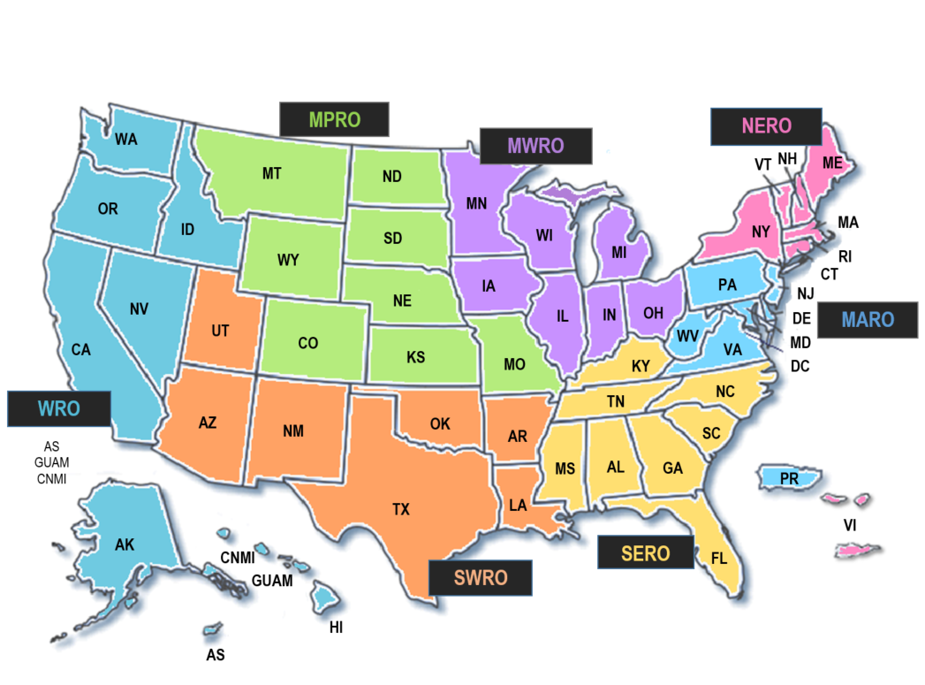
FNS Regional Offices
Notes:
7 FNS Regional Offices
Mid Atlantic -- Robbinsville, NJ (Delaware, DC, Maryland, New Jersey, Pennsylvania, Puerto Rico, Virginia, and West Virginia)
Midwest – Chicago, IL (Illinois, Indiana, Iowa, Michigan, Minnesota, Ohio, and Wisconsin)
Mountain Plains – Denver, CO (Colorado, Kansas, Missouri, Montana, Nebraska, North Dakota, South Dakota, and Wyoming)
Northeast -- Boston, MA (Connecticut, Maine, Massachusetts, New Hampshire, New York, Rhode Island, Vermont, and Virgin Islands)
Southeast -- Atlanta, GA (Alabama, Florida, Georgia, Kentucky, Mississippi, North Carolina, South Carolina, and Tennessee)
Southwest -- Dallas, TX (Arizona, Arkansas, Louisiana, New Mexico, Oklahoma, Texas, and Utah)
Western -- San Francisco, CA (Alaska, California, Hawaii, Idaho, Nevada, Oregon, Washington, Guam, Northern Mariana Islands, and American Samoa)

Slide 7
Administrative Flow
FNS National Office
Alexandria, VA
FNS Regions – 7
State Agencies – 56
School Food Authorities – nearly 20,000
Schools – approximately 100,000
Notes:
As you can see, the Administrative flow originates in FNS National Office (HQ in Alexandria, VA).
State Agencies (SAs) include :
Washington DC
Puerto Rico
Virgin Islands
Guam
Dual agencies include:
Arkansas (NSLP Private – DHS; NSLP Public – Dept. of Ed)
Oklahoma (NSLP Private – DHS; NSLP Public – Dept. of Ed)
Dual agencies separate between private and public schools, some states, like VA and CO, are prohibited from operating program at private schools due to state constitution.
It is important to note that in Texas, New Jersey, Florida, and Nevada the State Department of Agriculture administers the programs.

Slide 8
Respective Duties
National Office
Regional Offices
Analyzes legislation
Writes regulations and policy
Disburses Federal funds
Develops TA resources
Implements regulations
Offers technical assistance
Provides program oversight
Conducts management evaluations
Notes:
Responsibilities of HQ and the regions differ. This slide shows the basic differences.
In essence, the National Office in Alexandria :
Develops program policies and regulations that are consistent with the law and current nutrition science;
Disburses Federal funds provided to those who operate the programs; and
Develops technical assistance resources and guidance, and oversees program management to maximize effectiveness and value to clients and taxpayers.
The Regional Offices:
implement the regulations
offer technical assistance to SAs, and
conduct management evaluations of individual SAs.
State agency staff should contact their regional office as their first resource. And Local Education Agency (LEA)/School Food Authority (SFA) staff should go to their State agency for assistance.

Slide 9
Child Nutrition Programs
National School Lunch Program (NSLP)
  Afterschool Snack Service
  Seamless Summer Option
School Breakfast Program (SBP)
Special Milk Program for Children (SMP)
Child and Adult Care Food Program (CACFP)
  At-Risk Afterschool Meals
Summer Food Service Program (SFSP)
Fresh Fruit and Vegetable Program (FFVP)
Notes:
Themes:
1) State partnership
2) Building healthy habits that last a lifetime
FNS provides children and needy families better access to food and a more healthful diet through its food assistance programs and comprehensive nutrition education efforts.
Rather than simply providing food, FNS also works to empower program participants with knowledge of the link between diet and health. This element is what makes USDA’s school feeding programs different from other programs around the world.
FNS also works in partnership with States in all its programs:
FNS provides funding for the programs and sets the key requirements. FNS funds a significant portion of the State’s administrative expenses and also provides cash reimbursements for meals and commodity foods to help support local operators.
SAs handle most of the day-to-day administrative aspects of the program because the circumstances in which the program is operated can differ from state to state. SAs also provide technical assistance and training to the local SFAs and monitor compliance.

Slide 10
Scope of Child Nutrition Programs
About 100,000 schools in NSLP
About 91,000 schools in SBP
NSLP/SBP reimbursement payments to States in 2016 was approximately $16 billion
 | NSLP | SBP | SFSP | CACFP
ADP 2016 | 30.4 million children | 14.6 million children | 2.8 million children | 4.4 million children
Notes:
The slide gives an indication of the broad scope of the CNP:
The NSLP serves nutritionally balanced, low-cost or free lunches daily to more than 30 million children each school day through more than 100,000 public and non-profit private schools and residential child care institutions.
The breakfast program operates serves about 14 million children daily in about 91,000 schools.
NSLP/SBP reimbursement is about $16 billion.
Almost all public schools in the United States participate in the NSLP.
Student participation in the NSLP is approximately 60 percent of enrollment in participating schools. Free lunches are estimated at 67 percent of all lunches served.
ADP = average daily participation

Slide 11

Legislative Authority
The National School Lunch Act
National School Lunch Program
Fresh Fruit and Vegetable Program
Child and Adult Care Food Program
Summer Food Service Program
The Child Nutrition Act of 1966
School Breakfast Program
Special Milk Program
Notes:
The Richard B. Russell National School Lunch Act (1946) is the authorizing legislation for the National School Lunch Program (NSLP), which was established “… as a measure of national security, to safeguard the health and well-being of the Nation’s children and to encourage the domestic consumption of nutritious commodities…”
The National School Lunch Program (NSLP) also includes the service of Afterschool Snacks, as well as the Seamless Summer Option.
The National School Lunch Act (NSLA) also authorizes the Child and Adult Care Food Program (CACFP), which includes the service of meals and snacks in eligible afterschool programs in low-income areas.
The Fresh Fruit and Vegetable Program (FFVP) and Summer Food Service Program (SFSP) comes under the National School Lunch Act (NSLA), as well.
Twenty years later Congress passed the Child Nutrition Act of 1966. Expanded and modernized the school meal programs; established the School Breakfast Program (SBP); consolidated administration of school meals under a single Department (USDA)
These are two primary laws that guide the CN programs.
In addition, FNS issues:
regulations to implement the legislative requirements and
Guidance memorandum and instructions that address specific issues or aspects of the programs.

Slide 12
The Regulatory Process

Slide 13
Regulatory Process
Proposed Rule
  Seeks public comments; no implementation
Comment Evaluation
  USDA reads/considers comments on proposal
Final and Interim Rules
  Implement a requirement; Interim Regulation includes public comment period
Notices
  Announce routine updates
Notes:
When FNS issue a proposed rule describing a new requirements or changes to an existing requirement, the public has an opportunity to comment, typically 60 days.
This is the time for Program operators can to share their views.
FNS then evaluates the comments and incorporates relevant changes and suggestions into a final rule. The requirement is then codified in the Code of Federal Regulations.
An Interim Rule combines the features of a proposed rule and a final rule. It’s used in cases where there is an urgent need to put regulatory changes into place immediately while simultaneously taking comments.
An interim rule has both a comment period and an effective date. FNS may do an interim to get operational experience before finalizing a provision. For example, in the competitive foods rule which will be discussed later.
Notices: A Notice is published for public information but it does not include a public comment period. Examples of Notices are: National Average Payments-NAPs, and Income Eligibility Guidelines-IEGs). Public meetings are also announced via Notices.
Regulations are posted on the FNS website and on www.regulations.gov.

Slide 14

Your Role in the Regulatory Process
In order for the regulatory process to work, we need your help!
Your comments help FNS issue regulations that are meaningful and feasible for program operators.
  www.regulations.gov
Notes:
As child nutrition professionals and civic-minded citizens, you are a part of the regulatory process.
You are encouraged to view and comment on proposed and interim rules.
Please visit www.regulations.gov and follow the online instructions.
FNS reads and evaluates all comments. It is not necessary to submit duplicate comments via paper/fax/email. A comment will only be counted once. Regulations.gov is the best way to submit comments.
Please note that the comments become public information by law and anyone can read them.

Slide 15
The National School Lunch Program Regulations
7 CFR 210
Notes:
TITLE 7 CHAPTER II of the Code of Federal Regulations has the regulations for the Child Nutrition Programs administered by FNS. For the lunch program regulations, see Part 210 which spells out the requirements for the NSLP including meal pattern requirements, claims, reimbursement formulas, etc.
You can find the documents on the FNS website in pdf format, so you can search by keyword.

Slide 16
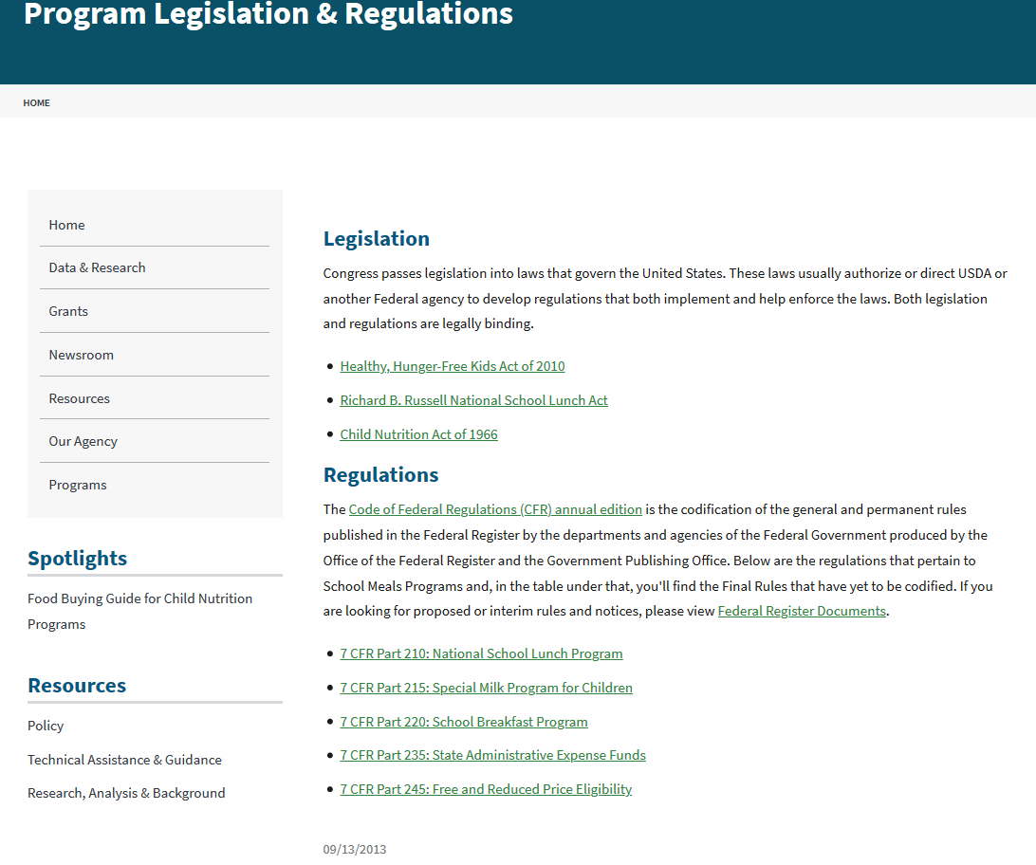
Notes:
This slide shows where to find the regulations for the school meals programs on the FNS website:
Part 210 contains the requirements for the NSLP and part 220 addresses the requirements for the SBP.
Many of the requirements in Part 210 are applicable to the Breakfast program and can be found to some extent in Part 220.
Part 245 covers free and reduced price eligibility.
Part 215 covers the Special Milk Program.
Part 235 covers State administrative expense funds.

Slide 17
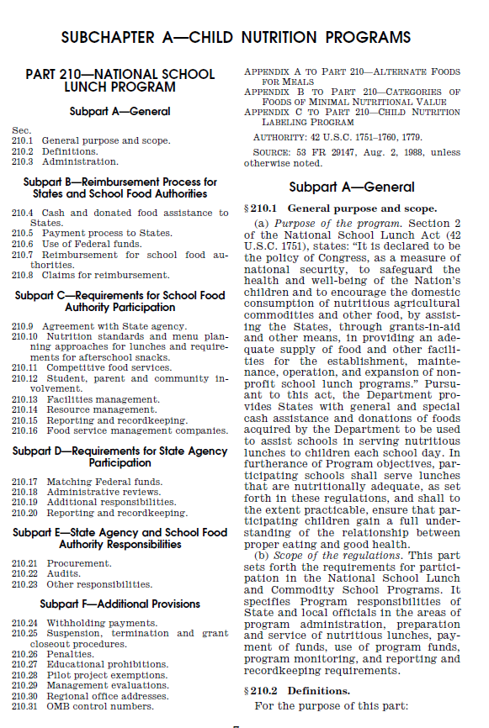
Notes:
This is Table of Contents for Part 210 and includes several Subparts with broad topics.
Each Section address a specific topic. The section numbers include a part number, a period, and a sequential number that starts with “1.”
For example:
210.2 contains definitions
210.9 explains in detail the agreement between the SFAs and the State agencies
210.10 contains the meal pattern requirements

Slide 18
National School Lunch Program Operations
Notes:
At this time, we will briefly cover the rules related to several different aspects of school meal operations.

Slide 19
SFA vs. LEA
School Food Authority
Local Educational Agency
SFA – School Food Authority
Governing body responsible for the administration of one or more school food service operations
Has legal authority to operate a Program
LEA – Local Educational Agency
Governing body responsible for broad scope functions, such as certifying and verifying F/RP school meal eligibility
Notes:
Some provisions of the regulations refer to LEA and some refer to SFA.
When an SFA wants to operate the NSLP or SBP, they must enter into a legal agreement with the State administering agency.
The SFA usually is a school district but the SFA may include sites that are under another school district, such as charter or private schools.
The school district and LEA are usually the entity responsible for the overall governing and running of the public schools in a county or city or is the private school sponsor.
The term LEA is used primarily in relation to free/reduced price meal application and eligibility/certification/verification processes.
So, let’s talk about some of the requirements for operating a Program.

Slide 20
Non-Profit Food Service
Observe limitations on:
  Food service revenues - 210.14(a)
  Competitive foods - 210.11(b)
  Maintain financial management system and account for all revenue and expenditures - 210.14
Money must be used for the meal program
Profits from competitive food must go to food service account
Notes:
The SFA has to maintain a non-profit food service operation.
This means that they have to observe limitations on:
Food service revenues
Competitive foods
Managing their finances, and keeping track of all revenues and expenditures
Money must be be used for the meal program – to make improvements to the Program(s)
Any money from competitive foods must accrue to the non-profit food service account.

Slide 21
Meals Priced as a Unit
A single reimbursable meal is priced as a unit
  Charges for reimbursable meals cannot be assessed based on individual components
Different prices may be charged depending on the total cost of producing each meal
  Some entrées are more expensive to purchase and/or prepare
Notes:
Reimbursable meals are priced as units.
A complete reimbursable meal has a unit price for all components or all components selected that meet the offer versus serve requirements. However, the SFA may set different prices because the components of different meals may be more costly than others. For example, the chef salad meal may be $2.50, while the salmon burger meal may be $2.75. The price of a meal is set by the SFA, and is based on the SFA’s food and labor costs as well as the requirements of paid lunch equity which we’ll talk about relative to the reimbursement rates.

Slide 22

Meal Service
The lunch period: 10:00 a.m. - 2:00 p.m.
Meals must meet nutrition requirements
Schools must display signage telling students what constitutes a reimbursable meal
Notes:
Another important aspect of the meal service is WHEN the meals are served.
The SFA agrees to serve lunches during the lunch period, between the hours of 10:00 am and 2:00 pm.
Much to parents’ (and maybe kids’ dismay), there is no requirement for meal length.
The lunches must meet the minimum nutrition requirements prescribed in 210.10.
Schools are required to display signage outlining the components that make up a complete, reimbursable meal. This is intended to help kids know what they’re supposed to take (e.g., 2 of 3 fruit choices) and reduce the unintended purchase of a la carte foods.

Slide 23
Point of Service Meal Counts
Count the number of reimbursable meals served by type at the point of service or through another system approved by the State
Count meals where you can accurately determine:
  If the meal meets component requirements
  The eligibility status of the child
Notes:
The point-of-service (POS) is important in the School Meal Programs. That’s the point where the student has selected their meal, and the cashier determines whether or not it’s reimbursable, and notes the meal based on the students’ eligibility category (paid, reduced-price, or free)
In a standard counting and claiming situation, the SFA has to count the number of free, reduced price and paid reimbursable meals served to eligible children at the point of service (or through another system approved by the State).
Schools must count meals at a point where they must be able to accurately determine:
If those meals contain all the required food components in the required amounts; AND
The eligibility status of the child receiving the meal.
The meal count is the foundation for the SFA’s claims for reimbursement.
Schools can offer foods after POS but schools need some type of monitoring in place to ensure that children take required components, in appropriate quantities, and that food safety measures are in place. An example of this is with salad bars and fruit/vegetable bars.

Slide 24
Unpaid Meal Charges: Policy Guidance
SP 46-2016: Local Meal Charge Policies
  Requires all SFAs operating the school meal
  programs to have a written meal charge policy in
  place by school year 2017-2018
SP 47-2016: Clarification on Collection of
Delinquent Meal Payments
  Clarifies how unpaid meal charges must be handled when debt is determined to be uncollectable
Notes:
**PLEASE ADJUST/SHORTEN NOTES AS NEEDED**
An issue that sometimes surfaces at the Point of Service is unpaid meal charges. We recognize that this can be a significant problem for many SFAs.
This slide shows FNS guidance and resources intended to assist State agencies, districts and schools with this issue.
The first resource is the “local charge policy requirement” (SP 46-2016: Local Meal Charge Policies). This policy required all SFAs operating the school meal programs to have a written meal charge policy in place by SY 2017-2018, in other words, by July 1, 2017. Specifically, the memorandum states that the written policy must address situations where children participating at the reduced price or paid rate do not have money to cover the cost of a breakfast of lunch at the time of the meal service. Beyond this requirement, SFAs have discretion in developing their individual policies. USDA will not review the quality or content of policies.
USDA also issued a memo to clarify how unpaid meal charges must be handled when meal charge debt is uncollectable (SP 47-2016: Clarification on Collection of Delinquent Meal Payments). This memo explains:
The process of designating delinquent debt determined to be uncollectable as bad debt,
The process of obtaining assistance to offset losses, and
How Federal regulations and the definition of bad debt apply when meal charges are not collected.
And finally, USDA issued a new Q&A memo about unpaid meal charges (SP 23-2017: Unpaid Meal Charges: Guidance and Q&A). This memo is a supplement to the other policy memos I mentioned, and addresses common questions from State agencies, school districts, and local program operators on the topic.
FOR REFERENCE ONLY:
Links to the policy memos listed above:
SP 46-2016: https://www.fns.usda.gov/unpaid-meal-charges-local-meal-charge-policies
SP 47-2016: https://www.fns.usda.gov/unpaid-meal-charges-clarification-collection-delinquent-meal-payments
SP 23-2017: https://www.fns.usda.gov/school-meals/unpaid-meal-charges-guidance-and-q

Slide 25
Unpaid Meal Charges: Policy Guidance
SP 23-2017: Unpaid Meal Charges:
Guidance and Q&A
  Addresses other key questions related to unpaid meal charges and alternate meals
SP 29-2017: Overcoming the Unpaid Meal Challenge: Proven Strategies from Our Nation’s Schools
  Provides support to State agencies and local program operators in their efforts to find workable solutions to the challenge of unpaid meal charges.
Notes:
**PLEASE ADJUST/SHORTEN NOTES AS NEEDED**
An issue that sometimes surfaces at the Point of Service is unpaid meal charges. We recognize that this can be a significant problem for many SFAs.
This slide shows FNS guidance and resources intended to assist State agencies, districts and schools with this issue.
The first resource is the “local charge policy requirement” (SP 46-2016: Local Meal Charge Policies). This policy required all SFAs operating the school meal programs to have a written meal charge policy in place by SY 2017-2018, in other words, by July 1, 2017. Specifically, the memorandum states that the written policy must address situations where children participating at the reduced price or paid rate do not have money to cover the cost of a breakfast of lunch at the time of the meal service. Beyond this requirement, SFAs have discretion in developing their individual policies. USDA will not review the quality or content of policies.
USDA also issued a memo to clarify how unpaid meal charges must be handled when meal charge debt is uncollectable (SP 47-2016: Clarification on Collection of Delinquent Meal Payments). This memo explains:
The process of designating delinquent debt determined to be uncollectable as bad debt,
The process of obtaining assistance to offset losses, and
How Federal regulations and the definition of bad debt apply when meal charges are not collected.
And finally, USDA issued a new Q&A memo about unpaid meal charges (SP 23-2017: Unpaid Meal Charges: Guidance and Q&A). This memo is a supplement to the other policy memos I mentioned, and addresses common questions from State agencies, school districts, and local program operators on the topic.
FOR REFERENCE ONLY:
Links to the policy memos listed above:
SP 46-2016: https://www.fns.usda.gov/unpaid-meal-charges-local-meal-charge-policies
SP 47-2016: https://www.fns.usda.gov/unpaid-meal-charges-clarification-collection-delinquent-meal-payments
SP 23-2017: https://www.fns.usda.gov/school-meals/unpaid-meal-charges-guidance-and-q

Slide 26

Unpaid Meal Charges: Website
Policy Guidance
Presentations
Best Practice Guide
And More!
Check it Out!
https://www.fns.usda.gov/school-meals/unpaid-meal-charges
Notes:
**PLEASE ADJUST/SHORTEN NOTES AS NEEDED**
Along with the policy guidance, USDA also developed new best practices resources designed to support State and local officials in their efforts to overcome the challenge of unpaid meal charges. All of these resources are available on a webpage devoted to unpaid meal charges, which USDA launched in the fall of 2016. On the webpage, you’ll find all of the policy guidance I mentioned, along with webinars, presentations, and a best practice guide USDA updated in May 2017. You can see a screen shot of the guide here, on the right hand side of the slide.
The guide shares specific tips program operators can use in their efforts to:
Reach all eligible children,
Assist families with the application,
Make payment convenient,
Send payment reminders,
Get buy-in for a local meal charge policy,
Prevent “lunch shaming,” or the embarrassment of children with school lunch debt, and
Find alternative funding sources.
FOR REFERENCE ONLY:
Link to the best practice guide: https://www.fns.usda.gov/school-meals/2017-edition-overcoming-unpaid-meal-challenge-proven-strategies-our-nations-schools

Slide 27
Overt Identification
Make no discrimination against any child because of his or her eligibility for F/RP meals
SFA will not overtly identify students based upon their eligibility status
SP-45-2012 clarified the prohibition on overt identification
Notes:
Overt Identification means that it’s obvious who’s receiving a free or reduced-price meal.
Schools can’t differentiate, in any way, among children receiving free, reduced or paid meals. In other words, they may not identify these kids by:
serving them different meals
utilizing different color-coded tickets
employing separate lines
allowing an observer to identify the child’s eligibility status
We encourage schools to have a system using pre-purchased tickets, tokens, or debit cards so that no one knows who’s in what benefit category.

Slide 28
Sanitation and Health
Obtain two food safety inspections per year and post report in visible location
  State agencies report to USDA the number of inspections obtained by their SFAs
Follow a food safety program/HACCP
  http://www.fns.usda.gov/food-safety/food-safety-resources#Nutrition
Notes:
Food safety is another key aspect of the School Meal Programs.
Schools across the Nation serve millions of lunches and breakfasts daily, and that means a large number of children could be affected by a school food safety problem.
Regulations require SFAs to follow sanitation and health standards established by State and local law. See section 210.13(a) for more information.
Regulations also require schools to obtain two food safety inspections per school year. This requirement is found in section 210.13(b). The food safety inspections must be conducted by a State or local governmental agency responsible for food safety inspections. USDA does not have authority to define the scope of the inspection or to specify a time interval between inspections. The inspection report must be posted in a visible location and must be released to the public upon request.
States must report the total number of inspections obtained by their SFAs. This information is posted on USDA’s public website.
SFAs are also required to implement a food safety program based on Hazard Analysis & Critical Control Point (HACCP). This includes any facility or part of a facility in which food is stored, prepared or served. See SP 37- 2013 Enhancing the School Food Safety Program Frequently Asked Questions (FAQ).
There FNS website also has food safety guidance and resources for food service professionals.

Slide 29
Recordkeeping Requirements
Upon request, make all accounts and records pertaining to school food service available to the State and FNS
Keep records for 3 (+) years
Records must be available for audit or review at a reasonable time and place
Notes:
The SFA has to retain each household’s application for at least three years.
These applications do not necessarily have to be hard copies. They could be electronic files, scanned images, microfiche (if anyone still used microfiche).
The SA monitors required recordkeeping during the administrative review.

Slide 30
Claims for Reimbursement
File claim monthly unless combined with short months
  By benefit category--free, reduced-price, paid
File claims within 60 calendar days or by State’s due date
Report number of children approved for free or reduced price meals and the total enrollment on last operating day of October
Notes:
After a SFA serves a month of meals, they submit a Claim for Reimbursement. The claims procedure is the mechanism through which SFAs receive reimbursement from the State agency for the meals served. All claims must be submitted in accordance with § 210.8
Section 210.9(b)(8) places responsibility for claim accuracy on the SFA official who signs the claim. The State agency reviews claims, and is ultimately responsible to FNS for the consolidated claim for the entire State.
The SFA’s claim should reflect a normal operation; otherwise an explanation is necessary.
The SFA has to file claims within 60 calendar days unless State sets earlier deadline.
The Claim for Reimbursement usually covers one month. However, SFAs may combine months with 10-or less operating days (but do not cross fiscal years).
The October Claim for reimbursement is an important one – it must report the number of children approved for free, reduced price or paid meals on the last operating day of October.
The reporting of the number of children on the last day of October is used for data collection nationally. This data is used to establish area eligibility for meal programs, and other government assistance.

Slide 31
Equity in School Lunch Pricing/Nonprogram Foods Revenue
Seeks to ensure that sufficient funds are provided to the food service account from paid lunches
Paid-lunch price must be determined annually
Paid Lunch Equity Tool updated annually
Non-program Revenue Tool
FNS guidance and tools address policy, calculations and flexibilities
Notes:
Historically, there have been three main sources of funds provided to nonprofit school food service accounts: Federal reimbursements, paid meal revenues, and state and local funding. The Paid Lunch Equity provision in 7 CFR 210.14(e) ensures that sufficient funds are provided to the nonprofit school food service account for meals served to students not eligible for free or reduced price meals, either through the prices charged for “paid” meals or through other non-federal sources provided to the nonprofit school food service account.
The law requires gradual increases to the average price of paid lunches in relation to the free reimbursement rate.
An updated Paid Lunch Equity (PLE) tool is available on the FNS website. The tool helps SFAs calculate average price across the SFA, new required average price across SFA, distribution of price increases across SFA, and the non-Federal source contribution amount. This tool is updated regularly.
State agencies may exempt an SFA in strong financial standing from the PLE requirements if the SFA has been certified as meeting the meal pattern requirements and can demonstrate that the required increase to paid lunch prices or revenue contributions would cause the SFA to exceed the 3-month operating balance limit. See memo SP 17-2017: Paid Lunch Equity: Guidance for School Year 2017-18
There is also a requirement that the price of non-program foods sold in schools is proportional to their cost in relation to program and non-program foods costs. This calculation must be done annually and there is also a tool to help SFAs calculate the revenue from nonprogram foods.

Slide 32
National Average Payment
The average per lunch rates for reimbursement of free, reduced price and paid meals
Adjusted each school year
New rates become effective every July 1
Notes:
Each summer, we publish the National Average Payment (NAPs), which establish the reimbursement per meal.
The reimbursement rates are updated every year in a Notice published in the Federal Register (also available on the FNS website).
The rate adjustments reflect changes in the Consumer Price Index for All Urban Consumers, which is released annually by the Bureau of Labor Statistics.
There is also the performance-based reimbursement, which is an additional 6 cents for SFAs that are certified as meeting the updated meal requirements.

Slide 33

7-Cents Performance Based Reimbursement
Provided to SFAs that demonstrate compliance with the updated meal patterns for lunch and breakfast
Additional 7 cents only for lunches; not breakfasts
Notes:
An additional 7 cents is available for lunches meeting the updated NSLP/SBP meal patterns. In order to be eligible to receive this performance-based reimbursement, the State agency must certify that the SFA is in compliance with the meal pattern requirements for both the NSLP and SBP.
Additional 7 cents paid only for lunches claimed, not breakfasts.

Slide 34
SFA 7-Cents Certification
All certifications are done at the SFA level
SFAs submits documentation to State agency using the FNS certification tool or USDA approved certification tool
If SFA does not submit certification materials, State agency will assess certification during an administrative review
Ongoing compliance with the NSLP/SBP meal pattern requirements is monitored during administrative reviews
Notes:
SFAs are certified by one of two methods:
SFA submits certification documentation to State agency using the FNS certification tool or USDA approved certification tool to demonstrate compliance with the updated meal patterns
or
2) SFA is certified during an administrative review
SFAs must demonstrate compliance with both lunch and breakfast, if the SFA offers breakfast.
State agency makes a certification determination within 60 days.
Ongoing compliance with the meal pattern requirements is monitored during administrative reviews.
If the SFA hasn’t submitted certification materials to the State agency, the State agency will assess certification when the SFA comes up for its Administrative Review.

Slide 35
Administrative Reviews
State agency monitors an SFA’s compliance with school nutrition programs
  Off-site review of records
  On-site assessment
3-year review cycle
Performance Standard 1: certification and benefit issuance process and meal counting and claiming
Performance Standard 2: meal pattern and nutritional quality of meals
General Areas of Review
Notes:
The scope of the Administrative Review focuses on two primary review components: Critical Areas of Review and General Areas of Review. The Critical Areas of Review are Performance Standard 1 and Performance Standard 2.
Performance Standard 1 focuses on the certification and benefit issuance process and the accuracy of meal counting and claiming. Performance Standard 2 focuses on whether meals claimed for reimbursement meet meal pattern and nutritional quality requirements.
The General Areas of Review are resource management and other general areas of program compliance. Resource Management addresses the maintenance of the nonprofit school food service account, paid lunch equity, revenue from non-program foods, indirect costs and USDA Foods. General program compliance includes civil rights, SFA on-site monitoring, Local School Wellness Policy, competitive food services, school meal environment, water, food safety, reporting and recordkeeping, and outreach.
The SA‘s on-site portion of the Administrative Review is intended to validate the information collected on the Off-site Assessment Tool and provide an opportunity for the SA to observe the operation of the school nutrition programs at the SFA and in selected schools.

Slide 36
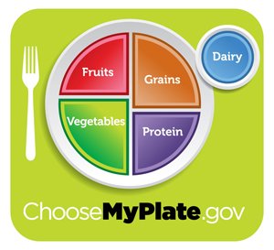
NSLP Meal Pattern Requirements
Notes:
We’re going to give a very brief overview of the meal patterns and related flexibilities available to SFAs.

Slide 37
K-12 Meal Requirements
Meal requirements were updated in 2012 to reflect the latest Dietary Guidelines for Americans
More fruits, vegetables and whole grain-rich foods
  Student must select at least ½ cup of fruit or vegetable under Offer versus Serve
Less saturated fat, trans fats and sodium
Age appropriate meals within weekly calorie ranges
Fat-free and low-fat milk
Notes:
The updated requirements are based on the Dietary Guidelines for Americans and specific recommendation from the Institute of Medicine for school meals.
The new standards are intended to result in healthier school meals. They:
Ensure that students are offered both fruits and vegetables every day of the week;
Substantially increase offerings of whole grain-rich foods;
Offer only fat-free or low-fat milk varieties;
Limit calories based on the age of children being served to ensure proper portion size; and
Increase the focus on reducing the amounts of saturated fat, trans fats and sodium.

Slide 38
Updated Infant & Pre-K
Meal Requirements
Similar to the grade K-12 meal requirements, USDA updated the nutrition standards for meals served to infants and preschoolers in the NSLP and SBP
  Changes effective October 1, 2017
  One-year transition period: Fiscal Year 2018
Notes:
Based on the Dietary Guidelines for Americans’ and American Academy of Pediatrics' recommendations
Many of the changes make the infant/preschool meal patterns more consistent with the requirements for older grade groups. Some of the requirements are different, though, because they are specifically designed for this younger age group and their nutritional needs. Taste preferences are formed early in a child’s life and meals served to infants and preschoolers are a critical part of establishing healthy habits that will last a lifetime.
Changes begin October 1, 2017
To ease the transition to the updated requirements, USDA is providing a one year transition period for FY 2018 (October 1, 2017-September 30, 2018). The transition period allows operators to focus on technical assistance and become familiar with the updated requirements without risk of fiscal action.

Slide 39
Updated Infant & Pre-K Meal Requirements
Infants
  Meals reimbursed when mother breastfeeds on-site
  Introduction of solid foods delayed until around 6 months
  More vegetables and fruit, and meat alternate options; no juice, cheese food or cheese spread
Preschoolers
  Fluid milk must be unflavored
  Juice is limited to once per day
  One “whole grain-rich” grain per day; grain-based desserts are not creditable
  Meat/meat alternate may be served in place of grains at breakfast 3x per week
  Tofu and soy yogurt are creditable meat alternates
  Sugar limits on yogurt and breakfast cereal
  Deep fat frying on-site is prohibited
Notes:
Infants
To encourage and support breastfeeding, meals may now be reimbursed when a mother breastfeeds her infant on-site
Two age groups: 0-5 months and 6-11 months
Encourages delay of solid foods until 6 months of age, as recommended by the AAP; solid foods are required when the infant is developmentally ready
More nutritious meals
Help increase whole vegetable and fruit consumption (cooked, mashed, pureed, or small diced as needed to obtain the appropriate texture and consistency) by requiring them at snack when infant is developmentally ready, and prohibiting juice
No longer allows cheese food or cheese spread due to their higher sodium content
May serve whole eggs and yogurt as meat alternates
Allows ready-to-eat cereals at snack as another grain option
Preschoolers
Flavored milk is no longer allowed to help reduce consumption of added sugars and help children develop healthy eating practices early
1 year olds: whole, unflavored milk
2-4 year olds: unflavored low-fat (1%) or unflavored fat-free (skim) milk
The updated vegetable and fruit requirements encourage consumption of whole vegetables and fruits and ensures a greater variety is offered:
Separate vegetable & fruit component
Juice is limited to one meal or snack per day
Grains
At least one grain per day must be whole grain-rich to help increase children’s consumption of whole grains, as recommended by the Dietary Guidelines
Grain-based desserts are not creditable to help reduce consumption of added sugar and saturated fats, as recommended by the Dietary Guidelines
The updated requirements provides more options to serve meat/meat alternates:
M/MA may be served in place of the entire grains component at breakfast up to 3 times per week
Tofu and soy yogurt are creditable meat alternates
To further reduce children’s consumption of added sugar and influence young children’s taste preference for less sweet foods, there are sugar limits on yogurt and breakfast cereals
Yogurt must contain no more than 23 grams of sugar per 6 ounces
Breakfast cereal must contain no more than 6 grams of sugar per dry ounce
Foods that are deep-fat fried on-site cannot contribute towards a reimbursable meal. Schools serving meals to preschoolers may still purchase and serve foods that are pre-fried, flash-fried, or par-fried by the manufacturer, such as fried fish sticks or potato wedges. Those foods must be reheated using a method other than deep-fat frying.

Slide 40
Flexibility for Co-Mingled
Preschool Meals
When students in Pre-K and grades K-5 are co-mingled during the meal service and Program operator is not able to serve grade-appropriate meals:
  School may serve the K-5 meal pattern to both grade groups
  See QAs in memorandum SP 37-2017, June 30, 2017
Notes:
To the extend possible, schools must serve age-appropriate meals to preschoolers and K-5 students.
Best practices include breakfast in the classroom or staggering the meal service time for preschoolers and K-5 students.
If this is not possible, there is flexibility to address co-mingling during the meal service. See memorandum SP 37-2017, June 30, 2017, which includes QAs.
Link for SP37-2017 https://www.fns.usda.gov/school-meals/flexibility-co-mingled-preschool-meals-questions-and-answers

Slide 41
Local School Wellness Policy
Guides school district’s efforts to establish a school environment that promotes students’ health, well-being and ability to learn. Policy must include:
  Specific goals to promote student wellness
  Guidelines for foods/beverages for sale or provided at no cost
  Food/beverage marketing policies that allow only those foods/beverages that meet Smart Snacks
  Description of public involvement, public updates, policy leadership, and evaluation plan.
Notes:
A local school wellness policy (“wellness policy”) is a document developed by the local educational agency (LEA) that guides a school district’s efforts to establish a school environment that promotes students’ health, well-being, and ability to learn.
The final rule issued on July 29, 2016, requires that policies include:
• Specific goals for nutrition promotion and education, physical activity, and other school-based activities that promote student wellness. LEAs are required to review and consider evidence-based strategies in determining these goals.
• Standards and nutrition guidelines for all foods and beverages sold to students on the school campus during the school day that are consistent with Smart Snacks.
• Standards for all foods and beverages provided, but not sold, to students during the school day (e.g., in classroom parties, classroom snacks brought by parents, or other foods given as incentives).
• Policies for food and beverage marketing that allow marketing and advertising of only those foods and beverages that meet the Smart Snacks in School nutrition standards.
• Description of public involvement, public updates, policy leadership, and evaluation plan.
Wellness Leadership: LEAs must establish wellness policy leadership of one or more LEA and/or school official(s) who have the authority and responsibility to ensure each school complies with the policy.
Public Involvement: LEAs must permit participation by the general public and the school community (including parents, students, and representatives of the school food authority, teachers of physical education, school health professionals, the school board, and school administrators) in the wellness policy process.

Slide 42
Local School Wellness Policy
LEAs must:
Assess local wellness policy every 3 years
Update or modify the policy as appropriate
Make available to the public:
  The wellness policy, including any updates to and about the wellness policy
  The Triennial Assessment, including progress toward meeting the goals of the policy
Notes:
LEAs must conduct an assessment of the wellness policy every 3 years, at a minimum. This assessment will determine:
• Compliance with the wellness policy,
• How the wellness policy compares to model wellness policies, and
• Progress made in attaining the goals of the wellness policy.
Updates to the Wellness Policy: LEAs must update or modify the wellness policy as appropriate.
Public Updates
LEAs must make available to the public:
• The wellness policy, including any updates to and about the wellness policy
• The Triennial Assessment, including progress toward meeting the goals of the policy.

Slide 43
Smart Snacks in Schools
Standards for all foods and beverages sold outside of the Federal child nutrition programs in schools.
Nutrition standards apply to all foods sold:
  outside the school meal programs
  on the school campus; and
  at any time during the school day.
Notes:
The Healthy, Hunger-Free Kids Act provided the Secretary authority to establish nutrition standards for all foods and beverages sold outside of the Federal child nutrition programs in schools.
These foods are typically referred to as competitive foods, as they compete with the meal.
The law specifies that the nutrition standards shall apply to all foods sold (a) outside the school meal programs; (b) on the school campus; and (c) at any time during the school day. Smart Snacks standards extend to areas under the jurisdiction of the school that are accessible to students.

Slide 44
Smart Snacks Applicability
Including:
  A la carte in the cafeteria
  In school stores
  Snack bars
  Vending machines
  Other venues
Notes:
Smart Snacks in schools would include foods and beverages sold a la carte in the cafeteria, in school stores, at snack bars, from vending machines or any other venues that sell food to students on the school campus during the school day.
The Smart Snacks apply to all areas of the school campus where competitive foods are sold. School campus is defined, for the purpose of competitive food standards implementation, as all areas of the property under the jurisdiction of the school that are accessible to students during the school day.
The Smart Snacks standards do not apply in areas for the exclusive use of the faculty and staff, such as teacher’s lounges, insofar as those areas are not accessible to students during the school day.

Slide 45

When do Smart Snacks standards apply?
School day is the period from the midnight before, to
30 minutes after the end of the official school day.
Notes:
The competitive food standards apply during the school day. With the many activities, programs and schedules established by schools, it is not possible to specify in regulations a precise time for the start of the school day; therefore, this rule retains the definition as proposed that the sale of competitive food to students be prohibited from the midnight before, to 30 minutes after the end of the official school day, or what may be considered the instructional day.
Specifying the period of midnight before ensures that the competitive food standards would apply to foods sold in the morning, including the School Breakfast Program meal service.
While USDA’s authority does not extend beyond the school day, States or local school districts have the discretion to apply these standards during afterschool, evening and weekend activities on campus, should they wish to do so.

Slide 46
Free and Reduced Price Meals
Notes:
Welcome back! We are going to spend a few minutes on eligibility determinations.

Slide 47

Eligibility
Two processes for determining:
  Household Application
    Income eligibility
    Categorical eligibility
  Direct certification
Notes:
The application process is the traditional method for establishing eligibility. It is for the most part a self-certification system with verification of a small number of households later in the school year.
Applications are distributed at the beginning of the school year and may be used to apply for free or reduced price meals based on income or categorical eligibility. The standard application packet distributed by the LEA/school includes:
The Income Eligibility Guidelines for reduced price meals
A notice letting families know they may be eligible for free or reduced price meals and
A waiver of meal benefit information for families that may qualify for low-cost health insurance programs
A few terms that are important to understand for purposes of household applications include income eligibility and categorical eligibility.
Income eligibility means a child is eligible for free or reduced price meals or free milk based on the number of persons in the household and the total gross income of the household.
Categorical Eligibility means a child is eligible for free meals or free milk, as applicable, based on documentation that a child is a member of a Family , as defined in this section, and one or more individuals in that family are receiving assistance under Supplemental Nutrition Assistance Program (SNAP), Food Distribution Program on Indian Reservations (FDPIR) or the Temporary Assistance for Needy Families (TANF) program, as defined in this section. A Homeless child , a Migrant child , a Head Start child and a Runaway child , as discussed next, are also categorically eligible. Categorical eligibility and automatic eligibility may be used synonymously.
Direct Certification, another process for determining eligibility, is the process of determining eligibility for certain categories of children by obtaining information directly from the State or local agency authorized to certify children’s status as being members of households receiving assistance from SNAP, TANF or FDPIR. A child is directly certified in lieu of completion of an application.

Slide 48
Categorical Eligibility
Receipt of SNAP, TANF or FDPIR benefits
  Eligibility extended to all children in household
“Other Source” status such as foster child or enrolled in Head Start
  Individual eligibility
May be determined by application or direct certification
Notes:
This slide discusses different types of categorical or automatic eligibility which includes, but is not limited to:
Recipients of SNAP, TANF or FDPIR benefits
Children in foster care
Children enrolled in Head Start or
Migrant, homeless, runaway children

Slide 49
A Comparison of Application Types
Income Application
Categorical Application
Last four digits of the SSN of signing adult
Current income
Frequency of income
Source of the income
Household members, including child
Signature of adult household member
Child’s name
Case number or indication of status
Signature of adult household member
Notes:
The application based on income requires more information from the household. It asks for the last four digits of the social security number of the signing adult (or for the applicant to check the box indicating he or she does not have an SSN); current household income; the source of that income; all household members, including the child; and the signature of the adult household member completing the application.
The application based on categorical eligibility requires less information. Applications submitted for children who are categorically eligible based on receipt by the household of SNAP, TANF or FDPIR benefits only need to list the children they are applying for, provide a case number and sign the application. All children in the household are eligible for free meals based on any household member’s receipt of SNAP, TANF or FDPIR benefits.
In addition, an application based on categorical eligibility may be submitted for homeless, Head Start and other categorically eligible children (discussed more in a few minutes). The household indicates on the application which program the child is under (i.e., homeless, etc.) and the LEA must obtain documentation to support the child’s participation in one of these programs from officials of these programs. For example, the LEA would contact the homeless liaison for supporting documentation.
Once an application has been submitted, school officials review the information supplied by the family.
For income applications, the official designated to make eligibility determinations compares the household size and total gross income on the application to the Free and Reduced Price Income Guidelines.
For categorical eligibility using case numbers (SNAP, TANF, FDPIR), the official determines if the case number is valid (i.e, has the correct format for their state) and approves the application for free meals based on the household’s receipt of benefits from one of these programs. All children are certified.
For categorical eligibility based on other programs (homeless, etc.), the official determines eligibility based on supporting documentation for each child based on their participation in these programs. Their eligibility based on these programs is not extended to other children in the household. The household may submit income information for these other children.
Once an application is approved or denied, the household must be notified of its eligibility status. Denials must be sent in writing.

Slide 50
Income Eligibility Guidelines (IEGs)
Used to determine eligibility for free or reduced price meals based on the family’s income
FNS makes these calculations based upon the Federal poverty guidelines
Issued in the Spring each year
Notes:
The income information contained on the completed income applications is then compared to the income eligibility guidelines, which, like the National Average Payments, are updated each year.
The Income Eligibility Guidelines (or IEGs) are used to determine Free/Reduced Price and Paid eligibility status and are calculated based upon the Federal poverty guidelines.

Slide 51
Income for Eligibility
Children from families whose income equals 130 percent of poverty or less are eligible for free meals
Children from families whose income is more than 130 and no more than than 185 percent of poverty are eligible for reduced price meals
Children from families whose household income is above 185 percent of poverty pay full price for their meals
Notes:
The Food and Nutrition Service adjusts its eligibility guidelines so that:
Children from families whose income equals 130% of the Federal poverty level or less are eligible for free meals
Children from families whose income is more than 130% and no more than 185% of poverty are eligible for reduced price meals
Children from families whose household income is above 185% of the poverty statistics for their household size pay full price for their meals

Slide 52
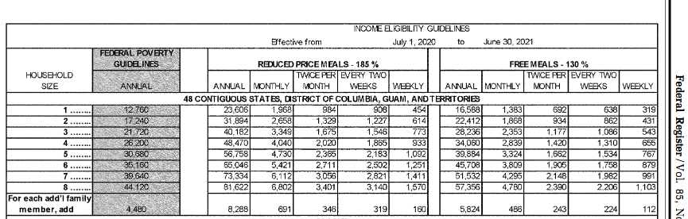
Income Eligibility Guidelines SY 2020-2021
Notes:
Many children qualify for our programs based on their family’s income and size. This chart represents the current income standard for our programs, based on the Federal Income Poverty Guidelines. They apply to the 48 contiguous states, DC, Guam, and the Territories.
Free meals are provided to households with incomes at 130 percent or less of the standard. Reduced price meals are provided to households with incomes between 130 and 185 percent.
Families apply based on income by submitting and application that shows any income earned by and household member. This includes all earnings before taxes or deductions are taken out, and money from certain government programs. Some income isn’t reported, such as income for disaster assistance or housing allowances for low-income persons. Each school district must “verify” three percent of applications each year to ensure families are accurately reporting their income.
Once a child is certified for free or reduced price meals, their eligibility remains in effect for the duration of the school year and for 30 days into the following school year. And, even if a child is determined ineligible for free or reduced price meals, they can still purchase a meal at the “paid” rate.

Slide 53
Income and Households
Income
  Before any deductions (such as taxes, Social Security taxes, insurance premiums, charitable contributions and bonds)
Household
  A group of related or non-related people living under one roof as one economic unit
Notes:
For the purposes of our application process, we define “income” to include earned and unearned income received on a regular basis, before any deductions. This may include,
Monetary compensation for services (wages, etc.)
Net income from non-farm self-employment
Net income from farm self-employment
Social Security
Dividends of interest on savings, bonds, etc.
Public assistance or welfare payments
Unemployment compensation
Other forms of regular income
It is important to note that there are no deductions for expenses or hardship conditions.
“ Household” means family as defined in 245.2(b): “Family means a group of related or non-related individuals, who are not residents of an institution or boarding house, but who are living as one economic unit.”

Slide 54
Migrant, Runaway, or Homeless Children
Migrant children in the Migrant Education Program
Runaways in the programs under Runaway and Homeless Youth Act
Homeless children under the McKinney-Vento Act
Notes:
Many children in these groups will be directly certified. Only children in these groups that are in the applicable program are considered categorically eligible as a migrant, runaway or homeless child. If for some reason they are not directly certified, they would submit the application we just spoke about.
Migrant children must be determined to be in the Migrant Education Program (or MEP) by the MEP coordinator or recruiter. A child who may be migratory but who is not identified as participating in the MEP is not considered categorically eligible under this criterion.
Similarly, runaways must be served by a program established by the Runaway and Homeless Youth Act (RHYA). This information is maintained by the LEA’s homeless coordinator or may be obtained from officials administering a program under this authority. Again, a runaway child not served by RHYA program is not categorically eligible under this criterion.
A child is determined homeless by the LEA’s homeless coordinator under the provisions of the McKinney-Vento Homeless Assistance Act. Unless a child’s homelessness is documented through the homeless coordinator or officials operating a homeless shelter, that child is not categorically eligible under this criterion.

Slide 55
Foster Children & Head Start
Foster Children
  Any child whose care and placement is the responsibility of the State
  Any child who is formally placed by a court with a caretaker household
Head Start
  All children enrolled in Head Start are categorically eligible
Notes:
A child in foster care is categorically eligible for free meals and may be certified without an application if documentation is received directly from a foster care agency or the court system.
Households with foster and non-foster children may choose to include the foster child as a household member, as well as any personal income earned by the foster child, on the same application that includes their non-foster children.
The presence of a child in foster care does not convey eligibility of free meals to all children in the household.
As a reminder, this provision applies only to formal foster care arrangements.

Slide 56
Mandatory Direct Certification
Requires the LEA to conduct direct certification with SNAP at least three times per year
All children in the household certified for free meals if any child or adult in the household receives SNAP
State agency enters into an agreement with their SNAP agency establishing direct certification procedures
Notes:
Direct certification of children in SNAP households is mandatory for all SFAs. The LEA conducts direct certification with SNAP 3 times are at or near the beginning of the School Year.
Direct certification is conducted in a variety of ways.
The SA may provide lists to LEAs of all school age children in their district or
LEAs may be able to directly access the data base
.

Slide 57
Discretionary Direct Certification
An LEA may certify a child for free meals without further application by directly communicating with officials to determine if the child is:
  A TANF family member
  Homeless
  Served by certain runaway or homeless youth programs
  A migrant
  A Head Start enrollee
  In foster care
Notes:
You likely already know that there is optional direct certification of children in TANF families. LEAs also have discretion to “directly certify” homeless children, runaway children covered under the Runaway and Homeless Youth Act and the McKinney-Vento Homeless Youth Act, and Migrant Education Program. This is at the option of the LEA.
The homeless coordinator/liaison may also be able to assist in identifying migrant, runaway or foster children.

Slide 58
Documentation for Direct Certification
SNAP or TANF officials provide documentation to schools that a child is certified
  Name of child
  A certifying statement
  Identifiers (e.g., SSN and Date of Birth)
  Signature of SNAP/TANF official
  Date
Notes:
As previously mentioned, direct certification is used for children eligible for free meals due to household participation in TANF or SNAP.
Through the direct certification process, a school receives documentation directly from SNAP or TANF officials that children are members of households receiving SNAP or TANF benefits. There is no application.
Unique identifiers such as birth date, social security number if available, or parent/guardian name ensure an exact match.
Directly certified children are not subject to verification since the LEA has already “verified” that the child is eligible because they are members of households receiving SNAP or TANF benefits.
For any directly certified children, families must be given the opportunity to decline benefits.

Slide 59
Confidentiality
Individual children’s eligibility status and information protected by NSLA
Law allows limited disclosures
Any direct certification system or data exchange must ensure limited disclosure within statutory requirements
Notes:
Any sharing of information must meet the disclosure limitations in the National School Lunch Act to protect children’s eligibility information. Disclosures without parental consent are limited to certain Federal or state education or health programs.
In addition, any individual receiving a children’s status must be directly connected with the administration and enforcement of these programs.
In general, access is limited to the child’s name or other identifier and their eligibility status. They do not have access to other information, such as the source of eligibility, i.e., income or SNAP eligible.

Slide 60
Eligibility Manual
Available on our website
Incorporates all memos and changes regarding F/RP policies
Updated annually
Notes:
The material we’ve covered in this section and the next is found in the eligibility manual. The Eligibility Manual for School Meals – Federal Policy for Determining and Verifying Eligibility is posted on our website under the Eligibility heading. You may find and download the Manual from the “Guidance” section on FNS website.
FNS updates the Manual annually to incorporate any policy memos or changes that occur.
After reading the Eligibility Manual, if you still aren’t sure whether the requestor is allowed to obtain the information, please contact your FNS Regional Office.
Eligibility manual link https://fns-prod.azureedge.net/sites/default/files/cn/2017eligibilitynohighlight.pdf

Slide 61
Recipient of Information | What May be Disclosed | Requirements
Programs under the National School Lunch Act or Child Nutrition Act | All eligibility information | Prior notice and consent not required
Federal/State or local means tested nutrition programs with eligibility standards comparable to the NSLP | Eligibility status only | Prior notice and consent not required
Federal education programs | Eligibility status only | Prior notice and consent not required
State education programs administered by a State agency or local education agency | Eligibility status only | Prior notice and consent not required
Local education programs | NO eligibility information, unless parental consent is obtained | Parental consent
Medicaid or the State Children’s Health Insurance Programs (SCHIP), administered by a State or local agency authorized under titles XIX or XXI of the Social Security Act to identify and enroll eligible children | All eligibility information unless parents elect not to have information disclosed | Must give prior notice to parents and opportunity for parents to decline to have their information disclosed
State health programs other than Medicaid/SCHIP, administered by a State agency or local education agency | Eligibility status only | Prior consent not required
Federal health programs other than Medicaid/SCHIP | NO eligibility information, unless parental consent is obtained | Parental consent
Local health program | NO eligibility information, unless parental consent is obtained | Parental consent
Comptroller General of the United States for purposes of audit and examination | All eligibility information | Prior notice and consent not required
Federal, State, or local law enforcement officials investigating alleged violations of any of the programs under the NSLA and CNA or investigating violations of any of the programs that are authorized to have access to names and eligibility status | All eligibility information | Prior notice and consent not required
Notes:
Here is a chart from the Eligibility Manual that is designed for easy reference on releasing student’s information. This information is from the National School Lunch Act and our regulations in 245.6.
The confidentiality of personal data is extremely important and the National School Lunch Act is very specific on what information about a child’s eligibility for free or reduced price meals may be disclosed and to whom.
FNS has tried to provide LEAs and state agencies with guidance on when to disclose information requested by various government and non-government entities.
Next we will discuss the verification process, community eligibility and the school breakfast program.

Slide 62
The Verification Process
Notes:
After the SFA makes student eligibility determinations at the beginning of the school year, they’re required to conduct verification of the information provided by the household on their application.

Slide 63
Verification
Local responsibility, though the State may conduct the process
Use number of applications approved as of October 1 as the pool
LEAs must verify the required number of applications by November 15 every year
Notes:
Verification must be conducted annually.
Based on the number of approved applications as of October 1 and the verification method used, the LEA determines how many applications must be verified.
The deadline for conducting Verification is November 15. (NOTE: old deadline was December 15)

Slide 64
Standard Sample Size
3% or 3000, whichever is less, of error prone applications
Error prone means income within $100 per month ($1200 per year) of the threshold established through the IEG
Notes:
The basic sample size is whichever is less: 3% of all approved applications selected from error-prone applications OR 3,000 approved error-prone applications. (so…only 3% or 3,000, no more).
Error-prone applications are those where the income is $100/month ($1,200/year) below or above the income eligibility limit for F/RP benefits.
If there are not enough error-prone applications, the LEA must complete the required sample size using applications selected at random up to the required number.
-Sometimes an LEA can qualify to use an alternate sample size. We didn’t include the alternate sample information on the slide because anecdotally, we’ve heard that the majority of LEAs use the standard sample size.
Briefly, the other options are for LEAs with non-response rates of less than 20% for the preceding school year or large LEAs with improved non-response rates. Eligibility for one of this options is done annually. These LEAs have a choice of two different verification alternatives.
And non-response rate is the percentage of approved household applications selected for verification (last year) for which verification information has not been obtained by the LEA. Basically, the households didn’t respond to last year’s verification request.
Non-response rates are based on data submitted in the Verification Collection Report (FNS-742), which we’ll talk about shortly.

Slide 65
The Verification Process
Confirmation Review
  Made by someone other than the person who made the initial determination to check for errors if no data system is used in the initial determination
Notifying Household
  Request documentation
  Provide contact information
Notes:
A confirmation review is when someone reviews the eligibility determination to verify that it was made accurately.
The confirmation review must be made by someone other than the person who made the original determination.
This procedure is intended to detect any arithmetic or other errors prior to beginning verification so that the LEA can appropriately review the documentation submitted by the household.
If the confirmation review indicates that the new eligibility status is to the household’s benefit, the LEA must notify the household and make the change as soon as possible, then proceed with verification.
If the confirmation review shows that there should be a decrease in benefits, the LEA proceeds with and completes verification before notification of a any change in eligibility status.
These procedures are designed to avoid a possible unnecessary reduction in benefits. The confirmation review isn’t required if the LEA has a data system with a “high degree of accuracy” that makes the initial eligibility determination. The State agency determines if the electronic data system is valid.
When conducting verification, the LEA sends a letter notifying the household that it has been chosen for verification.
The letter requests either:
documentation that the household is receiving SNAP, TANF FDPIR, etc. benefits or
documentation of the household’s current monthly income
On the notification of selection for verification, the LEA must include a telephone number that the household may call without charge.
The telephone number could be toll-free (1-800) or the LEA may allow households outside the local calling area to reverse charges.
The telephone number must be to a source that can respond to the household’s questions about the verification process.

Slide 66
Completing Verification
With non-respondents, one follow-up attempt is required
  LEA should document the follow-up attempt, perhaps on the application
If benefits reduced or terminated, inform household in writing and provide appeal rights
Unless appealed, change the child’s eligibility status within 10 days
Notes:
LEAs must make at least one follow-up attempt to contact any household that fails to respond to the initial request for verification.
The follow-up may be an email, phone call, by mail or a request sent home with a student.
The LEA should document the follow-up attempt, perhaps on the application.
The LEA to contract with a third party to conduct the follow-up. Of course, the contractor must follow the disclosure requirements about eligibility status.
If verification results in either termination of free or reduced price benefits or a change from free to reduced price, the household must be informed, in writing, of the basis for the denial and their appeal rights. The household has 10 days to appeal.
If the household doesn’t appeal within the 10 days, the LEA must update the child’s status as applicable.

Slide 67
Verification Collection Report
FNS-742, Verification Collection Report
  LEA submits annually to SA, by March 1
SA consolidates reports and submits to FNS by April 15
  Electronic submission
Notes:
After the verification process is completed every year, the LEA must submit the Verification Collection Report (FNS-742) to the State Agency. (NOTE: this was previously called the Verification Summary Report)
LEA data is due to the State agency by March 1.
The State agency must submit consolidated data to FNS by April 15.
This report is used for a number of things including eligibility for direct certification grants.

Slide 68
Special Provision Options:
Provisions 1, 2, 3 and the
Community Eligibility Provision
Notes:
There are a specific provisions that are intended to facilitate local level operations.
We call these the Special Provision Options. They include Provisions 1, 2, 3, and the Community Eligibility Provision.

Slide 69
Provision 1: Simplified Applications
> 80% enrolled students eligible for free or reduced-price meals
Students certified Free are eligible for 2 year period
All other households provided meal application and apply for benefits each year
Schools record daily meal counts by eligibility category as basis for Claims for Reimbursement
Notes:
In schools where at least 80 percent of the children enrolled are eligible for free or reduced price meals, annual notification of program availability and certification of children eligible for free meals may be reduced to once every 2 consecutive school years.
Provision 1 reduces application burdens by allowing students eligible for free meals to be certified for a 2 year period.
All other households must be provided a meal application and apply for meal benefits each school year. (Direct Certification still occurs)
The SFA is not required to serve free meals to all students.
Schools must continue to record daily meal counts of the number of meals served to children by type as the basis for calculating reimbursement claims.
Provision 1 has been an option for schools since publication of regulations in 1980.

Slide 70
Provision 2:
Simplified Counting and Claiming
Schools make eligibility determinations and count meals by type (F/RP/P) in the first year (Base Year)
Use claiming percentages from base year in non-base years, take total meal counts only.
Schools use the same F/RP percentage for four school years
All students receive meals at no charge
Notes:
For participation in Provision 2, there is no minimum percentage of free or reduced price (like the 80% threshold in Provision 1).
The school food service serves all meals at no charge.
BASE YEAR
They count daily meals by type (i.e., free, reduced and paid) to create the base year, and claim reimbursement from these counts.
Schools may delay implementation of the 1st claiming period in order to encourage households to get their applications turned in on time.
Schools must establish socio-economic data in the base year
SUBSEQUENT YEARS
In subsequent years, the school counts the total meals daily, and claim reimbursement based upon claiming percentages established during the base year.
The base year is not included as part of the 4 years.
At the end of each 4 year period, the State agency can approve 4 year extensions if the socio economic level of the school’s population remains stable.
Schools must use on-Federal funds to make up any deficit.
Provision 2 usually is advantageous in schools with greater than 70% free or reduced price.

Slide 71

Provision 2: Base Year
September 2012: 80 free meals
15 reduced price meals
+ 5 paid meals
100 total meals per day
80/100 = 80% Free
15/100 = 15% Reduced
5/100 = 5% Paid
Notes:
For example:
A school used school year 2012-2013 as its base year.
During September of 2012, the school serves an average of 100 meals per day:
of these meals,
80 are served free;
15 are served at a reduced price; and
5 are served at the paid rate
This means that for the month of September during the base year, the school served 80% free, 15% reduced price and 5% paid meals.

Slide 72
Provision 2: Non-Base Year Example
September 2013
Total meal count for the month: 150
Claim for Reimbursement:
0.80 x 150 = 120 free rate
0.15 x 150 = 23 reduced price rate
0.05 x 150 = 7 paid rate
Notes:
The following year-- September 2013 -- the school serves an average total of 150 meals per day and applies the percentages for September in the Base Year to the Claim for Reimbursement.
So, they use the percentages established in the base year for reimbursement claims in subsequent years.

Slide 73
Provision 3:
Simplified Counting and Claiming
Schools follow procedures similar to those under Provision 2
Schools receive the same level of federal cash and commodity assistance each year, with some adjustments, for a 4-year period
Notes:
This Provision reduces application burdens and meal counting and claiming procedures.
It allows schools to receive the same level of Federal cash and commodity assistance each year, with some adjustments, for a 4 year period.
Schools must serve meals to all participating children at no charge for a period of 4 years.
These schools do not make additional eligibility determinations. Instead, they receive the level of Federal cash and commodity support paid to them for the last year in which they made eligibility determinations and meal counts by type, this is the base year.
For each of the 4 years, the level of Federal cash and commodity support is adjusted to reflect changes in enrollment and inflation. The base year is not included as part of the 4 years.
At the end of each 4 year period, the State agency can approve 4 year extensions if the socio economic level of the school’s population remains stable.
Schools electing this alternative must pay the difference between Federal reimbursement and the cost of providing all meals at no charge. The money to pay for this difference must be from sources other than Federal funds.
Provision 3 has been an option for schools since 1995 through an implementing memorandum.

Slide 74
Provision 3: Base Year
Base Year
  Outside of the 4-year cycle
  Offer meals either at no charge, or charge students eligible for RP/P meals
  Make eligibility determinations and count daily meals by type
  Establish base year socioeconomic data
  Claim reimbursement from these counts
Notes:
Base Year
The school food service provides meals either at no charge or under a standard pricing program (F/RP/P). That is, the Provision 3 base year can be a pricing year in which counting and claiming is conducted normally.
Also, the Provision 3 base year is not included in the initial cycle; so, the four-year Provision 3 cycle begins after the base year.
The school counts daily meals by type in the base year,
Establishes base year socioeconomic data, and
Claims reimbursement based upon those counts.
There is no “delayed implementation” with Provision 3.

Slide 75
Provision 3: Non- Base Year
Non-Base Years
  Offer all meals at no charge
  Count total meals
  Claim reimbursement according to Base Year numbers adjusted for:
    Inflation
    Change in enrollment
    Change in number of operating days
Notes:
Non-Base Years
In non-base years, all meals are served at no charge, the school claims the same level of reimbursement as they did in the base year except the claim is adjusted for changes in enrollment, in the number of operating days, and inflation.
Schools continue to count total meals, but these counts are used to measure the quality of meal service and if participation levels have diminished.

Slide 76
Extensions
Provisions 2 and 3 can be extended for 4 years if the income level of the school’s population:
  Remained stable
  Declined
  Had negligible improvement (5% or less)
    7CFR 245.9(c)(1)(ii) and 7CFR245.9(e)(1)(ii)
Notes:
At the end of each 4 year period, the State agency may approve a 4-year extension if the income level of the school’s population remains stable, declined, or had negligible improvement.
Schools prove this by comparing the socio-economic data established in your Base Year to current data.
SFAs must understand that they agree to pay the difference between program costs and reimbursement funds. Difference must not come from federal funds.
More info on negligible improvement in the regulations noted on this slide 7CFR 245.9(c)(1)(ii) and 7CFR245.9(e)(1)(ii)
_____________________________
NEGLIGIBLE IMPROVEMENT
The change in the income level of the school’s population is considered negligible if there is a 5 percent or less improvement, after adjusting for inflation, over the base year in the level of the socioeconomic indicator which is used to establish the income level of the school’s population
Examples include household income, unemployment data, percentage below poverty, etc.

Slide 77
Community Eligibility Provision (CEP)
An alternative to household applications for high poverty local educational agencies (LEAs) and schools
Eligible LEAs/schools serve free lunches and breakfasts to all students for 4 successive school years
Meal reimbursement is based on Identified Student Percentage (ISP)
Notes:
The goal of Community Eligibility is to provide an alternative to standard paper applications and claiming for SFAs schools serving a high percentage of low-income students.
CEP relies on an identified student percentage for its eligibility and reimbursement determinations. The ISP is calculated by dividing the number of identified students by the number of enrolled students and multiplying by 100.
For example, a school has 550 identified students and 700 enrolled students:
550/700 = 0.78571429, which rounds to 0.7857. Multiply by 100 to calculate an ISP of 78.57 percent.

Slide 78
LEA Eligibility for CEP
LEAs may elect the CEP for the entire district, individual schools, or a group of schools
To be eligible, the LEA/individual school/group of schools must have an ISP of at least 40%
Identified Students are those certified for free meals that are NOT subject to verification (example: directly certified through SNAP)
Notes:
To be eligible for CEP, the LEA, school or group of schools needs to have an identified student percentage of at least 40%.
The identified students are the number approved as free eligible who are not subject to verification. This definition includes students directly certified through SNAP, TANF, and FDPIR and homeless (on the homeless liaison list), income-eligible Head Start, pre-K Even Start, migrant youth, runaways, and non-applicants approved by local officials.
Foster children certified through means other than an application are also included and students certified for free meals based on a letter provided by the household from the SNAP agency.
Students who are categorically eligible based on a case number submitted through a free and reduced price application are NOT included.

Slide 79
How Does the CEP Work?
The ISP multiplied by a factor of 1.6 equals the percentage of total meals reimbursed at the Federal free rate.
The remaining percentage of total meals reimbursed at the Federal paid rate.
Any meal costs in excess of the total Federal reimbursement must be covered with non-Federal funds.
Notes:
The percentage of meals claimed at the free rate is calculated by multiplying the identified student percentage times 1.6. The remaining percentage corresponds to the meals claimed at the paid rate.
So, the reimbursements are structured to incentivize direct certification for eligibility determinations.
If the Federal reimbursement isn’t enough to cover the meal costs, then the LEA needs to use non-Federal money to cover any excess costs over and above the meal costs.
Any funds other than Federal reimbursement can be used. So, similar to Provision 2 and 3, the use of non-Federal funds is only necessary if the total amount of Federal reimbursement through the CEP does not cover the costs of serving free meals to all students.
Examples of non-Federal sources include: State revenue matching funds (that exceeds the minimum requirement established in 7 CFR Part 210.17), profits from a la carte sales, and in-kind contribution funds from outside sources such as volunteer services or a cash donation.

Slide 80
How Does the CEP Work? - continued
LEA and schools run direct certification matches no later than April 1st of each year to obtain current counts of SNAP, TANF, and FDPIR participants.
Homeless, migrant youth, and foster children lists are matched no later than April 1st of each year to include in the ISP.
Each year, LEAs or schools may use the ISP from the year prior to the first year or an updated identified student percentage from the prior year, whichever is higher.
Notes:
CEP grants LEAs/SFAs the flexibility to establish new identified student percentages to adjust the reimbursement calculation and begin a new 4 year cycle with the new ISP. More choice for schools than CPI adjustments alone.
Schools may decide not to elect the CEP or to stop utilizing the CEP at any time as long as the State is notified by June 30th of the current school year.
Since the new percentage of identified students must be established as of April 1st of the prior year, schools will have time to decide if continuing or beginning the CEP will be advantageous for the next year.
Schools electing to stop the CEP must be prepared to return to their normal counting and claiming procedures in the next school year.

Slide 81
The School Breakfast Program
7 CFR Part 220
Notes:
The SBP can be an important part of the school day for children and the availability of school breakfast, especially outside of traditional methods is increasing.

Slide 82

How to Participate
Amend NSLP agreement with State agency
Serve complete breakfasts at the beginning of the child's school day (in the a.m.)
Count and claim meals by category
Conduct household outreach
Notes:
To participate in the School Breakfast Program, an SFA would amend its NSLP agreement with the State agency.
The SFA agrees to serve complete breakfasts at the beginning of the child’s school day (in the morning).
The SFA also agrees to count and claim these meals by category (free, reduced price and paid).
According to the 2011 Outreach to Households on the Availability of the School Breakfast Program policy memo (SP 40 – 2011), schools participating in the SBP must inform families of the availability of breakfasts. A notification of the availability of breakfast must be relayed just prior to or at the beginning of the school year in the informational packets that are sent to each household with free and reduced price meal applications for the new school year. In addition, schools should send reminders regarding the availability of the SBP multiple times throughout the school year.

Slide 83
Breakfast/Lunch Similarities
Use the same eligibility determinations
Take point of service meal counts by eligibility type
Consolidate and claim reimbursements
Use the same nonprofit food service account
Notes:
Breakfast is similar to lunch in that both:
Both require the same eligibility determinations based on IEGs
Both require point of service meal counts by type (F, RP, P) – not in snacks service
Both require SFAs to consolidate and claim reimbursements
Both operate from the same nonprofit food service account
If allowed by the SA, the SFA may submit one claim for reimbursement to cover lunches and breakfasts.

Slide 84
Severe Need Schools
Schools may receive a higher SBP reimbursement if at least 40% of lunches served in the second preceding year were served free or at reduced price
  Contact State agency
Schools without second preceding year history may qualify for higher reimbursement
Notes:
Sec. 220.9(d)
Schools in the SBP that meet the 40% threshold that you see on the slide may receive additional reimbursement for the breakfasts they serve. The SA approves or denies request for severe need reimbursement.
This is on a school basis, so some schools in the district may qualify and others won’t.
New schools or schools that weren’t on the program two years ago may be eligible.
If a school district has new schools with at least 40% F/RP, it should contact the State agency to see if there is a way it could qualify without the second preceding year history.
May keep track for first quarter and retroactively be reimbursed if 40% or more achieved.

Slide 85
School Breakfast Expansion
Breakfast at school helps all students enjoy a morning meal and get energy to learn
Serving methods (in addition to breakfast in the cafeteria):
  Grab and Go
  Breakfast in the Classroom (BIC)
  Breakfast After 1st Period
  Breakfast on the Bus
Market the SBP and seek buy-in from stakeholders such as principals, superintendents, teachers, custodians, parents, students, and other key partners
  See resources in SBP webpage
Notes:
There are several breakfasts service methods in addition to traditional breakfast service, which takes place at the start of the instructional day in the cafeteria.
Grab ‘N’ Go
Pre-packed breakfasts allow extensive flexibility in serving options;
Students can pick up meals in the cafeteria and take them elsewhere (class, hallways, outside, in the cafeteria, wherever school deems appropriate)
Breakfasts can be loaded onto carts and served in classrooms or high traffic areas throughout the school
Schools gain flexibility on when to serve;
Before or at the very beginning of the school day
In a homeroom type setting or in class
During a morning break
Breakfast in the Classroom (BIC)
BIC is a method of serving breakfasts while students are in class, either allowing them to consume meals during the course of instruction or while taking a meal break.
BIC is an extension of the Grab ‘N’ Go model, as breakfasts typically reach students by way of a delivery cart, or by allowing students to pick up their meals from the cafeteria or another location and bringing them to class.
We’ve seen rapid adoption of BIC and expanding interest, and we encourage schools to explore whether this option might be viable for them to adopt
To make Grab ‘N’ Go or BIC work, it is very important to get the school’s entire staff on board. Teachers, administrators, and service staff members should all be supportive of breakfast and have a sense of its importance to learning.
Breakfast after 1st period, alternatively referred to as the second chance breakfast or breakfast after the bell, provides a morning nutrition break to students, but slightly later in the day. This serving model is intended to capture students who may have skipped breakfast first thing in the morning because they were not hungry. It can be provided in the classroom or through grab n’ go bags most commonly.
Breakfast on the Bus is an innovative service model in which students are provided with a prepackaged breakfast while riding the bus to school. This is a potentially viable service option for schools at which most of the students not only bus in, but spend at least 15 minutes riding. This serving model is unique in that it requires a bit of special provisioning to handle delivery to the busses as well as trash disposal, but it can be a great way to feed a lot of students prior to the start of the instructional day.
https://www.fns.usda.gov/sbp/school-breakfast-program-sbp

Slide 86
SBP Toolkit
A collection of digital resources to assist in the launch or expansion of the SBP
Toolkit designed primarily for school food service directors
State agencies may use to supplement their materials
  Not intended to replace/duplicate policy or technical assistance documents
Notes:
Throughout the years, we’ve been successful in getting more and more schools to adopt the breakfast program. As the previous slides shows the alternative methods for serving SBP have been successful.
A lot of the growth potential today is in expanding the accessibility of school breakfast – roughly 90% of schools that operate lunch operate breakfast as well, but overall participation in much lower than it is for lunch. The updated SBP toolkit is designed to assist both current and prospective program operators.
Toolkit is not intended to be a technical resource for the meal pattern, and operators are provided links to the meal pattern webpage for more in-depth information on this topic.
These resources are technical assistance documents so they are designed with the school food service director in mind.
The toolkit is written in a way that is intended to be accessible to stakeholders at all levels, and many sections will be just as useful to parents, teachers, and school administrators as they would be to the SFA director.
Similarly, if your State agency already provides its own School Breakfast resources, you may wish to adopt or adapt some of these materials for your own purposes.

Slide 87


Where is the SBP Toolkit located?
Featured on: http://www.fns.usda.gov/healthierschoolday
Also accessible through: http://www.fns.usda.gov/sbp
Notes:
The Energize Your Day with School Breakfast toolkit will be made available on the School Breakfast Program webpage, and will also be directly accessible through the School Day Just got Healthier page, which highlights recent efforts by FNS to improve the school nutrition environment.

Slide 88
Fresh Fruit and Vegetable Program
Notes:
The Fresh Fruit and Vegetable Program started as a pilot program in the 2002 Farm Bill. It’s now available nationwide in selected elementary schools in all 50 states, the District of Columbia, Guam, Puerto Rico and the Virgin Islands. Section 19 of the National School Lunch Act covers the Fresh Fruit and Vegetable Program and addresses:
Adjustments to funding levels based on changes to the Consumer Price Index.
The number of schools that can participate determined by the per student allocation
The determination of fund allocation to States and schools
Funds available for State administration and
School selection criteria and requirements

Slide 89
FFVP School Selection Criteria
Must be an elementary school
Must operate the NSLP
Must submit an application
Must have at least 50% F/RP
  Priority given to schools with the highest % of low-income students
Total enrollment of all schools must result in a per-student allocation of $50-$75
Notes:
Selection for the Fresh Fruit and Vegetable Program requires several criteria be met, as show on the current slide.
TO THE MAXIMUM EXTENT PRACTICABLE, the State Agency must select schools with at least 50% Free and reduced price participation.
If all schools that meet the minimum 50% criteria have been selected and funding is available to serve more schools, the proposed rule requires that additional schools may be approved for the program in the order of their population of free and reduced price eligible children.

Slide 90
Outreach to Low Income Schools
SAs must inform elementary schools with the highest proportion of F/RP enrollment, including Native American schools, of eligibility for participation in the FFVP
  Includes the likelihood that they will be chosen to participate due to high F/RP eligibles
Notes:
State Agencies must inform elementary schools with the highest proportion of Free and Reduced Price enrollment, including Native American schools, of their eligibility for participation in the Fresh Fruit and Vegetable Program.
This includes informing schools of the likelihood that they will be chosen to participate due to high Free and Reduced Price eligibility.
To identify these schools, States first calculate the total school enrollment needed in the State to meet the $50 to $75 per student requirement, and then determine how many or which of the schools could be selected.
This outreach must be conducted before the State agency selects schools for participation in the program.

Slide 91
General Program Parameters
Addendum to Federal/State agreement
Properly executed State/Local agreements
School applications taken every year
State operates program on monthly reimbursement basis
Available during the school day in one or more areas of the school
Provided apart from lunch or breakfast
Widely publicize availability in school
Notes:
The Fresh Fruit and Vegetable Program operates under an addendum to the permanent Federal/State agency agreement.
States must also have properly executed State/local agreements for operation of the FFVP.
The State agency must operate the program on a monthly reimbursement basis.
The program is available during the school day in one or more areas of the school, but provided separately from the lunch or breakfast meal, not in the food service areas during program meals. Schools that participate in the program are required to widely publicize program availability within the school.

Slide 92
NSLP Afterschool Snack Service
Notes:
Let’s now turn to afterschool snacks.

Slide 93
NSLP Afterschool Snack Service
Sponsored or operated by the school district
Located in a district where at least one school participates in the NSLP
All snacks are served free at area eligible schools (where 50% or more of students qualify for F/RP meals)
Free, reduced price, and paid snacks at all other schools (non-area eligible schools)
Children must be age 18 or under at start of school year
Served on regular school days
Notes:
Afterschool care programs sponsored or operated by the school district can provide reimbursable snacks through the National School Lunch Program.
The program must be located in a school district where at least one school participates in the school lunch program.
In schools where a majority of the children qualify for free and reduced price meals, snacks are provided at no charge. In other schools, free, reduced price, or paid snacks are offered. Reimbursable snacks are available to children age 18, or under, at the start of the school year, only on days when school is regularly in session.

Slide 94
Afterschool Snack Reimbursement Claims
One afterschool snack per child per day
Meal pattern (2 of 4 items):
  Milk
  Vegetable or fruit
  Grains/bread
  Meat/meat alternate
School must keep records
Notes:
Participating SFAs can be reimbursed for snacks served in eligible afterschool care program Schools. The cost for a reimbursable snack must not exceed 15 cents.
Schools may serve snacks to all students through the age of 18, but students are not required to participate.
Schools are reimbursed for one afterschool snack per child per day.
Meal pattern and nutrition standards for snacks are in 210.10(a)(1)(ii) and 210.10(o). At least 2 components are required:
Milk
Meat/meat alternate
Fruit or Vegetable (100% juice is OK)
Grains/bread
Milk and a fruit juice cannot be offered at the same time. More information on portions can be found in the regulations.
Schools must keep records of its snack service.
Records that must be kept include:
Meal counts
Menu records
Individual income applications (when applicable)

Slide 95
The Child and Adult Care Food Program and Summer Food Service Program
7 CFR 226
Notes:
The Child and Adult Care Food Program (CACFP) plays a vital role in improving the quality of day care and making it more affordable for many low-income families.
CACFP is making important changes so that the Program provides meals with nutritious foods that contribute to the wellness, healthy growth, and development of young children and the health and wellness of adults in care.
CACFP is a leading source for information about health and wellness so that our children will get the best start when it comes to healthy eating and physical activity.

Slide 96
What Does the Child And Care Food Program (CACFP) Do?
Provides reimbursements for:
  Nutritious meals to eligible children 12 years and under* in non-residential child care
  Afterschool meals and snacks to children 18 and under in low-income areas
  Meals in emergency shelters to residents 18 and under
  Meals for eligible adults in
  non-residential day care centers
Operates year-round
Notes:
CACFP serves nutritious meals and snacks to eligible children and adults who are enrolled for care at participating child care centers, day care homes, and adult day care centers.
*The program serves children 12 and under. It also serves migrant children (who are eligible through age 15), and persons of any age who are determined by the State to be physically or mentally disabled and are enrolled in an institution serving children under 18.
CACFP also serves adults 60 years and older and chronically impaired people who are enrolled in adult day care.
The program also provides meals and snacks to children and youth 18 and under who participate in afterschool care programs or reside in emergency shelters.
CACFP operates year-round in most facilities, except at-risk afterschool centers (which can participate in the Summer Food Service Program when schools are closed for summer vacation).

Slide 97
CACFP At-Risk Afterschool Meals
Reimbursable supper, or another meal, and snack
Located in low-income areas
All suppers and snacks served free
Children age18 or under at start of school year
After school, weekends, and holidays
Notes:
Community organizations, including schools, can provide an additional meal and a snack to each child who attends an eligible afterschool program in low-income areas through the Child and Adult Care Food Program.
In CACFP, all sites must be area eligible. That is, the site itself must qualify before any meals or snacks can be reimbursed under the at-risk component.
If the afterschool program is area eligible, all meals and snacks are served free of charge and are reimbursed at the free rate.
These community-based programs can serve free meals and snacks to children age 18, or under (at the start of the school) after school, and on weekends, holidays, or school vacations during the regular school year.
Afterschool meals and snacks may not be claimed during summer vacation, unless the at-risk afterschool care center is located in the attendance area of a school operating on a year-round calendar. During long school vacations, organizations that qualify to serve CACFP afterschool meals can participate and provide meals and snacks through the Summer Food Service Program instead.

Slide 98
The Summer Food Service Program (SFSP)
Provides reimbursement for nutritious meals and snacks during the summer months and other extended school breaks in areas of economic need
Draws children to supervised activities that are safe, fun, healthy and educational
Fills the nutritional gap for children who rely on free and reduced price school meals
Schools can be sponsor sites when not in session
Notes:
The Summer Food Service Program (SFSP) operates when school is out. In most areas, SFSP begins in late May or early June and ends when school starts back in late August or September.
However, the Program is also available to year-round schools during breaks and also during the school year in the event of an emergency or unanticipated school closure.
Schools are very important to the SFSP. A recent national study found that about half of all sponsors are SFAs.

Slide 99

SFSP Advantages
Receive maximum rates of reimbursement
Pay for any allowable cost, whether operating or administrative
Plan and budget more reliably
Waive review of experienced school sponsors’ budgets
Notes:
The most significant changes in SFSP have been implementation of simplified procedures that give all sponsors the freedom to submit a single combined claim and use the money as they need for their food programs.
Under these procedures:
Sponsors receive the maximum reimbursements without regard to their actual costs.
Sponsors may combine their reimbursements to pay for any allowable cost, whether operating or administrative.
Sponsors can better estimate the amount of Federal dollars they will receive for summer meals. This gives sponsors a better handle on planning, budgeting their costs, and running their programs more efficiently.
These changes make it easier for all sponsors, including schools, to operate the program. FNS has also made it easier for schools to apply to participate in the program. State agencies may approve experienced school sponsors without requiring budget documents that they require other types of sponsors to submit.

Slide 100
How Can Schools Participate in SFSP?
Become a sponsor: organize meal services for children at local schools, as well as recreation centers, playgrounds, parks, and camps
Host a site: supervise children’s meals at a local school
Be a vendor: prepare and sell meals to a sponsor
Notes:
A school may serve as a sponsor and prepare its own meals, or contract with a vendor to purchase meals. Sponsors receive the maximum rates of reimbursement for all meals served that meet USDA’s nutrition standards.
Even if a school district cannot take on the responsibilities of a sponsor, a school can host a site. As a meal service site, the school supervises the children’s meals, along with recreation and enrichment activities, under the administration of an approved Summer Food Service Program sponsor.
A school may also serve as a vendor for another sponsor, and not administer or supervise a meal service site. As a vendor, the school keeps food service workers employed and earns money for the school food service account by selling prepared meals through an agreement with an approved sponsor.

Slide 101
Seamless Summer Option (SSO)
Combines aspects of NSLP/SFSP/SBP but operates much like NSLP
  Same recordkeeping/claim/documentation as NSLP/SBP
  Receive NSLP/SBP rates
  See SP 09-2017: 2017 Edition of Questions and Answers for the National School Lunch Program’s Seamless Summer Option
Serve all meals free to children
May be used over long breaks in year round schools
Goal is to encourage schools to provide summer meals
Notes:
The seamless summer option has the same recordkeeping, claiming, documentation, and reimbursement rate as the NSLP.
Schools would follow the same rules and claiming procedures for free, reduced price, and paid meals, as they would during the regular school year.
School districts that operate academic summer school programs and intend to serve meals only to students enrolled in summer school would continue to participate in the National School Lunch and School Breakfast Programs.
More information about SSO is provided in memo SP 09-2017, Questions and Answers for the National School Lunch Program’s Seamless Summer Option

Slide 102
Team Nutrition Overview and
Online Resources

Slide 103

Team Nutrition (TN)
GOAL: To improve children’s lifelong eating and physical activity habits by using the principles of the Dietary Guidelines for Americans
OBJECTIVES:
  Provide Foodservice Training and Technical Assistance
  Provide Nutrition Education and Promotion Materials
  Involve School and Community Partners in Promoting Healthy Eating and Physical Activity
Notes:
As you know, the school meal programs have nutrition education and technical assistance components.
FNS’ Team Nutrition helps schools offer meals that reflect the Dietary Guidelines for healthier and meet program requirements.
Team Nutrition offers:
training and technical assistance for foodservice,
nutrition education for children and their caregivers, and
involvement of school and community partners to promote healthy eating and physical activity.

Slide 104
Why Be a Team Nutrition School?
Encourages partnerships between teachers, school foodservice staff, principals and parents
Receive notification FIRST of new materials
Receive materials given ONLY to TN Schools
It’s easy and free
Notes:
Team nutrition…
Encourages partnerships between teachers, school foodservice staff, principals and parents
Offers notification to a Team Nutrition school with up and coming materials!
Becoming a team nutrition school is easy and free

Slide 105


Team Nutrition Resources
For schools
  MyPlate
  Eat Smart. Play Hard.
  Power of Choice
  Empowering Youth
  Nutrition Essentials
Notes:
Team Nutrition Schools have access to all our Team Nutrition materials. Please take the first step and enroll as a Team Nutrition School---the form is easy to fill out and can be found on our website at www.teamnutrition.gov

Slide 106
QUESTIONS?
Notes:
This concludes the formal part of our presentation. We will now take questions.

Slide 107
Thank You!

