Slide 1
Food Production and Operation Management

Slide 2
Lesson Objectives
Describe how the principles of food production impact food quality.
List the principles of developing and using standardized recipes.
Describe the importance of accurate weights and measurements in food production.
List the principles of using cycle menus.

Slide 3
Lesson Objectives, continued
Identify the importance of documenting and evaluating the amount of food planned, prepared, and served on food production records.
State the importance of production scheduling to achieve operational goals.
List food quality standards that ensure quality food production.

Slide 4
Change
Can you think of specific changes over the years that affect the way schools prepare and serve meals?

Slide 5
Role of the
School Nutrition Director
On a scale of 1–5, with 5 being proficient and 1 needing improvement, assess your role as a director.

Slide 6
Food Production System
The food production system is the core function of school nutrition service operations.

Slide 7
Principles of Food Production
Questions related to principles that help ensure the quality production of nutritious food for schoolchildren.

Slide 8
Developing and Using Standardized Recipes
A standardized recipe is one that has been tried, adapted, and re-tried several times for use by a given foodservice operation.

Slide 9
Benefits of a
Standardized Recipe
What are the benefits of a standardized recipe?

Slide 10
Standardized USDA Recipes
Identify the parts of a standardized USDA recipe.

Slide 11
Procedures Instead of a Recipe
What is the difference between a procedure and a recipe?

Slide 12
Recipe Adjustment
It will be necessary to adjust recipes to serve the projected number of customers that are forecast on any given day.

Slide 13
Increasing the Ingredients in a Standardized Recipe
number of servings needed
number of servings listed

Slide 14
Decreasing the Ingredients in a Standardized Recipe
number of servings needed
number of servings listed

Slide 15
Weights and Measures
The weight/volume of each ingredient is an important part of a standardized recipe, and accuracy is essential to preparing quality products.

Slide 16
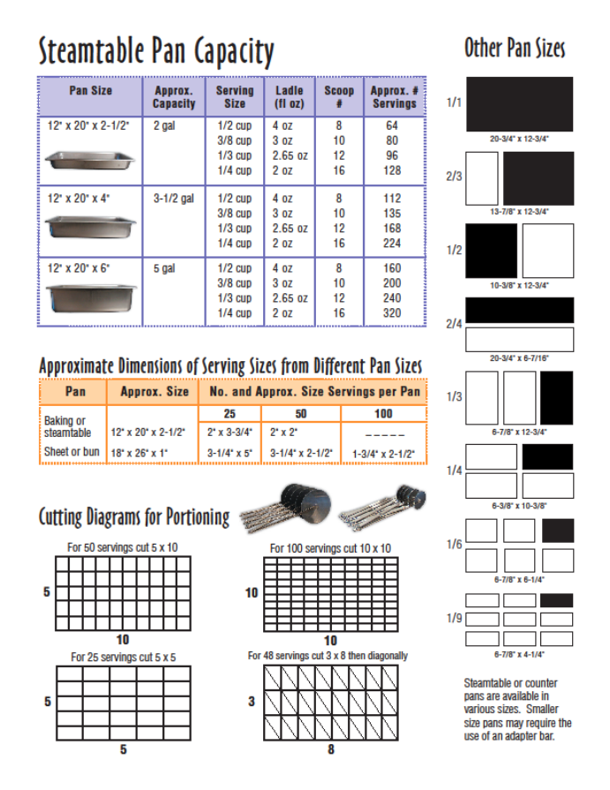
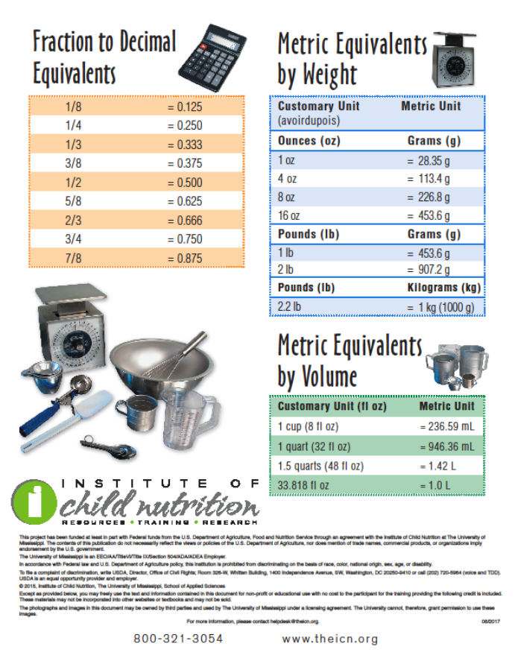
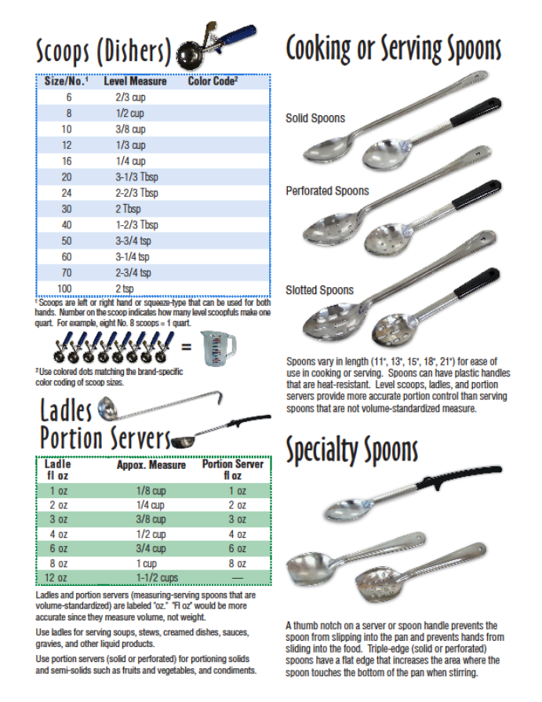
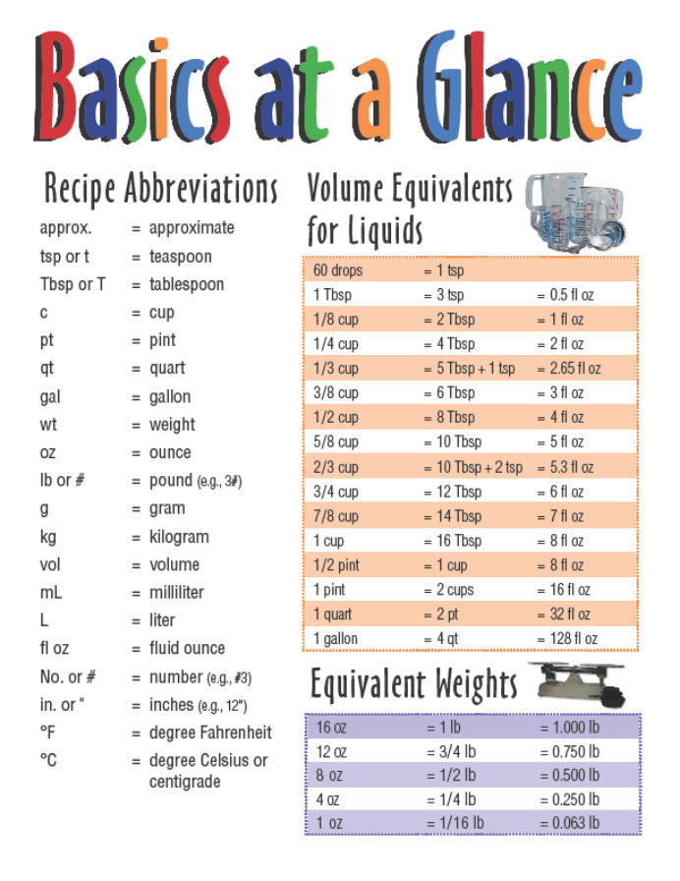
Basics at a Glance

Slide 17
Using Cycle Menus
A cycle menu “cycles” or repeats itself on a rotating basis of multiple days or weeks and offers different foods every day.

Slide 18
Food Production Records
Food production records provide a place for the manager to record information that communicates to the staff the food items and amounts to prepare and serve.

Slide 19
Food Production Record Requirements
Basic Information
Reimbursable Meals
Nonreimbursable Meals
All Menu Items Listed
Recipe/Product Number
Portion Size
Reimbursable Meal Components Provided by Portion Size
Meals Planned (Projected), Offered (Prepared), Selected, (Served), and Leftover
Verification Signature and Date

Slide 20
Required Information for
School Meals Production
Review the required information on a production record.

Slide 21
Food Production Record
Identify the required parts of a production record.

Slide 22
Types of
Production Schedules
Work Production Schedule
Cleaning Schedule
Service Line Food Placement Diagram

Slide 23
Work Production Schedule
A work schedule, sometimes called a production schedule, is an excellent tool to help employees stay on task.

Slide 24
Importance of a
Work Production Schedule
A work production schedule tells each school nutrition employee everything necessary to prepare for meal service, including any pre-preparation for the following day and a time standard for each task.

Slide 25
Daily Work Schedule for Food Production and Service
Discuss any recommended modifications, additions, or deletions to the schedule.

Slide 26
Cleaning Schedules
Cleaning schedules are a way of organizing daily, weekly, and special cleaning tasks.

Slide 27
Service Line Food Placement Diagram
It is recommended that the school nutrition director work with managers to design a service line food placement diagram that can be standardized for a set period of time or individualized according to the menu.

Slide 28
Food Quality Standards
Foods that look good can entice students to select healthy school meals.

Slide 29
Food Quality and Performance Assessment
Reviewing completed production records will ensure that:
The menu is being followed
High-quality meals that meet students’ nutrition needs and wants are being served
Fiscal accountability is maintained

Slide 30
ICN and CICN Resources
theicn.org
theicn.org/cicn

Slide 31
Conclusion
SMART Goals

