Slide 1
Reimbursable School Meals

Slide 2
Lesson Objectives
Identify the school lunch and breakfast reimbursable meal components.
Identify the school lunch and breakfast fruit component requirements.
Identify the school lunch vegetable component requirements.
Identify the school lunch and breakfast grains component requirements.

Slide 3
Lesson Objectives, continued
Identify the school lunch meats/meat alternates (M/MA) component requirements.
Identify the school lunch and breakfast fluid milk component requirements.
Recognize an Offer Versus Serve (OVS) reimbursable lunch meal.
Recognize an OVS reimbursable breakfast meal.
Discuss unit prices for a reimbursable meal.

Slide 4
Menu Planner
Compliant with Federal regulations
Student pleasing
Prepared within the limits of the operation
Includes textures, colors, and flavors
Includes a variety of choices

Slide 5
Menu Planner Skills
Menu planning skills include creating menus that:
  Are compliant with Federal regulations
  Are student pleasing
  Are prepared within the limits of the operation
  Include textures, colors, and flavors
  Include a variety of choices

Slide 6
Menu Choices
Reflects students’ preferences
Allows students to build healthy school meals
Increases consumption
Reduces waste

Slide 7
Grade Groups
K–5, 6–8, and 9–12
Specific amounts of foods/average calories required depending on the grade groups
Reflect school grade configurations
Check with State agency if unusual grade configuration

Slide 8
Dietary Specifications
All foods and beverages served in reimbursable meals contribute to the weekly dietary specifications for calories, saturated fat, added sugars, and sodium.

Slide 9
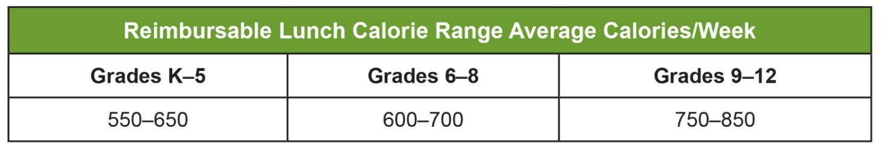
School Lunch Calorie Range

Slide 10
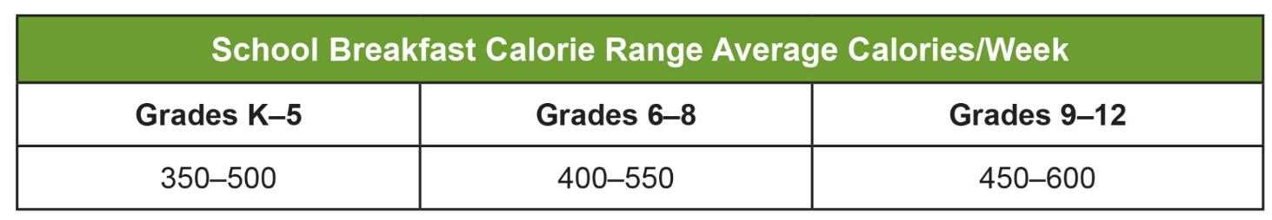
School Breakfast Calorie Range

Slide 11
Saturated Fat
School lunches and breakfasts, offered to all age/grade groups must, on average over the school week, provide less than 10 percent of total calories from saturated fat.

Slide 12
Added Sugar Limits
USDA is now implementing a two-step approach to reduce added sugars in school meals. This standard allows schools to decrease added sugars over the next several years to meet the weekly dietary limit of less than 10 percent of calories across the week in the school lunch and breakfast programs.

Slide 13
Sodium
For school lunch schools must meet Sodium Target 1A until July 1, 2027:
Grades K–5 < 1,110 mg
Grades 6–8 < 1,225 mg
Grades 9–12 < 1,280 mg

Slide 14
Meal Components for School Meals
Five required meal components for lunch
Three required meal components for breakfast

Slide 15

Meal Components for Lunch

Slide 16

Meal Components for Breakfast

Slide 17
Food Items
Can be from any required component
Must be offered in the minimum quantity

Slide 18

Fruit Component
Required component for reimbursable lunch and breakfast meal
Fresh
Frozen (with or without added sugar)
Canned in light syrup, water, or juice
Pasteurized, 100% fruit juice
Dried Fruit

Slide 19
Fruit Component Requirements for a Reimbursable Lunch
Must be offered daily and weekly minimum quantities
Minimum quantity is ⅛ cup
May select more than daily minimum serving (except for juice) if weekly calories averaged are not exceeded

Slide 20
School Lunch Fruit Requirements
Reimbursable School Lunch Fruit Component
 | Daily Minimum Requirements Offered | Weekly Minimum Requirements Offered
Grades K–5 | ½ cup | 2 ½ cups
Grades 6–8 | ½ cup | 2 ½ cups
Grades 9–12 | 1 cup | 5 cups

Slide 21
School Breakfast Fruit Requirements
Reimbursable School Breakfast Fruit Component
 | Daily Minimum Requirements Offered | Weekly Minimum Requirements Offered
Grades K–5 | 1 cup | 5 cups
Grades 6–8 | 1 cup | 5 cups
Grades 9–12 | 1 cup | 5 cups

Slide 22
Juice
Pasteurized, 100% full-strength fruit juice may also be offered
No more than half of the weekly fruit offering may be in the form of juice

Slide 23
Dried Fruit
Whole dried fruit pieces credit as twice as much
¼ cup raisins contributes ½ cup toward fruit requirements

Slide 24
School Meals Fruit Component Requirements
Identify if the fruit offered meets the fruit component criteria for a reimbursable breakfast and lunch meal for grades K–5 and grades 6–8.

Slide 25
School Lunch Vegetable Requirements
Reimbursable School Lunch Vegetable Component
 | Daily Minimum Requirements Offered | Weekly Minimum Requirements Offered
Grades K–5 | ¾ cup | 3 ¾ cups
Grades 6–8 | ¾ cup | 3 ¾ cups
Grades 9–12 | 1 cup | 5 cups

Slide 26
Vegetable Subgroups
Dark Green
Red/Orange
Legumes (beans/peas)
Starchy
Other Vegetables

Slide 27
Subgroups
Must be able to choose all subgroups each week
Serving less than ⅛ cup cannot be counted
If two subgroups are offered one day and students can only select one choice, both subgroups need to be offered again in the same week

Slide 28





Subgroup Requirements
 | Dark Green | Red/Orange | Beans, Peas, and Lentils | Starchy | Other | Additional vegetables to meet weekly requirements
Grades K–5 | ½ cup | ¾ cup | ½ cup | ½ cup | ½ cup | 1 cup
Grades 6–8 | ½ cup | ¾ cup | ½ cup | ½ cup | ½ cup | 1 cup
Grades 9–12 | ½ cup | 1 ¼ cups | ½ cup | ½ cup | 3/4 cup | 1 cup

Slide 29

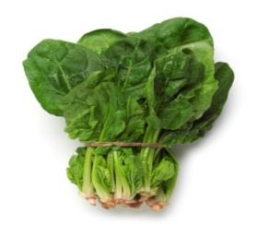
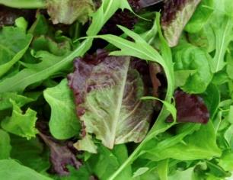
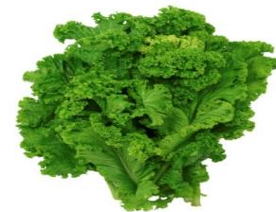
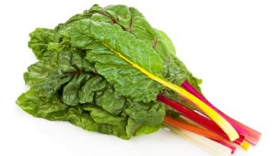
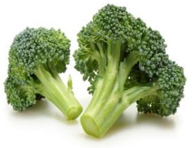
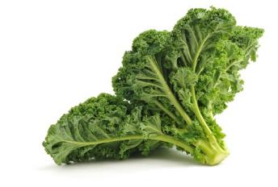
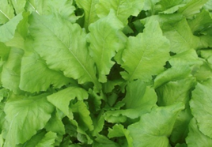
Dark Green Vegetables
Romaine Lettuce
Mustard Greens
Spinach
Dark Green Leafy Lettuce
Swiss Chard
Broccoli
Turnip Greens
Kale

Slide 30

Crediting Dark Green Vegetables
Raw leafy greens are credited as half the volume served
Cooked leafy green vegetables are credited as volume as served
Other dark green vegetables are credited at the same volume served

Slide 31




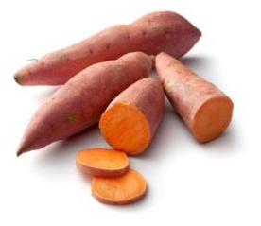
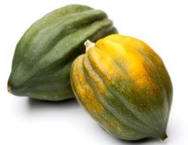
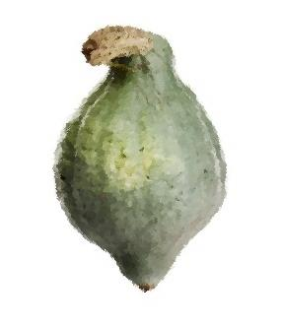

Red/Orange Vegetables
Red and Orange Peppers
Tomatoes
Carrots
Cherry Peppers
Sweet Potatoes
Acorn Squash
Hubbard Squash
Pumpkin

Slide 32
Beans, Peas, and Lentils Vegetable Subgroups
Excellent source of dietary fiber, folate, and potassium
Edamame will contribute to the beans/peas (legumes) vegetable subgroup
Fresh beans are credited as vegetables
They don’t have a high protein content

Slide 33

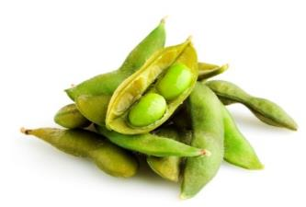


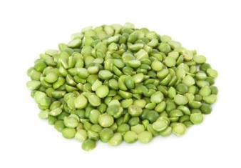
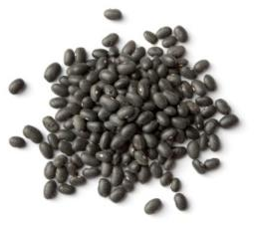
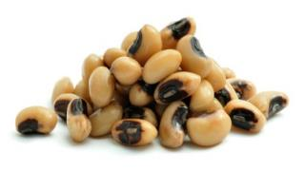
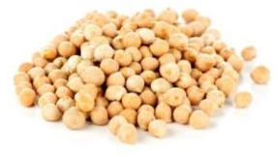
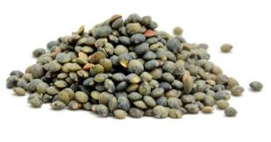
Beans, Peas, and Lentils
Navy Beans
Pink Beans
Kidney Beans
Edamame
Spilt Peas
Black-Eyed Peas, Dry, Mature
Garbanzo Beans (Chickpeas)
Black Beans
Lentils

Slide 34


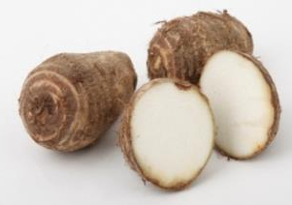
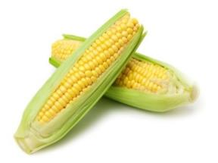
Starchy Vegetables
Jicama
Plantain
Corn
Taro (Malanga)

Slide 35

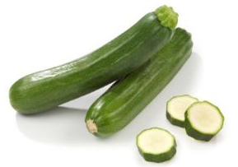

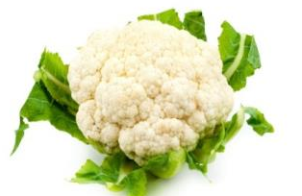

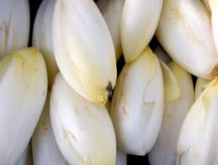

Other Vegetables
Zucchini
Okra
Avocado
Cauliflower
Cucumber
Belgian Endive
Onion

Slide 36
Vegetables Mixtures
Same vegetable subgroup mixture counts as subgroup
Different vegetable subgroups (minimum
⅛ cup) count as the different subgroups
If the quantities of vegetables is unknown, count as other vegetable subgroup

Slide 37
Vegetables K–8 Menu
Identify the name of all the vegetables, portion sizes, and the appropriate vegetable subgroup.

Slide 38
School Lunch Grains Requirements
Reimbursable School Lunch Grains Component
 | Daily Minimum Requirements Offered | Weekly Minimum Requirements Offered
Grades K–5 | 1 ounce equivalent | 8–9 ounce equivalents
Grades 6–8 | 1 ounce equivalent | 8–10 ounce equivalents
Grades 9–12 | 2 ounce equivalent | 10–12 ounce equivalents
Schools are only required to meet the daily and weekly minimum requirements for this food component. To meet the minimum weekly requirements, grades K–5, grades 6–8, and grades 9–12 will need to offer more than the minimum daily requirements on some days during the week.

Slide 39
School Breakfast Grains Requirements
Reimbursable School Breakfast Grains Component
 | Daily Minimum Requirements Offered | Weekly Minimum Requirements Offered
Grades K–5 | 1 ounce equivalent | 7–10 ounce equivalents
Grades 6–8 | 1 ounce equivalent | 8–10 ounce equivalents
Grades 9–12 | 1 ounce equivalent | 9–10 ounce equivalents
Schools are only required to meet the daily and weekly minimum requirements for this food component. To meet the minimum weekly requirements, grades K–5, grades 6–8, and grades 9–12 will need to offer more than the minimum daily requirements on some days during the week.

Slide 40
Grains Component
Are grains a required meal component for both breakfast and lunch?
Do all grade levels have the same daily requirements for reimbursable lunch? If not, what are they?
Do all grade levels have the same daily requirements for reimbursable breakfast? If not, what are they?

Slide 41
School Lunch
Meats/Meat Alternates (M/MA) Requirements
Reimbursable School Meats/ Meat Alternates Component
 | Daily Minimum Requirements Offered | Weekly Minimum Requirements Offered
Grades K–5 | 1 ounce equivalent | 8–10 ounce equivalents
Grades 6–8 | 1 ounce equivalent | 9–10 ounce equivalents
Grades 9–12 | 2 ounce equivalent | 10–12 ounce equivalents
Schools are only required to meet the daily and weekly minimum requirements for this food component. To meet the minimum weekly requirements, grades K–5, grades 6–8, and grades 9–12 will need to offer more than the minimum daily requirements on some days during the week.

Slide 42
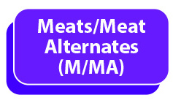
Beef, Fish, and Poultry
1 ounce cooked, skinless, unbreaded portion equals 1 oz eq
Beef, fish, poultry

Slide 43
Nuts and Seeds
Sunflower seeds, almonds, and hazelnuts
Meets the full meats/meat alternates component

Slide 44
Nut Butter
2 tablespoons equals 1 oz eq of:
Nut butter
Almond butter
Cashew nut butter
Peanut butter, reduced-fat peanut butter
Sesame seed butter
Soy nut butter
Sunflower seed butter

Slide 45
Tofu
Commercially prepared tofu must be 2.2 ounces (by weight) with 5 or more grams of protein to equal 1 oz eq
4 ounces (weight) or ½ cup (volume) of soy or dairy yogurt equals 1 oz eq

Slide 46
Crediting Tofu
The tofu ingredient must contain the required 5 grams of protein or more to be considered a meat alternate.

Slide 47
Firm or Extra Firm Tofu
Stir-fries
Omelets
Miso soup
Meat substitute products such as links and sausages

Slide 48
Soft or Silken Tofu
Tofu is not creditable if:
Incorporated into drinks
Smoothies
Added to dish for texture
Baked deserts
Blended tofu
Tofu noodles: not grain or meats/meat alternatives

Slide 49
Yogurt
4 ounces (weight) or ½ cup (volume) of soy or dairy yogurt equals one oz eq

Slide 50
Cheese and Eggs
May be used to meet all or part of the meats/meat alternates component in accordance with FNS guidance

Slide 51
Dry Beans or Peas
“Dry” or “mature” beans/peas is legume
“Immature” or “fresh” is starchy vegetable
USDA Foods program
Canned or frozen dry beans/peas

Slide 52
“Immature” or “Fresh” Beans or Peas
“Immature” or “fresh” beans or peas do not qualify as a meats/meat alternates
Immature lima beans, field peas, green peas can be credited as starchy vegetables

Slide 53
Meat Alternates or Vegetables
May be offered as meat alternates or as vegetables
Cannot count toward both food components
Menu planners must determine in advance how to count beans/peas in a meal

Slide 54
Cooked Beans
¼ cup of cooked beans equals 1 ounce of the meats/meat alternates requirement
If with liquid, there should be more than ¼ cup of beans and liquid
The liquid does not count as beans

Slide 55
Shelf-Stable, Dried, Semi-Dried Meat, Poultry, Seafood Snacks
Dried meat products used throughout CNPs
Simplify meal planning for operators
Use of the products is not limited to meals and snacks served off-site

Slide 56
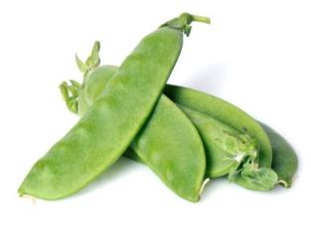
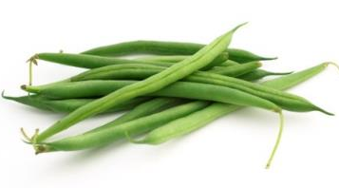
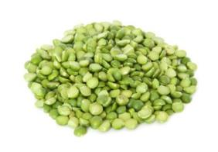

Beans, Peas, and Lentils (Legumes)
Chinese Snow Peas
Navy Beans
Beans, Green or Wax
Split Peas
Lentils
Pink Beans

Slide 57

Fluid Milk Requirements
Requirement same for lunch and breakfast
1 cup of fat-free or low-fat (1%) fluid milk must be offered daily
Weekly minimum of 5 cups
Unflavored milk must be offered at each meal service

Slide 58

Milk Substitutions
Required for disability accommodations
Optional for parent requests
Must meet regulatory standards
Subject to fat and calorie limits

Slide 59

“Plain” Potable Water
Must be available during meal service
Cannot promote water as alternative selection to milk
Not a food component or food item

Slide 60
Coconut, Hominy, Popcorn, Surimi Seafood, and Tempeh
Program operators will be allowed to credit these
FNS will issue new guidance describing how these products will credit towards specific food components

Slide 61
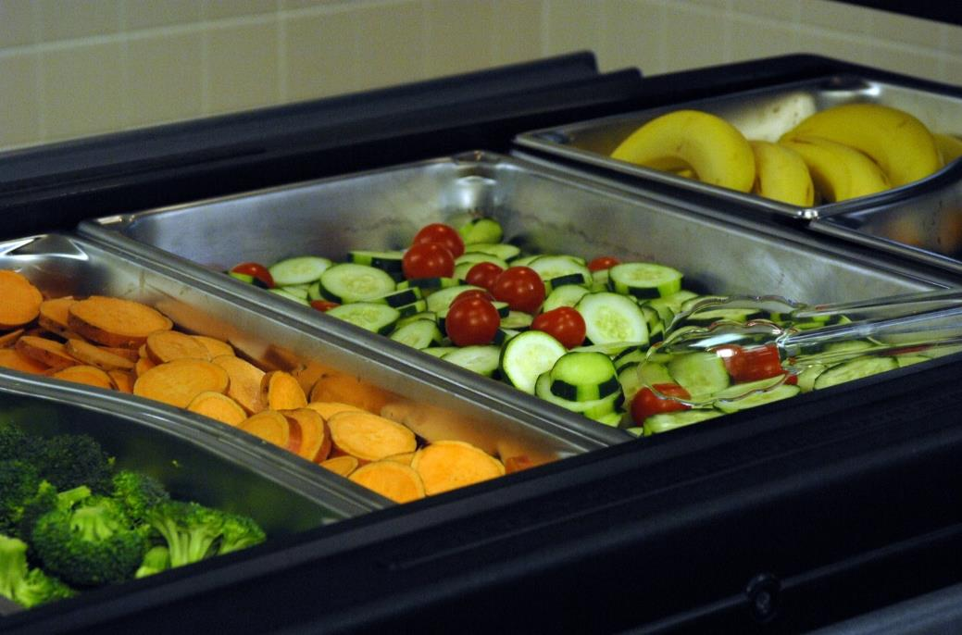
Offer Versus Serve (OVS) Concept

Slide 62
OVS
Required at senior high school level
Optional for:
  School Food Authority provided at-risk afterschool meals
  School Food Authority Summer Food Service Program meals
  National School Lunch Program Seamless Summer option

Slide 63
Planned, Offered, and Selected
Planned: what the menu planner intends
Offered: what actually is prepared
Selected/Served: refers to the foods that were actually served or selected

Slide 64


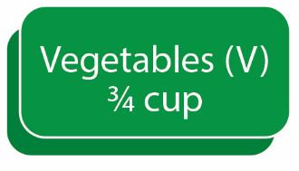
OVS Lunch
Needs a minimum of two additional components for a reimbursable lunch
or
Needs a minimum of one additional component for a reimbursable K–8 lunch
and

Slide 65
Extra Foods, Extra Calories
Non-creditable extra foods (e.g., grits, ice cream, or pudding)
In addition to a reimbursable meal
Not credited as food component or food item
No extra cost
Included in the nutrient analysis of weekly dietary specifications

Slide 66
Selecting Additional Fruits and Vegetables
Menu planner
Students may select more than the minimum daily requirements as long as weekly dietary specifications are not exceeded

Slide 67
Fruit and Vegetable Components for Lunch
½ cup of vegetables, or
½ cup fruits, or
½ cup of an item with both fruits and vegetables (e.g., a carrot/raisin salad), or
Two ¼-cup servings of either the same or a different fruit or vegetable

Slide 68

Fruits and Vegetables
Lunch Not Reimbursable

Slide 69


Fruit and Vegetable
Lunch Scenarios

Slide 70

Selecting Three Components
Lunch Not Reimbursable

Slide 71
K–8 Lunch Speed Round
You will have three seconds to review each slide and determine which of the slides represent a reimbursable meal.
At the end of the speed round we will discuss the answers. Be prepared to justify your answers.

Slide 72
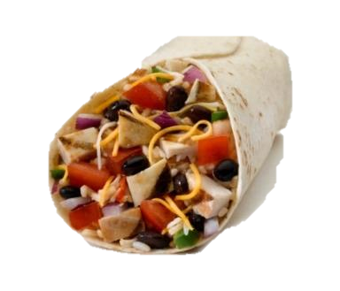
K–8 Lunch Speed Round 1
Grilled Chicken Wrap
2 oz eq Meats/Meat Alternates
WW Tortilla
2 oz Grains
Vegetables
⅛ cup Red/Orange Vegetable
⅛ cup Beans, Peas, and Lentils
Reimbursable Meal
____ Yes ____ No

Slide 73
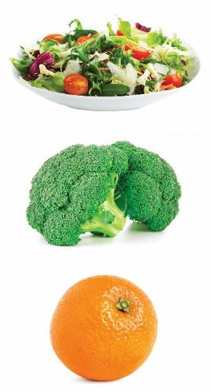
K–8 Lunch Speed Round 2
Tossed Salad
½ cup Dark Green Vegetable
½ cup Red/Orange Vegetable
Broccoli
¾ cup Dark Green Vegetable
Fresh Orange
½ cup Fruit
Reimbursable Meal
____ Yes ____ No

Slide 74
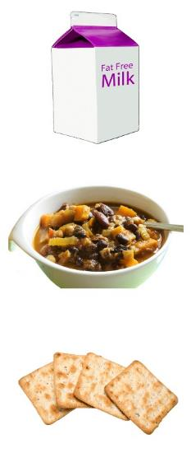
K–8 Lunch Speed Round 3
Milk
1 cup Milk
Vegetarian Chili
2 oz Meats/Meat Alternates
¼ cup Red/Orange Vegetable
WW Crackers
1 oz eq Grain
Reimbursable Meal
____ Yes ____ No

Slide 75

K–8 Lunch Speed Round 4
Hamburger on a WW Bun
2 oz Meats/Meat Alternates
1.5 oz eq Grains
Carrots
½ cup Red/Orange Vegetable
Bean Salad
½ cup Beans, Peas, and Lentils
¼ cup Other Vegetable
Milk
1 cup Milk
Reimbursable Meal
____ Yes ____ No

Slide 76
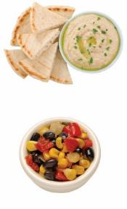
K–8 Lunch Speed Round 5
Hummus
2 oz Meats/Meat Alternates
WW Pita
1 oz eq Grain
Bean Salad
½ cup Beans, Peas, and Lentils
¼ cup Other Vegetable
Reimbursable Meal
____ Yes ____ No

Slide 77
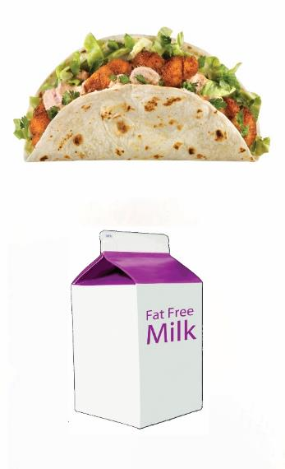
K–8 Lunch Speed Round 6
Fish Taco
2 oz Meats/Meat Alternates
WW Tortilla
1 oz eq Grain
Cole Slaw
¼ cup Other Vegetable
Milk
1 cup Milk
Reimbursable Meal
____ Yes ____ No

Slide 78

K–8 Lunch Speed Round 7
WW Spaghetti and Marinara
1 oz eq Grains
¼ cup Red/Orange Vegetable
Broccoli
¾ cup Dark Green Vegetable
Fresh Orange
½ cup Fruit
Reimbursable Meal
____ Yes ____ No

Slide 79

K–8 Lunch Speed Round 8
Milk
1 cup Milk
WW Spaghetti and Meat Balls
2 oz Meats/Meat Alternates
1 oz eq Grain
¼ cup Red/Orange Vegetable
Whole Grain-Rich Roll
1 oz eq Grain
Reimbursable Meal
____ Yes ____ No

Slide 80

K–8 Lunch Speed Round 1 Answer
Grilled Chicken Wrap
2 oz eq Meats/Meat Alternates
WW Tortilla
2 oz Grains
Vegetables
⅛ cup Red/Orange Vegetable
⅛ cup Beans, Peas, and Lentils
Not Reimbursable Meal
Only ¼ cup Vegetables
Must be ½ cup for a reimbursable meal

Slide 81
K–8 Lunch Speed Round 2
Answer
Tossed Salad
½ cup Dark Green Vegetable
½ cup Red/Orange Vegetable
Broccoli
¾ cup Dark Green Vegetable
Fresh Orange
½ cup Fruit
Not Reimbursable Meal
Only two meal components selected
Must select another component for a reimbursable meal

Slide 82
K–8 Lunch Speed Round 3
Answer
Milk
1 cup Milk
Vegetarian Chili
2 oz Meats/Meat Alternates
¼ cup Red/Orange Vegetable
WW Crackers
1 oz eq Grain
Not Reimbursable Meal
Only ¼ cup Vegetables
Must be ½ cup for a reimbursable meal

Slide 83
K–8 Lunch Speed Round 4
Answer
Hamburger on a WW Bun 2 oz Meats/Meat Alternates 1.5 oz eq Grains Carrots ½ cup Red/Orange Vegetable Bean Salad ½ cup Beans, Peas, and Lentils ¼ cup Other Vegetable Milk 1 cup Milk
Hamburger on a WW Bun
2 oz Meats/Meat Alternates
1.5 oz eq Grains
Carrots
½ cup Red/Orange Vegetable
Bean Salad
½ cup Legumes
¼ cup Other Vegetable
Milk
1 cup Milk
Reimbursable Meal

Slide 84

K–8 Lunch Speed Round 5
Answer
Hummus
2 oz Meats/Meat Alternates
WW Pita
1 oz eq Grain
Bean Salad
½ cup Beans, Peas, and Lentils
¼ cup Other Vegetable
Reimbursable Meal

Slide 85
K–8 Lunch Speed Round 6
Answer
Fish Taco
2 oz Meats/Meat Alternates
WW Tortilla
1 oz eq Grain
Cole Slaw
¼ cup Other Vegetable
Milk
1 cup Milk
Not Reimbursable Meal
Only ¼ cup Vegetables
Must be ½ cup for a reimbursable meal

Slide 86

K–8 Lunch Speed Round 7
Answer
WW Spaghetti and Marinara
1 oz eq Grain
¼ cup Red/Orange Vegetable
Broccoli
¾ cup Dark Green Vegetable
Fresh Orange
½ cup Fruit
Reimbursable Meal

Slide 87
K–8 Lunch Speed Round 8
Answer
Milk
1 cup Milk
WW Spaghetti and Meat Balls
2 oz Meats/Meat Alternates
1 oz eq Grain
¼ cup Red/Orange Vegetable
Whole Grain-Rich Roll
1 oz eq Grain
Not Reimbursable Meal
Only ¼ cup Vegetables
Must be ½ cup for a reimbursable meal

Slide 88


Meal Components for
OVS Breakfast

Slide 89
OVS Breakfast
All students, at any grade level, must select:
At least three food items
The minimum daily required serving for grains (meats/meat alternates or a combination of both) and milk, the student must select the minimum required daily serving.
At least ½ cup of fruit, vegetables, or fruit/vegetable combined

Slide 90
OVS Breakfast Choices
Select a minimum of ½ cup fruit
May decline food items
Cashier responsible for following the intent of the menu planner

Slide 91
Example Breakfast Choices for the Fruit Component
Menu Planner Choices
Grapes ½ cup
Peaches ½ cup
Pears ½ cup
Fruit Salad ½ cup

Slide 92
Combination Foods
Combination of foods contains more than one menu item
Examples
  Pre-plated waffle with fresh fruit topping must select both the waffle and fresh fruit topping
  Yogurt parfait, breakfast burrito, milk and fruit smoothie

Slide 93
Smoothies
1 cup milk and ½ cup fruit, vegetable, or fruit/vegetable combined
Yogurt
May count as two food items

Slide 94
Breakfast M/MA
Schools may offer grains, meats/meat alternates, or a combination of both to meet the combined component requirement based on ounce equivalents.

Slide 95
Breakfast Scenarios
Several factors to consider when implementing OVS in the School Breakfast Program

Slide 96
Unit Price
One price for a complete reimbursable meal in the paid meal category
One price for a complete reimbursable meal in the reduced-price meal category

Slide 97
Unit Price
Reimbursable Meals
OVS does not affect the meal’s unit price
Three, four, or five components, same unit price for lunch
Three or more food items for breakfast, same unit price

Slide 98
OVS and À La Carte Sales
Students and cashiers need to be able to distinguish between foods for a reimbursable meal and à la carte foods.

Slide 99
Signage
Program regulation
Near or at the beginning of the service line
What a student must select for a reimbursable meal

Slide 100
Clear Signage
Reinforces the menu planner’s intent
Identifies choices or combination of choices
Includes any minimum or maximum number of items to meet requirements

Slide 101
Signage Exceptions
Signage is not required for field trips, breakfast in the classroom, and other venues where signage may be problematic. However, other methods should be used to inform students of their choices.

Slide 102
Activity:
K–8 Breakfast Menu Example
If the student selects two milks, toast, and two fruit items, should the student be charged the unit price or the à la carte price for the selection of the extra milk?
If the student selects two grain items, four fruit items, and one milk item, should the student be charged the à la carte price or the unit price for the menu selection?
If the student selects two slices of toast along with 1 cup of fluid milk, should the student be charged the unit price or the à la carte price for the meal?

Slide 103
Conclusion
SMART Goals

