Slide 1


This training was developed by the
The University of Mississippi
School of Applied Sciences
www.theicn.org
800-321-3054

Slide 2

Identifying Reimbursable School Meals
Key Areas: 1 – Nutrition and 2 – Operations
USDA Professional Standards Codes: Menu Planning (1100) and Serving Food (2200)

Slide 3
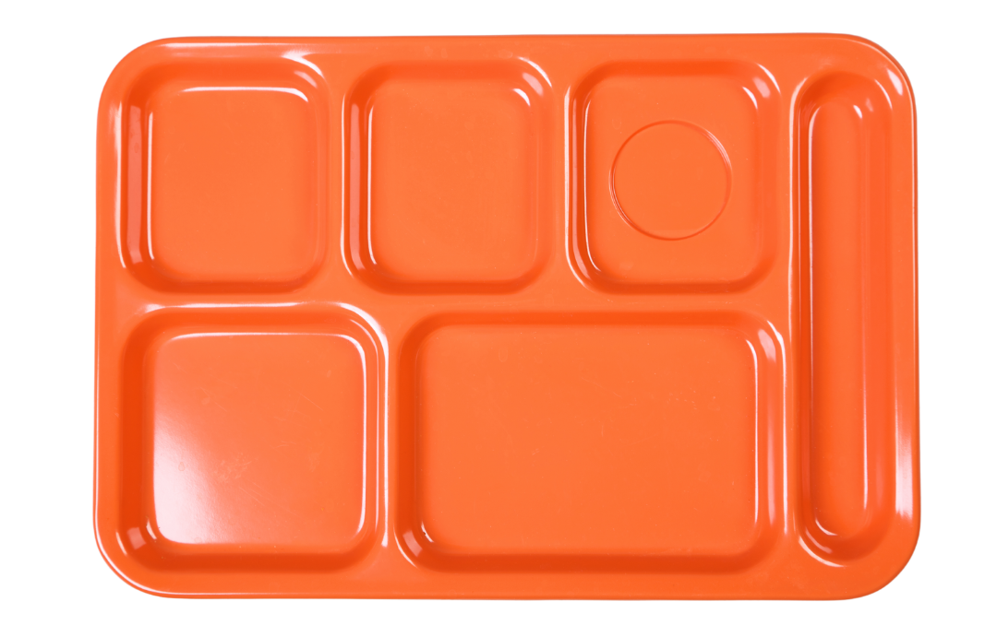
Icebreaker: My Favorite School Meal

Slide 4
Pre-Assessment
Trainer to add QR code to link the pre-assessment provided by the Training Team that is unique to each session

Slide 5
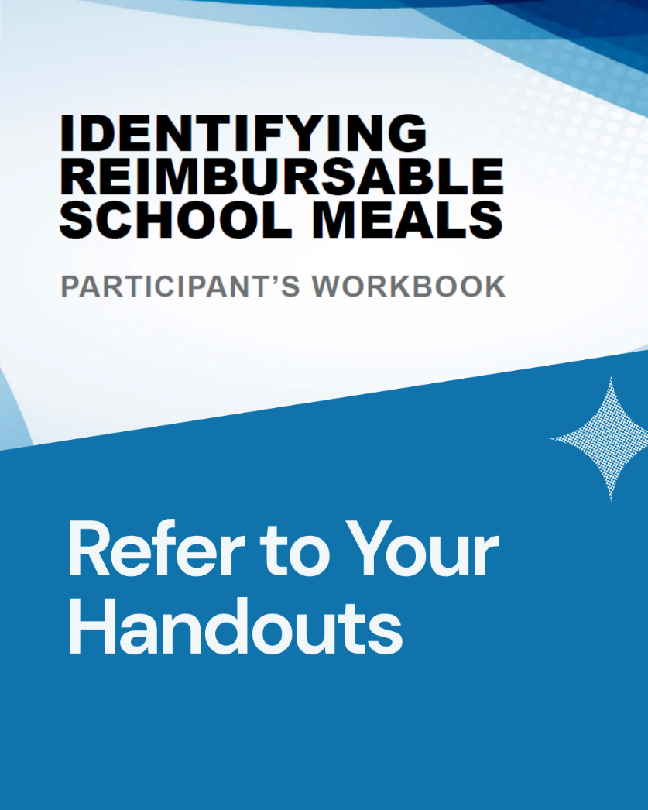
Reimbursable School Meals
National School Lunch Program (NSLP) guidelines
School Breakfast Program (SBP) guidelines
Offer Versus Serve (OVS) provision

Slide 6
Learning Objectives
Recall the required NSLP reimbursable meal components.
Categorize foods into the correct NSLP meal components.
Recognize OVS reimbursable meals at lunch.
Recall the SBP reimbursable meal components.
Categorize foods into the correct SBP meal components.
Recognize OVS reimbursable meals at breakfast.

Slide 7

Ground Rules
Show up on time.
Be present.
Let everyone participate.
Listen with an open mind.
Think before speaking.
Attack the problem, not the person.

Slide 8
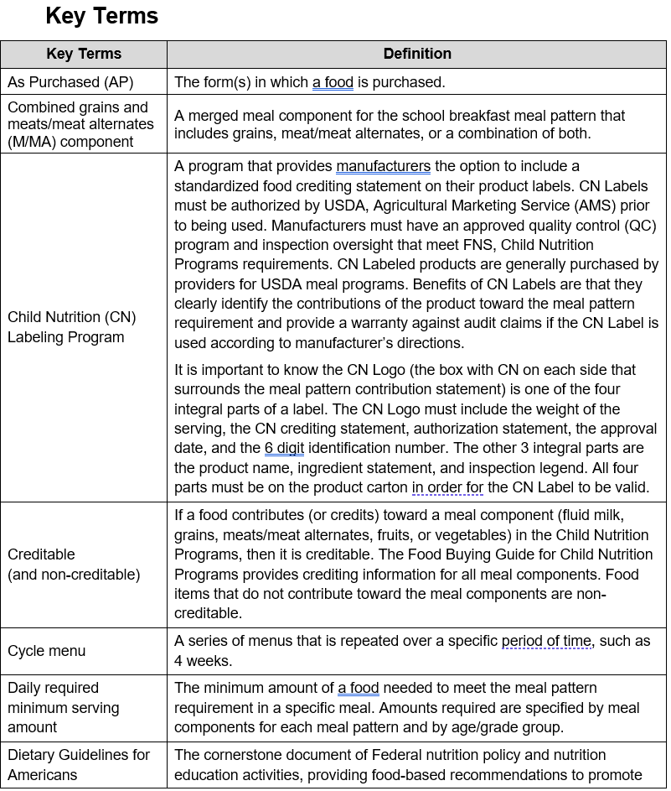
Key Terms

Slide 9
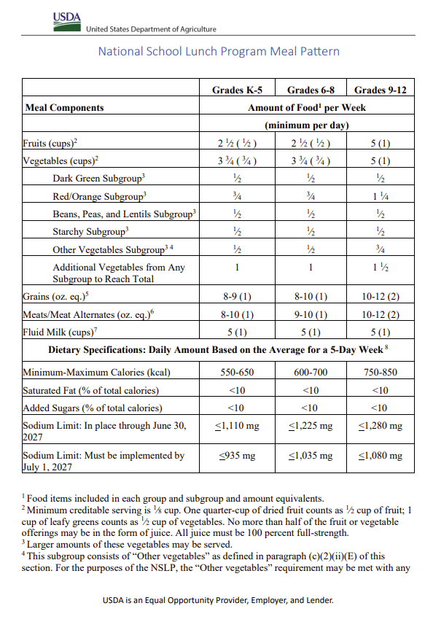
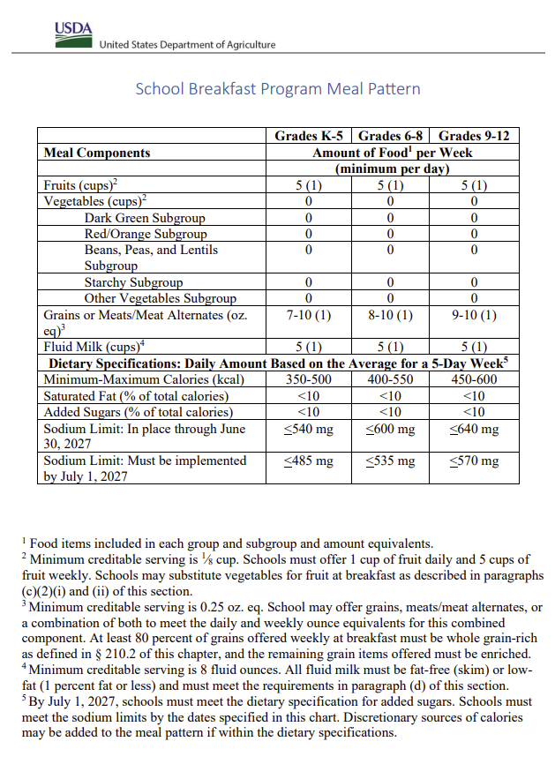
What Is the Meal Pattern?

Slide 10
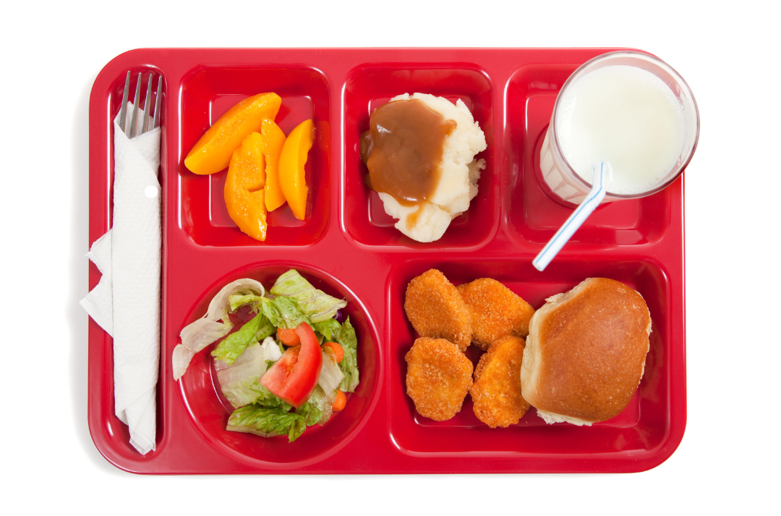
Meal Components

Slide 11
Based on update:
The Dietary Guidelines for Americans (DGA’s)
Are published jointly by USDA and HHS every five years
Provide science-based nutrition recommendations for all Americans
Inform the meal pattern requirements for school meals, including meal components, serving sizes, and weekly dietary specifications
School meal pattern requirements reflect the most current edition of the DGAs and may be updated as guidelines are revised.

Slide 12
Lesson 1: Reimbursable School Meals—Lunch

Slide 13
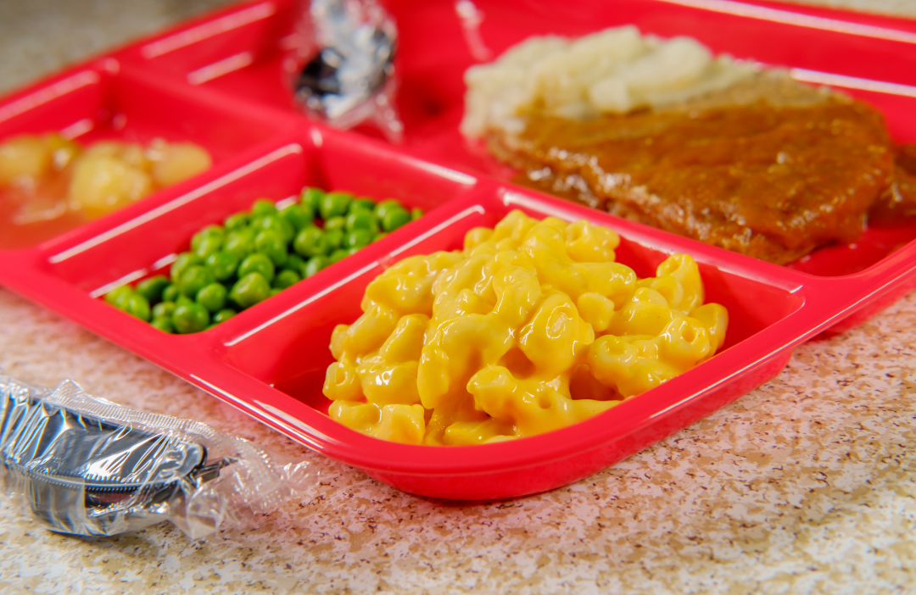
Reimbursable School Meals—Lunch
NSLP meal components
  Recall, categorize, recognize
OVS application explained

Slide 14
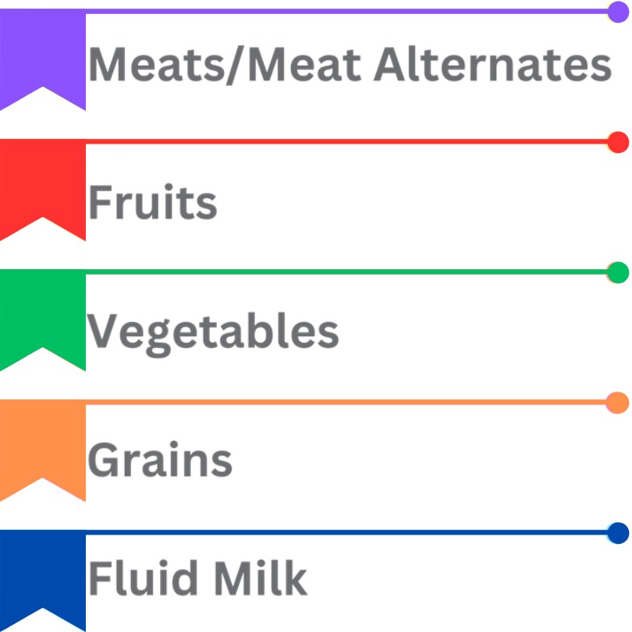
NSLP Meal Components Overview
Five (5) required meal components
Daily and weekly minimums

Slide 15
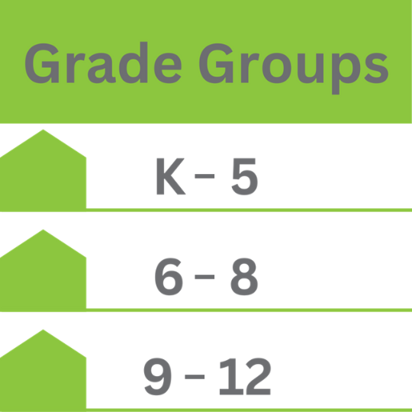
Grade Groups
Tailored component amounts
Nutritionally appropriate meals
Consult for variations

Slide 16

Role of the Menu Planner
Ensures meal compliance
Designs student-friendly menus
Adapts to operational limits
Updates according to regulation changes

Slide 17
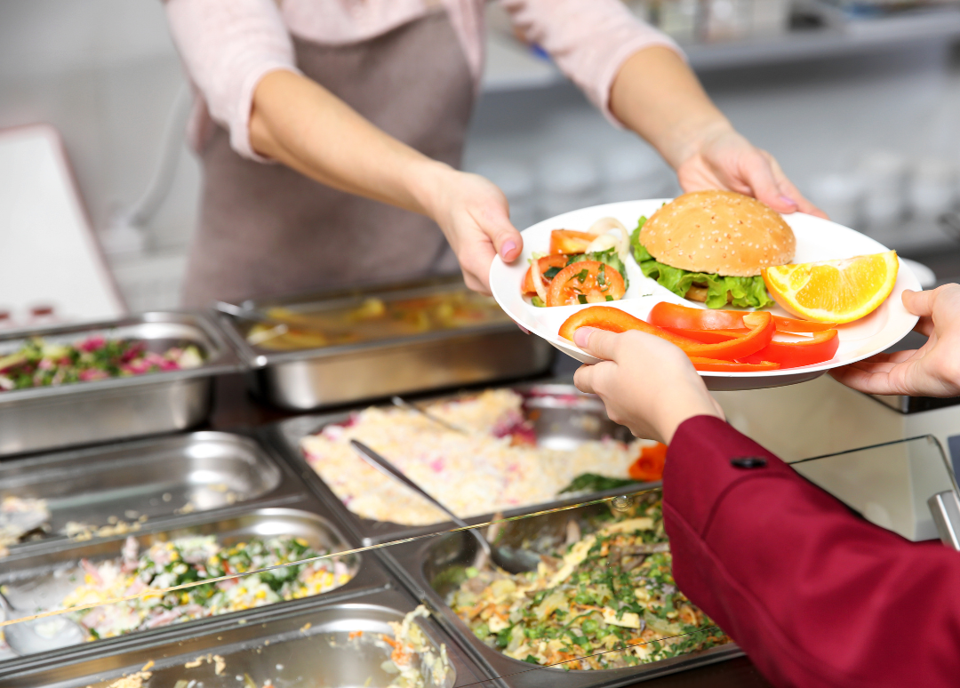
Menu Choices
Caters to student preferences
Offers component choices
Empowers healthy selections
Minimizes waste and boosts consumption

Slide 18
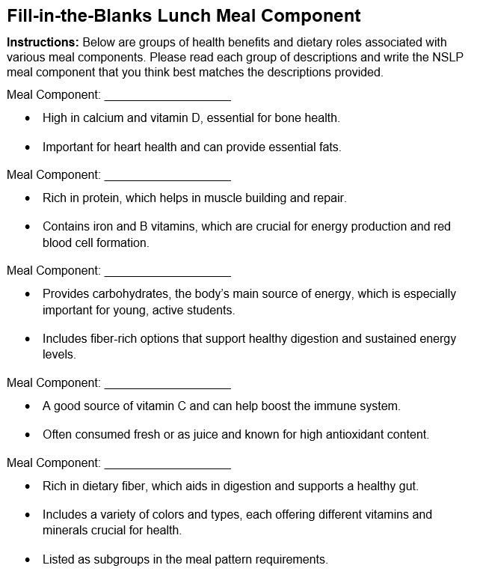

Recall NSLP Meal Components

Slide 19
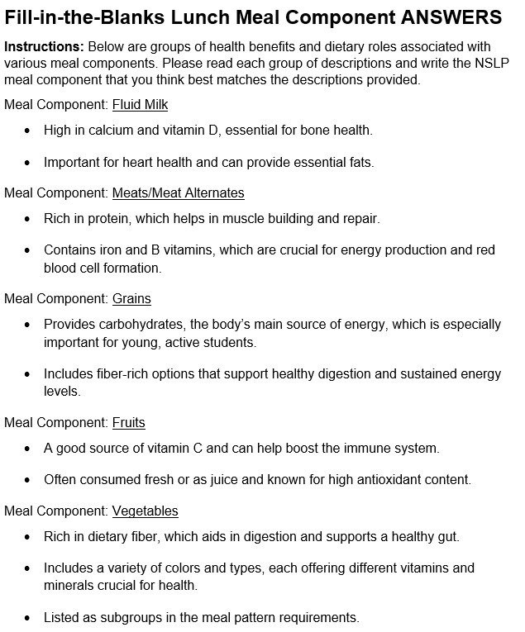
Recall NSLP Meal Components—Answers

Slide 20
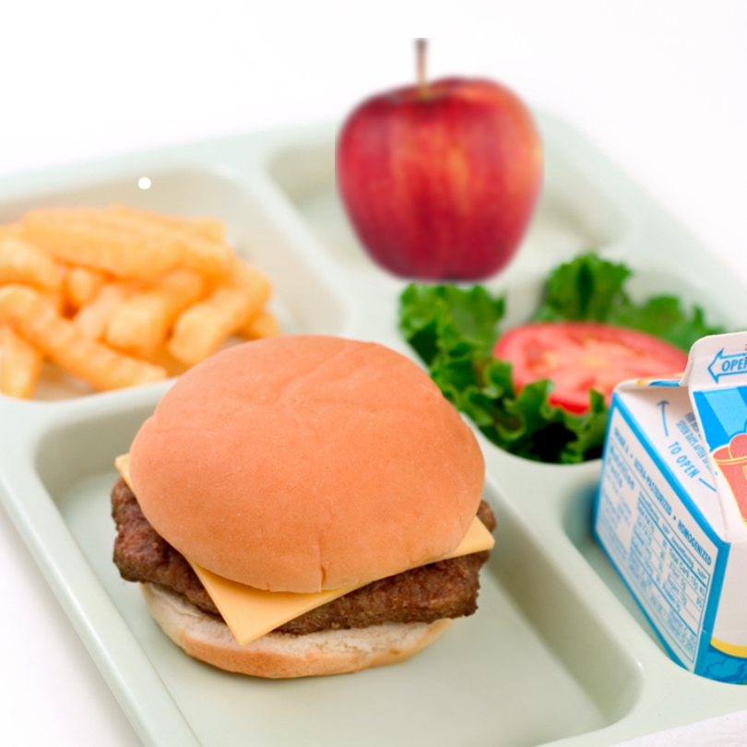
Meal Components Expanded
Fruits
Vegetables
Grains
Meats/Meat Alternates
Fluid Milk

Slide 21
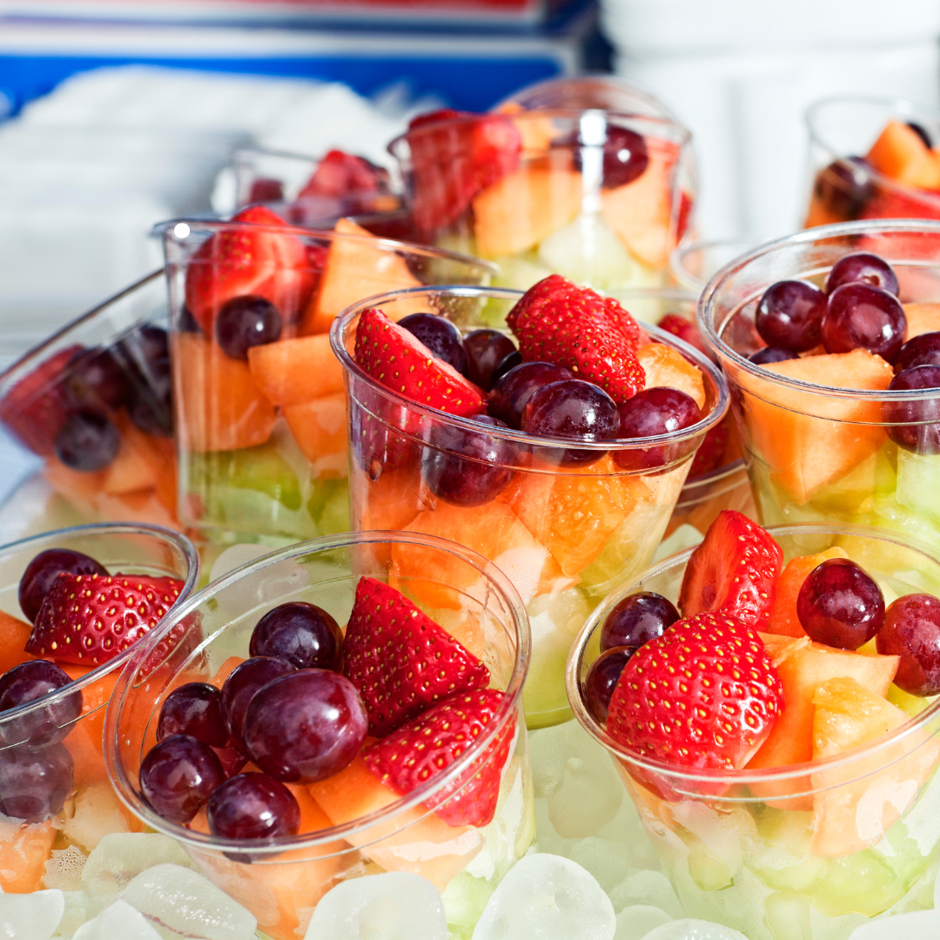
Fruits Component for the NSLP

Slide 22
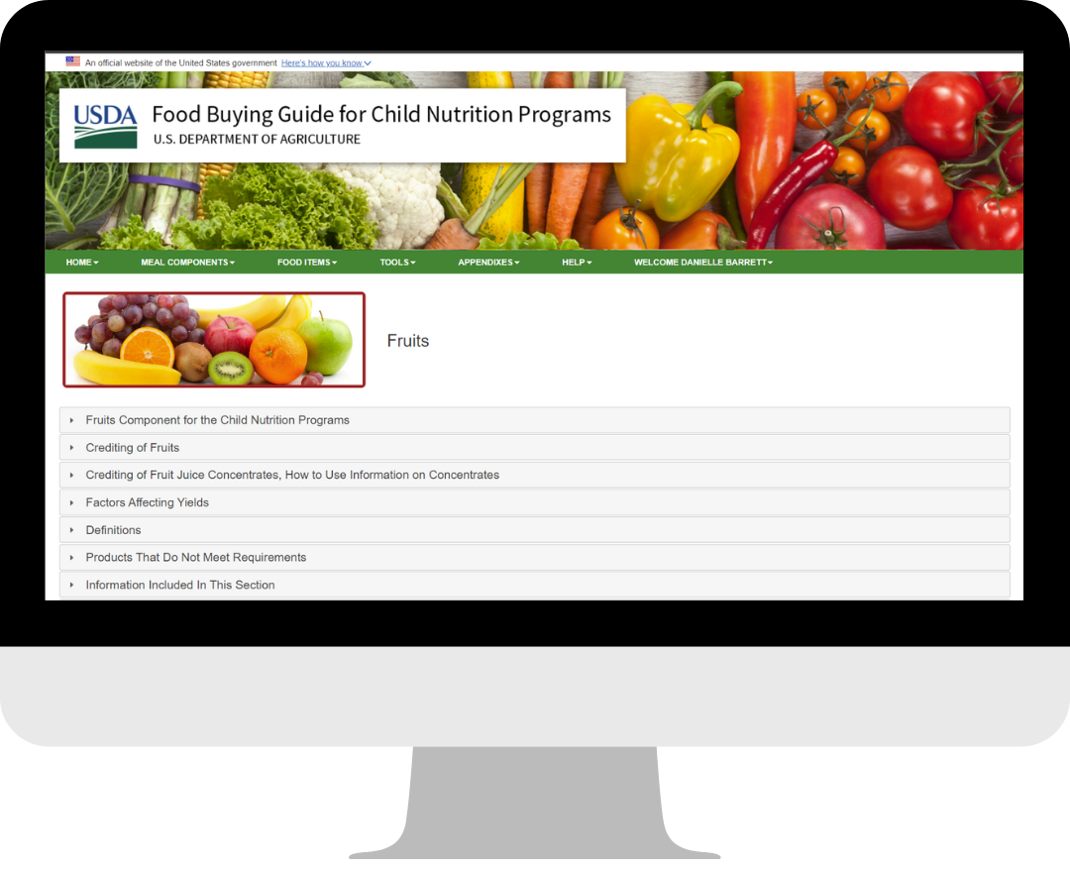
Creditable Types of Fruits
Include fresh, canned, frozen, dried
Includes more than 360 fruit types listed
Creditable in a minimum of ⅛ cup Includes 100% fruit juices

Slide 23
Fruits Component Requirements—NSLP

Slide 24

Crediting Specific to Fruits: Juice
Require 100% full-strength fruit juice to credit toward the fruit component
Apply half of the weekly limit
Allow crediting within smoothies

Slide 25

Crediting Specific to Fruits: Dried Fruit
Credit whole dried fruit and dried fruit pieces at twice the volume served
Count ¼ cup raisins as ½ cup fruit
Monitor the added sugar content

Slide 26
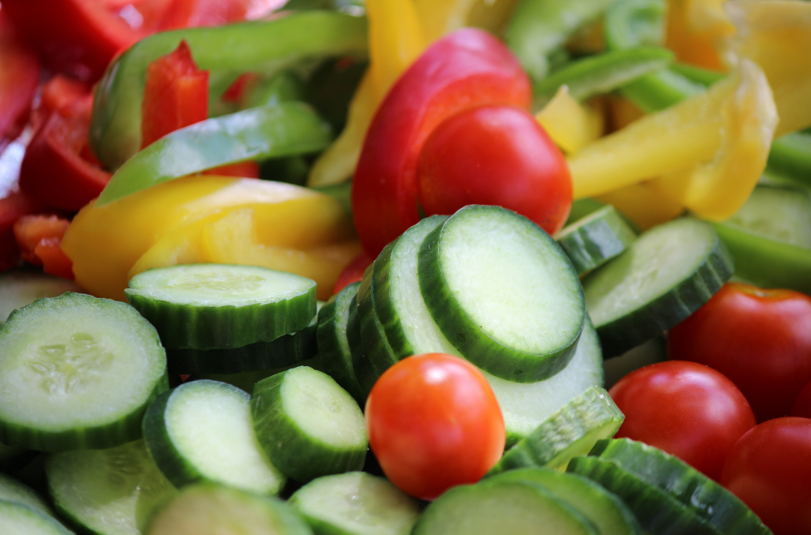
Vegetables Component for the NSLP

Slide 27
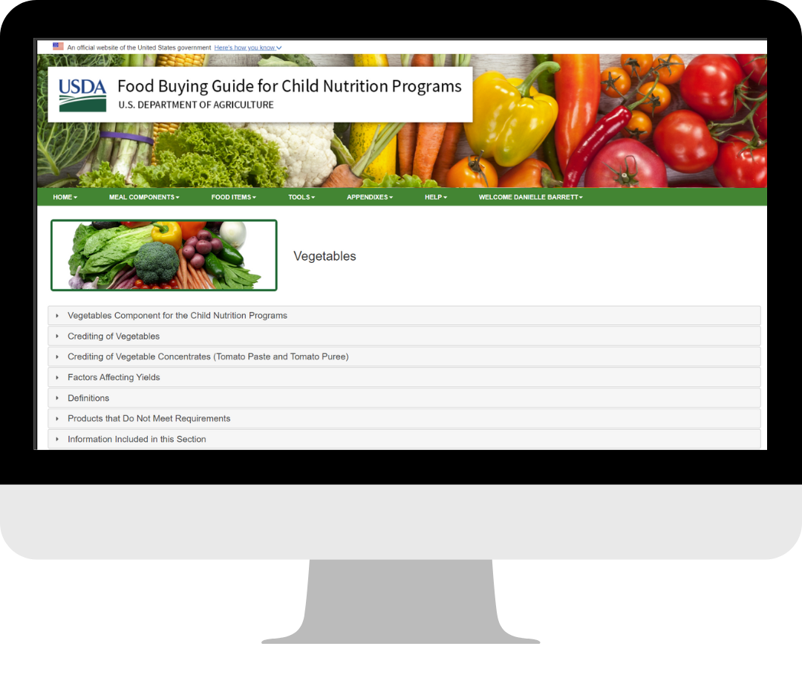
Creditable Types of Vegetables
Include fresh, frozen, canned, or dried options
Count 100% vegetable juice
List over 630 types of vegetables
Support nutrition through variety

Slide 28
Vegetables Component Requirements—NSLP

Slide 29
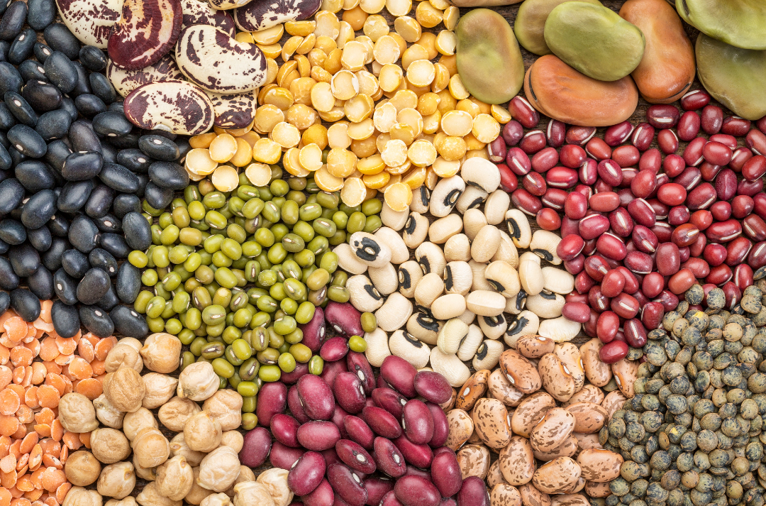
Crediting Specific to Vegetables: Beans, Peas, and Lentils
Includes dry, mature beans, lentils, and split peas
Does not include wax beans or green peas
May be counted toward the M/MA or vegetables component, but not as both simultaneously

Slide 30

Crediting Specific to Vegetables: Juice
Require 100% full-strength vegetable juice to credit toward the vegetable component
Apply half of the weekly limit
Allow crediting within smoothies

Slide 31
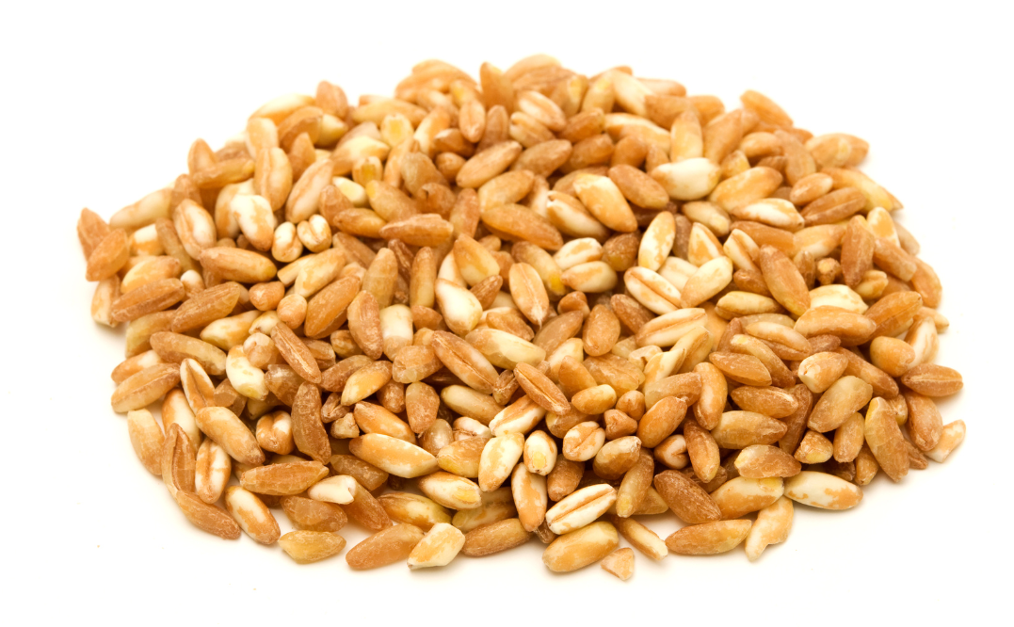
Crediting Specific to Vegetables:
In Lieu of Grains
Provide a special provision for schools
Substitute vegetables for grains
Credit ½ cup vegetables as 1 oz eq grains
Support regional dietary preferences

Slide 32
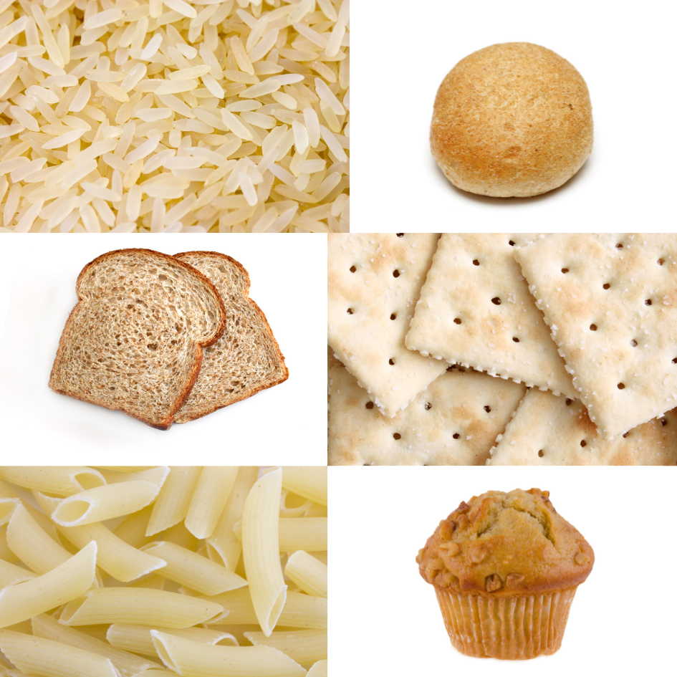
Grains Component for the NSLP

Slide 33
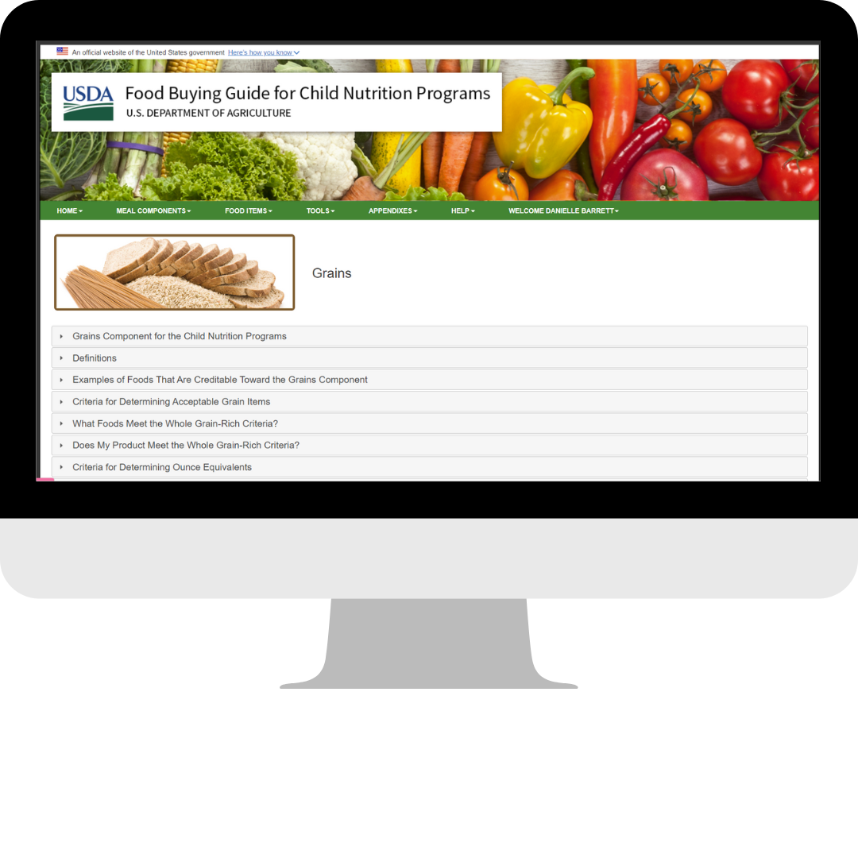
Creditable Types of Grains
Whole grains (i.e., whole wheat, whole-wheat meal/flour, brown rice, rolled oats, whole corn)
Enriched grains (i.e., enriched wheat meal/flour, enriched rice)
Bran or germ

Slide 34
Grains Component Requirements—NSLP

Slide 35
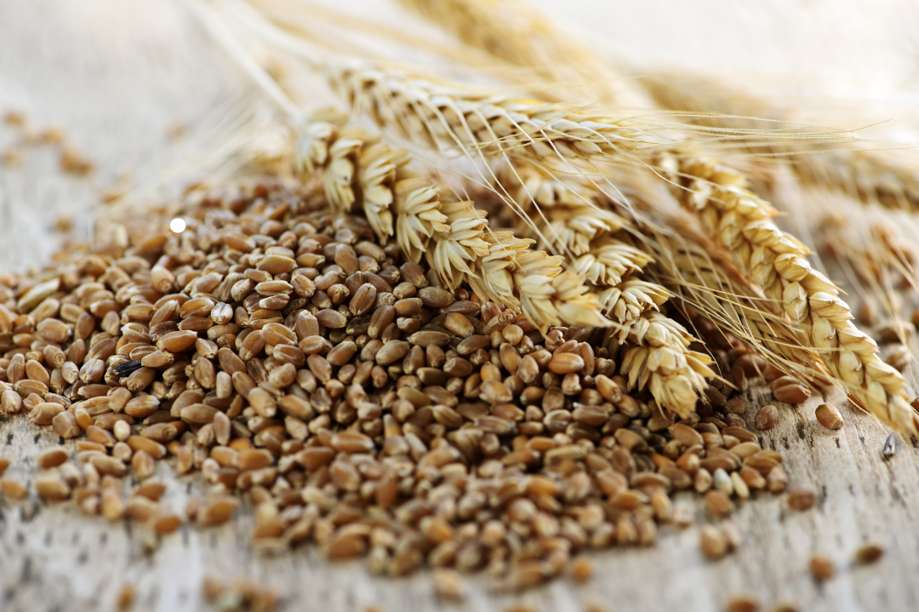
Crediting Specific to Grains: Whole Grain-Rich Criteria
Require 80% of grains to be whole grain-rich
Allow remaining grains to be enriched
Ensure nutritious grain offerings
Define whole grain-rich (WGR) as containing 50–100% whole grain, with any remaining grains being enriched

Slide 36

Meats/Meat Alternates Component for the NSLP

Slide 37
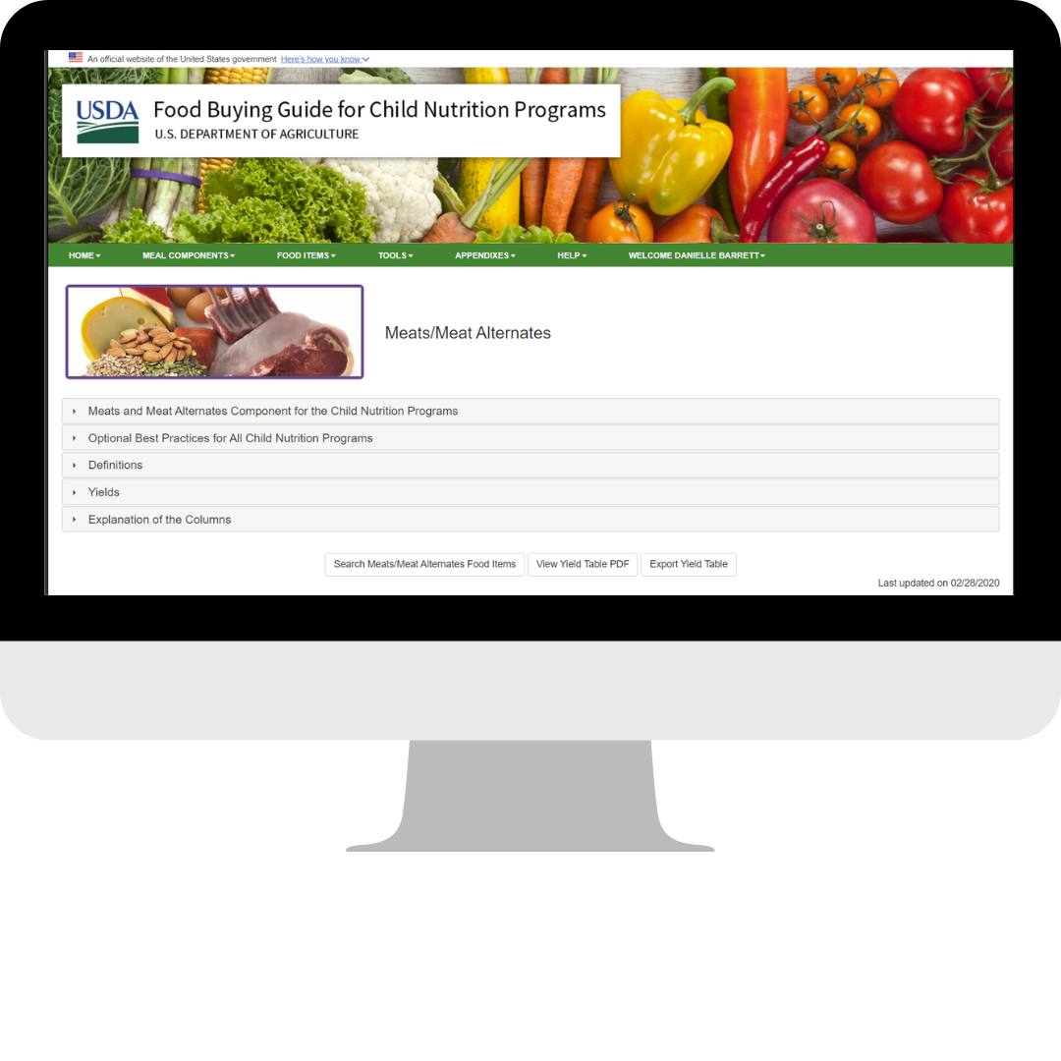
Creditable Types of Meats/Meat Alternates
Measured in ounce equivalents
Includes:
  Meats, poultry, seafood
  Options may be prepared in-house or purchased processed products (burger patties, chicken nuggets)
  Meat alternates: cheese, eggs, tofu, yogurt

Slide 38
Meats/Meat Alternates Component Requirements—NSLP

Slide 39
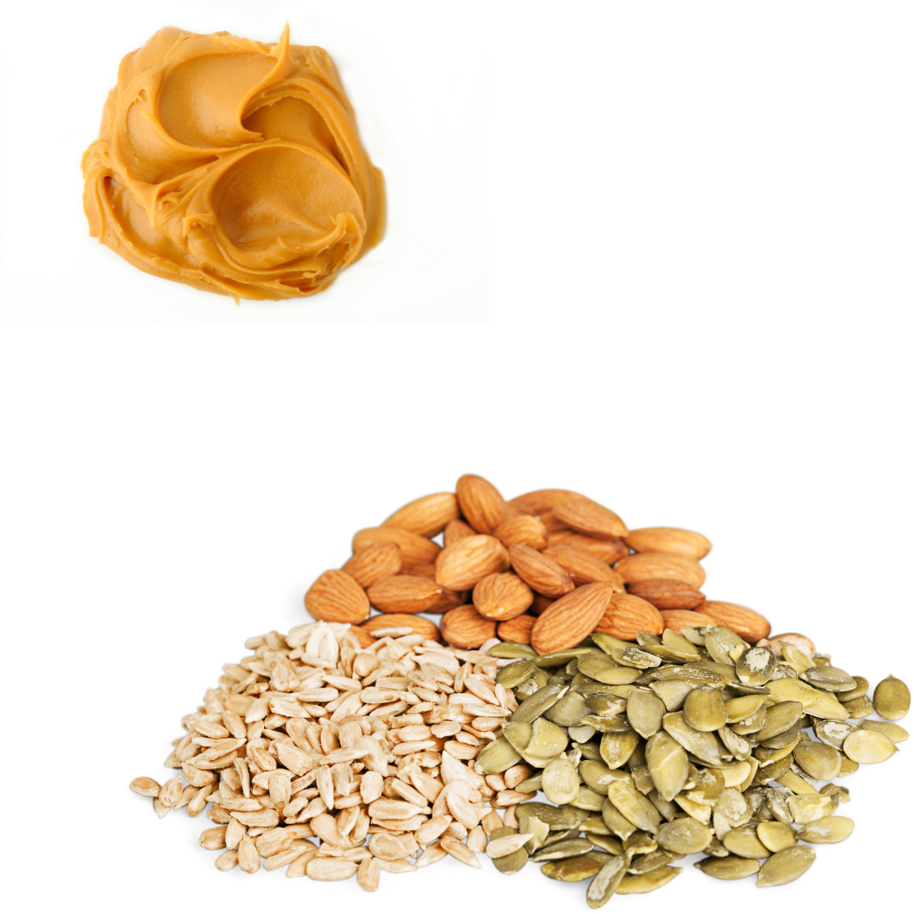
Crediting Specific to M/MA: Updates
Nuts, seeds, and their butters count as full M/MA
Beans, peas, and lentils may count towards M/MA or vegetable component—but not both
  If offered as M/MA, can still count towards subgroup requirement

Slide 40

Crediting Specific: Combination Foods
Identify offered combination foods
Includes examples such as pizza, soup, or casseroles

Slide 41
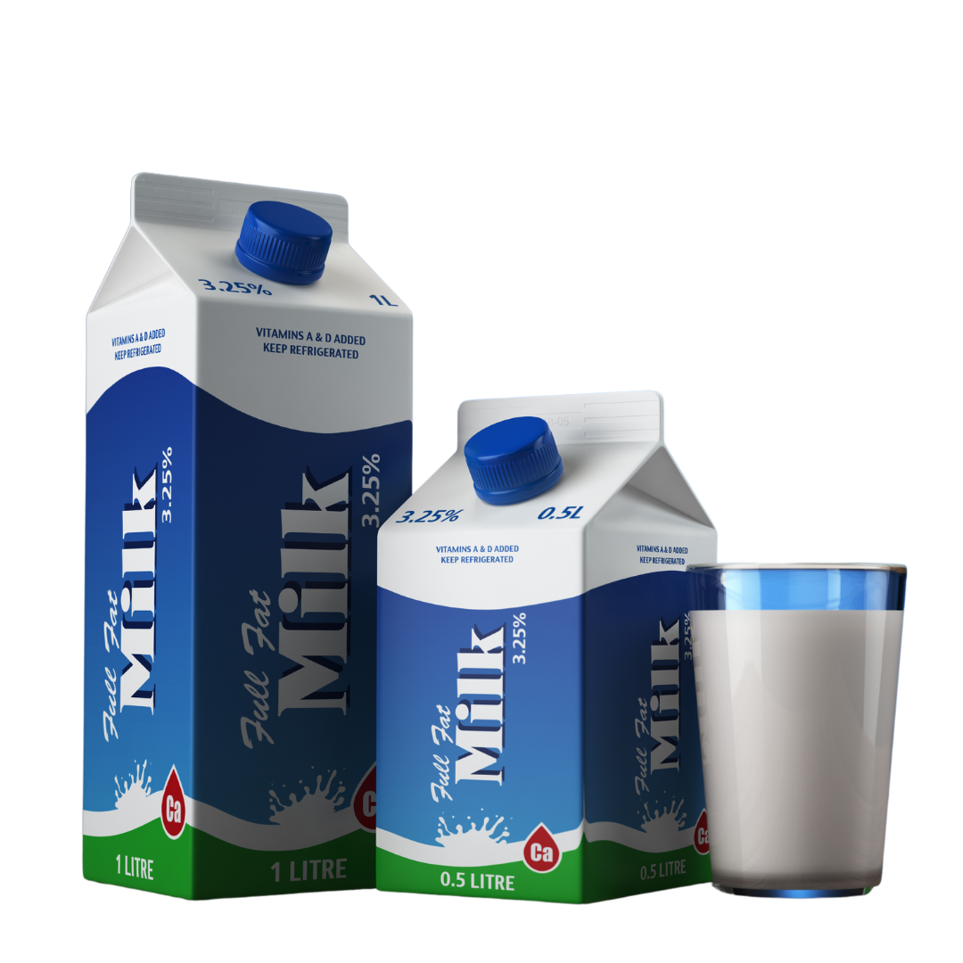
Fluid Milk Component for the NSLP

Slide 42
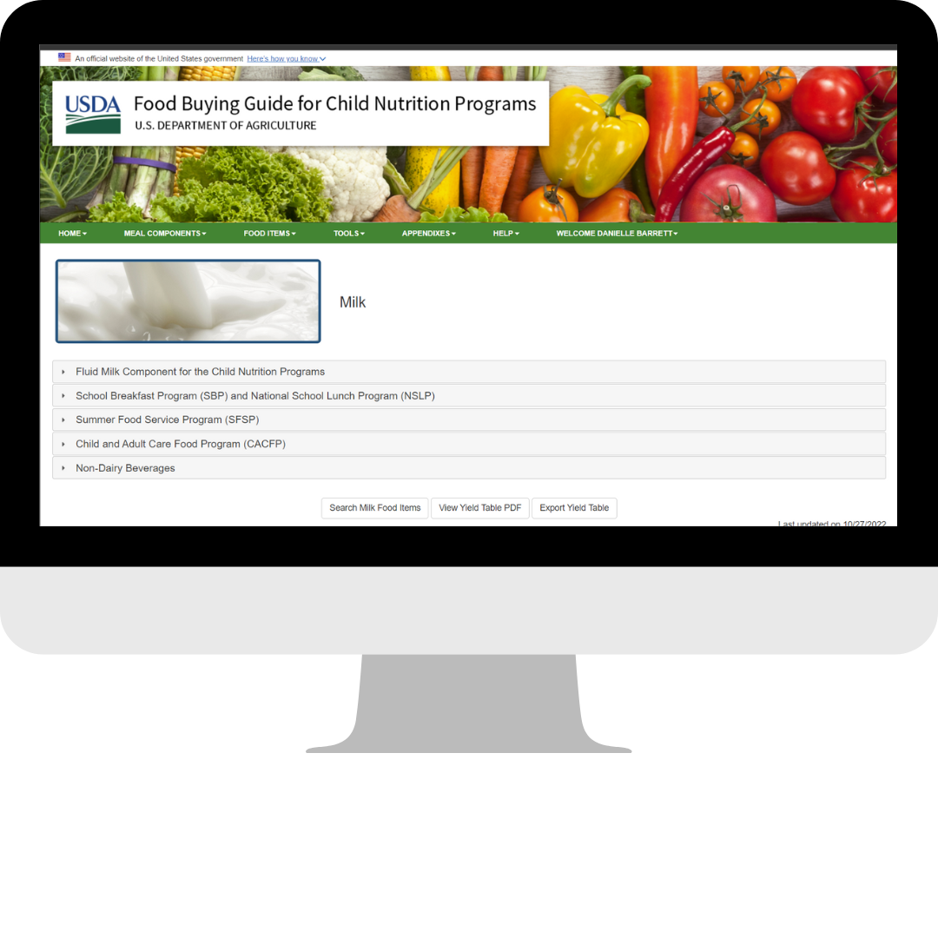
Creditable Types of Fluid Milk
Pasteurized
Meet State and local standards
Contain vitamins A and D at levels specified by FDA
Whole, reduced-fat, low-fat, or fat-free options
2 options must be offered, one must be unflavored

Slide 43
Nondairy Milk Substitutes
Nutrient | Requirement per Cup (8 fl oz)
Protein | 8 gm
Calcium | 276 mg
Vitamin A | 150 mcg
Vitamin D | 2.5 mcg
Magnesium | 24 mg
Phosphorus | 222 mg
Potassium | 349 mg
Riboflavin | 0.44 mg
Vitamin B12 | 1.1 mcg
* Q&As – Milk Substitution for Children with Medical or Special Dietary Needs (Non-Disability) Policy Memo SP 07-2010, CACFP 04-2010, SFSP 05-2010, page 4

Slide 44
SFA Offers Nondairy Beverages To All Students
State agency notification not required
Individual written request from student not required
Beverage must meet USDA fluid milk substitute nutrition standards

Slide 45
Fluid Milk Component Requirements—NSLP

Slide 46
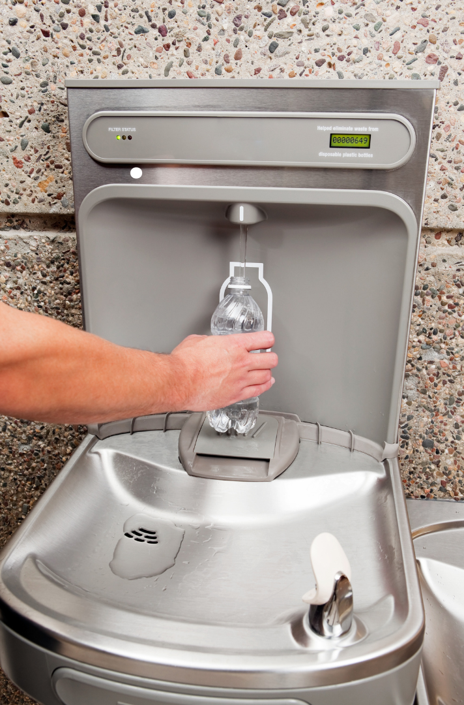
Non-Reimbursable Item: Offering Water
Water is not part of reimbursable meal
Must be available free
Separate from milk offerings
No promotion over milk

Slide 47

Offer Versus Serve (OVS) Concept
Applies to menu planning
Allows students to choose food items
Ensures meals are reimbursable
Training for cashiers essential

Slide 48
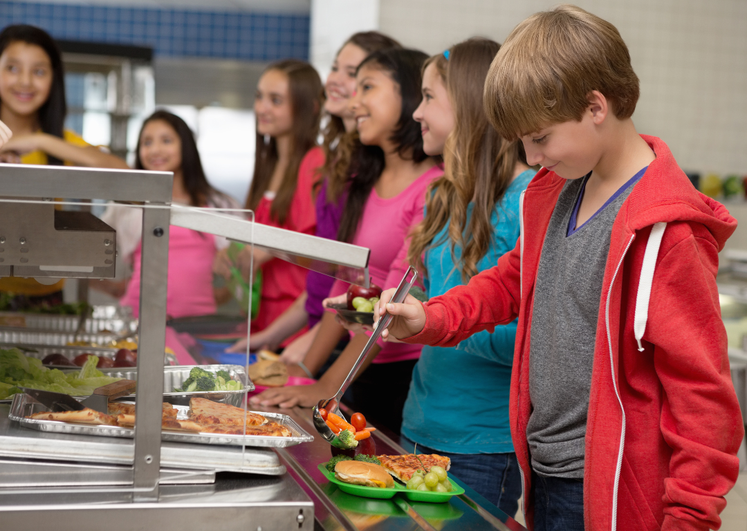
OVS Benefits
Reduces food waste
Empowers student choice
Reduces overall food costs

Slide 49

Planned, Offered, and Selected
Planned: Intended menu
Offered: Actual served
Selected: Student choices

Slide 50
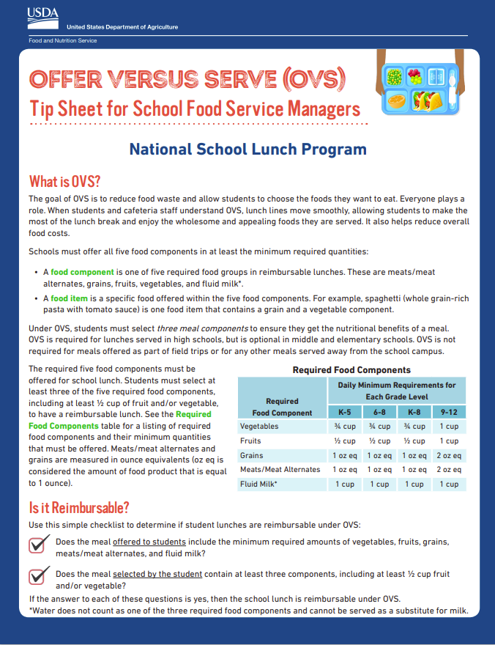
OVS at Lunch
All 5 meal components must be offered
Must select minimum three (3) components
½ cup fruit/vegetable required

Slide 51
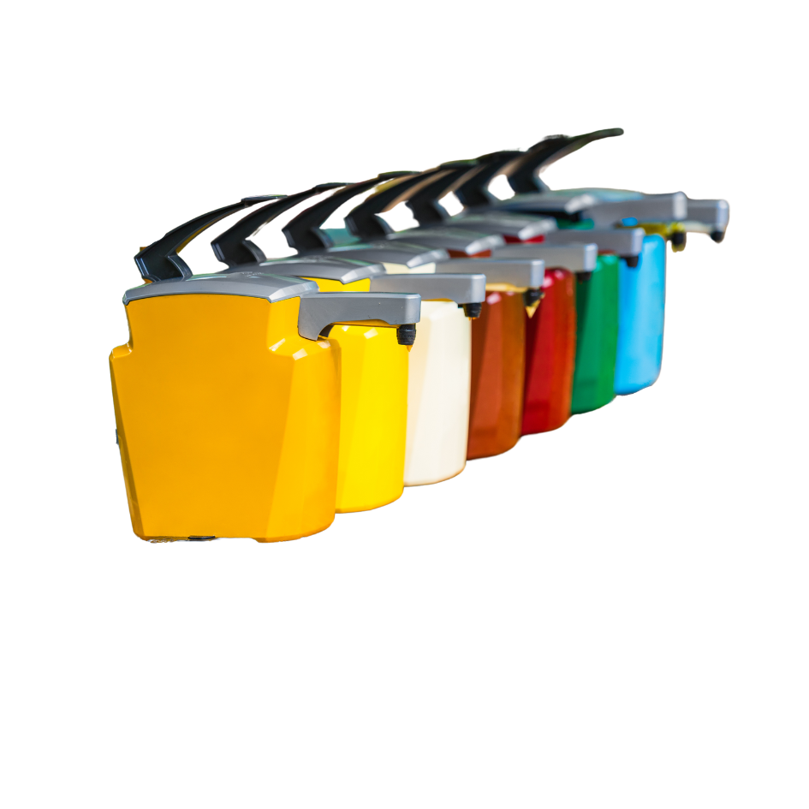
“Extra” Foods, Extra Calories
Offered, but not credited
Chosen freely by students
Included in nutrient analysis
Counts in dietary specs

Slide 52
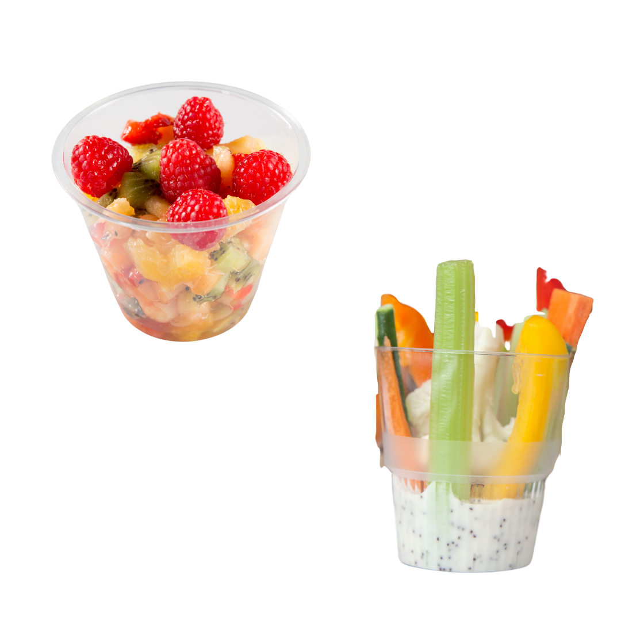
Fruit and Vegetable Components for Lunch
Minimum ½ cup required
Choose fruit or vegetable or mixed item serving
Non-compliance affects reimbursement

Slide 53
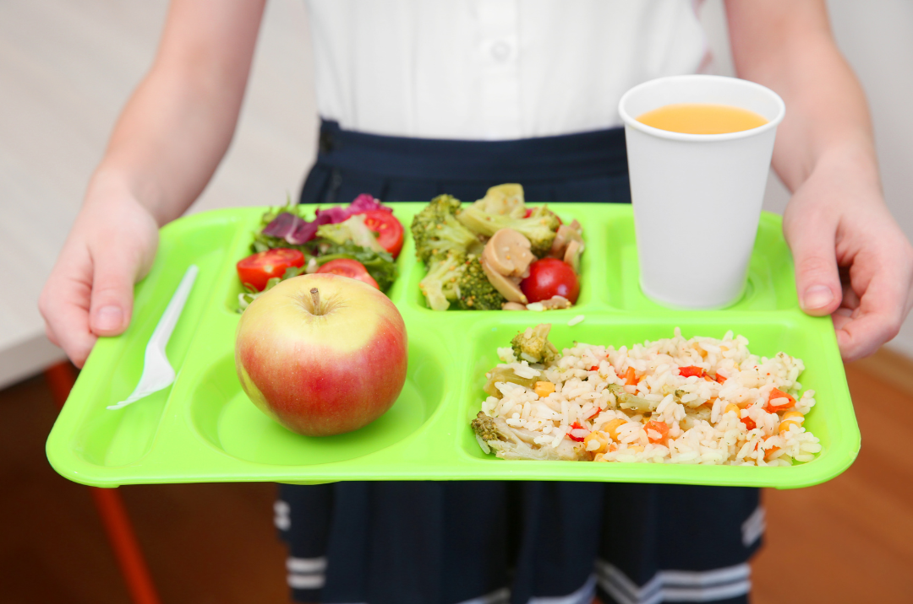
Selecting Additional Fruits and Vegetables
Credited once per meal
Daily minimums flexible
Excess allowed within specs

Slide 54
Recognize an OVS Reimbursable Meal at Lunch

Slide 55
Recognize an OVS Reimbursable Meal at Lunch— Answers

Slide 56
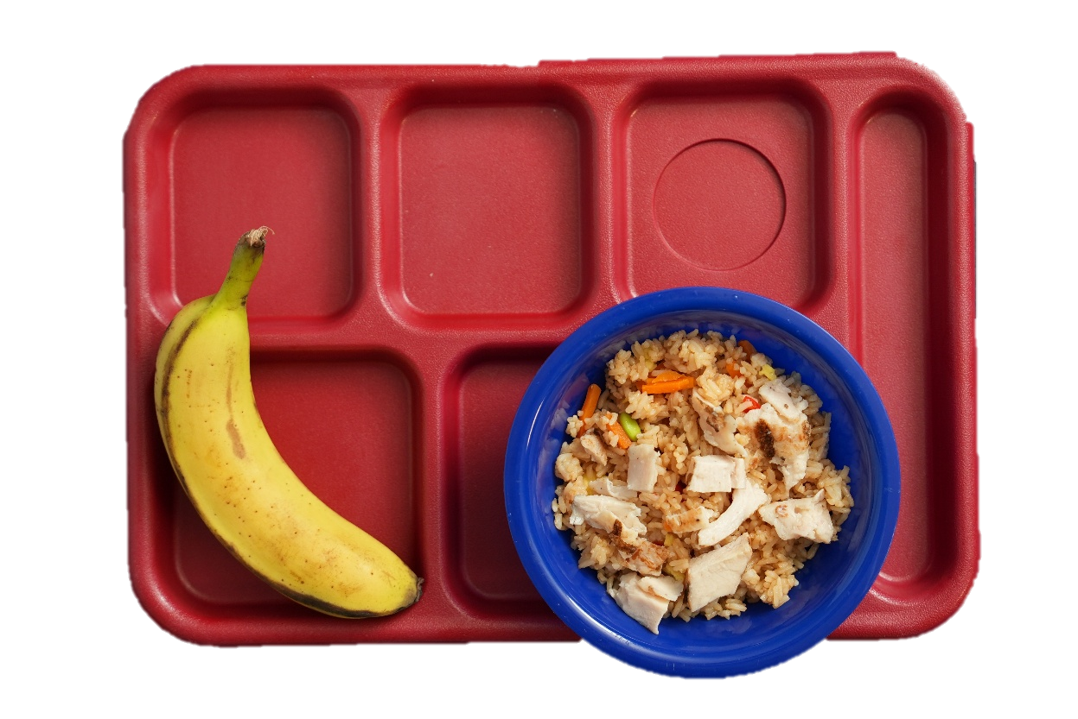
NSLP Meal—Photo 1
Chicken Fried Rice
2 oz eq grains
1 oz eq meats/meat alternates
1/8 cup of vegetables

Slide 57
NSLP Meal—Photo 1: NO MEAL!
While the student selected four meal components, they only selected a full serving of two meal components: fruits (banana) and grains (fried rice). The fried rice only provides only 1 oz eq M/MA, which falls short of the required daily minimum serving of the 2 oz eq for students in grades 9–12. The fried rice also only provides 1/8 cup of vegetables, which is less than the required 1/2 cup reduced portion of vegetables for students in grades 9–12. The student could select the chicken, a vegetable, or a milk for a reimbursable meal.

Slide 58
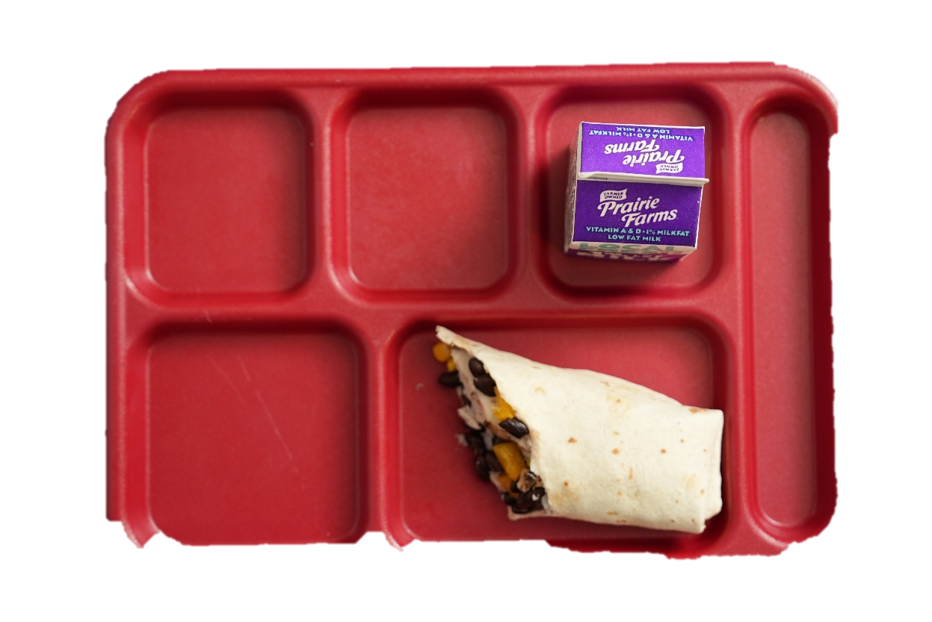
NSLP Meal—Photo 2
Fiesta Wrap
1 oz eq grains
1 oz eq meats/meat alternates
Milk
1 cup of milk

Slide 59
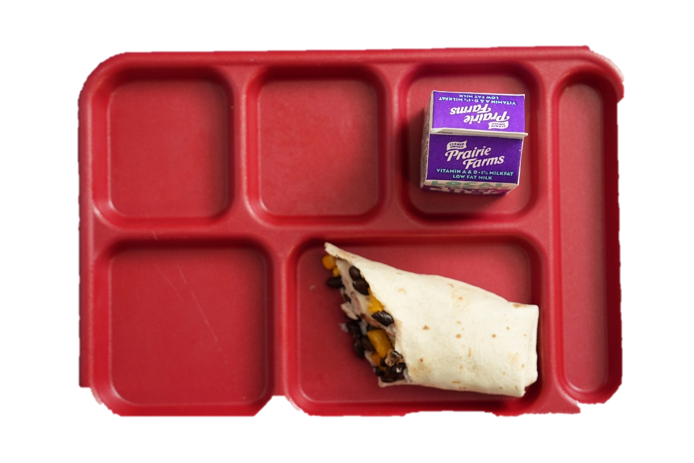
NSLP Meal—Photo 2: NO MEAL!
The menu planner chose the count the beans in the fiesta wrap as a meat alternate. So, while the student selected three meal components (milk, meats/meat alternates, and grains), they failed to select an F/V; and as we know, ½ cup is required for a reimbursable meal. Under the final rule, beans, peas, and lentils offered as a meat alternate may now also count towards the weekly vegetable subgroup requirement. However, OVS applies to daily selections and the beans in this wrap count towards the meats/meat alternates meal component and NOT the vegetable meal component. For this scenario, the corn and carrot sticks are the only menu items that count towards the vegetables meal component. In this example, the student could select a fruit OR vegetable for a reimbursable lunch.

Slide 60
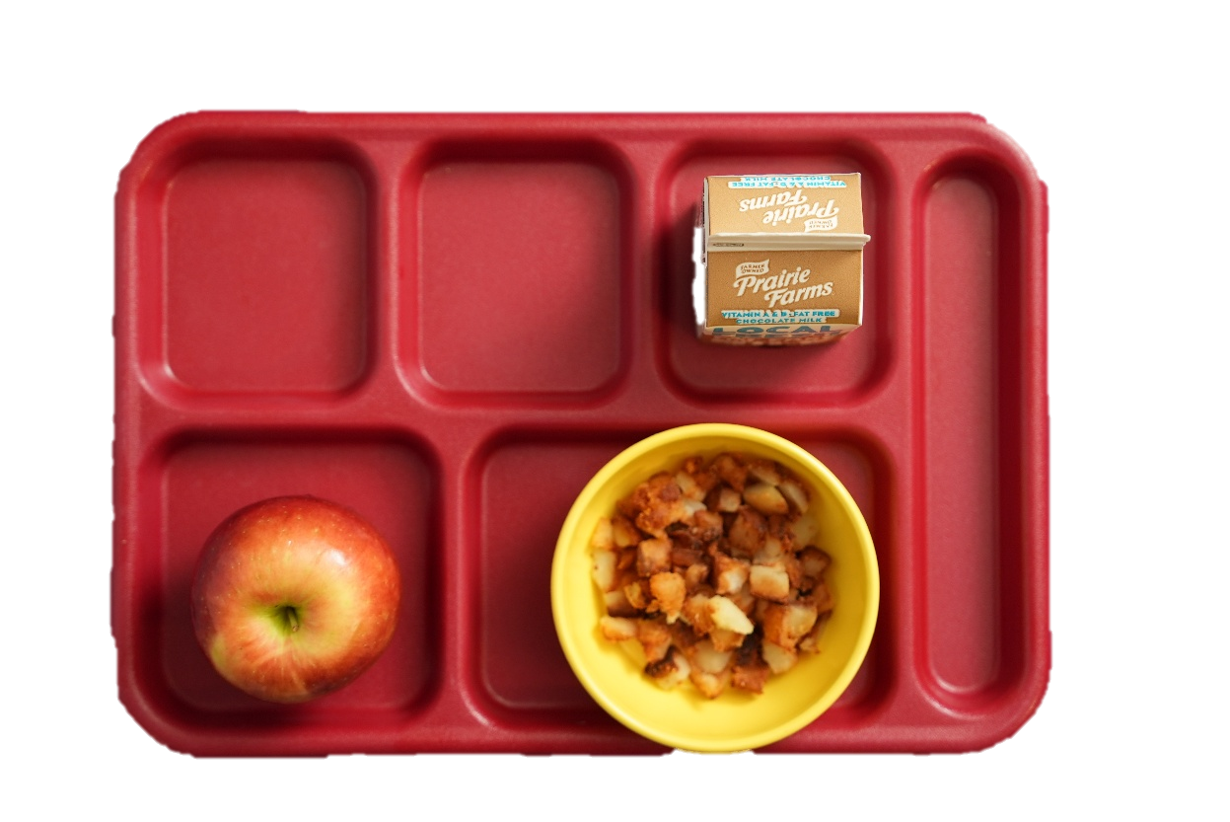
NSLP Meal—Photo 3
Apple
½ cup of fruits
Potatoes
½ cup of vegetables
Milk
1 cup of milk

Slide 61

NSLP Meal—Photo 3: NO MEAL!
While the student selected three meal components, they did not select a full serving of all three meal components, which is required for a reimbursable lunch. If a student wants to select both the fruits and vegetables components, they may select a ½ cup portion of one component but must select the full portion of the second component. For students in grades 9–12, a full serving both the fruits and vegetables meal components are 1 cup each. In this scenario, if the student wants to take a smaller portion of the fruits component, they must select 1 cup of vegetables to count as a full serving of the vegetables meal component. The student should be instructed to select a ½ cup of vegetables in addition to the ½ cup of potatoes for a reimbursable meal. If the student wants to select a smaller serving of vegetables, they must select another ½ cup of fruits in addition to the ½ cup of apples for a full serving of the fruits component.

Slide 62
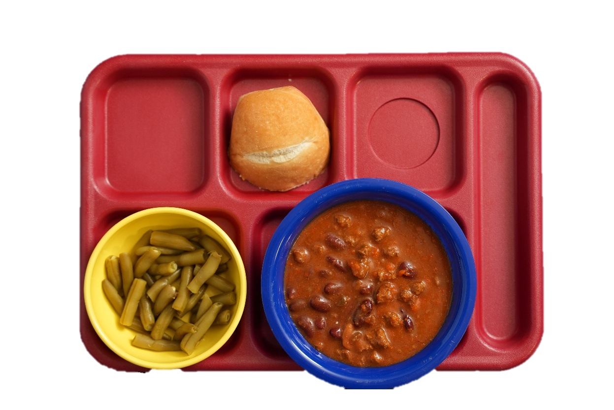
NSLP Meal—Photo 4
Bean and Meat Chili
2 oz eq meats/meat alternates
3/8 cup of vegetables
Roll
1 oz eq grains
Green Beans
½ cup of vegetables

Slide 63
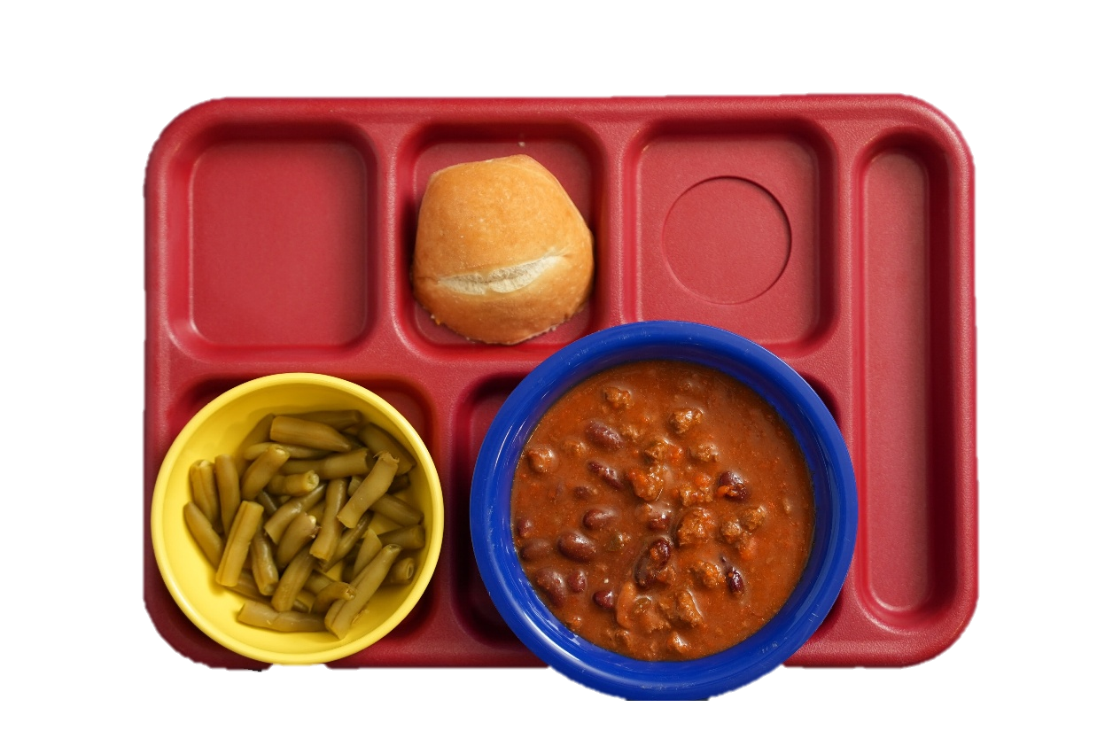
NSLP Meal—Photo 4: NO MEAL!
While the student selected a ½ cup of vegetables, they only selected two full meal components. The minimum daily required serving of the grains meal component for students in grades 9-12 is 2 oz eq, and one piece of cornbread only provides 1 oz eq. The student would need to select a second piece of cornbread for a full serving of the grains component for a reimbursable meal. The student could also select a milk, both fruit offerings, or one fruit offering and the potatoes for a reimbursable meal.

Slide 64
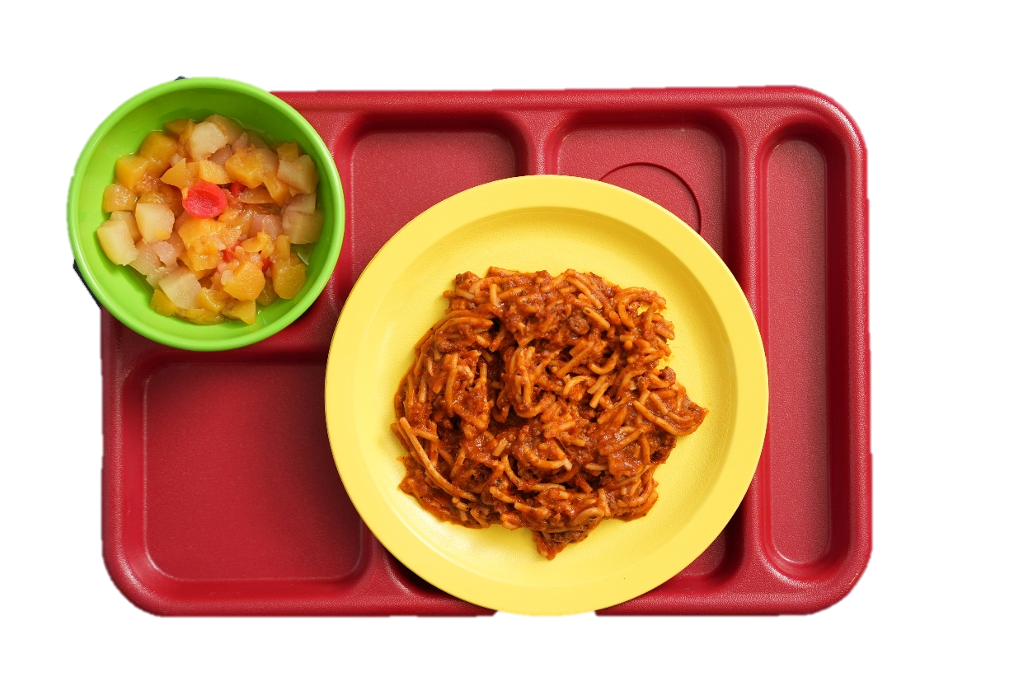
NSLP Meal—Photo 5
Spaghetti with Meat Sauce
2 oz eq meats/meat alternates
2 oz eq of grains
¼ cup of vegetables
Mixed Fruits
½ cup of fruits

Slide 65

NSLP Meal—Photo 5: NO MEAL!
While the student selected four meal components, they did not select a full serving of fruits or vegetables components, which is required for a reimbursable lunch. To make it reimbursable, you would need to offer additional vegetables to reach the full required amount. However, if other vegetable items are offered to reach the total 1 cup requirement, the meal could then be considered reimbursable if students select at least three components (one being at least ½ cup of fruits or vegetables).

Slide 66

OVS Lunch Wrap Up

Slide 67
Lesson 2: Reimbursable School Meals—Breakfast

Slide 68
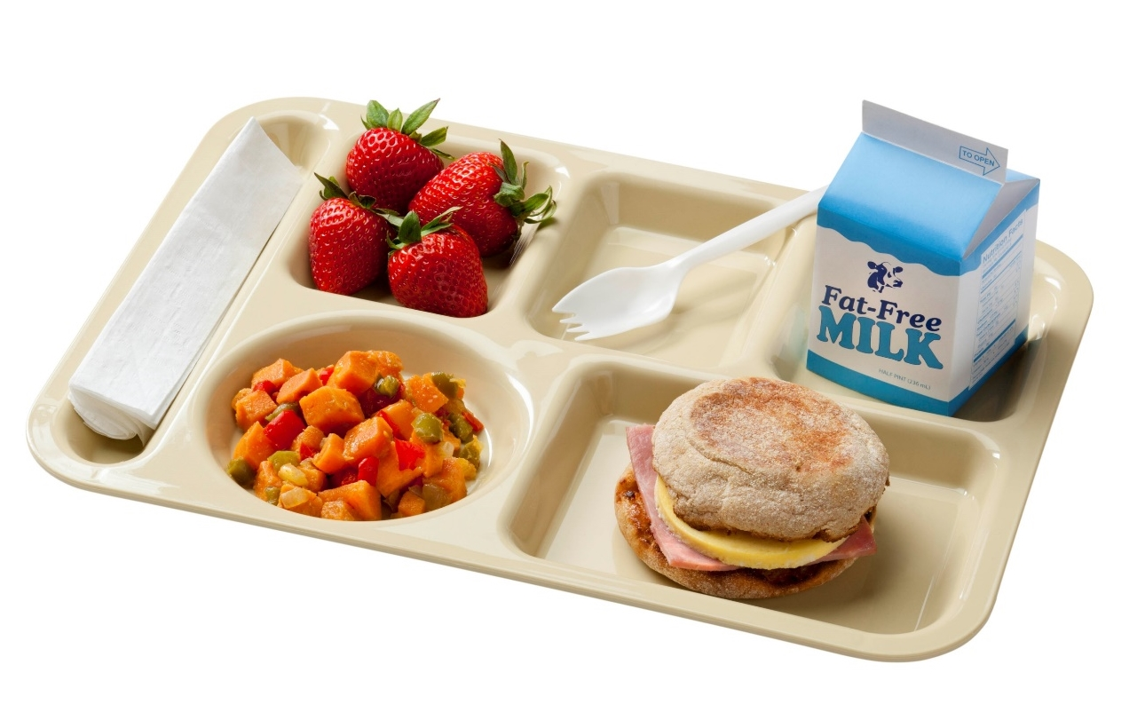
Reimbursable School Meals—Breakfast
SBP meal components
  Recall, categorize, and recognize
OVS application explained

Slide 69
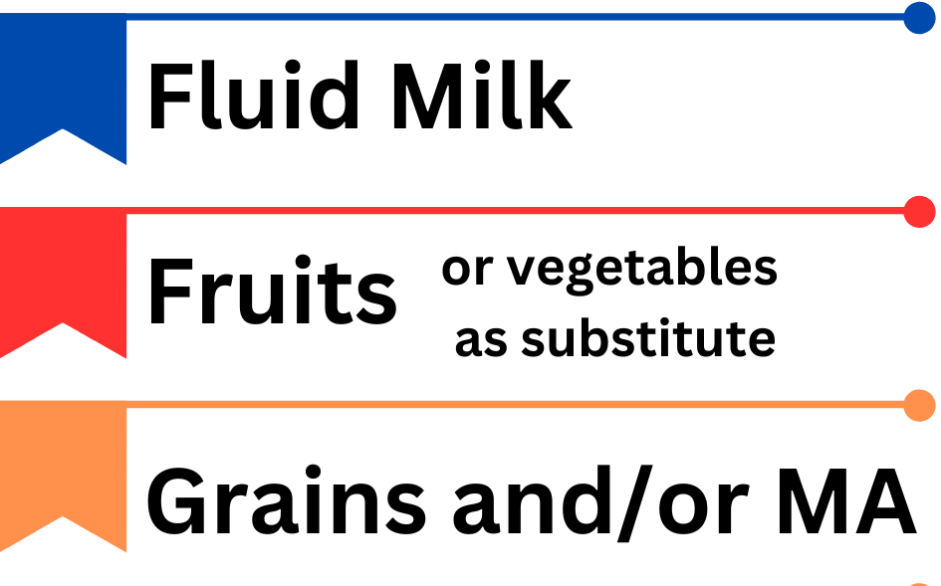
SBP Meal Components Overview
Three (3) required meal components
Daily and weekly minimums

Slide 70
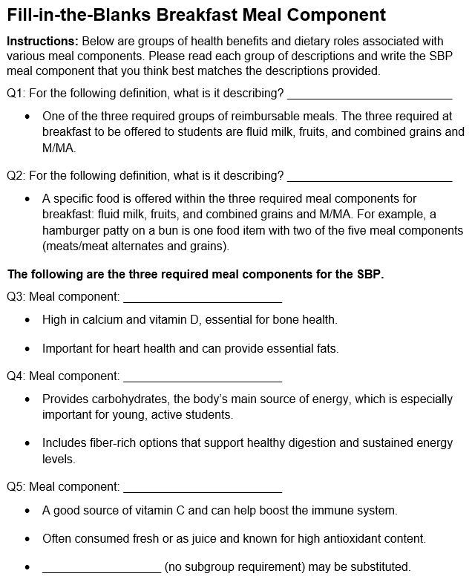
Recall SBP Meal Components

Slide 71
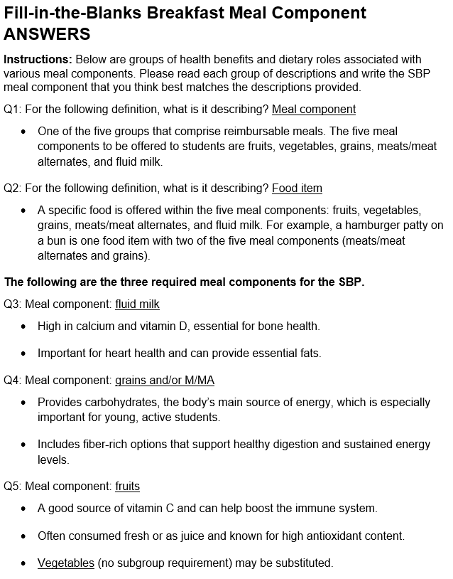
Fill-in-the-Blanks Breakfast Meal Component ANSWERS

Slide 72
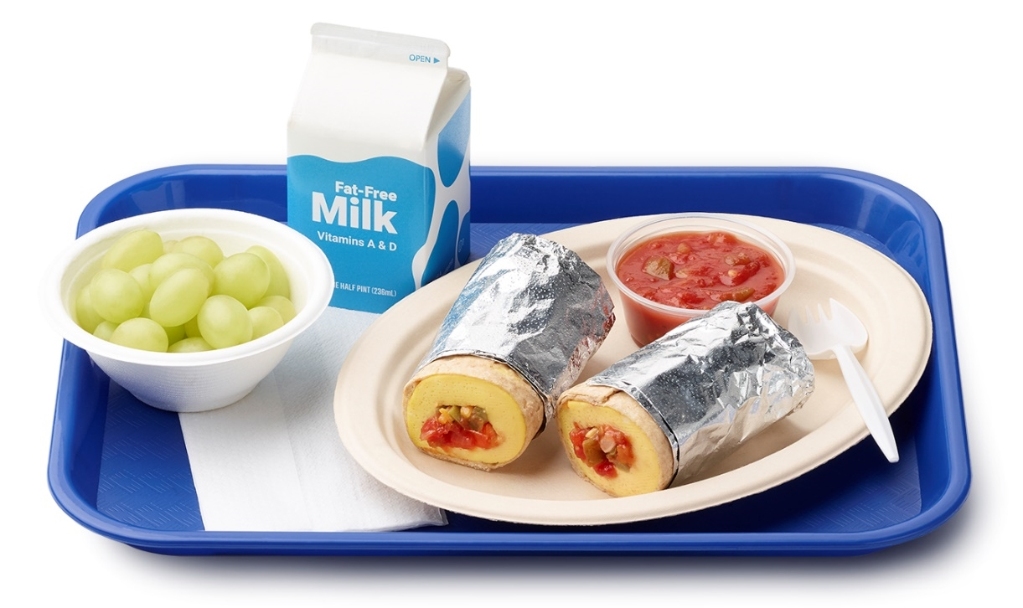
Meal Component Requirements—SBP
Focus on SBP requirements
Discuss required amounts
Explore optional substitutions

Slide 73
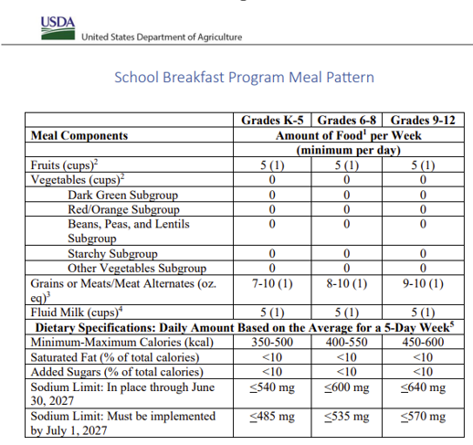
Fluid Milk Component Requirements—SBP

Slide 74
Fruits Component Requirements—SBP

Slide 75
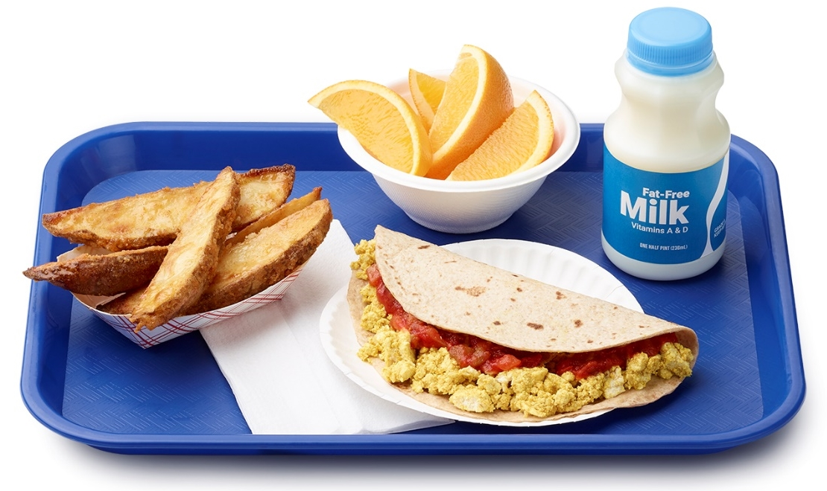
Fruits Component: Vegetable Substitutions
Menu planning flexibility; not required
May substitute vegetables for fruits at breakfast
  1x/week: any vegetable subgroup
  2x or more/week: at least two different vegetable subgroups
Allows for diverse menu offerings

Slide 76
Combined Grains and M/MA Component Requirements—SBP

Slide 77

Meal Components for OVS Breakfast
Fruits
  Vegetables as a substitute
Combined Grains and M/MA
Fluid milk

Slide 78
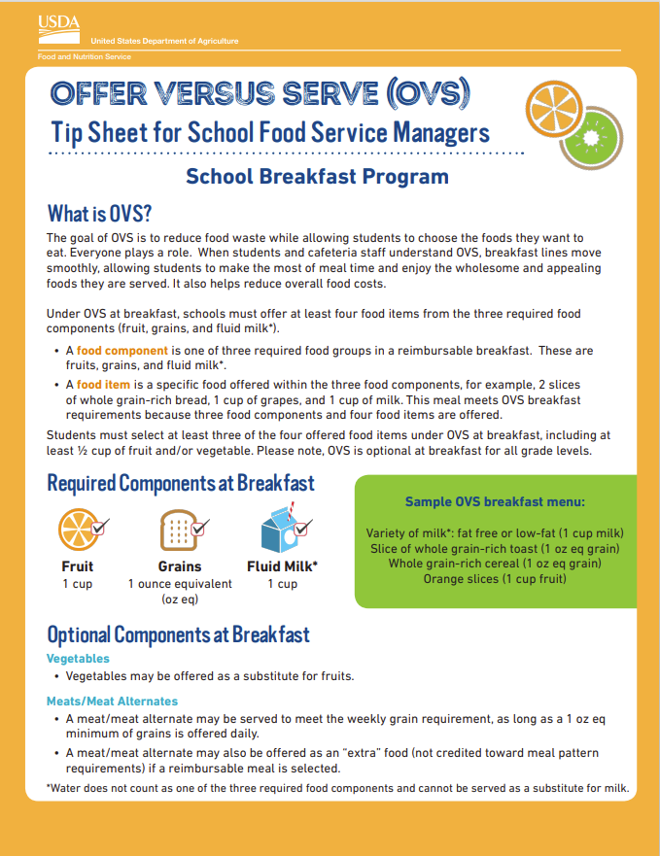
OVS at Breakfast
Offer at least four (4) food items
Choose at least three (3) food items
Required ½ cup fruits and/or vegetables
Optional for all grades

Slide 79
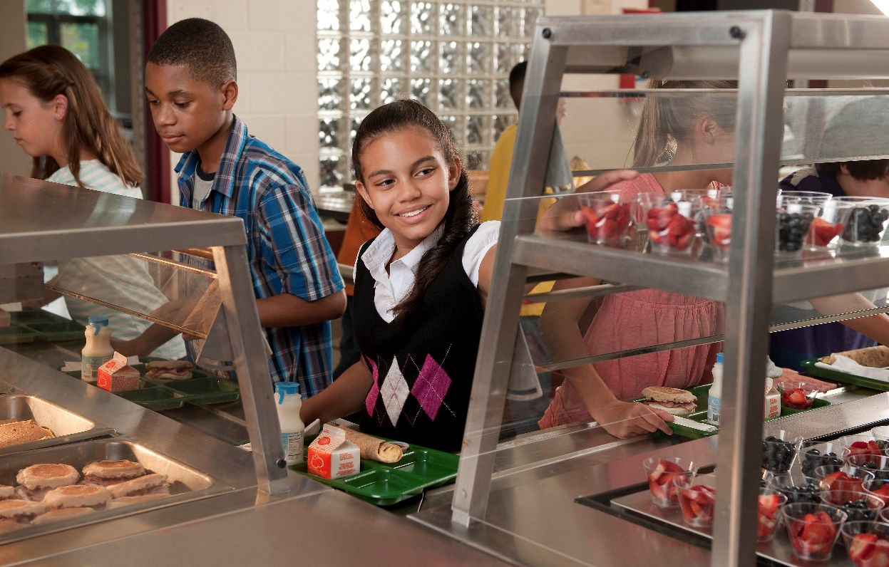
OVS Breakfast Choices
Student selects 3+ items
½ cup fruits and/or vegetables mandatory
Menu planner defines offerings
Cashier ensures compliance

Slide 80
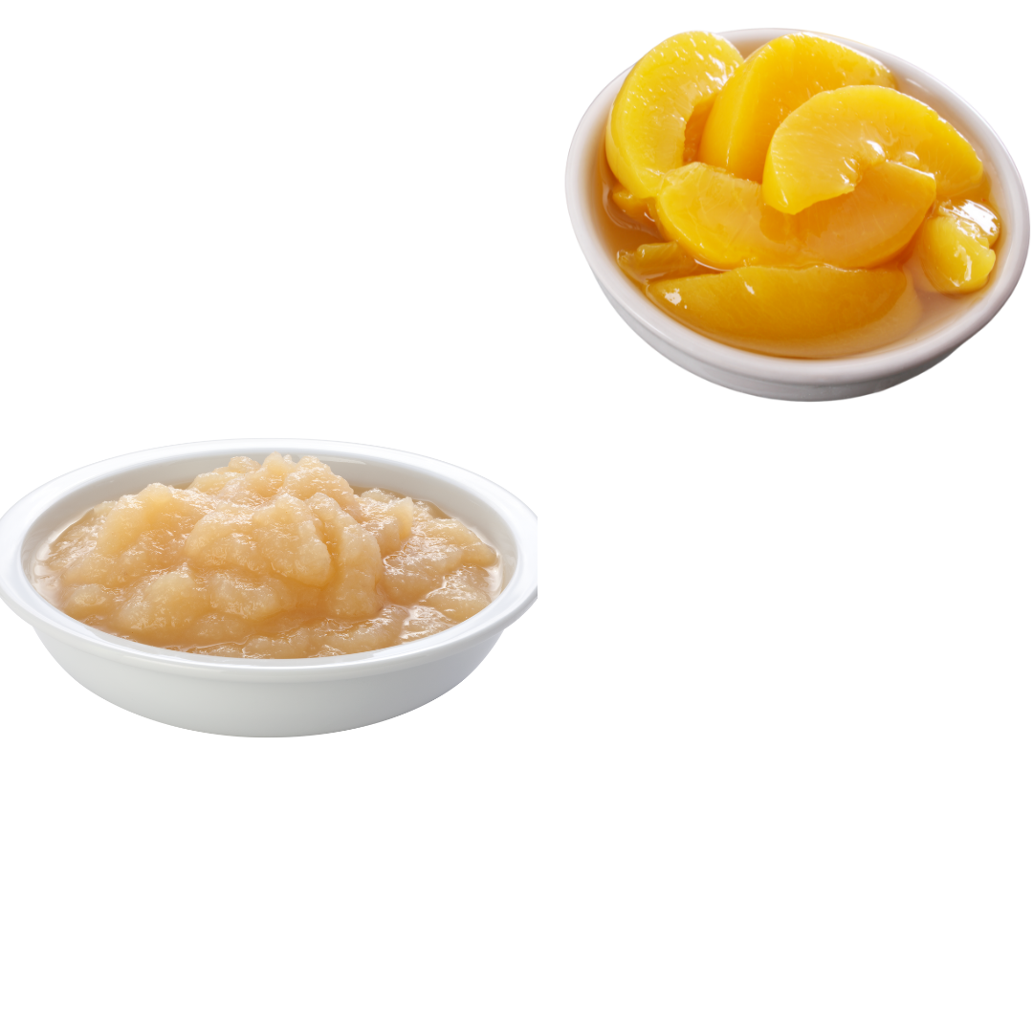
Food Items
Defines specific food choices
Includes multiple component choices
Minimum quantities required
Example: variety in fruits

Slide 81
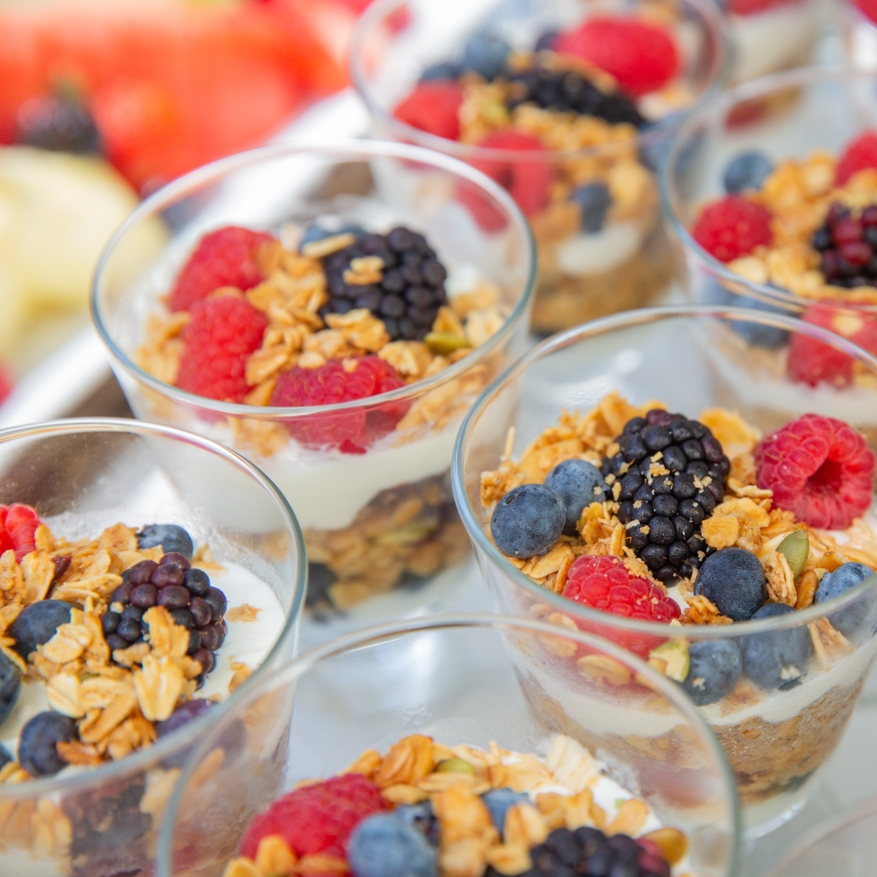
Combination Foods
Combination items offered
Items cannot be separated
Yogurt parfait and breakfast burrito

Slide 82

Smoothies
May be offered at breakfast
Ingredients may include milk, fruits, vegetables, or yogurt that credit toward meal components
May meet the OVS 1/2 cup fruit requirement
May be considered more than one food item if serving contains minimum amounts

Slide 83
Recognize an OVS Reimbursable Meal at Breakfast

Slide 84
Recognize an OVS Reimbursable Meal at Breakfast—Answers

Slide 85

SBP Meal—Photo 1
Breakfast Potatoes (1 food item each ½ cup serving
2–½ cup of combined fruits/vegetables
Banana (1 food item)
½ cup of fruits

Slide 86

SBP Meal—Photo 1: MEAL!!

Slide 87

SBP Meal—Photo 2
Breakfast Vegetable Quesadilla (2 food items)
½ cup of combined fruits/vegetables
2.5 oz eq combined grains and meats/meat alternates

Slide 88

SBP Meal—Photo 2: NO MEAL!
The breakfast vegetable quesadilla does contain the required ½ cup of F/V, but it is only 2 food items, and 3 food items are needed for a reimbursable breakfast. While the breakfast vegetable quesadilla is a single menu item, it is being counted as two food items for OVS because it contains a full serving of two meal components: the fruits component and the combined grains and meats/meat alternates component. As a reminder, menu planners have the flexibility to determine how to count food items at breakfast when planning menus. When combination foods, such as this quesadilla, are offered at breakfast, it is important to communicate how many food items are in the combination food and what additional food items a student needs to select for a reimbursable meal. In this scenario, the student could select fruit, potatoes, or milk for a reimbursable meal.

Slide 89

SBP Meal—Photo 3
Whole Grain Bagel (2 food items)
2 oz eq combined grains and meats/meat alternates
Milk (1 food item)
1 cup of milk

Slide 90

SBP Meal—Photo 3: NO MEAL!
While the student selected 3 food items, they did not select a fruit or vegetable, and as we know by now, a ½ cup of a fruit or vegetable is needed for a reimbursable meal. When large grain items are offered at breakfast, it is important to communicate how many food items the large grain item counts as and what additional food items a student needs to select for a reimbursable meal. In this scenario, if a student selects a bagel, they need to also select an apple for a reimbursable breakfast!

Slide 91

SBP Meal—Photo 4
Hard Boiled Egg (1 food item)
1 oz eq combined grains and meats/meat alternates
Apple (1 food item)
1 cup of fruits
Milk (1 food item)
1 cup of milk

Slide 92

SBP Meal—Photo 4: MEAL!!
Hard Boiled Egg (1 food item)
1 oz eq combined grains and meats/meat alternates
Apple (1 food item)
1 cup of fruits
Milk (1 food item)
1 cup of milk

Slide 93
OVS Breakfast Wrap Up

Slide 94

Training Summary
NSLP meal components and OVS requirements
SBP meal components and OVS requirements

Slide 95

Questions?

Slide 96
Post-Assessment
Trainer to add QR code to link the post-assessment provided by the Training Team that is unique to each session

Slide 97

Thank You!

Slide 98



www.theicn.org | 1-800-321-3054
Follow ICN on Social Media!
facebook.com/ichildnutrition
@ichildnutrition
instagram.com/theicn
linkedin.com/company/theicn

