Slide 1
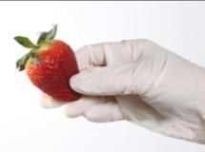
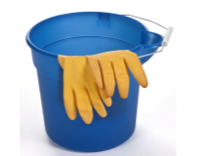
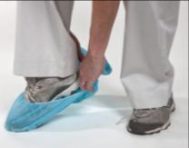
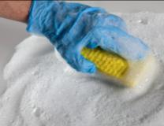

Norovirus in Schools
Everyone Plays a P.A.R.T.
^{Key Area: 2}
USDA Professional Standard: 2600

Slide 2
Goals for Today
Describe why norovirus is a concern in Child Nutrition settings
  What are the symptoms?
  How is it transmitted?
Describe norovirus control
  Prevention
  Assemble a Body Fluid Cleanup Kit
  Respond to an incident
  Total cleanup

Slide 3
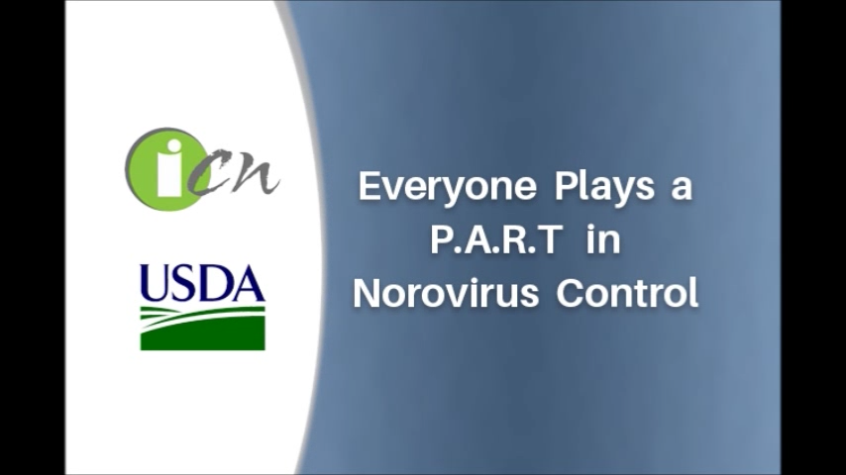
Everyone Plays a P.A.R.T. in Norovirus Control

Slide 4
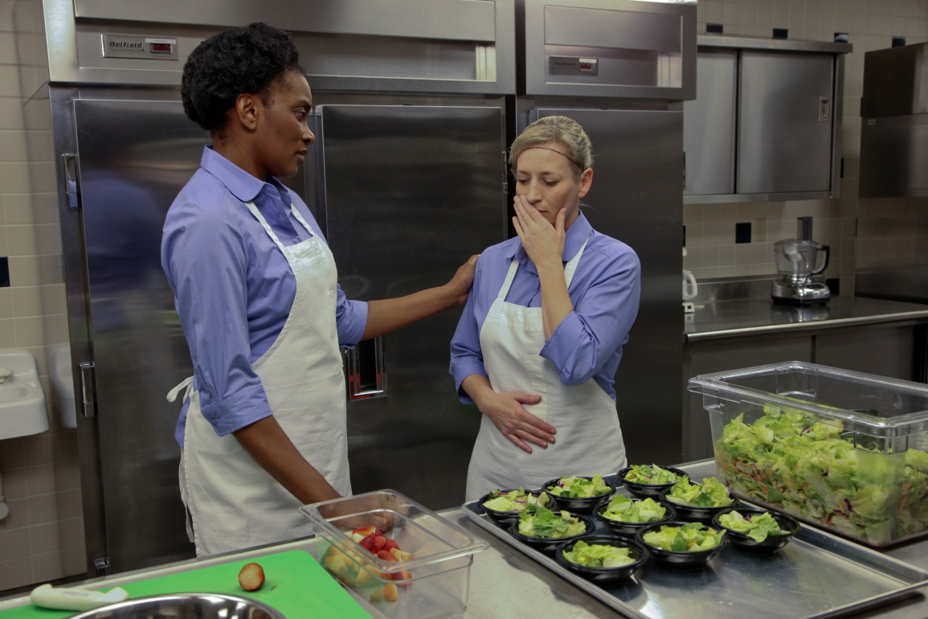
Video Viewing Guide –Norovirus
What mistakes were made?

Slide 5
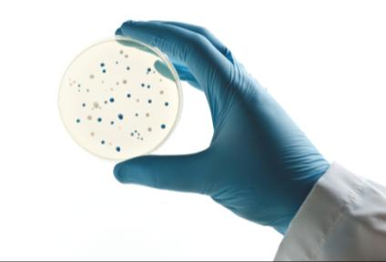
Why is Norovirus a Concern?
Leading cause of foodborne illnesses
  More than 50% of all food-related outbreaks
Survives at least a week on surfaces
Very resistant to routine cleaning and sanitizers

Slide 6
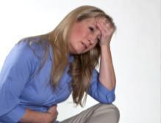
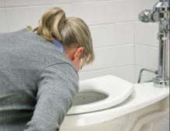
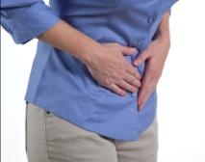
Norovirus Symptoms
Nausea
Vomiting
Diarrhea
Abdominal cramps
Onset – 12 to 48 hours after exposure
Duration - 1 to 3 days

Slide 7
Highly Contagious
About 1 Trillion viral particles per gram of feces
About 300,000 virus particles in one projectile vomiting incident
About 18 viral particles to make you sick
2013 FDA Food Code

Slide 8
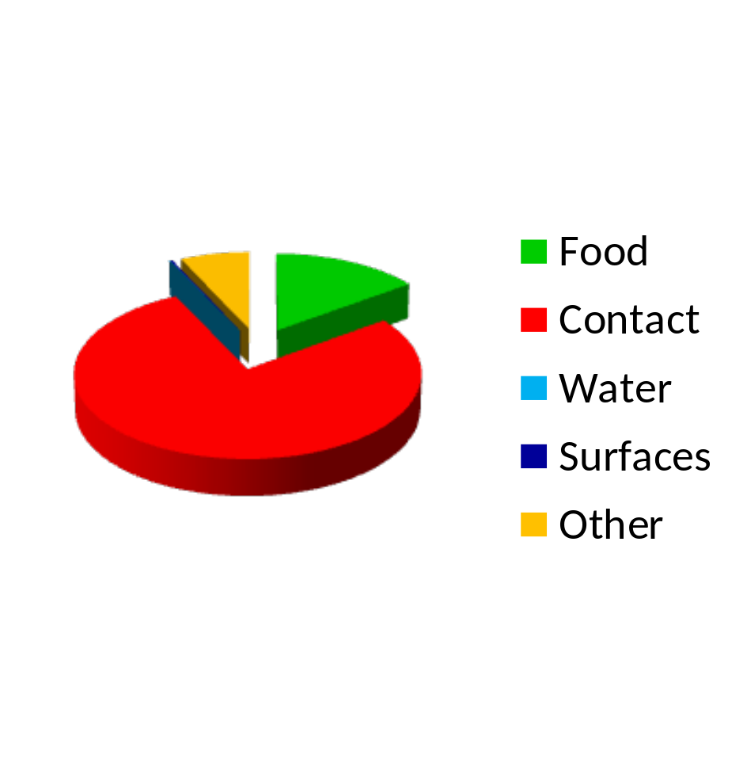
Norovirus Transmission
In stool or vomit of
infected people
Transmission through
  Person to person
  Food
  Water
  Environmental surfaces
  Air

Slide 9
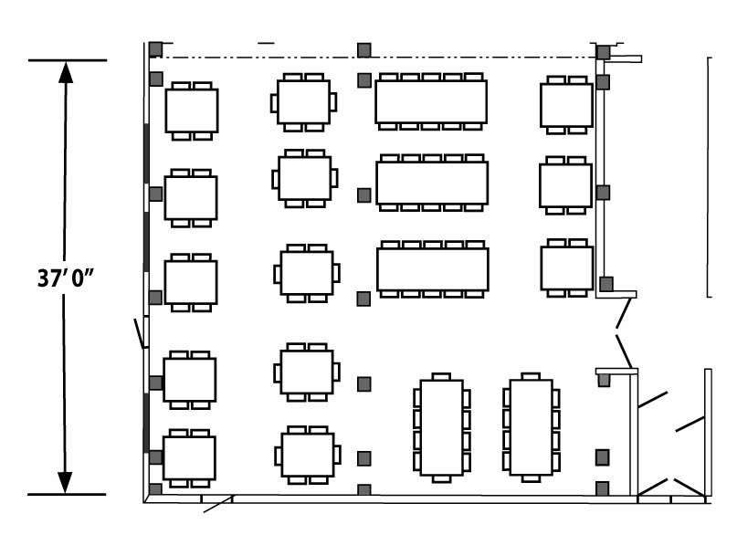

Transmission by Air: 25 feet
Notes:
*NOTE: This slide includes animation that depicts the 25 foot spread of aerosolized particles.

Slide 10
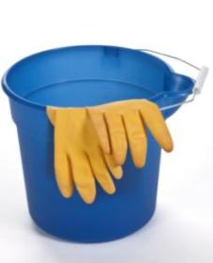
Everyone Plays a P.A.R.T.
Prevent through good personal hygiene
Assemble a Body-Fluid Cleanup Kit
Respond correctly to a vomiting incident
Total cleanup after an incident

Slide 11
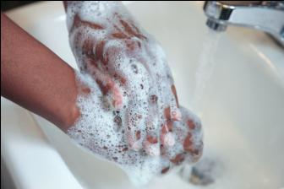
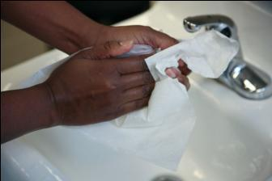
Prevent
Use frequent, appropriate handwashing.

Slide 12

Wash Your Hands

Slide 13
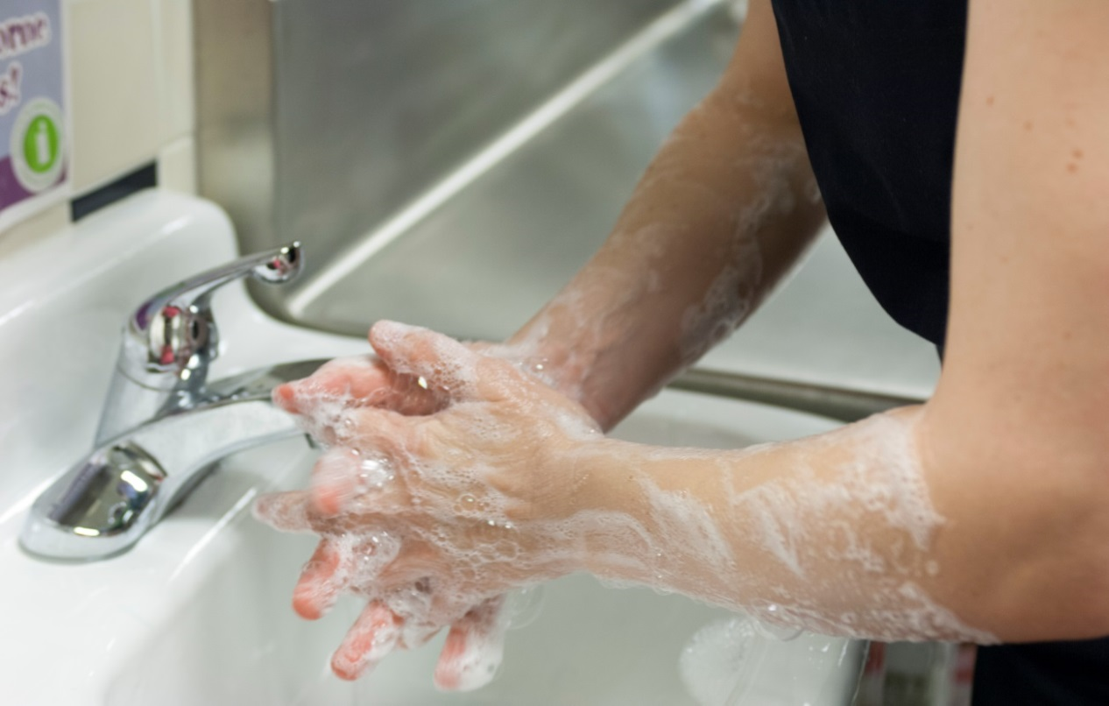
Video Viewing Guide –
Wash Your Hands
When do you wash your hands?

Slide 14
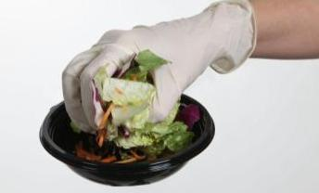
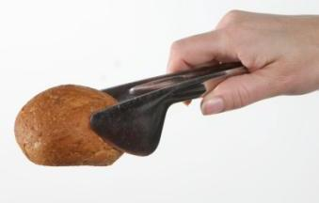
Prevent
Do not use bare hand contact with ready-to-eat foods

Slide 15
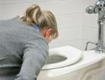

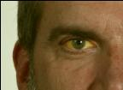
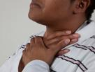
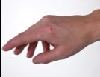
Prevent
Report symptoms:
Vomiting
Diarrhea
Jaundice (yellowing)
Sore throat with fever
Cuts & infected wounds on the hands, wrists, or exposed portions of the arms
A current or recent exposure to a foodborne illness

Slide 16

Prevent
Exclude: cannot come to work
Restrict: to limit the activities so that the foodservice employee does not work with exposed food

Slide 17
FDA “Three-Legged Stool”
FDA “three legged stool” for norovirus protection:
Effective handwashing
No bare hand contact with ready-to-eat foods
Employee health and wellness program

Slide 18
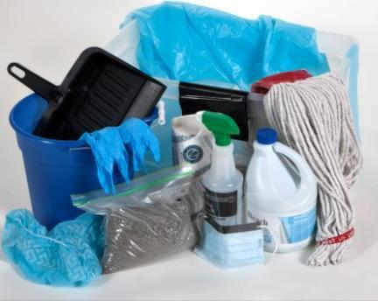
A Challenge….
Identify the components of a Body Fluid Cleanup Kit
  Which components are for Personal Protection Equipment (PPE)?
  Which components are for cleaning?

Slide 19
Items | PPE | Cleaning
Bucket and/or spray bottle
Disposable gown
Effective disinfectant
Facemask with face/eye shield
Gloves
Paper towels
Plastic garbage bag
Sand, cat litter, or commercial absorbent powder
Scoop, small shovel, or dustpan
Shoe covers
✓
✓
✓
✓
✓
✓
✓
✓
✓
✓
Notes:
*Note: This slide is animated. The answers (check marks) enter each time you click next (slide advance).

Slide 20
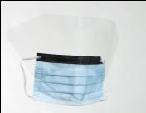
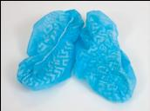
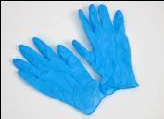
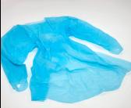
Assemble – Personal Protective Equipment
Disposable facemask with face shield or goggles
Disposable gown
Disposable shoe covers
Disposable, nonabsorbent, medical grade gloves

Slide 21
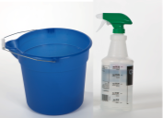
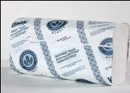
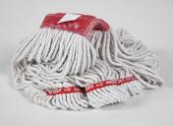
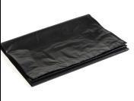
Assemble – Cleaning Supplies
Bucket and spray bottle
Paper towels
Designated, disposable mop head
Plastic garbage bag & twist-ties
Disposable scoop, small shovel, or dustpan
Sand, cat litter, or absorbent powder

Slide 22
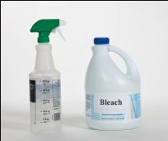
Assemble – Disinfectants
EPA-registered effective against norovirus on EPA website
Chlorine bleach (8.25% concentration)
  5,000 parts per million =
  1 cup bleach per 1 gallon of water

Slide 23

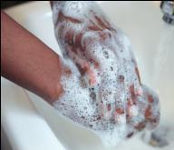
Respond – Stop All Operations
Remove individuals within 25 feet.
Wash hands.

Slide 24
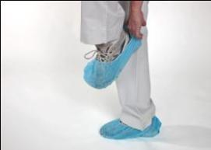
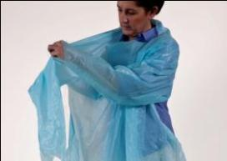
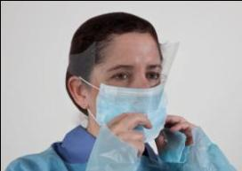
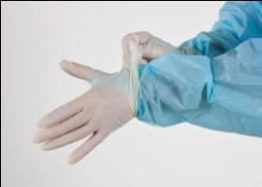
Respond – Put on Personal Protective Equipment

Slide 25
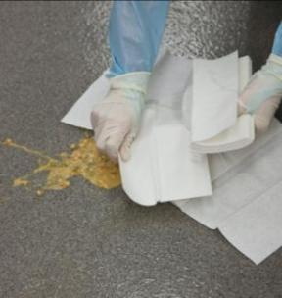
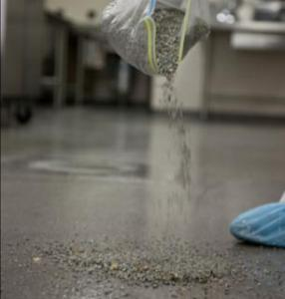
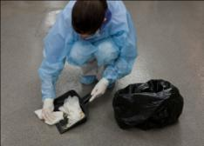
Respond – Cover and Remove Waste

Slide 26
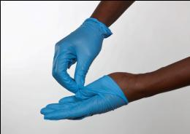
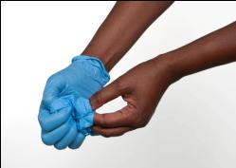
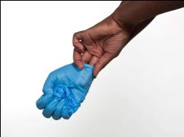
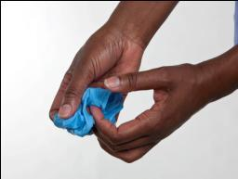
Wash Hands and
Change Gloves

Slide 27
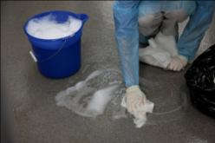
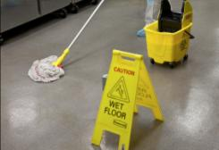
Respond – Clean Area

Slide 28
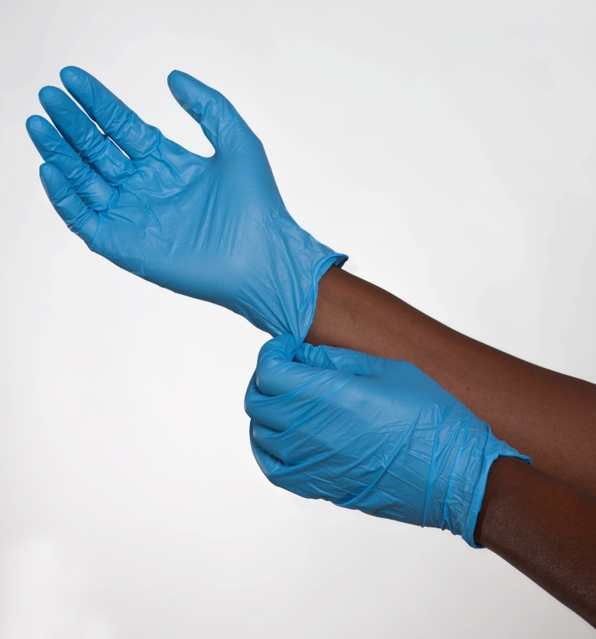
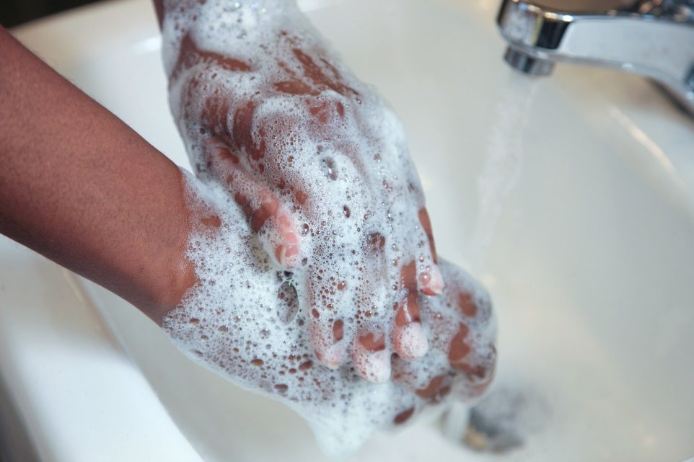
Wash Hands and Change Gloves

Slide 29
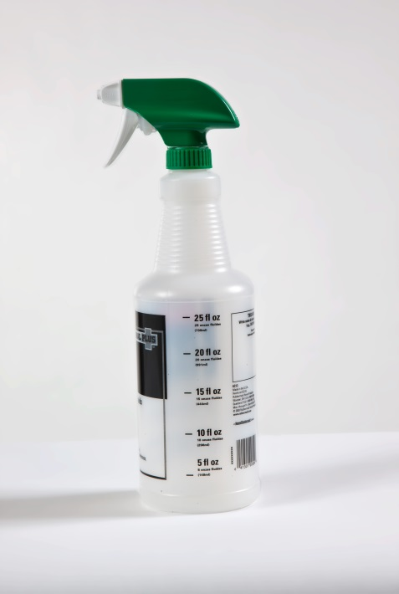
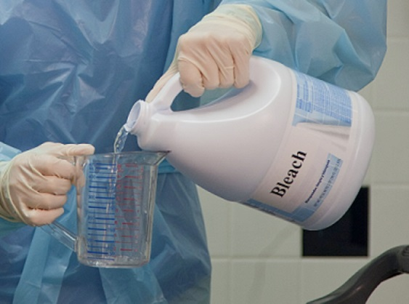
Respond – Mix Disinfectant
Mix a fresh disinfectant at recommended concentration
Transfer solution to a labelled spray bottle

Slide 30

Respond – Disinfect
Disinfect immediate area & adjacent 25 foot area-
  Include food contact surfaces
  High touch surfaces

Slide 31

Respond – Disinfect High Touch Surfaces

Slide 32

Respond – Rinse
Rinse surfaces with clean water, and paper towels and/or a disposable mop head.
Allow surfaces to air dry.

Slide 33


Wash Hands and Change Gloves

Slide 34

Respond - Disinfect Cloth Surfaces
Chemical disinfectant or steam clean for a minimum of 5 minutes at 170 °F.

Slide 35

Respond – Dispose of Exposed Foods
Dispose of exposed foods within 25 feet.

Slide 36


Wash Hands and Change Gloves

Slide 37


Respond - Disinfect
Non-disposable Tools

Slide 38




Respond - Remove PPE

Slide 39

Respond - Disposal
Dispose of garbage bag(s) in designated area.

Slide 40

Respond – Wash Up
Wash hands, arms and face with soap and water.
Put on clean clothing, if necessary.

Slide 41


Total Cleanup
Wash
Rinse
Sanitize (routine)
Air dry

Slide 42

Everyone Plays a P.A.R.T.
Prevent through good personal hygiene
Assemble a Body Fluid Cleanup Kit
Respond correctly to a vomiting incident
Total cleanup after an incident

Slide 43
Knowledge Challenge
Self-check
Post-Assessment

Slide 44

Resources from ICN
www.theicn.org/norovirus
4 –Minute Video
Online course
Tool kit
  Standard Operating Procedures
  Fact sheets
  Mini posters
Employee Health & Personal Hygiene
  http://theicn.org/employeehealth

Slide 45


Resources
The Stomach Bug Book
Available online at http://www.fns.usda.gov/fns/safety/pdf/stomach_bug_book.pdf
Hardcopies available from NEA http://neahealthyfutures.org/wpcproduct/stomach-bug-book-english/

Slide 46
Training Wrap-Up
Questions?
ICN Evaluation
ICN Roster

Slide 47

Thank You!
The University of Mississippi
School of Applied Sciences
www.theicn.org
800-321-3054

