Slide 1

Food Allergies for School Nutrition Managers and Staff

Slide 2


Food Allergy Background
About 5.6 million children have a food allergy
    Roughly 1 in 13 children
Research indicates that food allergies for children increased 18% (1997-2007)
    Some as high as 50% (1997-2011)

Slide 3
Logistics
Participant’s Workbook
Restrooms
Emergency Exits
Bike Rack
Ground Rules

Slide 4

Warm-Up Activity
List 3 food allergies that children have in your school/district.

Slide 5
Topics for Today
All About Food Allergies
Reading Labels for Allergens
Avoiding Cross-Contact
Accommodating Children with Food Allergies

Slide 6

Pre-Assessment
Test your food allergy knowledge
Use a 4-number identifier

Slide 7
Lesson 1: All About Food Allergies
Impact of an allergic reaction
Food allergies, symptoms, and treatments
Eight major food allergens
Food allergy vs food intolerance

Slide 8


Slide 9

The Power of a Story Activity
Personal reflection, how you felt
Record feelings on the worksheet
Discuss as a class

Slide 10
What is a Food Allergy?
Food Allergy
Adverse reaction to a food protein (allergen)
Body’s Immune System
Body thinks food protein is dangerous Creates antibodies against the allergen
EVEN A TRACE can result in an allergic reaction.

Slide 11
Allergic Symptoms
One + symptoms can occur from minutes to 2 hours
Can be MILD to SEVERE
Trouble swallowing
Shortness of breath
Repetitive coughing
Voice change
Nausea & vomiting
Diarrhea
Abdominal cramping
Swelling
Hives
Eczema
Itchy, red rash
Drop in blood pressure
Loss of consciousness
Death may occur

Slide 12
How a Child Might Describe Symptoms
This food is too spicy.
My tongue is hot (or burning).
It feels like something is poking my tongue.
My tongue (or mouth) is tingling.
My tongue (or mouth) itches.
My mouth feels funny.
There is a frog in my throat.
There’s something stuck in my throat.
My lips feel tight.
My throat feels thick.
It feels like there is a bump on the back of my tongue.

Slide 13

Anaphylaxis
A serious allergic reaction
Rapid in onset
May cause death

Slide 14

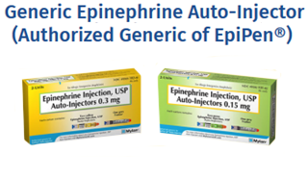
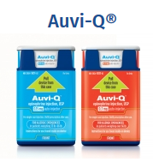
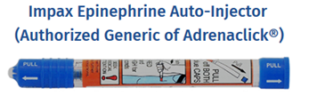
Epinephrine
Epinephrine auto-injectors treat anaphylaxis
Pictures from Food Allergy Research Education
Notes:
Trade names for this device include EpiPen®, Adrenaclick®, and Auvi-Q® (Allerject® in Canada). DEMONSTRATION

Slide 15
FARE
Resources

Slide 16
Food Allergy Management Plan
Five Priority Areas
Ensure the daily management of food allergies in individual children.
Prepare for food allergy emergencies.
Provide professional development on food allergies for staff members.
Educate children and family members about food allergies.
Create and maintain a healthy and safe educational environment.

Slide 17

Food Allergy Emergency Activity
Find Food Allergy Emergency worksheet
Answer questions, then discuss as a group

Slide 18
Emergency Reaction Questions
Child has reaction, what do you do first?
Who do you contact?
Who administers epinephrine?
Who is trained?

Slide 19

Response to Reaction
Quickly treat anaphylaxis with epinephrine
    A delay can be deadly
A serious food allergic reaction EMERGENCY
Call 911 or follow school’s food allergy emergency policy
Notify EMS that anaphylaxis is suspected and to bring epinephrine

Slide 20
Auto-Injector Questions
Can a child carry an auto-injector?
Is auto-injector in nurse’s office?
What if the nurse in unavailable?
Child without known food allergy has a reaction. Who do you contact?

Slide 21

Epinephrine Auto-Injector
Typically only available by prescription
State laws may allow ‘stock’ auto-injectors
Children who receive an auto-injector need follow-up care and observation
Symptoms can improve or disappear but child may have a second reaction

Slide 22
Responding to an Emergency
Is staff trained? Substitutes? Volunteers? Can kitchen phone call 911?
Will EMS have epinephrine?

Slide 23
Preparation is the Key to Success
Recognize
Know allergic reaction symptoms
Who can administer medication
Where the medication is stored
React
Quickly administer medication
Call 911
Delay could have deadly consequences

Slide 24

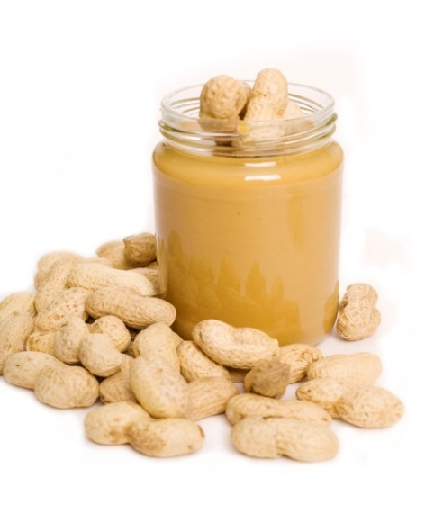
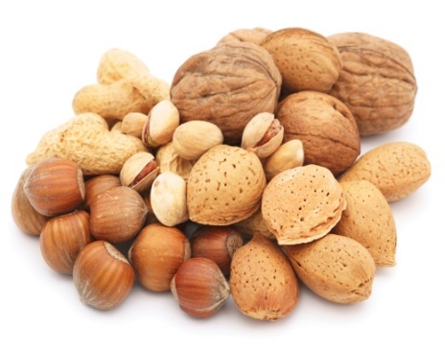
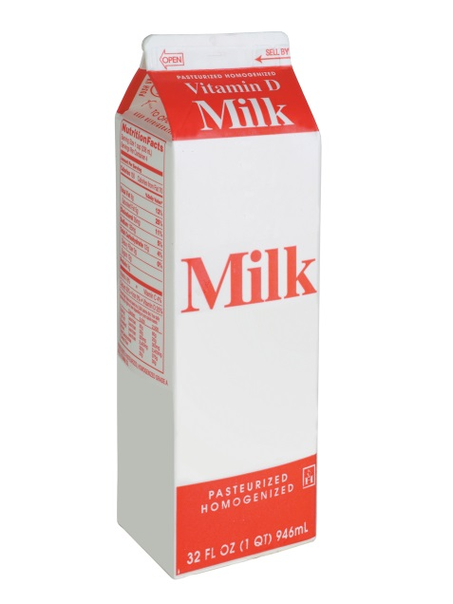
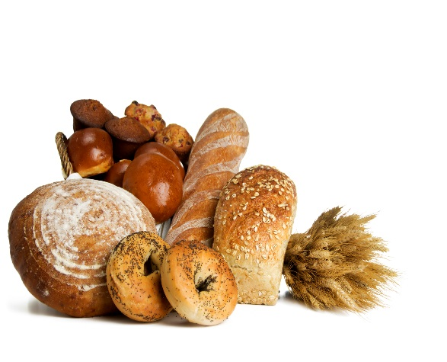
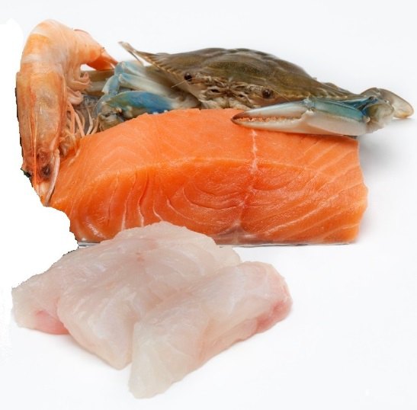
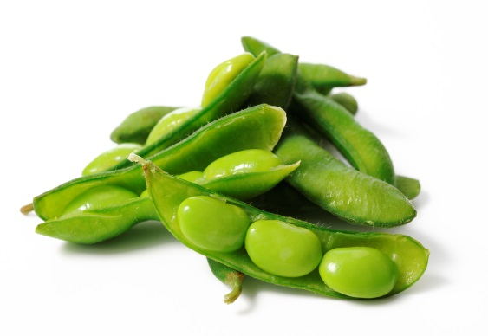
The Eight Major Food Allergens
Notes:
* Be aware that oysters, mussels, and clams do not fall under crustacean shellfish. Consideration must be taken with allergies related to them as they are not listed as one of the eight major allergens.

Slide 25

Only Way to Prevent an Allergic Reaction
Strict Avoidance of Known Food Allergens

Slide 26
What is a Food Intolerance?
Involves the Gastrointestinal System
Symptoms may
Affect the skin, respiratory tract, and gastrointestinal tract; individually or combination
Can cause more severe reaction
    Nausea, diarrhea, vomiting
Come on gradually
Not life-threatening
May be confused with food allergies

Slide 27
Celiac Disease
Autoimmune disorder involving the immune system in the small intestine only
Reaction to eating gluten – protein in wheat, barley, and rye
Follow a strict gluten-free diet
  Wheat-free ≠ Gluten-free
Can have long-term health effects
Considered a disability

Slide 28
Lesson 1 Review
Impact of an allergic reaction
Food allergies, symptoms, and treatments
Eight major food allergens
Food allergy vs food intolerance

Slide 29
Lesson 2: Reading Food Labels for Allergens
Eight major food allergens in the ingredient statement on the food label
Allergens not among the eight major, in bulk, and in USDA Foods
Procedures for reading ingredient statements

Slide 30
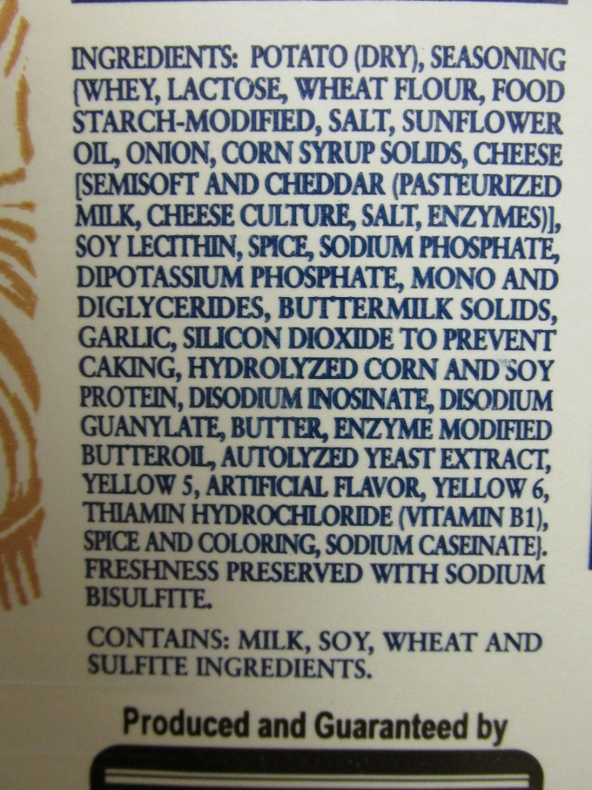
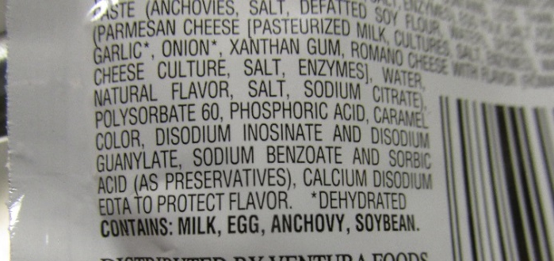
Reading Ingredient Statements
Notes:
Careful reading allows for wise food choices
Known allergens are required
Parents are skilled at reading labels

Slide 31
Food Allergen Labeling and
Consumer Protection Act (FALCPA)
Food labels must declare eight major food allergens in plain language:
Milk
Eggs
Fish
Shellfish
  Usual or common name
  Example: “wheat flour”
  Parenthesis
  Example: “albumin (egg)”
  “Contains” statement
  Example: “Contains: milk and wheat”
Peanuts
Tree nuts
Soy
Wheat

Slide 32
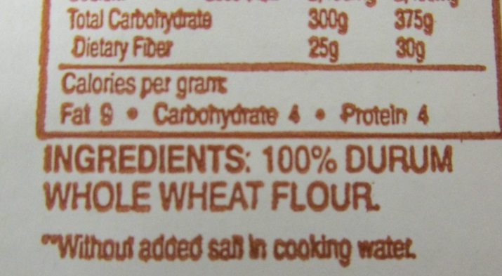
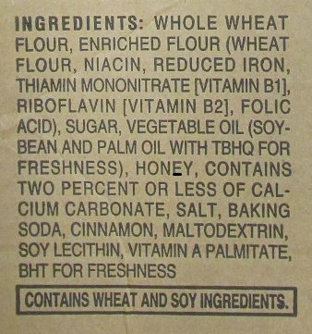
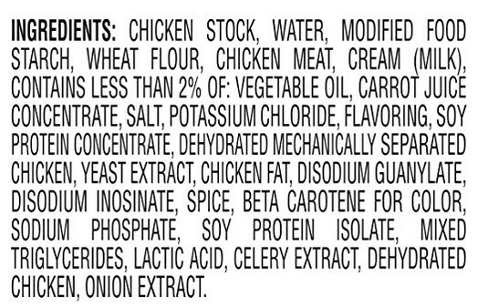
Label Samples
Usual or Common Name
Contains
Parenthesis
Notes:
Remove border

Slide 33
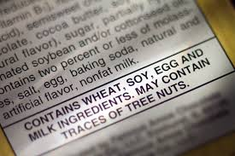
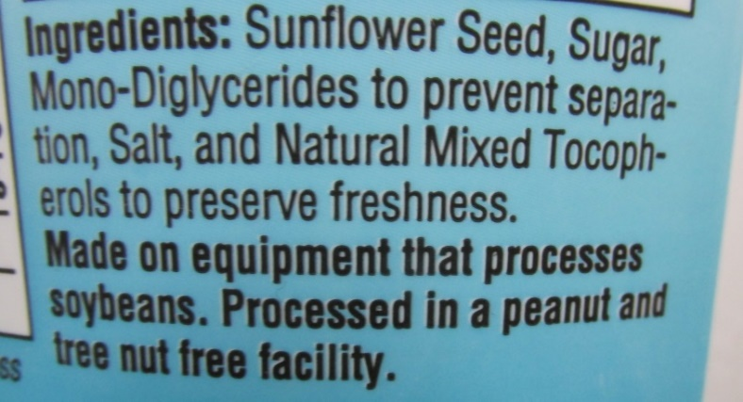
Precautionary Labeling
Not regulated
Not safe for people with known food allergies
“May Contain”
“Made on equipment that also makes…”
“Processed in facilities that also processes…”

Slide 34
Hide and Seek Label Reading Activity
Work in groups
Read product label
Answer questions for label
Share answers with group

Slide 35

Recall Notifications
Coordinate with director
50% of recalls due to undeclared food allergens
FSIS.USDA.gov
FDA.gov
Notes:
Subscribe to food allergy recall notices and a have system to take action if you serve the product being recalled

Slide 36
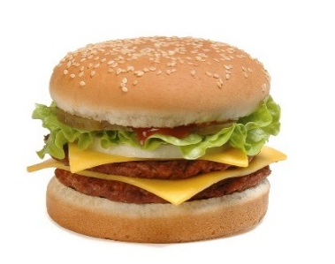
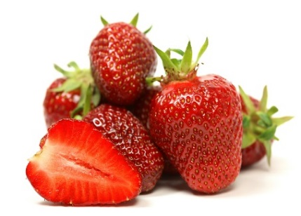
Reading Labels for Other Allergens
Not the Eight Major
90% = 8 Major
10% = Not 8 Major
    Sesame
    Strawberries
    Mustard
    Sulfites
Read the entire ingredient statement
Work with parent, director, and nurse
Notes:
Remove borders

Slide 37
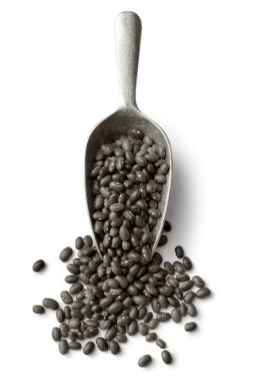
Recognizing Allergens in Bulk Items
Bulk Foods and USDA Foods
Read ingredient statements
SOP for handling bulk
    Mixing lots
    Scooping out of bulk
    Cleaning bulk containers
    Preventing cross-contact
Any doubts, ask your director

Slide 38

Food Allergens in USDA Foods
USDA Foods have same labeling requirements
Read actual labels for food allergens
Do not rely on USDA Foods Fact Sheets

Slide 39
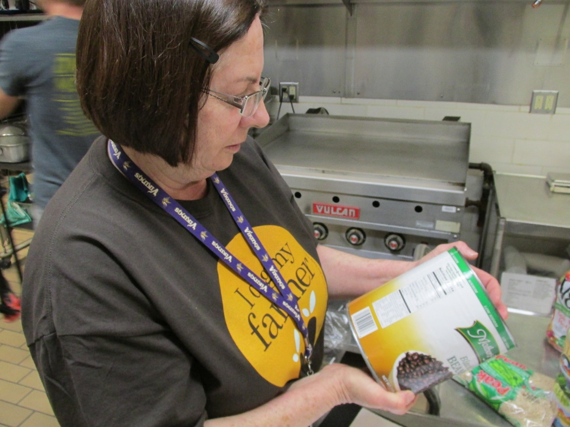
Procedures for Reading Food Labels
Build in time to read labels
Read all ingredient statements
Store labels according to district policy
Notes:
Reading food label pictures

Slide 40

Reading Food Labels Activity
Find Reading Food Labels worksheet
Write answers to questions
If unsure, check “Ask my Director”

Slide 41
Procedures for Reading Food Labels
Who reads labels? If they are out, who is responsible?
Can subs read labels? Part-time staff? Volunteers?
How often are labels read?

Slide 42
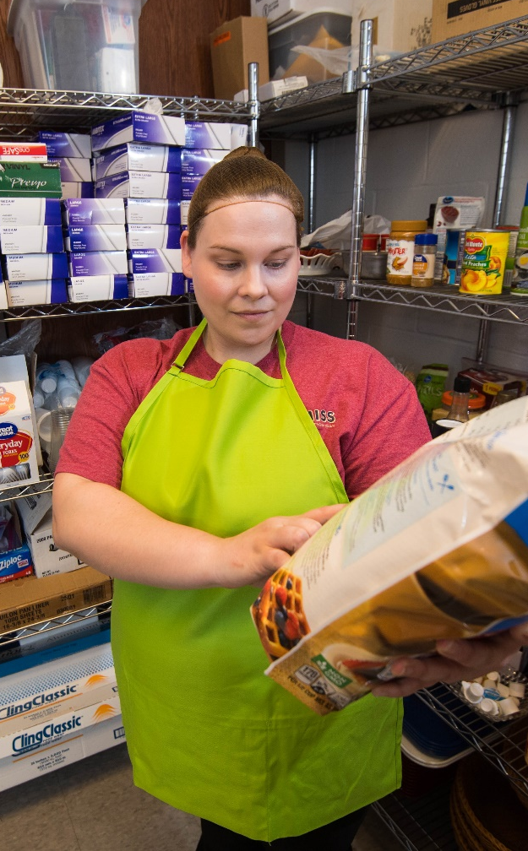
Reading Food Labels
Check all labels carefully every time
    When product is received
        Suppliers may make product substitutions
        Formulas may change
        Vendors could change
  Before using in cooking
Build time into the schedule for reading label

Slide 43
Storing Food Labels
Keep food labels? How long?
Cannot find label?
How to find label when case is thrown away?
Where are food labels stored?

Slide 44
Food Label Storage
CDC recommends keeping food labels for 24 hours
    Available in case of allergic reaction (will likely occur day of service)
For leftovers and food reused in another recipe, keep label until all product is consumed or disposed
Maintain food label
    Label library
    Keep actual label
    Scan or photograph label

Slide 45
Procedure for Changes in Food Labels
What do you do if a substitute product contains allergen?
    Recipe has changed?
    Now has new precautionary label?
What is chain of command for communicating new allergen?
If misread label, what do you do?

Slide 46
Changes in Food Labels
Know chain of communication for a food product that now contains a food allergen.
    Can prevent an allergic reaction.
Food allergy management plan outlines:
    Chain of command
    Actions employees take if a food label is read incorrectly and contains a food allergen.
        Contact your director.
        Do not serve the food to the child with the allergy.
Train employees on plan.

Slide 47
Communicating Food Allergy Information
How does your district share food allergy information?
Parent/guardian requests additional information?
Communicate with other school employees (school nurse, principal, teacher)?
If you cannot answer, who do you contact?

Slide 48
Communicating Food Allergies
Methods for sharing food allergy information
    District/school website
    Prepare handouts
    Provide training for your staff and parents or guardians.
By communicating, families will understand how child is being protected:
    Priority of the school nutrition department
    Precautions taken
    Emergency action plan in place

Slide 49

Label Reading Role Play Activity
Each group will be assigned a scenario
Design skit to show solution
Notes:
Add picture of a group discussion

Slide 50
Lesson 2 Review
Eight major food allergens in the ingredient statement on the food label
Allergens not among the eight major, in bulk, and in USDA Foods
Procedures for reading ingredient statements

Slide 51
Lesson 3: Avoiding Cross-Contact
Cross-contact definition
Ways cross-contact occurs
Strategies to avoid cross-contact

Slide 52
Cross-Contact versus
Cross-Contamination
Cross-Contact
Cross-Contamination
Allergen transferred to a food or surface that does not contain the allergen
Cooking does not reduce or eliminate allergen
Microorganisms from different sources contaminate other foods
Cooking does reduce or eliminate microorganisms

Slide 53

Potential Sources of Cross- Contact
Food handling and preparation
Insufficient handwashing
Insufficient cleaning
Shared equipment, utensils, cutting boards, counters
Splatter or steam from cooking
Salad bars, buffets, serving stations

Slide 54
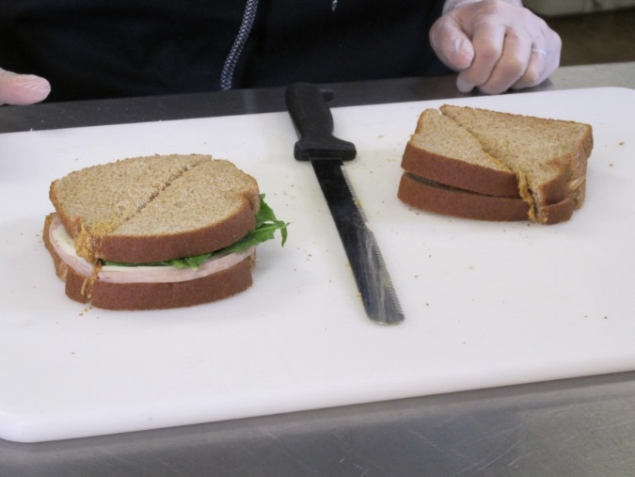
Where are the Allergens?
Activity

Slide 55
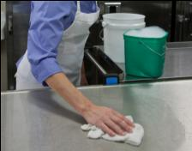
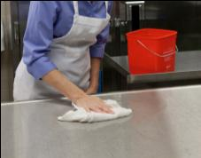
Cleaning and Sanitizing
Cleaning with soap, warm water, and friction
WILL REMOVE ALLERGEN RESIDUE
Sanitizing to reduce microorganisms
WILL NOT REMOVE ALLERGEN RESIDUE

Slide 56
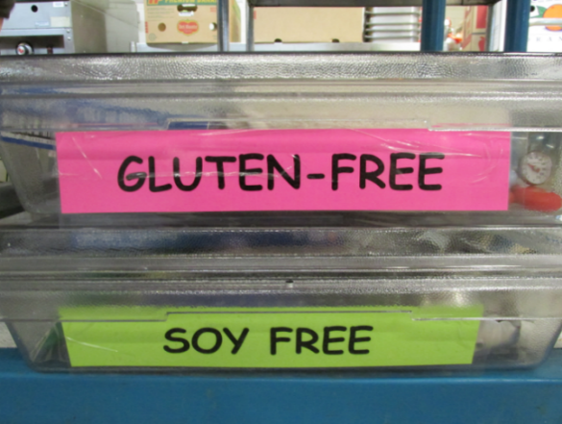
Preventing Cross-Contact
Color coding utensils, equipment, etc.
Isolate ingredients containing allergens
Individual prep of menu items without allergens
Sticker or color code wrapped food
Follow SOPs for handwashing, cleaning, and sanitizing

Slide 57

HACCP-Based Food Safety
Plan
HACCP: Control/prevent/minimize food safety hazards that may cause illness or injury
SOP: Step-by-step instructions for following your school’s food safety practices

Slide 58
Avoiding Cross-Contact Plan
Activity
Find Avoiding Cross-Contact Plan worksheet
Think about your kitchen
Write where cross-contact could occur during these food processes
Write procedures your district uses to avoid cross-contact

Slide 59

Avoiding Cross-Contact
Scenario Activity
Each group will be assigned a scenario
Come up with solution
Report out
Notes:
Add picture of a group discussion

Slide 60
Lesson 3 Review
Cross-contact definition
Ways cross-contact occurs
Strategies to avoid cross-contact

Slide 61
Lesson 4: Accommodating Children with Food Allergies
Supporting children with food allergies
Manage food outside of the cafeteria

Slide 62

Respect and Protect
Children with Food Allergies
Civil rights and privacy must not be violated
Prevent a child with food allergies from being singled out
Be alert to prevent and address bullying from other children and/or adults

Slide 63

Federal Disability Laws
Laws that cover the treatment of those with disabilities
  Rehabilitation Act of 1973
  Individuals with Disabilities Education Act (IDEA)
  Americans with Disabilities Act (ADA)
Notes:
gavel

Slide 64
Federal Privacy Laws
Laws that protect the privacy of children with disabilities
  Health Insurance Portability and Accountability Act of 1996 (HIPPA)
  Family Educational Rights and Privacy Act of 1974 (FERPA)

Slide 65

Written Plans for Food Allergies
504 Plan
Individualized Education Plan (IEP)
Individualized Healthcare Plan (IHP)
Notes:
Remove border

Slide 66
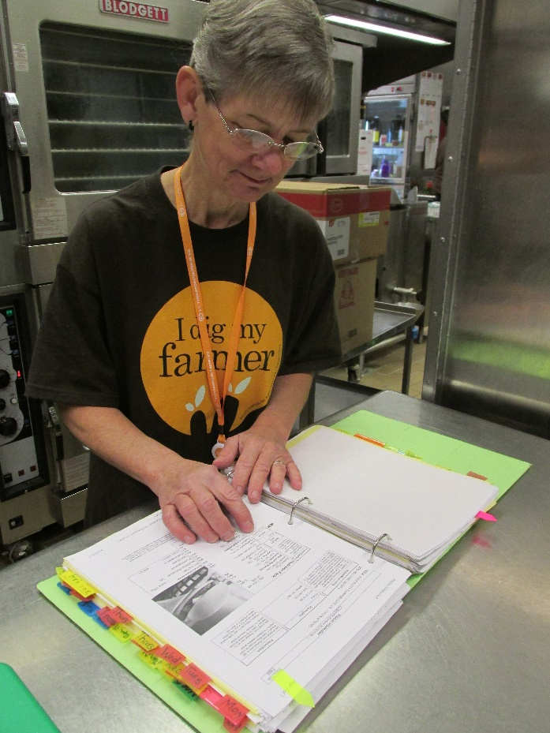
Strategies to Accommodate Students with Food Allergies
Be aware of the food allergies in your school
Notes:
graphic

Slide 67
School Meal Requirements
Must make substitutions for students whose disability prevents them from consuming the school meal as prepared
No extra charge
A disability determination can only be made by a state licensed healthcare professional
Notes:
67

Slide 68
The Team
School Nutrition Director
Communication
School
Nurse
Child’s Safety
Communication
School Nutrition Managers and Staff
Communication

Slide 69
Accommodating Students with Other Food-Related Disabilities
Food Related Disabilities
Other Accommodations
Diabetes
Phenylketonuria (PKU)
Celiac disease
Texture
IV
Tube feeding

Slide 70
Strategies to Manage Outside Food
Outside food sources contracted to serve in the cafeteria | SNP food served outside the cafeteria | Outside food sources served outside the cafeteria
Restaurants Caterers | Breakfast in Classroom Fresh Fruit and Vegetable Program Afterschool Snack Program | Potlucks Classroom projects Club/Sports events

Slide 71
Reduce the Risk Activity
Work in groups
Each group has a scenario of a child with a known life-threatening food allergy
On the flip chart paper, record the actions you would take to safely provide food for the child
Select a spokesperson share your group’s scenario and the actions

Slide 72
Lesson 4 Review
Laws for accommodating students with food allergies
Accommodating children with food allergies
Manage food outside of the cafeteria

Slide 73


Make it Stick

Slide 74
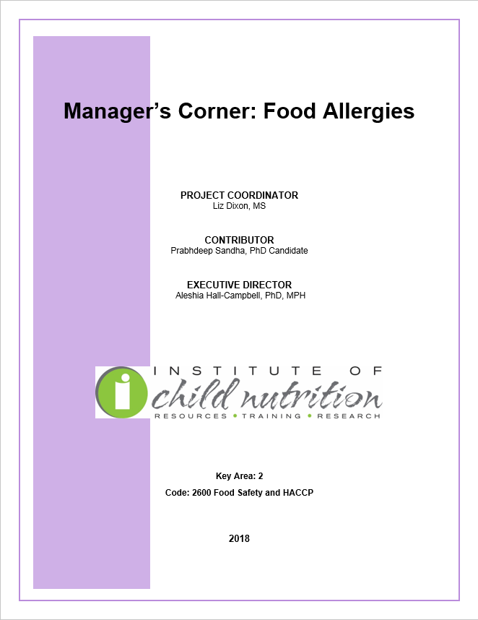

Slide 75

Post-Assessment
Test your food allergy knowledge

Slide 76
Training Wrap-Up
What questions may I answer for you?
ICN Evaluation
Make sure you sign the class roster

Slide 77




Thank you!
The University of Mississippi
School of Applied Sciences
www.theicn.org
800-321-3054
facebook.com/
ichildnutrition
@ichildnutrition
instagram.com/theicn
pinterest.com/theicn

