Slide 1
Produce Safety
Receiving and Storing

Slide 2
Objectives
At the end of this training session, participants will be able to:
Identify best practices for receiving fresh produce.
Identify best practices for storing fresh produce.
Discuss how ethylene gas affects the storage of fruits and vegetables.

Slide 3
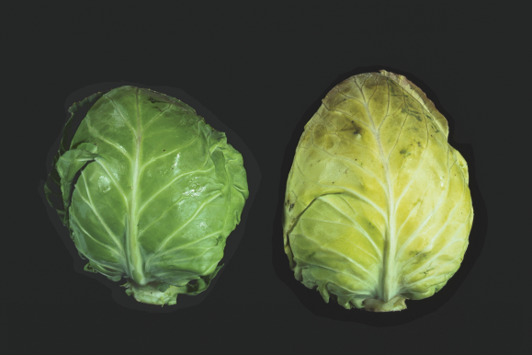
Receiving Produce
Inspect based on specifications
Check temperatures for refrigerated produce
Check produce “best if use by” dates
Reject produce that does not meet specifications

Slide 4
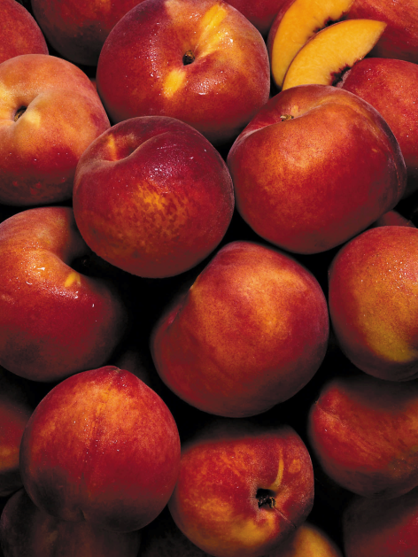
Receiving Produce
Receive based on bid specifications
Size
Count
Quality or grade
Appearance
Quantity ordered

Slide 5
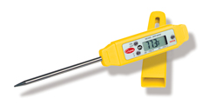
Receiving Produce
Check temperatures for refrigerated produce, including fresh-cut produce
Infrared thermometer
Probe thermometer
Clean and sanitize before touching produce
Do not pierce sealed plastic bags
Calibrate

Slide 6
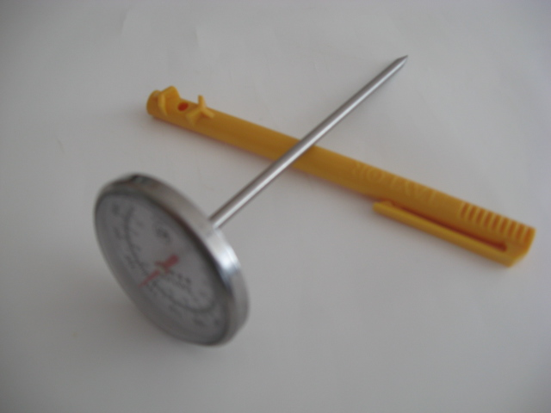
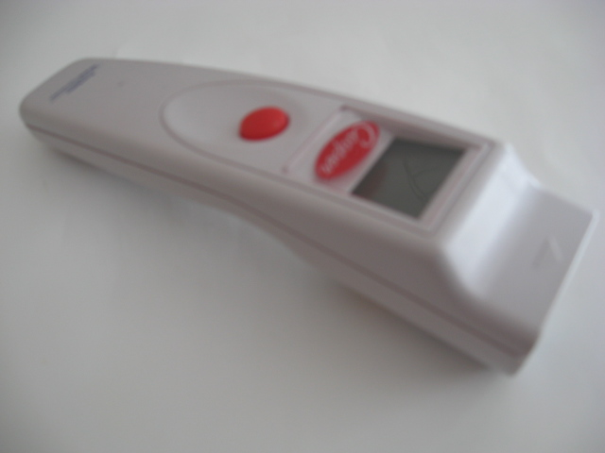
Receiving Produce

Slide 7
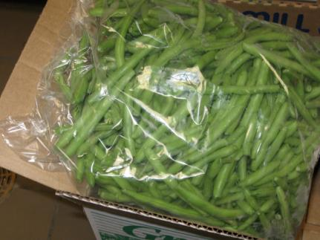
Receiving Produce
Check dates on fresh-cut produce
Best if used by date
Produce quality and appearance should aid in determining shelf life
Maximum shelf life based on ideal conditions

Slide 8
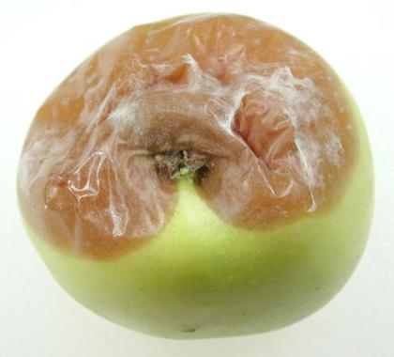
Receiving Produce
Reject if specifications are not met
Provide staff training
Accepting poor quality affects
eye appeal of fresh fruits and
Vegetables!

Slide 9
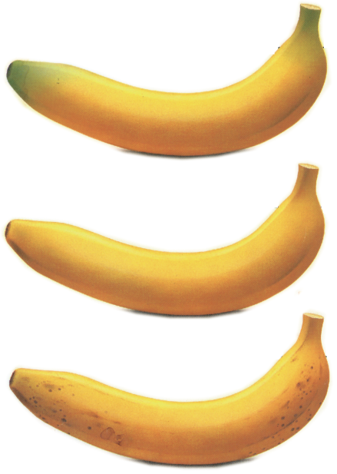
Storing Produce
Date and store immediately
Use FIFO
Traceability

Slide 10
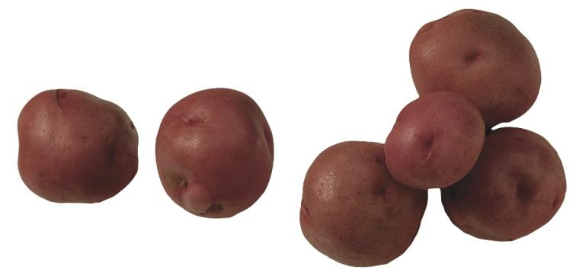
Storing Produce
Refrigerated or dry
Shelf life
FIFO
Protection from contamination

Slide 11
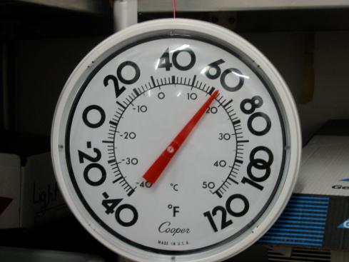
Storing Produce
Refrigerated storage
Dry storage
Room temperature

Slide 12
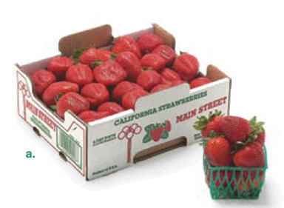
Storing Produce
Shelf life
Depends on quality and condition at receiving
Depends on storage temperature
  Refrigerator
  Dry

Slide 13
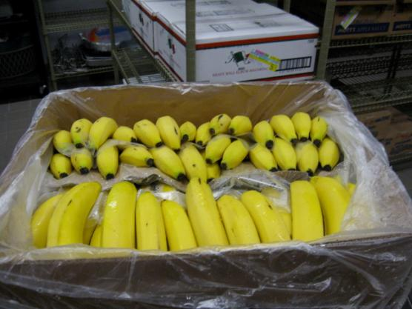
Storing Produce
First In, First Out (FIFO)
Inventory rotation system

Slide 14
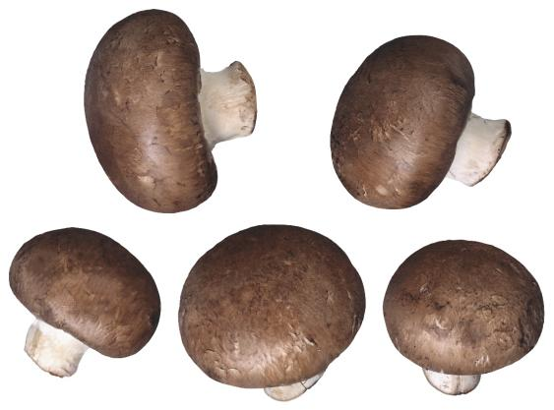
Storing Produce
Protect from contamination
Store 6 inches off the floor
Store above raw meat, poultry, and eggs

Slide 15
Ethylene Gas
Ethylene gas may cause:
russet spotting of lettuce (brown streaks)
bitter tasting carrots
yellowing of broccoli, cucumber, and spinach
decreased shelf life

Slide 16
Ethylene Gas
Store fruits and vegetables away from one another
Separate refrigerators is ideal, but not always practical

Slide 17

Refrigeration Temperatures
Take and record temperatures at least every 24 hours
Take corrective actions as necessary

Slide 18
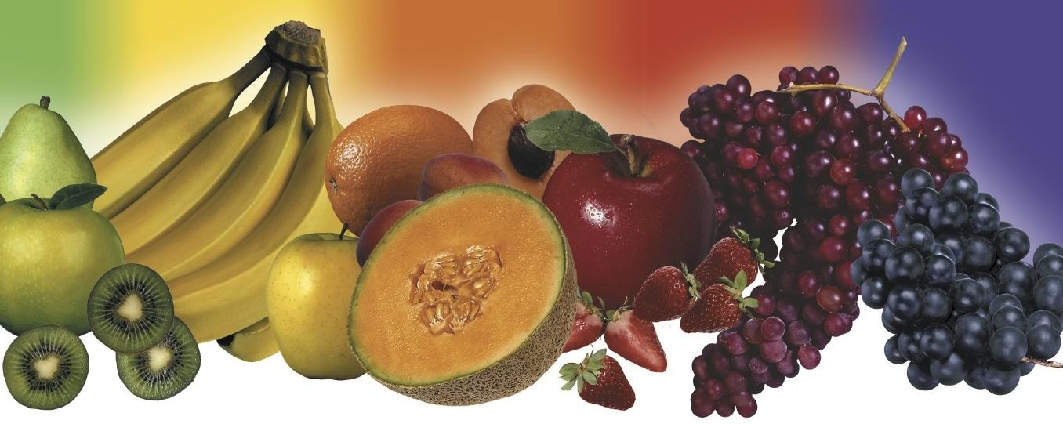
Activities and Discussion

