Slide 1


Child and Adult Meal Pattern
Requirements Training
Notes:
Confirm participants have printed and signed their names on the sign-in sheet(s) and encourage them to make sure it is legible. Also, confirm they have all the necessary materials for this training (e.g., Participant’s Workbook, pens or pencils, and activity supplies).
Begin training by advancing to the next slide.

Slide 2
Child Nutrition Programs: Meal Patterns Consistent with the 2020–2025 Dietary Guidelines for Americans
NEW Federal Rule (CACFP)
Implementation Date: July 1, 2024
  Dietary Accommodations: Institutions and facilities are encouraged to accommodate non-disability dietary preferences in CACFP meal planning and preparation.
Implementation Date: October 1, 2025
  Added Sugars Limits: Changes sugar limits for breakfast cereals and yogurt, shifting from total sugars to added sugars.
  Medical Statements: State licensed healthcare professionals and registered dietitians can write medical statements.
Notes:
Overview: The USDA’s Food and Nutrition Service (FNS) has published a final rule titled, Child Nutrition Programs: Meal Patterns Consistent With the 2020-2025 Dietary Guidelines for Americans. This rule marks a significant advancement in improving child nutrition programs based on scientific research and stakeholder input.
Purpose and Impact: The update reinforces USDA's commitment to nutrition security by aligning with the latest dietary guidelines. It follows a comprehensive review of the 2020–2025 Dietary Guidelines for Americans and incorporates lessons learned from prior rulemakings.
Audience: In addition to standards for schools, the rule introduces specific requirements for those operating the Child and Adult Care Food Program and the Summer Food Service Program.
Key Focus Areas: Added Sugars Limits and Meal Modifications
Beginning July 1, 2024: Meal Modifications will go into effect.
Regarding non-disability requests, the regulation clarifies that the USDA encourages institutions and facilities to accommodate participants’ non-disability dietary preferences when planning and preparing CACFP meals.
Beginning October 1, 2025, additional meal modifications and the Added Sugars limits will go into effect:
Changes sugar limits for breakfast cereals and yogurt from total sugars to added sugars. CACFP total sugars limits remain in place until Oct. 1, 2025, when the added sugars limits must be implemented. Breakfast Cereals: Must contain no more than 6 grams of added sugars per dry ounce. Yogurt: Must contain no more than 12 grams of added sugars per 6 ounces.
Clarifies that both state licensed healthcare professionals and registered dietitians may write medical statements to request meal modifications on behalf of participants with disabilities.

Slide 3

Child Nutrition Programs: Meal Patterns Consistent with the 2020–2025 Dietary Guidelines for Americans (cont.)
NEW Federal Rule (CACFP)
CACFP & SFSP Standards:
  www.bit.ly/49PeLMZ
Available Support: The ICN’s Help Desk:
  Email: helpdesk@theicn.org
  Phone: 1-800-321-3054
Notes:
It’s important to note that other technical changes are included in the final rule, but they do not require modifications to menus or operations.
Please scan this QR code or use the link to the CACFP and SFSP standards to learn more about the latest standards.
Most importantly, the Institute of Child Nutrition is committed to your success with these new standards. If you have any questions, please feel free to contact our help desk for assistance or your State agency.

Slide 4

Welcome to the Child and Adult Meal Pattern Requirements Training!
Notes:
SAY:
Welcome to the Child and Adult Meal Pattern Requirements training. First, the Institute of Child Nutrition would like to thank you for providing us with the opportunity to offer this CACFP Meal Pattern Requirements Supplemental training. It is our hope that you will gain the knowledge and skills for implementing the latest changes featured in the updated Child and Adult Care Food Program (CACFP) meal patterns regulations.
NOTE TO INSTRUCTOR: If this training is not sponsored by the Institute of Child Nutrition, provide information regarding the host organization.

Slide 5

Lesson Overview
Complete participant & trainer introductions
Review the purpose & some general changes
Explore the training topics & the general schedule
Notes:
SAY:
In this introduction lesson, we are going to cover some general information before exploring specific meal pattern components. Particularly, we will focus on these three outcomes:
Complete participant and trainer introductions.
Review the purpose and some general changes to the CACFP meal patterns.
Lastly, review the training topics and general schedule for this training.
SAY:
In this introduction lesson, we are going to cover some general information before exploring each meal pattern component updates. We will focus on these three tasks:
Complete participant and trainer introductions.
Review the purpose and some general changes to the CACFP meal patterns.
Explore the training topics and today’s schedule.
Let’s begin by getting to know each other.
DO:
Introduce yourself and other special guests. Be sure to state your name, title/credentials, and your experience in child care, CACFP, and other child nutrition programs.
Confirm that participants have printed and signed their names on the sign-in sheet(s), and they have all necessary materials for this training (e.g., Participant’s Workbook, pens or pencils, and activity supplies).

Slide 6

Activity: Define Training Success
Notes:
DO:
(Activity): Define Training Success
The purpose of this activity is to allow participants to network with their peers as well as identify their expectations for this training. This activity will also help the trainer to identify ways to meet the needs of each participant.
Materials Needed: Chart Paper (1 piece of paper per group) and markers
Time: 10 minutes
Instructions:
DO: Divide the class into groups of 3–5 participants, and distribute a piece of chart paper and a marker(s) to each group. Ask participants to move to their group space, taking their things with them. They should remain in these groups throughout the course of this training.
SAY: Let’s begin by thinking about the benefits of attending this training and your overall expectations for what you would like to learn today. In your groups, introduce yourself and state one or two key points to complete the sentence: “This training will be a success for me, if ____.” For example, this training will be a success for me, if everyone learns how to implement the updated infant meal pattern requirements. After everyone has shared within your group, use your chart paper to create a list of each of your responses.
DO: Allow participants 5 minutes to complete this activity. Then, request that each group share their responses with the large group and post their chart paper in the training area.
FEEDBACK:
If the training size is not conducive to large group sharing, discuss the following general training expectations and allow the participants to add any additional comments:
Learn how to implement all requirements
Learn more about the whole grains requirements
Gain a better understanding of meeting the added sugars limit requirements
Learn more about the separation of the fruit and vegetable component

Slide 7

Logistics
Ground rules
Breaks
Restroom location
“Bike Rack” for questions
Notes:
SAY:
To help ensure this training is a success, there are a few key things to keep in mind.
The ground rules are posted (state location) and featured in your Participant’s Workbook. Please take a moment to review them.
We will take a minimum of three breaks during this training. Please be sure to return on time, as starting and ending breaks on time will allow us to cover all the training information and activities within the time allotted. If you should need to stretch or attend to a need at a different time, please feel free to do so. All that I ask is that you leave and return without disturbing the training.
The restrooms are located (state location).
Last, I have posted a chart paper with the title “Bike Rack” (the former parking lot concept) (state location). Feel free to write any questions on a sticky note and post it to the “Bike Rack.” I will aim to answer all questions and share the information with the class before the end of this training. Although I will try to answer questions throughout the training, some questions may require research or a longer answer than time allows. Any questions I cannot answer, I will forward them to the ICN for further assistance.
Now that we have reviewed some basic logistical information, let’s shift our focus to the CACFP and the purpose for the updates to the meal patterns.

Slide 8

CACFP in the Last 50 Years
Source for nutritious meals & snacks
  Infants, children, & adults
Shift in nutritional needs & eating habits
Notes:
SAY:
Since 1968, the CACFP has helped to ensure participants receive nutritious meals and snacks while attending child care and later, those attending adult care. Over the years, however, the nutritional needs and the eating habits of children and adults have shifted from those when the program first began.
In particular, the overall health status of this country has shifted from deficiencies in essential nutrients, such as a lack of vitamins A and C, to chronic diseases, such as hypertension, heart disease, type 2 diabetes, and even some forms of cancer.

Slide 9

Purpose of the Update
Address the current health status of children & adults
Align the CACFP meal patterns with the Dietary Guidelines for Americans
Help children develop healthy eating habits
Safeguard the wellness of adult participants
Notes:
SAY:
Understanding the shifts, the Healthy, Hunger-Free Kids Act of 2010 called for USDA to review and revise the CACFP meal pattern requirements to better align with the DGA and to address the current health status of children and adults.
Ultimately, the updated meal pattern requirements are expected to enhance the overall nutritional quality of meals and snacks served in CACFP settings. Additionally, these improvements are projected to help young children develop healthy eating habits early and safeguard the overall wellness of adult participants.
You can learn more about these changes by referring to the handouts, CACFP in the Last 50 Years, the 2020-2025 Dietary Guidelines for Americans, and the Child and Adult Meal Patterns in your Participant’s Workbook.

Slide 10

Child & Adult Meal Pattern Requirements Overview
Wider varieties of protein options
Greater varieties of vegetables & fruits
More whole grains
Less added sugars & saturated fat
Notes:
SAY:
Ultimately, the updated meal pattern requirements are expected to enhance the overall nutritional quality of meals and snacks served in CACFP settings. Specifically, the changes provide:
A wider varieties of protein options
Greater varieties of vegetables and fruits
More whole grains
Less added sugars and saturated fat
NOTE TO INSTRUCTOR: This slide provides an overview of the content in the training. If there are questions regarding the information, explain that you will provide additional information on each of the requirements throughout this training.

Slide 11

Meal Patterns
Previous vs. Updated
Notes:
SAY:
As in the previous meal pattern, the updated meal pattern requirements continue to reflect the different nutritional needs for each age group, such as specific amounts of foods and minimum serving sizes for nutritious and reimbursable meals. However, there are a few general changes worth noting before exploring each meal component.
Turn to the Previous vs. Updated Child and Adult Meal Pattern Requirements handout in your Participant’s Workbook. Take a few minutes to review the changes to the meal pattern for the age groups in your care.
DO:
Allow 3–5 minutes for participants to review the charts.

Slide 12
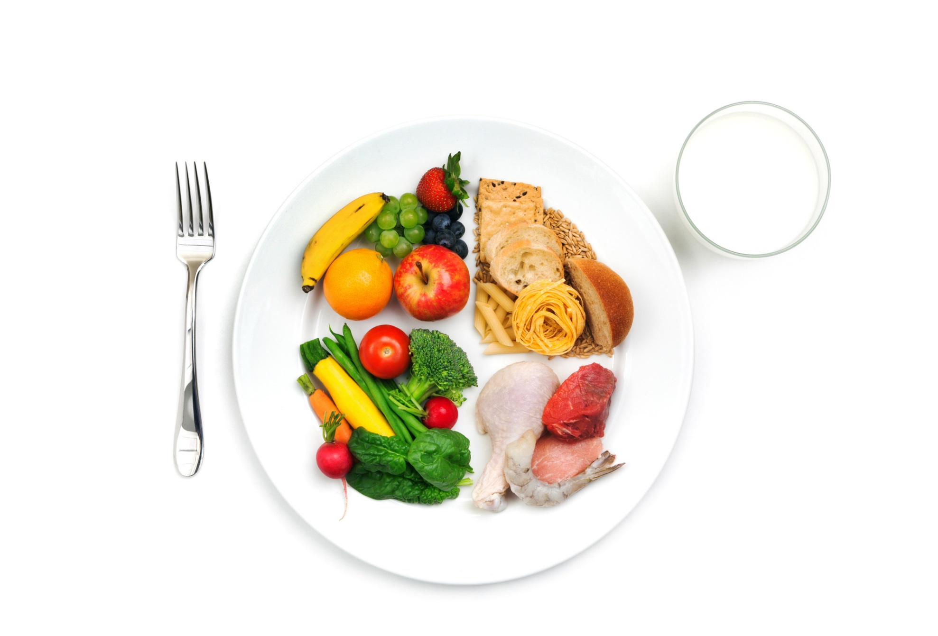
How many meal components?
Notes:
Now that you have had the opportunity to review the chart, let’s discuss the general changes.
ASK:
First, how many meal components are there?
DO:
Allow the participants to respond.

Slide 13
Meals & Meal Components
Five meal components
Offer the minimum serving sizes for a reimbursable meal
Notes:
SAY:
As you just mentioned, there are five meal components: fluid milk, meats/meat alternates, vegetables, fruits, and grains. Looking at the chart, the fruit and vegetable component is now separated into two components at lunch, supper, and snack. During breakfast, it remains a single component.
As previously mentioned, meal components must continue to be served in the minimum required sizes to receive reimbursement for each meal or snack served. We will cover this update more in depth in the Vegetable and Fruit Component Update(s) lesson.

Slide 14

Grains Component?
Notes:
ASK:
What changes did you notice to the grains component?
DO:
Allow the participants to respond.

Slide 15

Grains Component
Name Change – Breads and Grains to Grains
Ounce Equivalents
Notes:
SAY:
As you just mentioned, this component was previously called breads and grains; however, it is now simply called grains.
Another change to the grains component is the serving size. The serving size has changed from servings to ounce equivalents.

Slide 16





Age Groups
1–2 years
3–5 years
6–12 years
13–18 years
Adults
Notes:
SAY:
The last overall change to the meal pattern focuses on the age groups. The 13 through 18-year-old age group is an addition to the meal pattern requirements. This age group was added to better reflect the characteristics of the populations served in the CACFP, specifically those in the at-risk afterschool programs and emergency shelters. This age group may be used for individuals operating at-risk afterschool programs and emergency shelters only.

Slide 17

Training Overview
Connect the previous with the updated requirements
Highlight previously implemented policies
Explore current policies
Notes:
SAY:
In today’s training, we will explore the Federal regulations and policies for the meal pattern, focusing on each meal component, where to locate additional information, and some key strategies for implementation.

Slide 18

Comprehensive Pre-Assessment
Notes:
DO:
Comprehensive Pre-Assessment
The purpose of this Comprehensive Pre-Assessment is to determine current knowledge of the updated meal pattern requirements.
Materials Needed: Comprehensive Pre-Assessment and pen or pencil
Time: 10 minutes
Instructions:
SAY: Before we begin exploring the first topic, let’s assess what you already know about the updated meal pattern requirements by completing a Pre-Assessment.
DO: Distribute the Comprehensive Pre-Assessment.
SAY: Now that you have the Pre-Assessment, begin by placing an easy to remember, unique, non-name identifier, such as a word, phrase, or symbol, at the top of each page. Then, read each question carefully and select the best answer. Make a note of your non-name identifier as you will use it again when completing the Post-Assessment.
DO: Allow a minimum of 10 minutes for participants to complete the Pre-Assessment. Remind them to list a non-identifier and to make a note of it for the Post-Assessment. Then, collect each assessment and set them aside.
NOTE TO INSTRUCTOR: If the Institute of Child Nutrition (ICN) provides this training, collect the Pre-Assessments and return them along with the evaluations to ICN.

Slide 19


Lesson: Fluid Milk Component Updates
Notes:
DO:
To begin this training, advance to the next slide.

Slide 20

Fluid Milk Component Overview
More defined age groups for milk
Yogurt is a substitute for milk (adults only)
Nondairy milk substitutes for those with medical/special dietary needs
Notes:
There are three key updates to the fluid milk component for the CACFP:
More defined age groups for each milk type
Yogurt may be served in place of milk once per day for adults only
Nondairy milk substitutes that are nutritionally equivalent to milk may be served in place of milk to children or adults with medical or special dietary needs

Slide 21

Updates & Benefits
Right type & amount
Promotes healthy eating habits
Notes:
SAY:
There are a number of benefits for incorporating these updates. For example, they aim to provide all participants with the right type and amount of milk. They also promote the development of healthy eating habits in young children and foster healthy habits for all CACFP participants.
ASK:
What are some other benefits of the three changes to the fluid milk component?
DO:
Allow participants to respond, and then advance to the next slide.
FEEDBACK:
A potential response may include preventing obesity by ensuring children and adults are receiving the right types and amounts of milk.

Slide 22

Lesson Objectives
Classify the fluid milk component requirements for each age group
Summarize the two ways for managing fluid milk substitutions
Recall the requirement for serving water in CACFP settings
Notes:
SAY:
Throughout this lesson, we will explore the following objectives:
Classify the fluid milk component requirements for each age group.
Summarize the two ways for managing fluid milk substitutions based on the updated requirements.
Recall the requirement for serving water in CACFP settings.
At the end of this lesson, you should know the latest updates, as well as some key strategies for implementation. For your reference, refer to the Fluid Milk Basics handout in your Participant’s Workbook.
NOTE TO INSTRUCTOR: If this training is offered in the comprehensive 6-hour version, skip the lesson pre-assessment. However, if this training is offered in individual lesson form, follow the instructions below to complete the pre-assessment.

Slide 23

Pre-Assessment
Notes:
DO:
Pre-Assessment
The purpose of this Pre-Assessment is to determine current knowledge of the updated meal pattern requirements.
Materials Needed: Pre-Assessment and pen or pencil
Time: 5–10 minutes
SAY: Before we begin objective 1, let’s assess what you already know by completing a Pre-Assessment.
DO: Distribute the Pre-Assessment.
SAY: Now that you have the Pre-Assessment, begin by placing a four-digit number in the box at the top of your assessment. Make a note of this number, as you will use it again when completing the Post-Assessment. Then, read each question carefully and select the best answer. When you have finished, place your assessment in the center of the table (or in a specified location).
DO: Allow a minimum of 5–10 minutes for participants to complete the Pre-Assessment. Remind them to list a non-identifier and to make a note of it for the Post-Assessment. Then, collect each assessment and set them aside.
NOTE TO INSTRUCTOR: If the Institute of Child Nutrition (ICN) sponsors this training, collect the Pre-Assessments and return them along with the evaluations to ICN.

Slide 24

Activity: Team Quiz
Notes:
OBJECTIVE 1: Participants will be able to classify the fluid milk component requirements for each age group.
DO:
(Activity): Team Quiz
The purpose of this activity is to determine participants’ knowledge on the current policies.
Materials Needed: Quiz Questions, True/False Double-Sided Poster (1 per group)
Time: 5 minutes
Instructions:
SAY: Prior to implementing the updated meal pattern requirements, a few changes were implemented for the fluid milk component. Let’s see how well you know these changes. At your tables, you should have a mini-poster with TRUE on one side and FALSE on the other side. I will state a few statements. In your groups, discuss each statement and decide if it is true or false. Then, hold up the “True” poster if you believe the statement is true, or the “False” poster if you believe the statement is false. Are you ready?
DO: Read each statement. Allow each group to discuss the statements, and then ask for their response. If time permits, allow participants to correct the false statements. Otherwise, review the responses with the participants, and explain that the latest changes build on these previously implemented requirements.
Question #1: Milk served to children 2 years old must be low-fat or fat-free. True or False? True. Older children and adults must also be served pasteurized low-fat or fat-free fluid milk.
Question #2: Almond milk is a creditable fluid milk option for child and adult meals. True or False? False. Almond milk is not an allowable fluid milk option for child and adult meals. Some common examples of creditable fluid milk options include fat-free or low-fat lactose reduced, lactose free, buttermilk, or acidified milk for children 2 years old and older, and adult meals.
Question #3: Nondairy beverages that are nutritionally equivalent to cow’s milk may NOT be served in place of milk. True or False? False. If a child or adult cannot have fluid milk due to a non-disability special dietary need, nondairy beverages may be served in its place without a medical statement. However, the nondairy beverage must be nutritionally equivalent to cow’s milk. In addition, a parent or guardian, an adult participant, or a person on behalf of an adult participant must request the substitution in writing.
A medical statement is required when a child or adult has a disability that requires a nondairy beverage that is not nutritionally equivalent to cow’s milk. The medical statement must be signed by a State licensed healthcare professional (an individual authorized to write medical prescriptions under State law) or registered dietitian.
DO:
Upon completion of the game, thank everyone for participating and state that this activity was an opportunity to review some of the previously-implemented requirements that build on the content in this lesson.

Slide 25
Breast Milk Past 12 Months
May be served to children of any age
Reimbursable
  If a parent/guardian provides expressed breast milk
  A mother breastfeeds her child on-site
Notes:
SAY:
Now that we have reviewed the previously implemented requirements, let’s explore those that went into effect October 1, 2017, the basis for the changes, and key ways to implement each requirement.
The first change focuses on breast milk past the age of one. Breast milk may be served to children older than 12 months of age. This update allows operators to claim reimbursement when a mother chooses to breastfeed in the facility, or if she or a guardian provides expressed breast milk to be fed to their child.

Slide 26
Breast Milk Past 12 Months (cont.)
May be served in combination with other milk types
Example: Mother brings ¼ cup for 1-year-old, provider would supply ¼ cup whole unflavored milk for a total of ½ cup serving
Breast milk & whole milk do not need to be mixed
Notes:
SAY:
For a reimbursable meal or snack containing expressed breast milk, a parent or guardian must supply the age-appropriate minimum serving size for their child. If a parent or guardian provides less than the minimum serving size, you must make up the difference by serving milk. For example, a parent brings ¼ cup of breast milk for her 1-year-old child. The minimum serving size for this age group is ½ cup; therefore, you would need to provide an additional ¼ cup of whole unflavored milk for a total of ½ cup to make up the difference for the meal to be reimbursable. Always check with parents or guardians to ensure they are aware of this requirement.
Another key point is breast milk and whole milk do not need to be mixed—they can be served separately.

Slide 27

1 Year Olds
Most 1 year olds need whole milk
  Provides higher fat content
Whole unflavored milk is required at breakfast, lunch, & supper
  Optional at snack
Serve 4 fl oz (½ cup) of unflavored whole milk
Notes:
SAY:
The next change focuses on 1 year olds. According to the American Academy of Pediatrics (AAP), most children between the ages of 1 year and 23 months need whole milk because it provides a higher fat content, which promotes healthy growth and development. The updated requirements call for children age 1 year through the end of 23 months to be served a minimum of 4 fluid ounces (½ cup) of unflavored whole milk at breakfast, lunch, and supper; and it is optional at snack time.

Slide 28

Transition Period
One-month transition period is allowable
12 months to 13 months
  Switch from infant formula to whole milk
24 months to 25 months
  Switch from whole milk to low-fat(1%) or fat-free (skim) milk
  May serve whole milk or reduced-fat (2%) milk
Notes:
SAY:
During the early years, making an immediate switch in milk can be challenging for some children. Some children will need time to get adjusted to the new milk; therefore, a one-month transition period is allowed for children between the ages of 12 months to 13 months and 24 months to 25 months to switch milk types. This means you may serve iron-fortified formula to children between the ages of 12 months to 13 months. Also, you may serve children 24 months to 25 months whole milk or reduced-fat milk (2%).
The updated meal pattern requirements allow a one-month transition period to switch from whole milk to low-fat or fat-free milk when a child turns 2 years old. You may claim reimbursement for meals served to children 24 months to 25 months old that contain whole milk or reduced-fat milk (2%).

Slide 29


2 to 5 Year Olds
Serve unflavored low-fat (1%) milk or fat-free (skim) milk
Minimum serving sizes
  2 years
    4 fl oz (½ cup) at meals/snacks
  3–5 years
    6 fl oz (¾ cup) at meals
    4 fl oz (½ cup) at snacks
Flavored milk is not reimbursable
Notes:
SAY:
Currently, children between the ages 2–5 years old, must be served unflavored low-fat (1%) milk or fat-free (skim) milk. These requirements remain the same for the updated meal pattern. Continue to serve children 2 years old a minimum of 4 ounces (½ cup) of milk and children 3–5 years a minimum of 6 ounces (¾ cups) at breakfast, lunch, and supper, and 4 ounces (1/2 cup) at snack.
It is important to note, flavored milk of any sort, including milk with added flavorings (such as syrup), is not allowed for children below the age of 6 as part of a reimbursable meal.

Slide 30
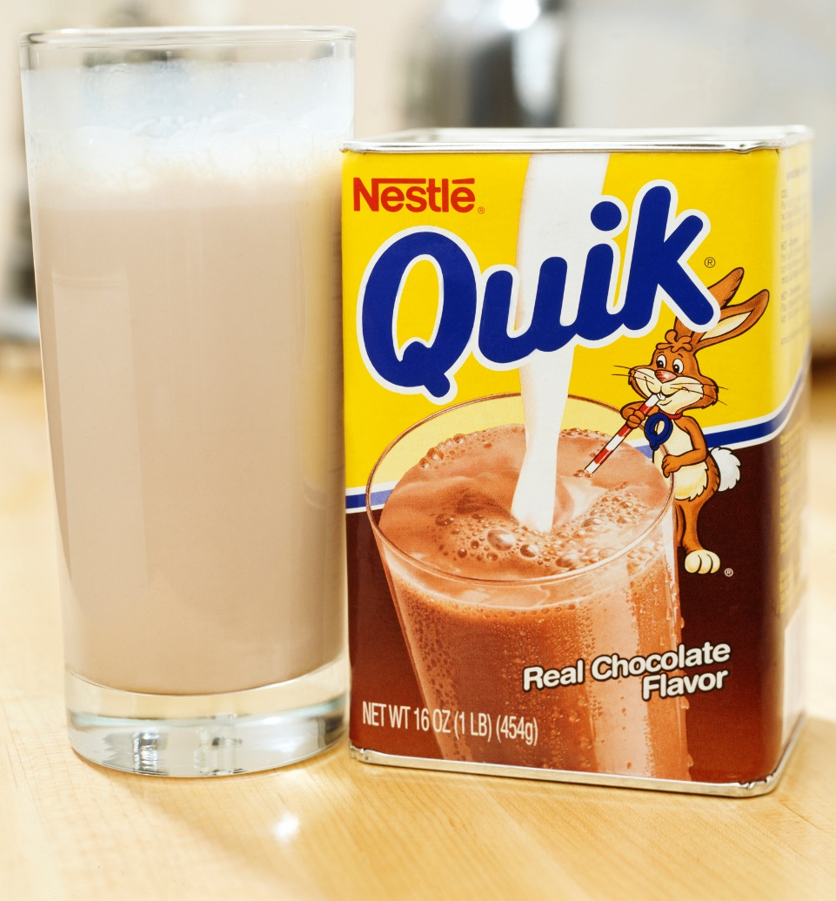
6 Year Olds +
Minimum serving sizes
  8 fl oz or 1 cup
Creditable types
  Low-fat (1%), flavored or unflavored
  Fat-free (skim), flavored or unflavored
Flavored milk options
  Commercially prepared
  Flavored milk powder, syrup, or straws
Notes:
SAY:
When working with children ages 6 years and older, and adults, there are some additional options for the milk component. First, you must continue to serve a minimum of 8 fluid ounces (1 cup) of unflavored low-fat (1%) or fat-free (skim) milk.
You may also serve fat-free or low-fat flavored milk. This update allows you to add syrup, flavored milk powder, and flavored straws to fat-free or low-fat plain milk for these age groups only.

Slide 31
Yogurt & Adult Participants Only
Once per day, 6 oz (¾ cup) of yogurt may be served in place of fluid milk
Added Sugars Limit
Credits for only one meal component in a single meal
Notes:
SAY:
Yogurt is a great source of calcium and can offer greater flexibility to the menu planner when planning meals for adult participants. One way in particular is the updated requirements now allow 6 ounces (¾ cup) of yogurt to meet the fluid milk requirement once per day for adult participants. The 6 ounces (¾ cup) of yogurt is equivalent to 8 fluid ounces (1 cup) of milk.
When serving yogurt to adult participants, there are some key requirements to remember.
Yogurt may not be substituted for fluid milk for children of any age.
Through September 30, 2025, yogurt must contain no more than 23 grams of total sugars per 6 ounces. By October 1, 2025, yogurt must contain no more than 12 grams of added sugars per 6 ounces (2 grams of added sugars per ounce).
Yogurt may only credit for one meal component in a single meal. Therefore, it may not credit as milk and as a meat alternate in the same meal.

Slide 32

Activity: Milk Component Requirements
Notes:
DO:
(Activity): Milk Component Requirements
The purpose of this activity is to ensure participants understand the changes to the fluid milk component.
Materials Needed: Fluid Milk Component Requirements worksheet and pen or pencil
Time: 10 minutes
Instructions:
SAY: Now that we have explored the new requirements for the milk component, let’s complete an activity. Turn to the Milk Component Requirements worksheet in your Participant’s Workbook. This handout consists of two parts.
Part 1: There are four milk types approved for child and adult meals and one milk substitute approved for adult meals only. In the space provided, list the required milk or milk substitute for each age. Remember, there can be more than one option for each age group.
Part 2: Read the following statements. Determine if each statement is true or false. Take 5–10 minutes to complete the worksheet, and then review your answers with those in your group.
DO: Allow 5–10 minutes for participants to complete this activity, and then review the answers with the participants using the following Answer Key: Milk Component Requirements.

Slide 33
Milk Substitutions
Allowed for non-disability medical or special dietary need
Medical statement is not required if nutritionally equivalent to cow’s milk
Request must be made in writing
Notes:
OBJECTIVE 2: Participants will be able to identify the key requirements for meeting the milk substitutions requirements.
SAY:
As we previously covered during the team quiz, if a child or adult participant cannot have fluid milk due to a special dietary need that is not a disability, you may serve nondairy beverages in its place without a medical statement. However, the nondairy beverage must be nutritionally equivalent to cow’s milk. In addition, a parent or guardian, an adult participant, or a person on behalf of an adult participant must request the substitution in writing.

Slide 34

“Medical statements … required when a disability calls for a nondairy beverage that is not nutritionally equivalent to cow’s milk …”
Notes:
SAY:
On the other hand, if a participant has a disability that requires a nondairy beverage that is not nutritionally equivalent to cow’s milk, you must have a medical statement on file. In these cases, it is important to know when you need it and what to look for when reviewing the form.
You can find a sample Medical Statement in your Participant’s Workbook. This handout indicates some of the key information featured on a medical statement. However, always refer to your State agency for the best form, as each State’s medical statement will vary.

Slide 35

What to Look For
Detailed information about the participant’s disability
Foods to omit
Alternate food items
Prescribed & signed by a State licensed healthcare professional or registered dietitian
Notes:
SAY:
When requesting and accepting a medical statement, it should feature the following:
Detailed information about the participant’s disability to allow a greater understanding of how it affects their diet
List of foods to be omitted and alternate food items to serve to ensure you know what to serve the participant
Prescribed and signed by a State licensed healthcare professional (an individual authorized to write medical prescriptions under State law) or registered dietitian

Slide 36
What to Look For (cont.)
Review it carefully
Request additional information, if necessary
Policy Memo: CACFP 14-2017 Modifications to Accommodate Disabilities in the Child and Adult Care Food Program and Summer Food Service Program
Notes:
SAY:
Once you receive a medical statement, review it carefully to make sure that it provides the previously mentioned information. If not, request additional information to ensure you can best meet the needs of those requiring substitutions. In addition, always keep medical statements on file in your facility.
For additional information on how to provide meal accommodations to participants of any age, refer to the policy memo, CACFP 14-2017 Modifications to Accommodate Disabilities in the Child and Adult Care Food Program and Summer Food Service Program. The link to this memo is featured on the Training Resources handout in the Appendix of your Participant’s Workbook.

Slide 37

Activity: Revisiting Medical Statements
Notes:
DO:
(Activity): Revisiting Medical Statements
The purpose of this activity is to review participants’ knowledge on when a medical statement is required for milk substitutions.
Materials Needed: Revisiting Medical Statements worksheet and pen or pencil
Time: 5–10 minutes
Instructions:
SAY: Now that we have explored the key requirements for medical statements, let’s revisit and summarize what you learned. Turn to the Revisiting Medical Statements worksheet in your Participant’s Workbook, and answer the four questions. Once you have finished, stand up.
DO: Allow 3–5 minutes for participants to complete this activity, and then review the questions and answers found in the Answer Key: Revisiting Medical Statements.

Slide 38

Water
Must be offered and made available throughout the day
May not be served in place of milk
May be offered alongside milk at meals or at snack
Notes:
OBJECTIVE 3: Participants will be able to recall the requirement for serving water in CACFP settings.
SAY:
The last update we will cover in this lesson is water. Child care programs participating in the CACFP are required to make water available to children upon their request throughout the day, including mealtimes and offer it to them throughout the day.
There are few key requirements for serving water. First, water is not a part of a reimbursable meal, and there is no requirement for serving water during meal service.
Next, it cannot be served in place of milk. However, you may offer it alongside milk or during snack when there are no other beverages. For example, you serve string cheese and celery at snack; you could serve water as a beverage.

Slide 39

Flavoring Water
Fruits, vegetables, & herbs for added flavor
Plain, potable water must be available
Commercially flavored water not allowed
Flavorings are not creditable for any food component
Notes:
SAY:
Last, the updated requirements allow for flavoring water with fruits, vegetables, and herbs as long as plain, potable water is available. It is important to note that commercially flavored water is not allowed, nor can the fruits or vegetables used to flavor the water credit toward the fruit or vegetable component(s).
For more information on serving water, refer to the USDA policy memo, CACFP 20-2016: Water Availability in the Child and Adult Care Food Program. The link to this memo is featured on the Training Resources handout in the Appendix of your Participant’s Workbook.

Slide 40

Video:
Tips for Drinking More Water
Notes:
SAY:
Now that we’ve covered the key requirements, let’s watch a quick video on tips for serving water.
DO:
Show the video: 7 Ideas to Help Kids Drink More Water. At the conclusion of the video, ask for some ideas the participants might use to help children to drink more water.
FEEDBACK:
If the video does not immediately start, you can find it at
https://www.youtube.com/watch?v=QFSGMt1-baE

Slide 41

Lesson Conclusion
Updated requirements for milk and each age group
Two ways for managing milk substitutions
New requirements for serving water
Notes:
CONCLUSION:
SAY:
Throughout this lesson, we covered the key topics for meeting the updated meal pattern requirements for the milk component. In particular, we explored:
The requirements for each age group
Two ways for managing milk substitutions
The new requirements for serving water
ASK:
At this time, are there any questions before we move to the last activity in this lesson?
DO:
Answer any questions, and then begin the next activity.
NOTE TO INSTRUCTOR: If there are questions that you are unable to answer, refer the participant(s) to their State agency or to the ICN Help Desk.

Slide 42

Activity: Apply in Three
Notes:
DO:
(Activity): Apply in Three
The purpose of this activity is to ensure participants identify an action plan for implementing the milk component updated requirements.
Materials Needed: Apply in Three worksheet, pen or pencil
Time: 5–10 minutes
Instructions:
SAY: Turn to the Apply in Three worksheet in your Participant’s Workbook. Write at least three things you learned about the milk component, how you will apply this information, and the estimated date in which you would like to have completed each action item. Once you have finished, stand up and find someone from a different group, and share your responses.
DO: Allow 3–5 minutes for participants to complete this activity. Then, request volunteers to share their responses.
FEEDBACK:
There are no right or wrong answers for this activity. However, some potential responses might include those noted in the following Answer Key: Apply in Three.
NOTE TO INSTRUCTOR: If this training is offered in the comprehensive 6-hour version, skip the lesson post-assessment. However, if this training is offered in individual lesson form, follow the instructions below to complete the post-assessment.

Slide 43
Post-Assessment
Notes:
DO: Distribute the Post-Assessment and the Training Evaluation.
SAY: The Post-Assessment is designed to assess what you have learned during this training. Begin by placing a four-digit number in the box at the top of your assessment. Then, complete the Post-Assessment by reading each question carefully and selecting the best answer. Upon completion, please complete the training evaluation.
DO: Allow a minimum of 10 minutes for participants to complete the Post-Assessment. Remind them to list the identifier they used on the Pre-Assessment. Following, collect the Post-Assessments and the Training Evaluations, and return them to the ICN. Then, dismiss the participants from the training.
NOTE TO INSTRUCTOR: If this training is not sponsored by the ICN, allow the participants to keep their assessments. Review the answers with them using the Answer Key in the Appendix section. Then, dismiss the participants from the training.

Slide 44


Lesson: Meats & Meat Alternates Component
Notes:
DO:
To begin this training, advance to the next slide.

Slide 45

Meats/Meat Alternates
(M/MA) Overview
Optional: At breakfast, serve M/MA a maximum of 3 times per week
Tofu credits as a meat alternate
Yogurt, including soy yogurt, must meet the CACFP added sugars limit
Notes:
SAY:
Meats and meat alternates are essential for good health because they contain protein, and this nutrient is the building block for strong bones, muscles, and healthy skin.
The great news is the updated meal pattern requirements aim to provide more protein options for planning nutritious meals and snacks. These three updates allow operators to serve:
A M/MA in place of the entire grains component at breakfast, a maximum of three times per week
Tofu
Soy yogurt
Additionally, the requirements aim to reduce added sugars, by requiring a limit on the amount of added sugars in yogurt. Through September 30, 2025, yogurt must contain no more than 23 grams of total sugars per 6 ounces. By October 1, 2025, yogurt must contain no more than 12 grams of added sugars per 6 ounces (2 grams of added sugars per ounce)..

Slide 46

Lesson Objectives
Select M/MA to serve in place of the grains component
Recall the three requirements for using tofu
Select yogurt products, including soy yogurt, that meet the CACFP added sugars limit
Notes:
SAY:
Throughout this lesson, we will explore the following objectives:
Select M/MA to serve in place of the grains component for breakfast meals.
Recall the three requirements for using tofu in the CACFP.
Select yogurt products, including soy yogurt, that meet the CACFP added sugars limit requirements.
At the end of this lesson, you should know the latest updates, as well as some key strategies for implementation. For your reference, refer to the Meats and Meat Alternates Basics handout in your Participant’s Workbook.

Slide 47
Pre-Assessment
Notes:
DO:
Pre-Assessment
The purpose of this Pre-Assessment is to determine current knowledge of the updated meal pattern requirements.
Materials Needed: Pre-Assessment and pen or pencil
Time: 5–10 minutes
SAY: Before we begin objective 1, let’s assess what you already know by completing a Pre-Assessment.
DO: Distribute the Pre-Assessment.
SAY: Now that you have the Pre-Assessment, begin by placing a four-digit number in the box at the top of your assessment. Make a note of this number, as you will use it again when completing the Post-Assessment. Then, read each question carefully and select the best answer. When you have finished, place your assessment in the center of the table (or in a specified location).
DO: Allow a minimum of 5–10 minutes for participants to complete the Pre-Assessment. Remind them to list a non-identifier and to make a note of it for the Post-Assessment. Then, collect each assessment and set them aside.
NOTE TO INSTRUCTOR: If the Institute of Child Nutrition (ICN) sponsors this training, collect the Pre-Assessments and return them along with the evaluations to ICN.

Slide 48

Activity: Sticky Bank
Notes:
OBJECTIVE 1: Participants will be able to select meats or meat alternates to serve in place of the grains component for breakfast.
DO:
(Activity): Sticky Bank
The purpose of this activity is to identify meats and meat alternates for determining current knowledge on the varied options for this meal component.
Materials Needed: Sticky note pads, marker, chart paper, pen or pencil
Time: 10–15 minutes
Instructions:
SAY: Take a few minutes to think about meats or meat alternates commonly served in your facility. Then, use sticky notes to write some of these items.
DO: Allow 2–3 minutes for participants to complete this activity. As they complete this portion of the activity, post a chart paper and title it M/MA Examples. Once the participants finish, ask them to call out their examples and place them on the chart paper, making certain to include items that have not been called. Following, encourage participants to take note of any new M/MA they wish to incorporate in their menus.
FEEDBACK:
There are no right or wrong answers for this activity. However, some potential responses might include:
Nuts and nut butters
Yogurt
Cheese
Eggs
Beans, peas, and lentils
Poultry
Beef
Fish
Seafood

Slide 49

M/MA at Breakfast
Breakfast: May be served in place of the grains component a maximum of 3 times per week
Menu Example:
  Cheese Omelet (Credits as the M/MA)
  Fruit
  Milk
Increases variety in the menus
Notes:
SAY:
Now that we have identified some meats and meat alternates, let’s shift our focus to the first update.
Previously, serving meats and meat alternates at breakfast was optional and it did not credit as part of a reimbursable meal. For greater variety and flexibility when planning the breakfast menu, the updated requirements now allow meats and meat alternates to be served in place of grains at breakfast up to three times per week.
For example, a cheese omelet with fruit and milk—the omelet credits as a M/MA, and it may be used to meet the entire grains component requirement for the breakfast meal. No additional grain is needed for this reimbursable breakfast meal. As a reminder, you may continue to serve a M/MA as an additional item to the three required breakfast components: milk, vegetable/fruit, and grains.

Slide 50

Crediting Guidelines
Serving M/MA in place of grains:
  1 oz of M/MA credits as 1 ounce equivalent of grains
Example: 2-year-olds & cheddar cheese
Notes:
SAY:
When serving a M/MA in place of grains at breakfast, 1 ounce of M/MA credits as 1 ounce equivalent of grains. For example, an operator serves 2-year-olds ¼ ounce of cheddar cheese as part of breakfast. This amount is only a portion of the grains component at breakfast because ½ ounce is equal to ½ ounce equivalent of grains for children between the ages of 1 to 2 years.

Slide 51
Ounce Equivalent
1 oz eq of M/MA credits as 1 oz eq of grains
A way to measure amounts of food
1 oz eq of M/MA credits as:
  2 tablespoons of peanut butter
  ½ of a large egg
  1 oz of lean meat, poultry, or fish
Notes:
SAY:
A 1-ounce equivalent of M/MA is equal to 1-ounce equivalent of grains. Ounce equivalents are a way to measure amounts of food. For example, in the CACFP, 1-ounce equivalent of a meat or meat alternate is equal to 2 tablespoons of peanut butter, ½ of a large egg, or 1 ounce of lean meat, poultry, or fish. Refer to the Serving Meats and Meat Alternates at Breakfast handout in your Participant’s Workbook for more information on meeting the ounce equivalents.
Remember, if you want to serve a M/MA more than 3 days a week, you must offer them as additional foods, which do not count toward the reimbursable meal.

Slide 52
Activity: Breakfast Ideas with Meats & Meat Alternates
Notes:
DO:
(Activity): Breakfast Ideas with Meats and Meat Alternates
The purpose of this activity is to identify meats and meat alternates for breakfast and methods for serving them.
Materials Needed: Meats/Meat Alternates for Breakfast worksheet, chart paper, markers, pen or pencil
Time: 10–15 minutes
Instructions:
SAY: Now that we have explored the update for serving M/MA at breakfast, we are going to identify some ideas to use when you return to your facility. In your groups, identify six different ways to serve M/MA at breakfast. If you need some ideas, feel free to use the list of M/MA or the entrée ideas featured on Breakfast Ideas with Meats and Meat Alternates worksheet in your Participant’s Workbook.
DO: Allow 3–5 minutes for participants to complete this activity. Then, ask the groups to share their responses. List the responses on a piece of chart paper and post in the training room.
FEEDBACK:
There are no right or wrong answers for this activity. However, some potential responses might include those noted in the following Answer Key: Breakfast Ideas with Meats and Meat Alternates chart.

Slide 53

Tofu
Credits as a Meat Alternate
Notes:
OBJECTIVE 2: Participants will be able to recall the three requirements for using tofu in the CACFP.
SAY:
The next topic is tofu and the three requirements for using it in the CACFP.
Tofu credits for all or part of the M/MA component.
ASK:
By show of hands, how many eat or have ever tried tofu? What were your experiences?
DO:
Allow participants to respond, and then advance to the next slide.
SAY:
It appears that some of you [have or have not] tried tofu. Let’s watch a video to learn more about it.

Slide 54
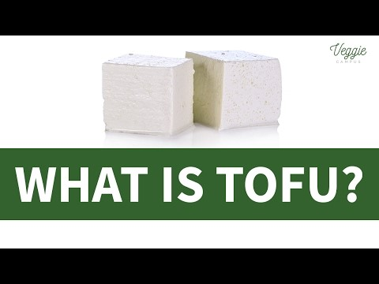
What is Tofu?
Notes:
DO:
Show the video: What Is Tofu?
FEEDBACK:
If the video does not immediately start, you can find it at:
https://www.youtube.com/watch?v=M80wOarJ5Vc
DO:
Review the basics of the video. Tofu is:
Made of soybeans
A great source of protein and iron
Available in silken, soft, medium, firm, and extra firm forms
A great substitute for meat

Slide 55

Tofu C.E.F.
Commercially prepared
Easily recognized as meat substitute
Five grams of protein
Notes:
SAY:
There are three requirements for using tofu. A great way to remember the requirements is through the acronym: C.E.F.
Commercially prepared
Easily recognized as a meat substitute
Five grams of protein
Let’s review each of these requirements.

Slide 56

Commercially Prepared
Must be commercially prepared tofu
Non-commercial or non-standardized are not creditable
  Example: homemade tofu
Notes:
SAY:
First, when using tofu and tofu products, they must be commercially prepared. Those products that are non-commercial or non-standardized are not creditable. For example, preparing or purchasing homemade tofu would not credit because it is not commercially prepared.

Slide 57
Recognized as Meat Substitutes
CREDITABLE
NOT CREDITABLE
Tofu links & tofu sausages
Tofu pieces in a salad
Tofu cubes in a stir fry
Tofu omelets
Tofu miso soup
Tofu noodles: Credit as a grain component
Smoothies with soft or silken tofu: Adds texture
Baked desserts with soft or silken tofu: Adds texture
Notes:
SAY:
Second, tofu must be easily recognized as a meat substitute to credit as a meat alternate. A good way to apply this requirement is to think about it from a child’s perspective. Children should be able to easily recognize the tofu item as a meat product.
Some allowable ways to use this item include:
Tofu links and tofu sausages
Tofu pieces in a salad
Tofu cubes in a stir fry
Tofu omelets
Tofu miso soup
However, if tofu mimics another food group or is used to add texture, it is not creditable because it is not easily recognized as a meat alternate. Some examples include:
Tofu noodles: Mimics a grain
Smoothies with soft or silken tofu: Adds texture
Baked desserts with soft or silken tofu: Adds texture

Slide 58
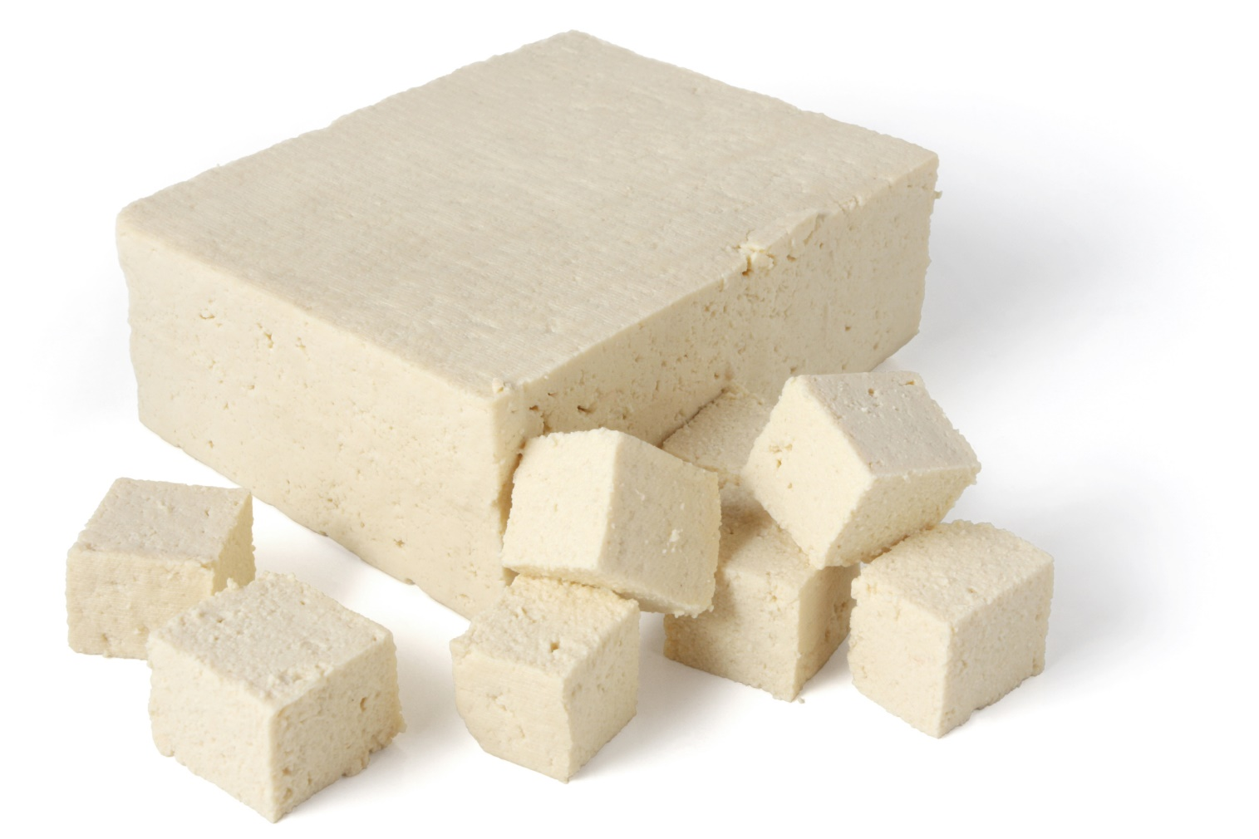
Five Grams of Protein
Tofu must contain 5 grams of protein per 2.2 ounces (¼ cup) by weight
Locating products
  Nutrition Facts label
  Child Nutrition (CN) Label
  Product Formulation Statement
Notes:
SAY:
The third requirement is that tofu must contain 5 grams of protein per 2.2 ounces (¼ cup) to credit as 1 ounce of the M/MA. In plain unprocessed tofu, you can find the total amount of protein by reading the Nutrition Facts label on the back of the product. However, if it were a processed tofu product, such as links and sausages made from tofu, a Nutrition Facts label would not provide enough information to determine if the item meets the minimum requirement.
In these cases, you will need a Child Nutrition (CN) Label or product formulation statement to verify the food item contains the minimum protein requirement. If you purchase from your local grocery store, you may find that CN Labels are not commonly available for food items. Therefore, you may need to contact the manufacturer to request a product formulation statement.
DO:
Ask participants to turn to the Sample CN Label handout in their Participant’s Workbook. Then, review the basics of the handout.
FEEDBACK:
The purpose of reviewing the handout is to give the participant insight on what the CN Label looks like and what it contains. Allow participants to respond, and then advance to the next slide.

Slide 59

Activity: Serving Tofu
Notes:
DO:
(Activity): Serving Tofu
The purpose of this activity is to identify the requirements for serving tofu in facilities participating in the CACFP.
Materials Needed: CACFP Tofu Recipes handout, Tofu Requirements worksheet, pen or pencil
Time: 5–10 minutes
Instructions:
SAY: Now that we have explored the requirements for serving tofu, let’s review them using the C.E.F. acronym.
DO: Review the Answer Key: Tofu Requirements with the participants.
SAY: Please turn to the CACFP Tofu Recipes in your Participant’s Workbook. Take a couple of minutes and select one or two recipes you could incorporate in your program. List the titles in the space provided on the Tofu Requirements worksheet.
DO: Allow 3–5 minutes for participants to complete this activity. Then, request a few volunteers to share their selected recipes.

Slide 60


Yogurt
Added Sugars Limit:
  Current: No more than 23 grams of total sugar per 6 oz
  Effective October 1, 2025: no more than 12 grams of added sugars per 6 ounces
Notes:
OBJECTIVE 3: Participants will be able to select yogurt products that meet the CACFP added sugars limit requirements.
NOTE TO INSTRUCTOR: If this lesson is taught in combination with the Infant Meal Pattern Requirements Training, skip forward to the lesson conclusion, as this information was previously covered.
SAY:
Yogurt is a great source of protein; this macronutrient provides energy, builds and maintains muscle, and promotes a healthy metabolism. However, some yogurts have significantly more sugar than others do. Exposing young children to high amounts of sugar early on can have a negative influence on their eating habits. As a result, the meal pattern requirements limit the added sugars in creditable yogurts, including soy yogurts. Through September 30, 2025, yogurt must contain no more than 23 grams of total sugars per 6 ounces. By October 1, 2025, yogurt must contain no more than 12 grams of added sugars per 6 ounces (2 grams of added sugars per ounce).

Slide 61
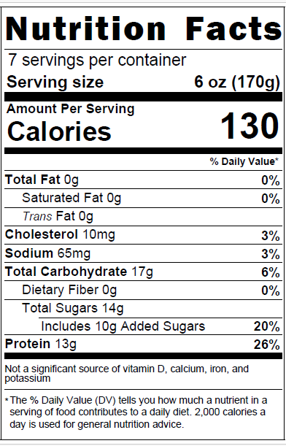
Nutrition Facts Label
Helpful for identifying nutritious foods
  Example: Yogurt
Found on packaged foods
Notes:
SAY:
The first step in determining yogurt products that meet the added sugars limit is to know exactly what to look for on the Nutrition Facts label. This step is helpful in identifying nutritious foods that align with the meal pattern requirements.

Slide 62
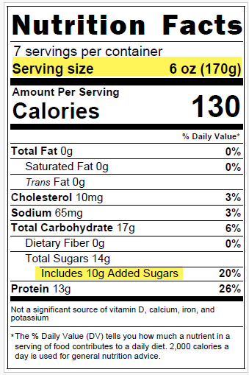
Key Terms
Serving Size
  Number of servings in a package
  Unit: ounces, cups, per container, etc.
Added Sugars
  Amount per serving
Notes:
SAY:
When reading Nutrition Facts labels to determine if it meets the added sugars requirements, there are two key terms to look for: Serving Size and Added Sugars. The serving size is the number of servings in a food package, in which the serving size is provided in units, such as ounces, cups, or container. It is also provided in grams in parentheses.

Slide 63
Table Method: Yogurt
Yogurt Added Sugars Limits
Serving Size (Ounces) | Serving Size (Grams) | Added Sugars Limit
2.25 ounces | 64 grams | 4 grams
3.5 ounces | 99 grams | 7 grams
4 ounces | 113 grams | 8 grams
5.3 ounces | 150 grams | 10 grams
6 ounces | 170 grams | 12 grams
8 ounces | 227 grams | 16 grams
Notes:
SAY:
There are a couple methods to determine if a yogurt meets the added sugars limit. Today, we will explore the table method for yogurt, as it is the easiest and the fastest way to determine if a yogurt item meets the added sugars limit. This method features a table with common sizes of yogurt and the pre-calculated added sugars limit for each size. For your reference, you can find this method on the Yogurt and Added Sugars Guide handout, as well as a link to the USDA’s training worksheets, in your Participant’s Workbook.
As you can see in this table, there are three major columns.
The left column, Serving Sizes (Ounces) is used when a yogurt’s Nutrition Fact label lists the serving size in ounces, such as 6 ounces or 8 ounces.
The middle column, Serving Sizes (Grams), is used when the Nutrition Fact label’s serving size is not in ounces, but in cups, containers, or other units. In situations such as these, you can use the number in parenthesis, the grams, to determine if the yogurt is within the sugar limit.
The right column lists the added sugars limits for each serving size.
The table method was adapted from the USDA Team Nutrition’s training worksheet “Choose Yogurts That Are Low in Added Sugars.” You can find a link to this resource on the Training Resources handout in the Appendix of your Participant’s Workbook.

Slide 64
Table Method Steps
Step 1: Find the Serving Size, in ounces (oz) or grams (g): 6 oz
Step 2: Find the amount for Added Sugars: 10 grams
Notes:
SAY:
This method features four steps.
First, use the Nutrition Facts label to find the Serving Size, in ounces (oz) or grams (g), on the yogurt. In this case, the Serving Size is 6 ounces.
Next, look at the number next to Added Sugars. There is 10 grams of added sugars in this package per serving.

Slide 65
Table Method Steps
(cont.)
Yogurt Added Sugars Limits Table
Serving Size (Ounces) | Serving Size (Grams) | Added Sugars Limit
2.25 ounces | 64 grams | 4 grams
3.5 ounces | 99 grams | 7 grams
4 ounces | 113 grams | 8 grams
5.3 ounces | 150 grams | 10 grams
6 ounces | 170 grams | 12 grams
8 ounces | 227 grams | 16 grams
Step 3: Find the serving size in the Added Sugars Limits Table
Step 4: Look at the number to the right of the serving size, under the “Added Sugars Limit” column
  Serving size: 6 oz
  Added sugars: 10 grams
Notes:
SAY:
Then, locate the yogurt’s Serving Size in the “Serving Size in Ounces” column on the “Added Sugars Limits Table.” In this case, it is 6 ounces.
Last, look at the number to the right of the serving size amount, under the “Added Sugars Limit” column in the table. If your yogurt has that amount of added sugars or less, the yogurt meets the added sugars requirement.
DO:
Encourage participants to look at the Added Sugars Limits Table to determine if the yogurt is within the added sugars limit requirements. Then ask is this yogurt creditable?

Slide 66
Is It Creditable?
Yogurt Added Sugars Limits Table
Serving Size (Ounces) | Serving Size (Grams) | Added Sugars Limit
2.25 ounces | 64 grams | 4 grams
3.5 ounces | 99 grams | 7 grams
4 ounces | 113 grams | 8 grams
5.3 ounces | 150 grams | 10 grams
6 ounces | 170 grams | 12 grams
8 ounces | 227 grams | 16 grams
Yes, it is creditable—10 grams is less than the 12 grams added sugars limit!
Notes:
SAY:
According to the table, for a 6-ounce serving, the added sugars limit is 12 grams of added sugars. Therefore, this item is creditable because the added sugars amount, 10 grams, is less than the added sugars limit of 12 grams.

Slide 67
Serving Size in Grams
Yogurt Added Sugars Limits Table
Serving Size (Ounces) | Serving Size (Grams) | Added Sugars Limit
1 ounce | 28 grams | 2 grams
1.5 ounces | 43 grams | 3 grams
2 ounces | 57 grams | 4 grams
2.5 ounces | 71 grams | 5 grams
3 ounces | 85 grams | 6 grams
4 ounces | 113 grams | 8 grams
Serving size:
½ cup (85g)
Added Sugars: 9 grams
Not Creditable
9 grams is not less than 6g added sugars limit
Notes:
SAY:
Sometimes you may find yogurts that do not list the serving size in ounces, but in cups or grams. In the second example, this yogurt label lists “1/2 cup (85 grams)” as the serving size and “9 grams” for added sugars. Using the middle column in the Yogurt Added Sugars Limits Table, this product would not be creditable because 9 grams of added sugars is not less than the added sugars limit requirements 6 grams for a product with 85 grams per serving size.
Some yogurts may list the serving size as one container and not list ounces and grams on the Nutrition Facts label. In these cases, refer to the front of the package, to see how many ounces or grams are in the container.

Slide 68

Activity: Yogurt, Is It Creditable?
Notes:
DO:
(Activity): Yogurt, Is It Creditable?
The purpose of this activity is to provide an opportunity to practice identifying yogurt products that meet the added sugars limit requirements for the CACFP.
Materials Needed: Yogurt, Is It Creditable? worksheet, pen or pencil
Time: 10–15 minutes
Instructions:
SAY: Please turn to the Yogurt, Is It Creditable? worksheet in your Participant’s Workbook. Use the Added Sugars Limits Table to determine if the yogurt is creditable.
DO: Allow 5–10 minutes for the participants to complete the assignment. Then, use the Answer Key: Yogurt, Is It Creditable? to review the answers with the participants.

Slide 69

Using Yogurt
Use commercial yogurt products only
Soy yogurt is a dairy-free option
4 oz credits as 1 oz of meat alternate
Adults only:
  Yogurt may be used as a milk substitute or meat alternate
Notes:
SAY:
When incorporating yogurt in your menus, there are some additional points to note. As previously mentioned, soy yogurt now credits as a dairy-free option for children and adult meals. In addition, 4 ounces of yogurt, including soy yogurt, credits as 1 ounce of meat alternate.
In addition, yogurt may credit as a meat alternate or as a milk substitute for adults only. However, it may not credit for the milk component and the meat alternates components in the same meal. Also, yogurt may only be served as a milk substitute once per day.

Slide 70

Non-Creditable Yogurt Products
Frozen yogurt
Drinkable yogurt
Homemade yogurt
Yogurt flavored products
Yogurt bars
Yogurt covered fruits & nuts
Yogurt in commercially prepared smoothies
Notes:
SAY:
Lastly, when purchasing yogurt items, you may find a variety of options. However, some of these items are not creditable in the CACFP, such as:
Frozen yogurt
Drinkable yogurt
Homemade yogurt
Yogurt flavored products
Yogurt bars
Yogurt covered fruits and nuts
Yogurt in commercially prepared smoothies
For reimbursable meals and snacks, always choose plain or flavored, sweetened or unsweetened commercially prepared yogurt.

Slide 71
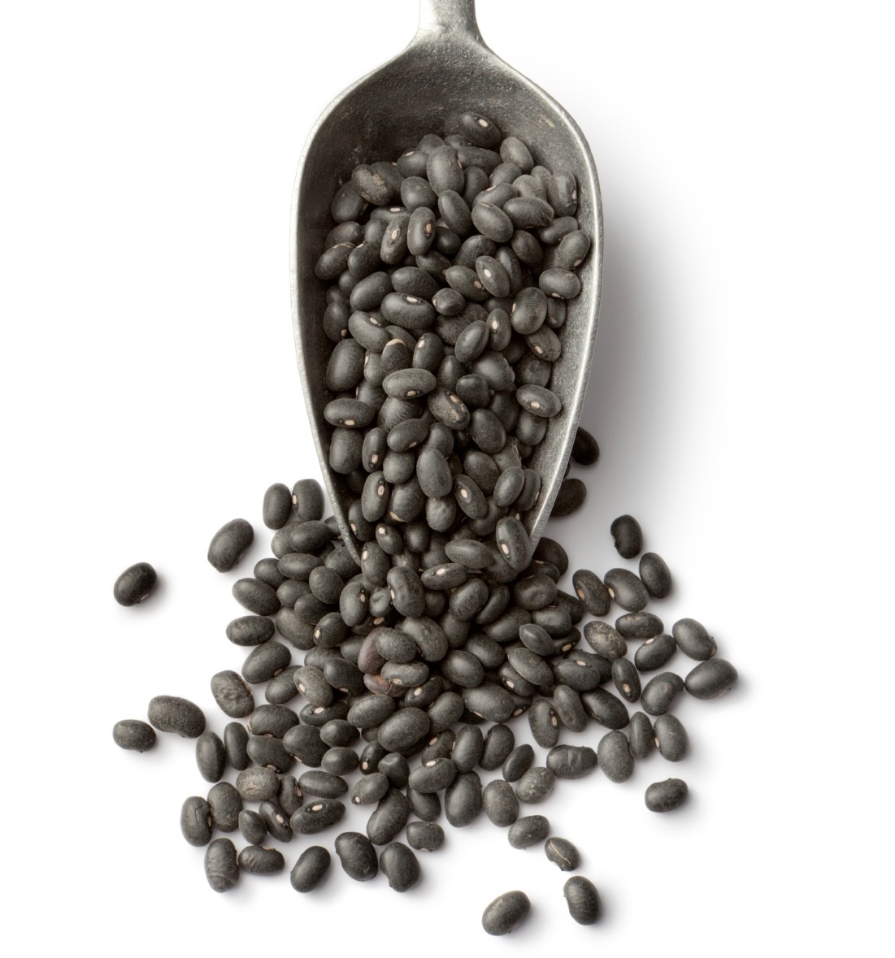
Other M/MA
Nuts and seeds
Beans, peas, and lentils
Eggs
Cheeses
Notes:
SAY:
It is important to note that nuts, seeds, beans, peas, lentils, eggs, and cheese may be used to meet all or part of the M/MA component. Please refer to the Child and Adult Meal Pattern Requirements handout in your Participant’s Workbook for examples of M/MA and specific serving sizes for each food type.

Slide 72
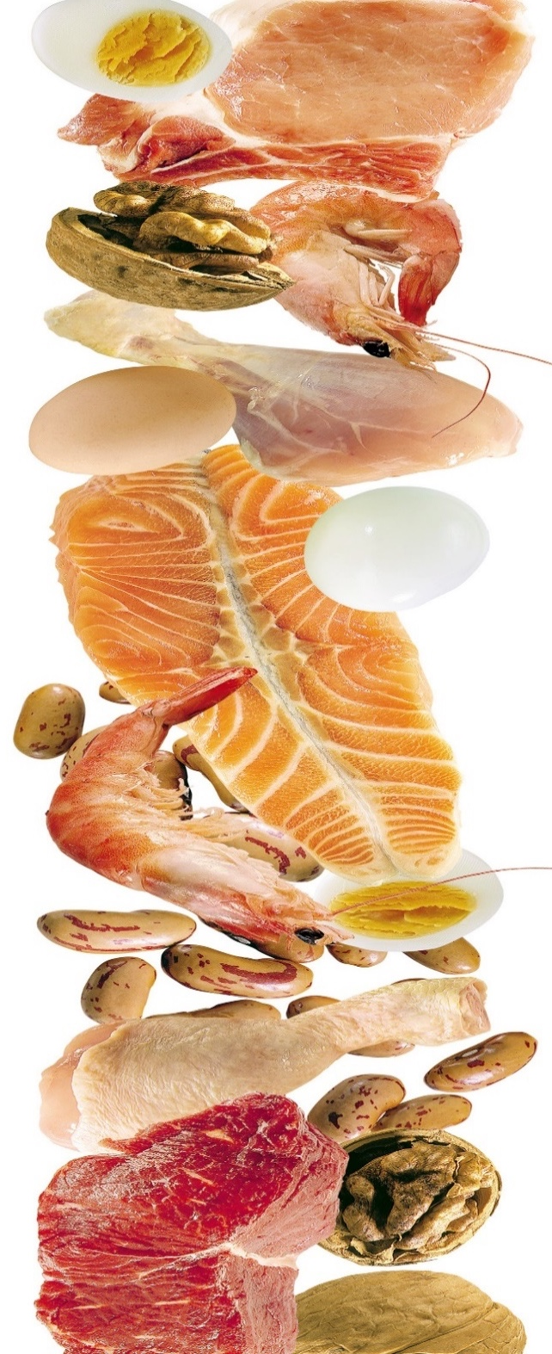
Lesson Conclusion
Optional: At breakfast, serve M/MA a maximum of 3 times per week
Tofu credits as a meat alternate
Yogurt and soy yogurt must meet added sugars limit
Notes:
SAY:
Throughout this lesson, we explored three key topics for meeting the updated meal pattern requirements.
M/MA may be served in place of the entire grains component at breakfast a maximum of three times per week.
Tofu counts as a meat alternate.
Creditable yogurt, including soy yogurt, must meet added sugars limit. Through September 30, 2025, yogurt must contain no more than 23 grams of total sugars per 6 ounces. By October 1, 2025, yogurt must contain no more than 12 grams of added sugars per 6 ounces (2 grams of added sugars per ounce)..
ASK:
At this time, are there any questions before we move to the last activity in this lesson?
DO:
Answer any questions, and then begin the next activity.
NOTE TO INSTRUCTOR: If there are questions that you are unable to answer, refer the participant(s) to their State agency or to the ICN Help Desk.

Slide 73
Activity: Apply in Three
Notes:
DO:
(Activity): Apply in Three
The purpose of this activity is to ensure participants identify an action plan for implementing the M/MA component requirements.
Materials Needed: Apply in Three worksheet, pen or pencil
Time: 5–10 minutes
Instructions:
SAY: Turn to the Apply in Three worksheet in your Participant’s Workbook. Write at least three things you learned about the M/MA component, how you will apply this information, and the estimated date in which you would like to have completed each action item. Once you have finished filling in the worksheet, stand up, find someone from a different group, and share your responses.
DO: Allow 3–5 minutes for participants to complete this activity. Then, request volunteers to share their responses.
FEEDBACK:
There are no right or wrong answers for this activity. However, some potential responses might include those noted in the following Answer Key: Apply in Three.
NOTE TO INSTRUCTOR: If this training is offered in the comprehensive 6-hour version, skip the lesson post-assessment. However, if this training is offered in individual lesson form, follow the instructions below to complete the post-assessment.

Slide 74
Post-Assessment
Notes:
DO:
Post-Assessment
The purpose of the Post-Assessment is to determine what the participants learned throughout the training.
Materials Needed: Post-Assessment, Training Evaluation, and pen or pencil
Time: 10 minutes
Instructions:
DO: Distribute the Post-Assessment and the Training Evaluation.
SAY: The Post-Assessment is designed to assess what you have learned during this training. Begin by placing a four-digit number in the box at the top of your assessment. Then, complete the Post-Assessment by reading each question carefully and selecting the best answer. Upon completion, please complete the training evaluation.
DO: Allow a minimum of 10 minutes for participants to complete the Post-Assessment. Remind them to list the identifier they used on the Pre-Assessment. Following, collect the Post-Assessments and the Training Evaluations, and return them to the ICN. Then, dismiss the participants from the training.
NOTE TO INSTRUCTOR: If this training is not sponsored by the ICN, allow the participants to keep their assessments. Review the answers with them using the Answer Key in the Appendix section. Then, dismiss the participants from the training.

Slide 75

Lesson: Vegetables & Fruits Components
Notes:
DO:
To begin this training, advance to the next slide.

Slide 76

Vegetables & Fruits Components Overview
Findings:
  Most do not eat enough vegetables & fruits
  Often prepared with added salt, sugar, solid fat, & refined starch
Separates vegetables & fruits components into two components
Limits the serving of juice to once per day
Notes:
SAY:
According to the Dietary Guidelines for Americans, most Americans do not consume enough vegetables and fruits. Also, when people do eat them, they are often prepared with added salt, sugar, solid fat, and refined starch. Therefore, the meal pattern requirements focus on increasing nutritious vegetables and fruits in the diet by:
Separating the vegetables and fruits components
Limiting juice to once per day

Slide 77

Lesson Objectives
Recall the requirements for separating the vegetables & fruits components
Describe the meaning of limiting juice to once per day
Notes:
SAY:
Throughout this lesson, we will explore the following objectives:
Recall the requirements for separating the vegetables and fruits components.
Describe the meaning of limiting juice to once per day.
At the end of this lesson, you should know the latest updates, as well as some key strategies for implementation. For your reference, refer to the Vegetables and Fruits Basic handout in your Participant’s Workbook.
NOTE TO INSTRUCTOR: If this training is offered in the comprehensive 6-hour version, skip the lesson pre-assessment. However, if this training is offered in individual lesson form, follow the instructions below to complete the pre-assessment.

Slide 78
Pre-Assessment
Notes:
DO:
Pre-Assessment
The purpose of this Pre-Assessment is to determine current knowledge of the updated meal pattern requirements.
Materials Needed: Pre-Assessment and pen or pencil
Time: 5–10 minutes
Instructions:
SAY: Before we begin objective 1, let’s assess what you already know by completing a Pre-Assessment.
DO: Distribute the Pre-Assessment.
SAY: Now that you have the Pre-Assessment, begin by placing a four-digit number in the box at the top of your assessment. Make a note of this number, as you will use it again when completing the Post-Assessment. Then, read each question carefully and select the best answer. When you have finished, place your assessment in the center of the table (or in a specified location).
DO: Allow a minimum of 5–10 minutes for participants to complete the Pre-Assessment. Remind them to list a non-identifier and to make a note of it for the Post-Assessment. Then, collect each assessment and set them aside.
NOTE TO INSTRUCTOR: If the Institute of Child Nutrition (ICN) sponsors this training, collect the Pre-Assessments and return them along with the evaluations to ICN.

Slide 79

Separation of Vegetables & Fruits
Breakfast: 1 meal component
Lunch & Supper: 2 meal components
Snack (Optional): 2 meal components
Notes:
OBJECTIVE 1: Participants will be able to recall the requirements for separating the vegetables and fruits components.
SAY:
Let’s begin by exploring the separation of the vegetables and fruits components. The meal pattern requirements separate the vegetables and fruits components into two components at lunch, supper, and snack. This means one fruit and one vegetable must be served during lunch and supper meals, and a reimbursable snack may consist of a vegetable and a fruit.
Vegetables and fruits are still a combined component at breakfast. This means vegetables, fruits, or a combination of both may be served at breakfast to meet the fruit and vegetable component.

Slide 80

Increase Vegetable Consumption
Lunch & Supper: A vegetable may be used to meet the entire fruits component
Must be at least the same serving size as the fruits component it replaced
Notes:
SAY:
To increase the amount of vegetables eaten by CACFP participants and to provide greater flexibility to the menu planner, a vegetable may be used to meet the entire fruits component for lunch and supper. For example, a serving of broccoli and a serving of carrots would credit towards a reimbursable lunch.
This change allows a vegetable and fruit, or two vegetables at lunch or supper. However, serving two fruits at mealtimes is not creditable in the meal pattern requirements. Also, the vegetable substitute must be at least the same serving size as the fruit component it replaced.
Refer to the Vegetables and Fruits Components handout for a sample menu, reflecting the separation of the fruits and vegetables component.

Slide 81
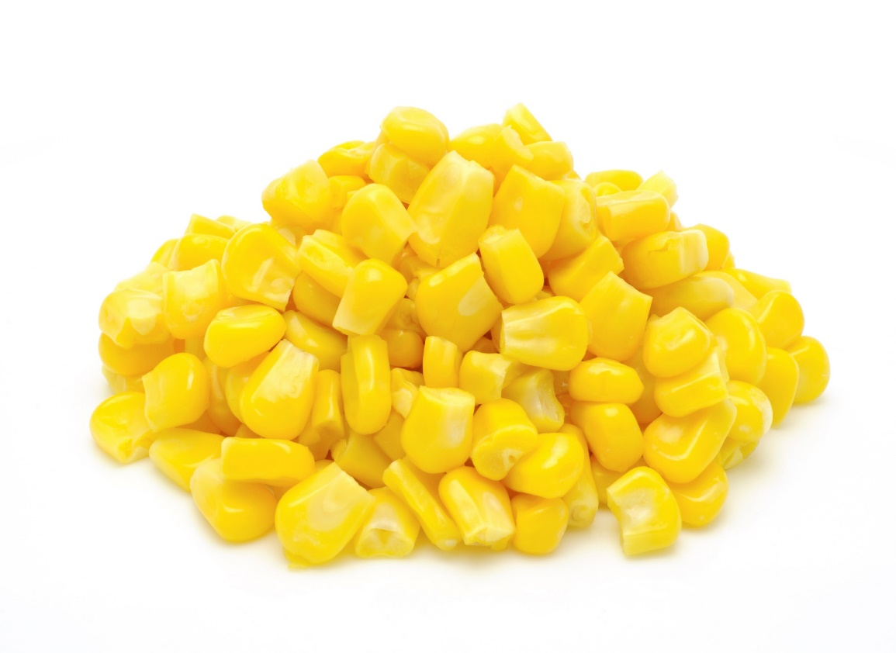

Two Vegetable Types
Must offer two different types of vegetables
  Example: two servings of carrots would not credit, but corn & green beans would
Selecting based on vegetable subgroups is not required
Notes:
SAY:
When using this option, it is important to note that for a reimbursable meal, you must offer two different types of vegetables. For example, a serving of roasted carrots and a serving of steamed carrots would not credit towards a reimbursable meal because the meal only includes one type of vegetable.
The two different types of vegetables do not need to be from different vegetable subgroups (e.g., dark green vegetables, red and orange vegetables, starchy vegetables, beans, peas, and lentils, or other vegetables). For example, you could serve tomatoes and carrots, which are both from the red/orange group, and count it towards a reimbursable meal.

Slide 82

Juice Blends & Purees
Credit as the fruits component or a vegetables component
Contributes to the meal component with the highest ingredient
  Fruits component: if it has more fruits than vegetables
  Vegetables component: if it has more vegetables than fruits
Notes:
SAY:
Because of the separation of the vegetables and fruits component, 100% juice blends and purees credit as either a fruit or a vegetable. Juice blends and purees will contribute to the meal component with the highest ingredient. For example, if the juice blend or puree contains more fruits than vegetables, the beverage will contribute to the fruits component. If it has more vegetables than fruit, it will contribute to the vegetables component.

Slide 83
Activity: Recall That Phrase
Notes:
DO:
(Activity): Recall that Phrase
The purpose of this activity is to ensure participants understand the changes for separating the vegetables and fruits components.
Materials Needed: Recall that Phrase worksheet and pen or pencil
Time: 5–10 minutes
Instructions:
SAY: Now that we have explored the updated requirements for separating the vegetables and fruits components, let’s complete an activity. Turn to the Recall that Phrase worksheet in your Participant’s Workbook. Complete each sentence using those featured in the Phrases column. Then, select a few items to complete each menu. Once you have finished, stand up.
DO: Allow 5 minutes for participants to complete this activity, and then review the sentences with the participants using the following Answer Key: Recall that Phrase.

Slide 84

Juice
Great source of essential nutrients
Lacks dietary fiber, major source of sugar
May be served at one meal or snack per day
  Extra item, not encouraged
Notes:
OBJECTIVE 2: Participants will be able to describe the meaning of limiting juice to once per day.
SAY:
The next update focuses on juice. Pasteurized, 100% juice can be a source of essential nutrients. However, it lacks the dietary fiber found in other forms of fruit. Also, juice is often a major source of sugar in which some juices can contain almost the same amount of sugar as soft drinks.
To reduce the amount of sugar in the diets of young children, the requirements limit the service of juice to one meal or snack per day for child and adult participants. If you should claim fruit or vegetable juice at more than one meal, including snack, the meal with the lowest reimbursement rate containing juice would be disallowed.
As a reminder, juice is not allowed under the infant meal pattern for those of you who have infants in your care.

Slide 85
Juice & Different Groups
Served to only
1 group
Morning Group AM Snack
Afternoon Group
PM Snack
Notes:
ASK:
How many of you serve different meals to different groups, such as a morning group and an afternoon group?
DO:
Allow participants to respond.
SAY:
If you have two different groups, such as a morning group and an afternoon group, and you serve different meals to each group, you may serve juice to only one of the groups as part of a reimbursable meal. The reason being, the juice limit requirement applies to the facility—not the individual child or adult participant. Therefore, serving juice to both groups would not comply with the latest updated requirements.

Slide 86
Serve to all participants at a single meal or snack
Shift: 1:30
Shift: 2:00
Shift: 2:30
Juice & Different Shifts
Notes:
ASK:
How many of you serve one meal in two shifts, such as serving lunch to 3 year olds at 11:30 am and 4 year olds at 12:30 pm?
SAY:
Often times, spacing, licensing requirements, or other measures may call for operators to serve each meal or snack in shifts. For example, an operator serves snack to two years olds at 1:30 pm, three year olds at 2:00 pm, and four year olds at 2:30 pm. In this and similar situations, it is reimbursable to serve juice to all participants because juice is being used to meet the vegetable component or fruit component for a single meal or snack.
However as previously mentioned, juice may not be used to meet the vegetable component or fruit component at two distinctly different meals or snacks.

Slide 87

Activity: Juice, Does It Comply?
Notes:
DO:
(Activity): Juice, Does It Comply?
The purpose of this activity is to ensure participants understand the changes for separating the vegetable and fruit component.
Materials Needed: Juice, Does It Comply? worksheet and pen or pencil
Time: 5–10 minutes
Instructions:
SAY: Now that we have explored the updated requirements for serving juice, let’s complete an activity. Turn to the Juice, Does It Comply? worksheet in your Participant’s Workbook. Determine if the scenarios comply with the juice requirement. Once you have finished, stand up.
DO: Allow 3–5 minutes for participants to complete this activity, and then review the sentences with the participants using the following Answer Key: Juice, Does It Comply?
FEEDBACK:
The menu for two vegetables should contain two different types of vegetables.

Slide 88
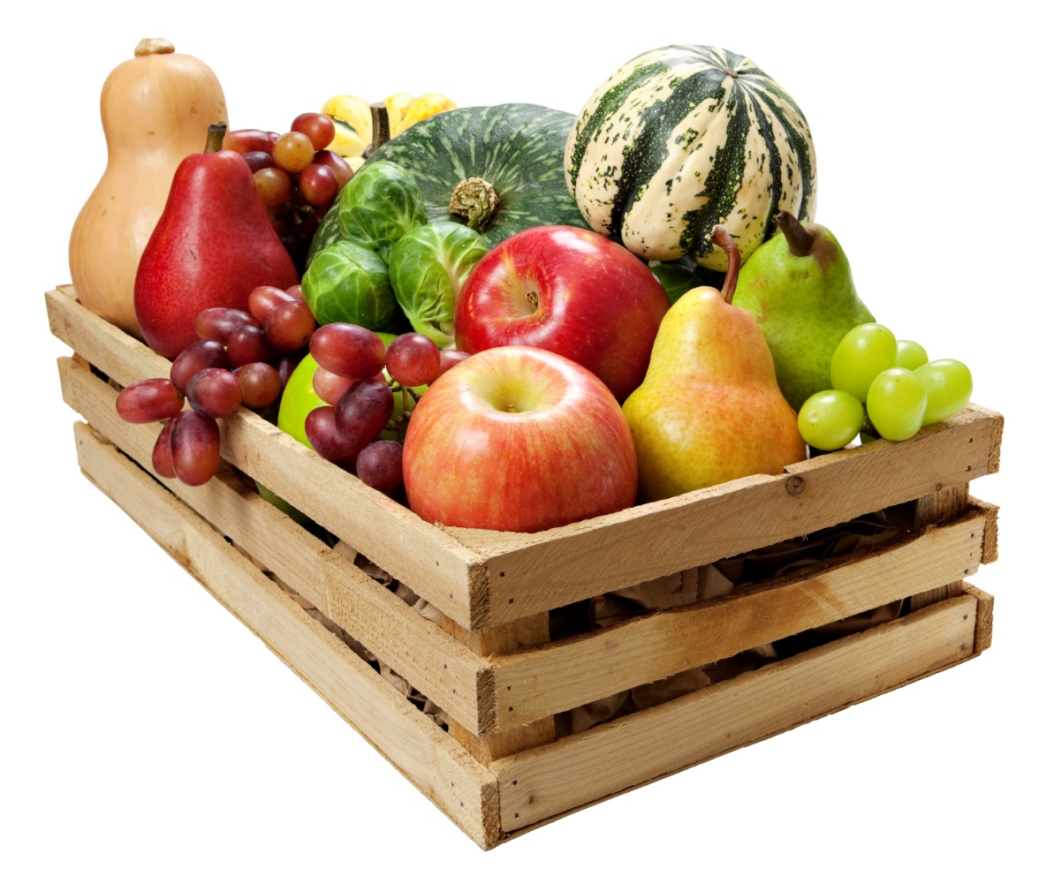
Lesson Conclusion
Fruits & vegetables components
  Single component at breakfast
  Separate components at
  lunch, supper, & snack
Juice is limited to once
per day
Notes:
SAY:
Throughout this lesson, we explored the requirements for the vegetables and fruits components. In particular, we explored the requirements for:
Separating the vegetables and fruits components at lunch, supper, and snack
Limiting juice to once per day
ASK:
At this time, are there any questions before we complete the last activity in this lesson?
DO:
Answer any questions, and then begin the next activity.
NOTE TO INSTRUCTOR: If there are questions that you are unable to answer, refer the participant(s) to their State agency or to the ICN Help Desk.

Slide 89
Activity: Apply in Three
Notes:
DO:
(Activity): Apply in Three
The purpose of this activity is to ensure participants identify an action plan for implementing key vegetables and fruits components requirements.
Materials Needed: Apply in Three worksheet and pen or pencil
Time: 5–10 minutes
Instructions:
SAY: Turn to the Apply in Three worksheet in your Participant’s Workbook. Write at least three things you learned about the vegetables and fruits components, how you will apply this information, and the estimated date in which you would like to have completed each action item. Once you have finished, stand up and find someone from a different group, and share your responses.
DO: Allow 3–5 minutes for participants to complete this activity. Then, request volunteers to share their responses.
FEEDBACK:
There are no right or wrong answers for this activity. However, some potential responses might include those noted in the following Answer Key: Apply in Three.

Slide 90
Post-Assessment
Notes:
DO:
Post-Assessment
The purpose of the Post-Assessment is to determine what the participants learned throughout the training.
Materials Needed: Post-Assessment, Training Evaluation, and pen or pencil
Time: 10 minutes
Instructions:
DO: Distribute the Post-Assessment and the Training Evaluation.
SAY: The Post-Assessment is designed to assess what you have learned during this training. Begin by placing a four-digit number in the box at the top of your assessment. Then, complete the Post-Assessment by reading each question carefully and selecting the best answer. Upon completion, please complete the training evaluation.
DO: Allow a minimum of 10 minutes for participants to complete the Post-Assessment. Remind them to list the identifier they used on the Pre-Assessment. Following, collect the Post-Assessments and the Training Evaluations, and return them to the ICN. Then, dismiss the participants from the training.
NOTE TO INSTRUCTOR: If this training is not sponsored by the ICN, allow the participants to keep their assessments. Review the answers with them using the Answer Key in the Appendix section. Then, dismiss the participants from the training.

Slide 91
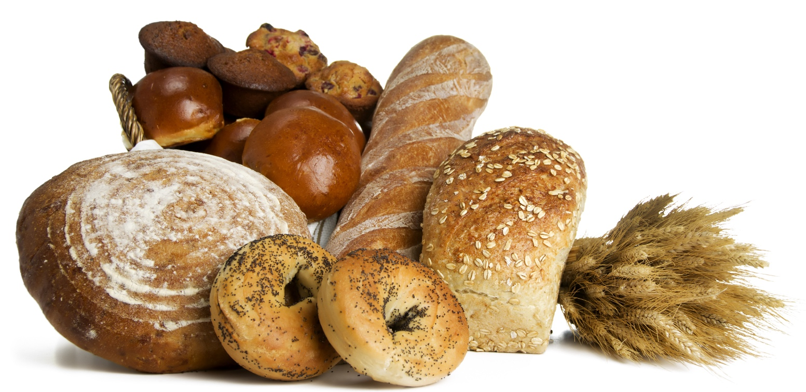
Lesson:
Grains Component
Notes:
DO:
To begin this training, advance to the next slide.

Slide 92
Grains Component Overview
At least 1 serving of grains per day must be whole grain-rich
Breakfast cereals must meet the CACFP added sugars limit
Grain-based desserts do not credit toward the grain component
Use ounce equivalents (oz eq) to determine the amount of creditable grains
Notes:
SAY:
As we all know, a grain is a required component at breakfast, lunch, and supper, and is an optional component at snack. The updated requirements feature some key changes to enhance the overall variety and nutrient quality of meals and snacks. In particular, the four updates state:
At least one serving of grains per day must be whole grain-rich.
Breakfast cereals must meet the CACFP added sugars limit.
Grain-based desserts do not count toward the grain component.
Ounce equivalents (oz eq) are used to determine the amount of creditable grains.

Slide 93
Ounce Equivalents Requirement
Resources
  State agency or sponsor
  USDA’s Using Ounce Equivalents for Grains in the CACFP Training Worksheet
  ICN’s Serving-Up Grains in the CACFP training
Notes:
This training does not go into how to implement ounce equivalents.
For additional information on meeting the ounce equivalents requirements, refer to:
Your state agency or sponsoring organization
USDA’s Using Ounce Equivalents for Grains in the CACFP Training Worksheet
ICN’s Serving-Up Grains in the CACFP training

Slide 94

Lesson Objectives
Describe the requirements for serving a whole grain-rich item as part of a reimbursable meal
Recall four ways to determine if a grain product meets the whole grain-rich criteria
Use two methods for selecting breakfast cereals that meet the CACFP added sugars limit
Recall at least five creditable alternatives to grain-based desserts
Notes:
SAY:
Throughout this lesson, we will explore the updates through the following objectives:
Describe the requirements for serving a whole grain-rich item as part of a reimbursable meal.
Recall four ways to determine if a grain product meets the whole grain-rich criteria.
Use two methods for selecting breakfast cereals that meet the CACFP added sugars limit.
Recall at least five creditable alternatives to grain-based desserts.
At the end of this lesson, you should know the latest updates, as well as some key strategies for implementation. For your reference, refer to the Grains Basics handout in your Participant’s Workbook.
NOTE TO INSTRUCTOR: If this training is offered in the comprehensive 6-hour version, skip the lesson pre-assessment. However, if this training is offered in individual lesson form, follow the instructions below to complete the pre-assessment.

Slide 95
Pre-Assessment
Notes:
DO:
Pre-Assessment
The purpose of this Pre-Assessment is to determine current knowledge of the updated meal pattern requirements.
Materials Needed: Pre-Assessment, pen or pencil
Time: 5–10 minutes
Instructions:
SAY: Before we begin objective 1, let’s assess what you already know by completing a Pre-Assessment.
DO: Distribute the Pre-Assessment.
SAY: Now that you have the Pre-Assessment, begin by placing a four-digit number in the box at the top of your assessment. Make a note of this number, as you will use it again when completing the Post-Assessment. Then, read each question carefully and select the best answer. When you have finished, place your assessment in the center of the table (or in a specified location).
DO: Allow a minimum of 5–10 minutes for participants to complete the Pre-Assessment. Remind them to list a non-identifier and to make a note of it for the Post-Assessment. Then, collect each assessment and set them aside.
NOTE TO INSTRUCTOR: If the Institute of Child Nutrition (ICN) sponsors this training, collect the Pre-Assessments and return them along with the evaluations to ICN.

Slide 96
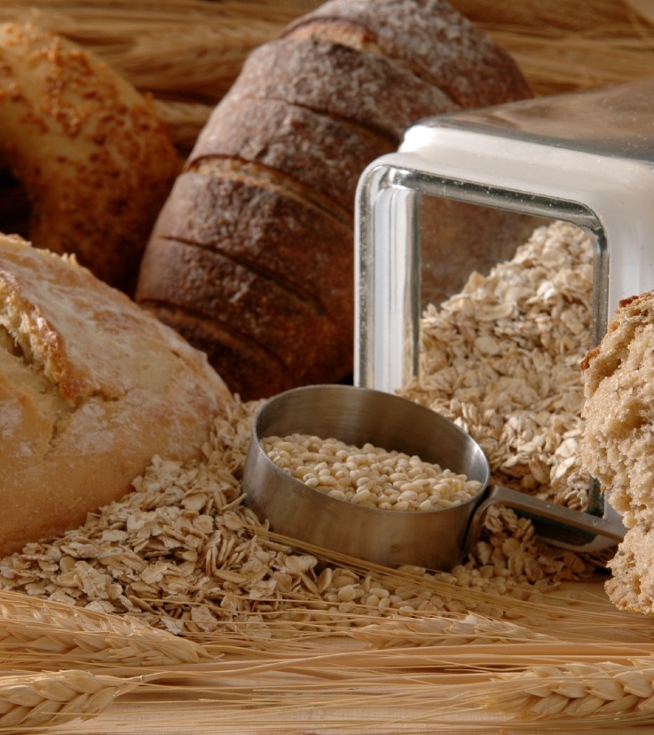
Whole Grain-Rich
“… between 50 and 100% whole grain, with any remaining grains being enriched”
Notes:
OBJECTIVE 1: Participants will be able to describe the requirements for serving a whole grain-rich item as part of a reimbursable meal.
SAY:
The first update for the grain component focuses on whole grain-rich foods. At least one serving of grains per day must be whole grain-rich. These foods are those in which the grain content of a product is between 50 and 100 percent whole grain, with any remaining grains being enriched.
It is important to note that this requirement only applies to meals served to children and adults; it does not apply to infant meals.

Slide 97
Key Terms – Grains
Whole: contains the bran, germ, & the endosperm
Refined: milled, removing the bran & germ
Enriched: nutrients are added back to the refined grain
Fortified: additional vitamins & minerals are added to product
Notes:
SAY:
To meet the whole grain-rich requirement, there are few key terms to highlight. The first term is whole grain. Whole grains are the most nutritious when compared to other grains because they contain all three parts of the kernel: the bran, the germ, and the endosperm. This means they naturally contain the fiber, iron, and other essential nutrients for good health.
Refined grains are milled, which is a process that removes the bran and the germ. During processing, dietary essential nutrients found in whole grains are removed. When a grain is enriched, however, it means the nutrients were added back to the refined grain(s).
The last major term is fortified, and it is commonly associated with breakfast cereals or infant formula. Fortified simply means that vitamins and minerals were added to the product that weren’t originally in the food.
Cereal in particular will list the added vitamins and minerals near the bottom of the Nutrition Facts label. However, those that are not fortified will not list any added vitamins and minerals.
This information can be found on the Grains Key Terms handout in your Participant’s Workbook.

Slide 98
Whole Grain-Rich Foods at Meals & Snacks
Each day, at least one meal or snack must include a whole grain-rich food
Option to choose between breakfast, lunch, or snack
Exception: If serving snacks only, no whole grain-rich food is required, unless a grain is served
  Example: at-risk afterschool programs
Notes:
SAY:
As previously mentioned, one grain served per day must be whole grain-rich. As an operator, you can choose which meal or snack to serve the whole grain-rich food. For instance, operator served a whole grain-rich food at breakfast, a refined grain food at lunch, and did not serve a grain at snack. In this case, the menu complies with the requirement because at least one grain served was whole grain-rich. On the other hand, if the operator served lunch and no other meals or snacks, this meal must include a whole grain-rich food because a grain is required at lunch.
There are some variations on how to apply this requirement based on the meals or snacks served. Take those that only serve snack, such as in an at-risk afterschool program. As we all know, a reimbursable snack consists of two of the five components. If an at-risk afterschool program should serve a fruit and a vegetable or any other non-grain combination, it is not necessary to serve a whole grain-rich food. However, if they serve a grain as part of the snack, it must be a whole grain-rich item.

Slide 99

Documentation & Whole Grain-Rich Foods
Document whole grain-rich foods on menu
  “Whole wheat” bread
  “Whole grain-rich” English muffins
  English muffins “whole grain-rich”
Check with your State agency or sponsor for additional requirements
Notes:
SAY:
Another key factor to meeting the whole grain-rich requirement is documentation. There are several ways to demonstrate compliance with this requirement. For example, you can list which grain items are whole grain-rich directly on the menu by writing one of the following:
“Whole wheat” in front of “bread” so that the menu item reads “whole wheat bread”
“Whole grain-rich” in front of a food item, such as “whole grain-rich English muffins”
It’s important to note that State agencies have the authority to determine other types of acceptable recordkeeping documents required to demonstrate compliance. For example, a State agency may require operators to keep meal production records in addition to their menus. Always check with your State agency or sponsoring organization to learn the best way to demonstrate compliance with the whole grain-rich requirement within your state.

Slide 100
Reviews & Whole Grain-Rich Foods
Review menus, labels, & product information
When a whole grain-rich food is not served:
  The meal or snack containing a grain with the lowest reimbursement will be disallowed
  If no whole grain-rich food was served for breakfast, lunch, or snack, the snack would be disallowed
Notes:
SAY:
When State agency or sponsoring organization staff conducts a review, they will need to check your menus, labels, and product information to ensure that the whole grain-rich items being served meets FNS whole grain-rich criteria.
When these foods are not served, the meal with the lowest reimbursement from that day will be disallowed. For example, last Tuesday you served grains at breakfast, lunch, and snack; however, none of the items were whole grain-rich. In this case, the snack would be disallowed because it is the meal with the lowest reimbursement rate containing a grain.
On the other hand, if you only served grains during breakfast and lunch, and none of the grain items were whole grain-rich, the breakfast would be disallowed because it is the meal with the lowest reimbursement rate containing a grain.
For additional information, refer to the Whole Grain-Rich Foods and Disallowed Meals handout in the reference section of this course.
NOTE TO INSTRUCTOR: For spacing and graphic purposes, the following handout is slightly different from the handout in the Participant’s Workbook.

Slide 101
Revisit the Whole Grain-Rich Requirement
What is the whole grain-rich requirement?
If only serving snacks, such as an at-risk afterschool program, what is the requirement for serving whole grain-rich foods?
Which meal or snack is disallowed if a whole grain-rich food is not served?
What is one other requirement you learned in this portion of the lesson?
Notes:
DO:
Review the key concepts for meeting the whole grain-rich requirement by asking the following questions:
What is the whole grain-rich requirement? One grain served per day must be whole grain-rich.
If you only serve snacks in your program, what is the requirement for serving whole grain-rich foods? A whole grain-rich item is not required if you do not serve a grain. However, if you serve a grain, it must be whole grain-rich.
What happens if you do not serve a whole grain-rich food? The meal with the lowest reimbursement will be disallowed.
What is one other requirement you learned in this portion of the lesson?

Slide 102

Determining Whole Grain-Rich Products Methods
WIC-Approved Whole Grain Food
Labeled as “Whole Wheat” and has a FDA Standard of Identity
FDA Whole Grain Health Claim
Meets the FNS Rule of Three
Meets the Whole Grain-Rich criteria for the NSLP
Proper documentation from a manufacturer or a standardized recipe
Notes:
OBJECTIVE 2: Participants will be able to recall four ways to determine if a grain product meets the whole grain-rich criteria.
SAY:
Now that we have explored the key requirements for serving whole grain-rich items, let’s explore some ways for determining items that meet the FNS whole grain-rich criteria. There are six ways to determine if a grain product is whole grain-rich:
WIC-Approved Whole Grain Food
Bread and Pastas are labeled as “Whole Wheat” and has a FDA Standard of Identity
FDA Whole Grain Health Claim
Meets the FNS Rule of Three
Meets the Whole Grain-rich criteria for the National School Lunch Program (NSLP)
Proper documentation from a manufacturer or a standardized recipe
Any of these six ways can be used to determine if a grain product meets the whole grain-rich criteria.
Let’s review four of these methods and how to apply them when identifying whole grain-rich foods. For additional ways to identify whole grains, refer to the Methods for Identifying Whole Grain-Rich Foods handout in your Participant’s Workbook.

Slide 103

Use WIC-Approved Grains Food List
Special Supplemental Nutrition Program for Women, Infants, & Children (WIC) food lists
Choose whole grains from ANY State’s WIC Approved list
Notes:
SAY:
First, use any State agency’s Special Supplemental Nutrition Program for Women, Infants, and Children (WIC) approved whole grain food list. Each State’s WIC agency provides food lists for identifying nutritious foods for pregnant women, infants, and children. Therefore, any whole grain food featured on these lists will meet the whole grain-rich requirements.
To locate your state’s contact information, refer to the Methods for Identifying Whole Grain-Rich Foods in your Participant’s Workbook. There you will find the website that will take you to each state’s website. Simply enter the web address as indicated on the page in the address bar. Likewise, you can check other States’ websites to identify a variety of other options.

Slide 104
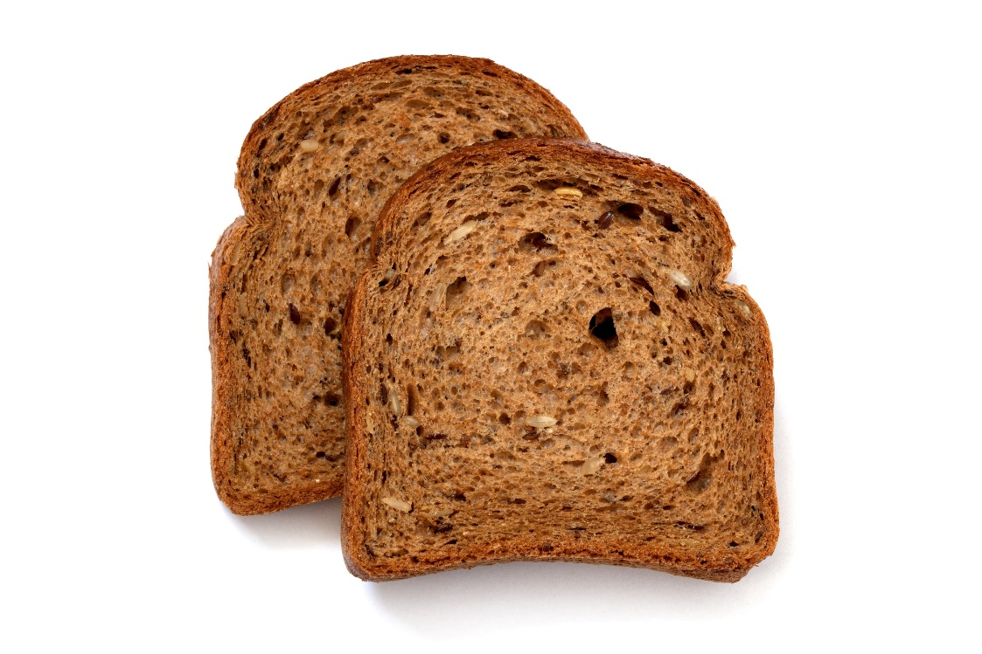
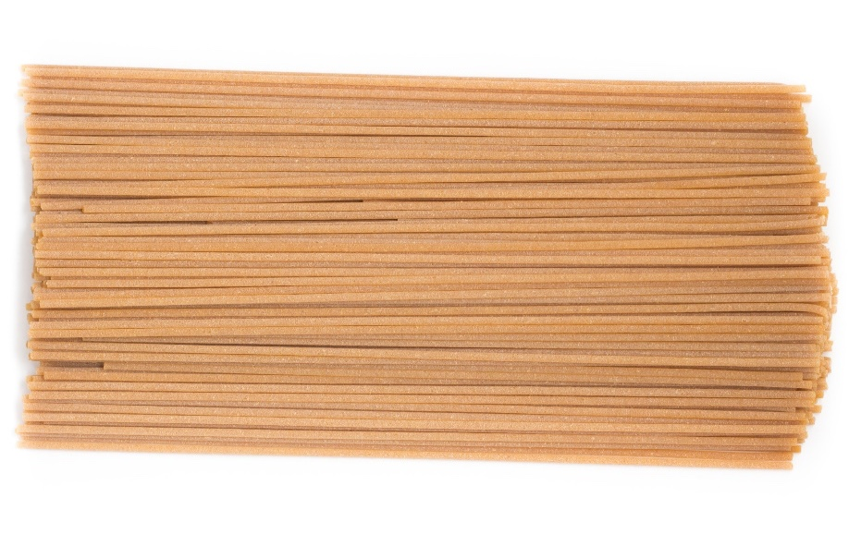
FDA Standard of Identity
Whole wheat breads & pastas only
Contains specific grain ingredients to be labeled as “whole wheat”
Must list the exact product name
Notes:
SAY:
The second method is designed specifically for breads and pastas only. The FDA established a Standard of Identify for whole wheat breads and pastas. These rules identify the grain ingredients manufacturers must include to legally label certain products as “whole wheat.”
Turn to the FDA Standard of Identity and Whole Grain-Rich Breads and Pastas handout in your Participant’s Workbook.
DO:
Allow participants to turn to the handout.
SAY:
As you can see on this handout, there are specific products under both columns for breads and pastas. To be considered as whole grain-rich using this method, the product must list the exact product name as indicated in the chart.
ASK:
Looking at the list, are whole wheat buns whole grain-rich?
DO:
Allow participants to respond.
SAY:
[As you just mentioned,] Yes—whole wheat buns are whole grain-rich using this method.
However, if it were whole grain buns, it would not credit as whole grain-rich because “whole grain” is not a FDA Standard of Identity for breads and pastas. You may still be able to credit the whole grain buns as whole grain-rich. However, you would need to use one of the other methods.

Slide 105
Products Without a Standard of Identify
May not be used on products without a Standard of Identity
  Example: crackers, tortillas, bagels, & biscuits
Watch for tricky wording
  “whole grain”
  “made with whole grains”
  “made with whole wheat”
  “contains whole grains”
Notes:
SAY:
There are two factors to keep in mind when using this method to identify whole grain-rich foods. First, this method may not be used on products without a Standard of Identity, regardless if they are labeled “whole wheat.” These items include crackers, tortillas, bagels, and biscuits; this method must be used for breads and pastas only.
Second, some product labels will have similar, yet tricky wording, such as:
“whole grain”
“made with whole grains”
“made with whole wheat”
“contains whole grains”
ASK:
How many have you seen these labels on packages?
DO:
Allow participants to respond.
SAY:
These terms do not meet the FDA Standard of Identify requirements. Therefore, you must use one of the other methods to determine if items with these labels meet the whole grain-rich criteria.

Slide 106
Whole Grain Health Claims
“Diets rich in whole grain foods & other plant foods & low in total fat, saturated fat, & cholesterol may reduce the risk of heart disease & some cancers.”
OR
“Diets rich in whole grain foods & other plant foods, & low in saturated fat & cholesterol, may help reduce the risk of heart disease.”
Notes:
SAY:
The next way to determine if a product is whole grain-rich is to look for a whole grain health claim on the packaging. A food contains at least 51% whole grains if it has one of these two FDA-approved whole grain health claims on the package:
“Diets rich in whole grain foods and other plant foods and low in total fat, saturated fat, and cholesterol may reduce the risk of heart disease and some cancers.”
“Diets rich in whole grain foods and other plant foods, and low in saturated fat and cholesterol, may help reduce the risk of heart disease.”
It is important to note that the health claims may not be used for documentation purposes in the school meal programs.

Slide 107
Rule of Three
Second GRAIN Ingredient is a whole grain, enriched grain, bran, or germ
Third GRAIN Ingredient is a whole grain, enriched grain, bran, or germ
WHOLE GRAIN-RICH
First Ingredient is a whole grain
Notes:
SAY:
The next method for identifying whole grain-rich items is called the Rule of Three. This method calls for a three-step process for identifying whole grain-rich foods using the product’s ingredients label. Using this method, a product is whole grain-rich if the first ingredient (or second after water) is a whole grain, and the next two grain ingredients (if any) are whole grains, enriched grains, brans, or germs.
To be successful in using this method, it is important to know the following three categories:
Creditable grains or flours
Ingredients to disregard
Non-creditable grains or flours
Let’s take a minute to review these items. Please turn to the Rule of Three: Choosing Creditable Grains handout in your Participant’s Workbook.
DO:
Explain that this handout is ideal for determining food items that meet the Rule of Three criteria. Then, review the components of the handout with the participants. Pay special attention to the following two types of grains they should disregard when reviewing a product using this method:
Those that follow the wording “contains 2% or less” because they are only small amounts in the package
Grain derivatives because they are often small or trace amounts of by-products of grains
Also, explain that if the product has any of the non-creditable grains or flours from the list as one of the first three grain ingredients, the product does not meet the whole grain-rich criteria.
Lastly, explain that this handout is not an exhaustive list of grains. Therefore, if they have additional questions about other grains, they should refer to their sponsoring organization or State agency.

Slide 108
English Muffins
INGREDIENTS: WHOLE WHEAT FLOUR, WATER, ENRICHED WHEAT FLOUR, WHEAT STARCH, YEAST, SUGAR, AND SALT.
Yes, it is whole grain-rich
Notes:
SAY:
Using the Applying the Rule of Three worksheet in your Participant’s Workbook, let’s review three examples for applying this method.
The first example is an English muffin. The ingredients label lists “whole wheat flour, water, enriched wheat flour, wheat starch, yeast, sugar, and salt.” The first ingredient (whole wheat flour) is a whole grain, and the second grain ingredient (enriched wheat flour) is an enriched grain. The only other grain is wheat starch, and it is a grain derivative; therefore, it does not count as a grain ingredient in CACFP.
As a result, this product meets the Rule of Three criteria for whole grain-rich, based on the first two-grain ingredients.

Slide 109
Corn Chips
INGREDIENTS: WHOLE CORN, VEGETABLE OIL, SALT, CHEDDAR CHEESE, MALTODEXTRIN, WHEAT FLOUR, ROMANO CHEESE, WHEY PROTEIN CONCENTRATE.
INGREDIENTS: WHOLE CORN, VEGETABLE OIL, SALT, CHEDDAR CHEESE, MALTODEXTRIN, WHEAT FLOUR, ROMANO CHEESE, WHEY PROTEIN CONCENTRATE.
INGREDIENTS: WHOLE CORN, VEGETABLE OIL, SALT, CHEDDAR CHEESE, MALTODEXTRIN, WHEAT FLOUR, ROMANO CHEESE, WHEY PROTEIN CONCENTRATE.
No, it is not whole grain-rich
Notes:
SAY:
Let’s try another one together. A corn chip’s ingredient list reads: “whole corn, vegetable oil, salt, cheddar cheese, maltodextrin, wheat flour, Romano cheese, whey protein concentrate.”
ASK:
Looking at this ingredient’s list, Is It Whole Grain-Rich based on the Rule of Three criteria?
DO:
Allow time for participants to review the ingredients and respond if it is whole grain-rich. Click through to show answers on the slide.
SAY:
[As you just mentioned,] this item is not whole grain-rich based on the Rule of Three criteria. Although the first ingredient is a whole grain (whole corn), the next grain ingredient (wheat flour) is unenriched wheat flour. You may still serve this item to meet the grain component; however, it would not credit for the whole grain-rich requirement.

Slide 110
Mixed Dishes
Second GRAIN Ingredient is a whole grain, enriched grain, bran, or germ
Third GRAIN Ingredient is a whole grain, enriched grain, bran, or germ
WHOLE GRAIN-RICH
First GRAIN Ingredient is a whole grain
CHEESE PIZZA CRUST
INGREDIENTS: MOZZARELLA CHEESE, PARMESAN CHEESE, WHITE WHOLE WHEAT FLOUR, BROWN RICE FLOUR, ENRICHED FLOUR, NON-FAT MILK, WATER, TOMATO PASTE, YEAST
Notes:
SAY:
When working with mixed dishes, such as pizza crusts or tortillas for burritos, there is a slightly different approach to identifying if the item is whole grain-rich. In this case, the first grain ingredient must be a whole grain, and the next two grain ingredients (if any) must be whole grain, enriched grain, bran, or germ.
For example, this cheese pizza’s ingredients list reads “mozzarella cheese, parmesan cheese, white whole wheat flour, brown rice flour, enriched flour, non-fat milk, water, tomato paste, yeast.”
ASK:
Can you identify the grain ingredients, as well as if this product is whole grain-rich based on the Rule of Three criteria?
DO:
Allow time for participants to review the ingredients and respond if it is whole grain-rich.
SAY:
The grain ingredients are white whole wheat flour, brown rice flour, and enriched flour. This product is whole grain-rich based on the Rule of Three criteria because the first and second grain ingredients are whole grains and the third grain ingredient is enriched.

Slide 111
Flour Blends
Second GRAIN Ingredient (IF ANY) consists of whole grains, enriched grains, brans, or germs
Third GRAIN Ingredient (IF ANY) consists of whole grains, enriched grains, brans, or germs
WHOLE GRAIN-RICH
First INGREDIENT consists of only whole grains
BREAD
INGREDIENTS: FLOUR BLEND (WHOLE WHEAT FLOUR, BROWN RICE FLOUR, WHOLE GRAIN OAT FLOUR), WATER, FLOUR BLEND (WHOLE RYE FLOUR, ENRICHED WHEAT FLOUR, WHEAT BRAN), YEAST, SALT
Notes:
SAY:
You may see an ingredient list that includes a flour blend as an ingredient. Flour blends have a list of sub-ingredients of grains or flours in parentheses after the name. Treat flour blends as one grain ingredient when applying the Rule of Three.
If the flour blend is the first ingredient, it must be a whole grain and consist of only whole grains. If any grains in the flour blend are not whole grains, then the flour blend is not considered a whole grain. If the flour blend is the second or third grain ingredient, then it must be made up of whole grains, enriched grains, brans, or germs.
For example, this bread’s ingredients list reads “flour blend (whole wheat flour, brown rice flour, whole grain oat flour), water, flour blend (whole rye flour, enriched wheat flour, wheat bran), yeast, salt.”
ASK:
Can you identify if the flour blends are whole grains, enriched grains, brans, or germs? Is this product whole grain-rich based on the Rule of Three criteria?
DO:
Allow time for participants to review the ingredients and respond if it is whole grain-rich.
SAY:
The first ingredient is a flour blend consisting of whole wheat flour, brown rice flour, and whole grain oat flour which are all whole grains, therefore, this flour blend is a whole grain ingredient. The second grain ingredient is a flour blend consisting of whole rye flour (whole grain), enriched wheat flour (enriched grain) and wheat bran (bran) making it a creditable second grain ingredient. Therefore, this product is whole grain-rich based on the Rule of Three criteria because the first ingredient is a whole grain and second grain ingredient consists of a whole grain, enriched grain and bran.

Slide 112
Whole Grain-Rich Cereal
Cereal is fortified
WHOLE GRAIN-RICH
First Grain Ingredient is a whole grain
Notes:
SAY:
Similar to mixed dishes, there is a slightly different approach for identifying whole grain-rich breakfast cereals. In this case, if the first grain ingredient is a whole grain and the cereal is fortified, the product meets the whole grain-rich criteria.
ASK:
How do you identify fortified breakfast cereals?
DO:
Allow participants to respond.
SAY:
[As you just mentioned], fortified cereals are those that have added vitamins and minerals not originally in the product. You can determine if a product is fortified if it has a list of vitamins and minerals on the back of the Nutrition Facts label.

Slide 113
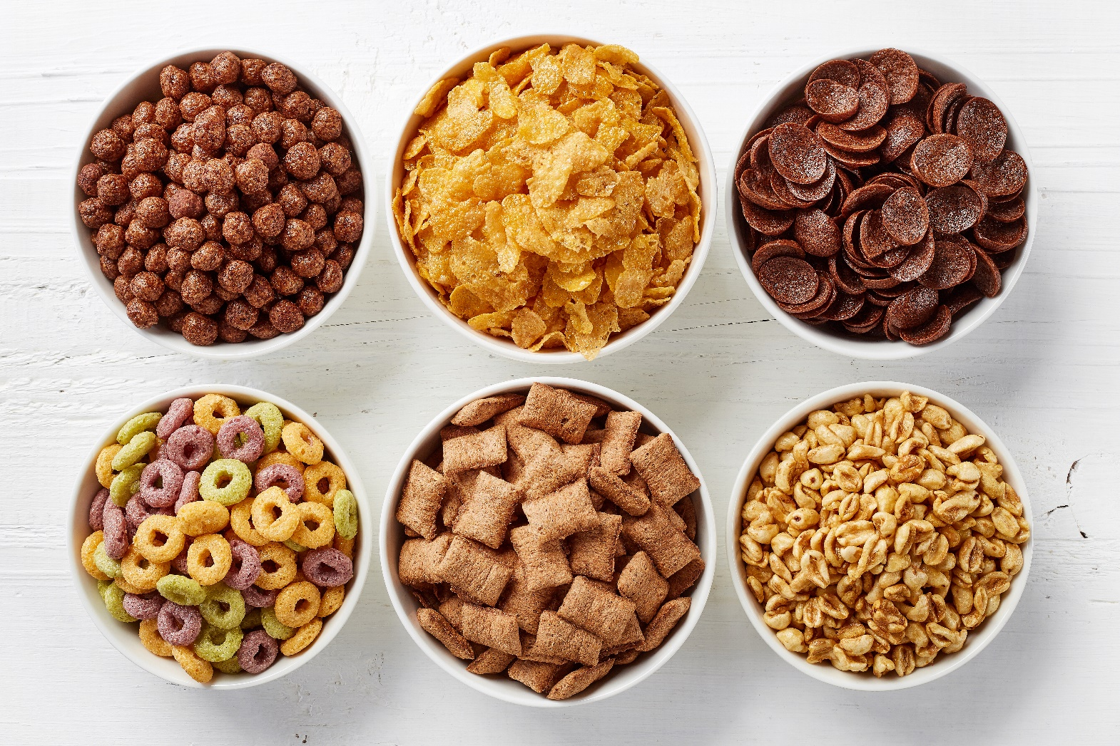
Activity: Rule of Three – Is It Whole Grain-Rich?
Notes:
DO:
(Activity): Rule of Three – Is It Whole Grain-Rich?
The purpose of this activity is to ensure participants are able to read an ingredients list to determine if an item is whole grain-rich based on the Rule of Three criteria.
Materials Needed: Rule of Three – Is It Whole Grain-Rich? worksheet, pen or pencil
Time: 5–10 minutes
Instructions:
SAY: Now that we have reviewed a few examples for determining whole grain-rich foods based on the Rule of Three criteria, let’s complete an activity to practice what you learned. Turn to the Rule of Three – Is It Whole Grain-Rich? worksheet in your Participant’s Workbook. Read each ingredients list to determine if the food item is whole grain-rich based on the Rule of Three criteria.
DO: Allow 5–10 minutes for participants to complete this activity. Then review the answers using the following answer key with the participants.

Slide 114

Whole Grain Stamps
Cannot be used to determine a grain to be whole grain-rich for the CACFP
X
X
X
Notes:
SAY:
Often you will find Whole Grain Stamps on packages to indicate the total amount of whole grains in a product. Although this is great information, they are not sufficient documentation to determine if a food meets FNS whole grain-rich criteria. To ensure you are purchasing products that meet FNS whole grain-rich criteria, you must use any one of the six methods presented in this training.

Slide 115

Breakfast Cereals
Source of added sugars
Types: Ready-to-eat, instant, & regular hot cereal
Must meet the CACFP added sugars limit
Notes:
OBJECTIVE 3: Participants will be able to use two methods for selecting breakfast cereals that meet the CACFP added sugars limit.
SAY:
The next major update to the grains component focuses on breakfast cereals. Both children and adults commonly enjoy breakfast cereal. Yet, some cereals are filled with added sugars, and as we’ve already learned, too much sugar can cause a number of health challenges.
Therefore, to help reduce the amount of added sugars consumed by children and adults, all breakfast cereals, including ready-to-eat, instant, and regular hot cereal; must meet the CACFP added sugars limit. Through September 30, 2025, breakfast cereals must contain no more than 6 grams of total sugars per dry ounce. By October 1, 2025, breakfast cereals must contain no more than 6 grams of added sugars per dry ounce.

Slide 116
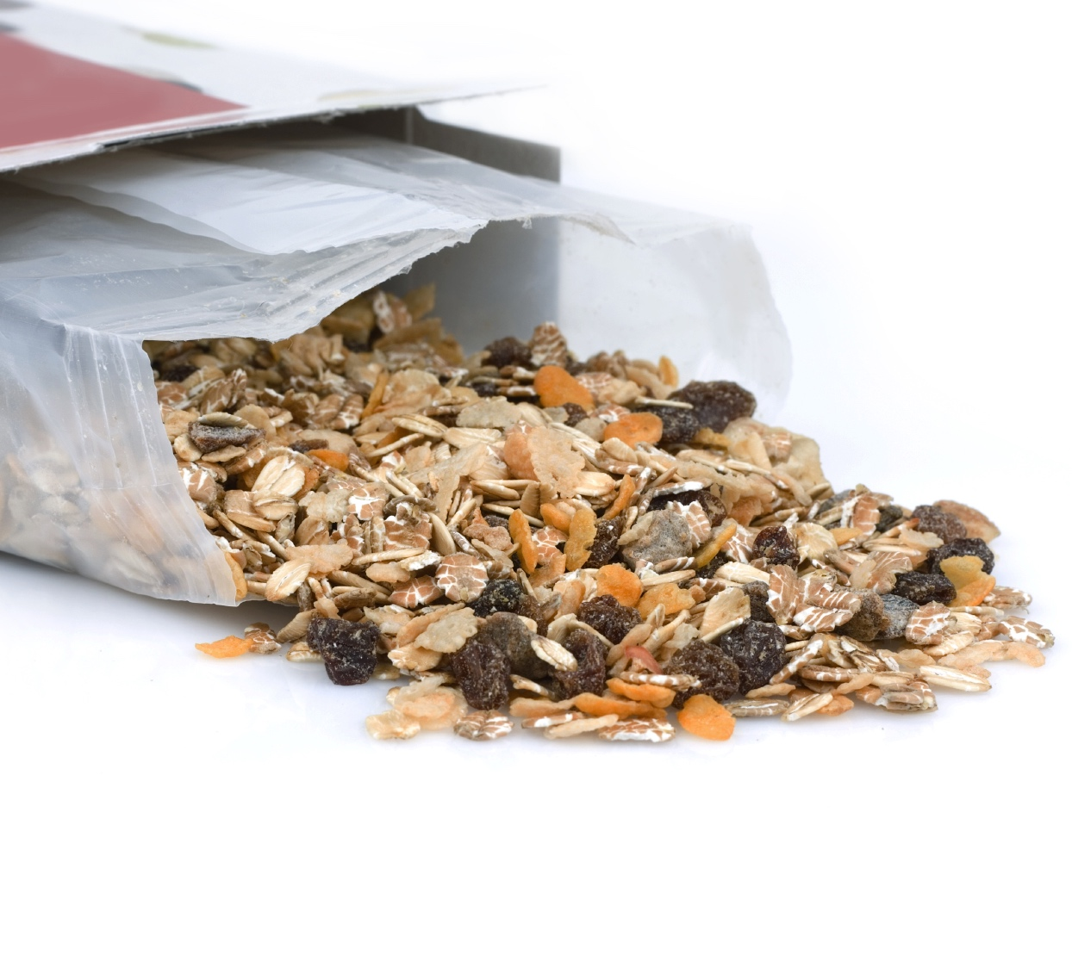
Selecting Creditable
Breakfast Cereals
WIC-Approved Breakfast Cereals List
Table Method
Notes:
SAY:
The great news is there are two easy ways to identify creditable breakfast cereals:
WIC-Approved Breakfast Cereals List
Table Method
Each of these methods are valid ways of determining if a cereal meets the added sugars limit. Therefore, if a cereal falls within the added sugars limit using at least one of these methods, it is within the added sugars limit and is creditable.
Let’s review both methods to identify which one is best for you and your program. Turn to the Breakfast Cereal and Added Sugars Guide handout in your Participant’s Workbook.
NOTE TO INSTRUCTOR: The handout was separated into two sections to align with the script.

Slide 117

Use WIC-Approved Breakfast Cereal Lists
All WIC approved breakfast cereals meet the added sugars limit
Website: www.fns.usda.gov/wic/wic-contacts
Notes:
SAY:
The first method calls for you to use WIC-Approved breakfast cereal list. Similar to the CACFP, all WIC-approved breakfast cereals must meet the added sugars limit. Therefore, if you choose a breakfast cereal from any approved WIC cereal list, it will meet the added sugars limit requirements for breakfast cereals. To locate WIC-approved food lists for each state, visit the following website: www.fns.usda.gov/wic/wic-contacts.

Slide 118
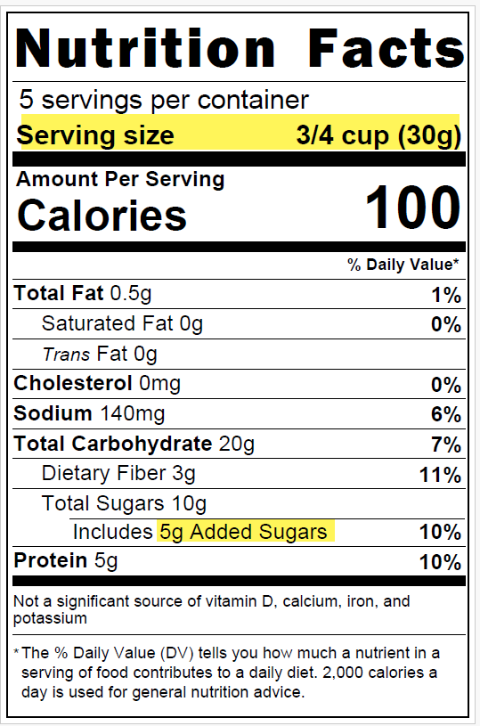
Table Method: Breakfast Cereal
Breakfast Cereal Added Sugars Limits
Serving Size | Added Sugars Limit
If the serving size is: | Added Sugars must not be more than:
0–2 grams | 0 grams
3–7 grams | 1 gram
8–11 grams | 2 grams
12–16 grams | 3 grams
17–21 grams | 4 grams
22–25 grams | 5 grams
26–30 grams | 6 grams
31–35 grams | 7 grams
Notes:
SAY:
The next way for determining if a breakfast cereal meets the added sugars limit is to use the table method. Very similar to determining yogurt products that meet the added sugars limit, this method uses a table to help identify breakfast cereals that meet the added sugars limit.
It features pre-calculated added sugars limits for common serving sizes for breakfast cereals. In addition to finding this method on the Breakfast Cereal and Added Sugars Guide handout, you can also find it on the USDA Team Nutrition’s training worksheet “Choose Breakfast Cereals That Are Low in Added Sugars.” The link to this memo is listed on the Training Resources handout in the Appendix of your Participant’s Workbook.
Take 1–2 minutes to review the Breakfast Cereal and Added Sugars Guide handout.
DO:
Allow 1–2 minutes for participants to review the handout, and then review the steps with the participants. After you have completed this task, ask if there are any questions before advancing to the next slide.

Slide 119
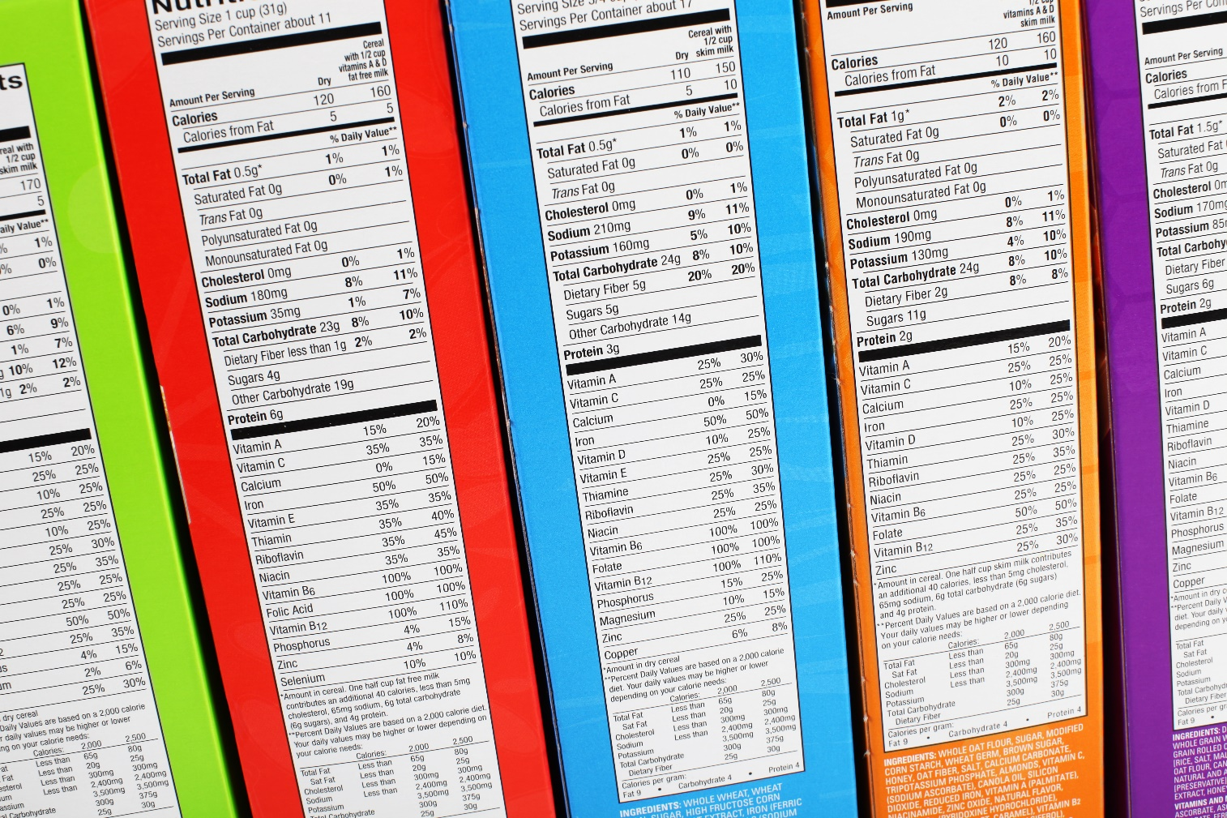
Activity: Breakfast Cereal, Is It Creditable?
Notes:
DO:
(Activity): Breakfast Cereal, Is It Creditable?
The purpose of this activity is to determine if each cereal meets the breakfast cereal guidelines for the CACFP meal pattern requirements.
Materials Needed: Breakfast Cereal, Is It Creditable? worksheet, pen or pencil
Time: 5–10 minutes
Instructions:
SAY: Please turn to the Breakfast Cereal, Is It Creditable? worksheet in your Participant’s Workbook. Review each label. Then, use the table method (added sugars limits table) to determine if the breakfast cereal meets the CACFP added sugars limit.
DO: Allow 5–10 minutes for the participants to complete the assignment. Then, review the answers with the participants using the following answer key.

Slide 120

Grain-Based Desserts
Source of added sugars & saturated fats
  Increases risk of chronic illnesses
Not creditable toward the grains component
Notes:
OBJECTIVE 4: Participants will be able to recall at least five creditable alternatives to grain-based desserts.
SAY:
The next major update to the grains component focuses on grain-based desserts. According to the Dietary Guidelines for Americans (DGA), grain-based desserts are sources of added sugars and saturated fats. Eating too much sugar and saturated fat may increase the risk of heart disease, stroke, and other chronic illnesses. Because of these findings, grain-based desserts are not creditable toward the grains component in the CACFP.

Slide 121



Exhibit A: Grain Requirements for Child Nutrition Programs
Superscripts 3 & 4:
  Grain-based dessert – not creditable
  Example: breakfast bars, brownies, cakes, cereal bars, cookies, etc.
Superscript 5:
  Sweet cookies – graham crackers and animal crackers
  Creditable
Notes:
SAY:
Turn to the Exhibit A: Grain Requirements for Child Nutrition Programs handout in your Participant’s Workbook. USDA revised this chart to be consistent with other child nutrition programs and to provide an easy identifier for grain-based desserts.
Grain-based desserts are those food items found in the Food Buying Guide for Child Nutrition Professional’s Exhibit A with a superscript 3 or 4. These items include:
Breakfast bars
Brownies
Cakes
Cereal bars
Cookies
Doughnuts
Granola bars
Sweet pie crusts
Sweet rolls
Toaster pastries
There is one exception for cookies, and it is indicated with a superscript 5. Sweet crackers, consisting of graham crackers in all shapes and animal crackers are creditable as part of a reimbursable meal or snack.

Slide 122


“Exhibit A is not a complete list of grain-based desserts …”
Notes:
SAY:
It is important to note that although the Exhibit A chart lists specific grain-based desserts, it is not an exhaustive list. For example, sweet scones, sweet bread pudding, and rice pudding are grain-based desserts, while savory scones and savory bread pudding are not.

Slide 123

Exhibit A (cont.)
Some foods are not easily identified as
grain-based dessert
  Example: a cookie is labeled “breakfast round”
Ask the question:
  Is this food thought of as a dessert?
Notes:
SAY:
Also, some foods are advertised in a way that may not be easily identified as a grain-based dessert. For example, a cookie may be labeled a “breakfast round.”
When planning menus and searching for creditable grains, always ask the question, “Is this food thought of as a dessert?” If so, then it is likely a grain-based dessert. If you are unsure about a food item, always work with your sponsoring organization or State agency to determine if a food item is a grain-based dessert.

Slide 124

Grain-Based Desserts
& Special Occasions
Annual festival, birthday celebrations, end-of-year bash, or other special events
May be served as an additional item only
Notes:
SAY:
Often, grain-based desserts are served during special occasions, such as an annual festival, birthday celebrations, end-of-year bash, or other special events. Therefore, you have the flexibility to serve grain-based desserts as additional items; however, these items are not reimbursable.

Slide 125
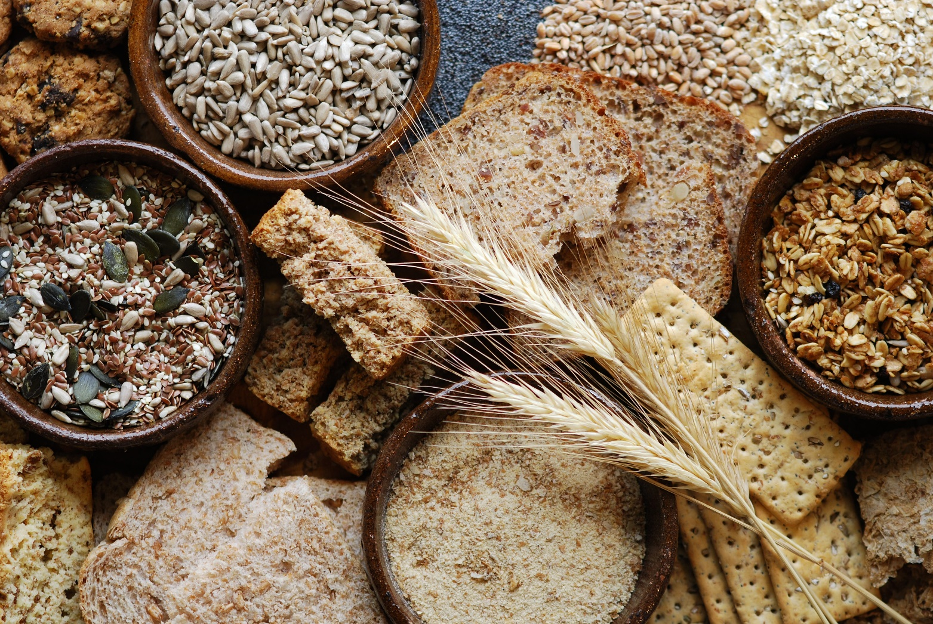
Activity: Speed Grains
Notes:
DO:
(Activity): Speed Grains
The purpose of this activity is to identify at least five creditable alternatives to grain-based desserts.
Materials Needed: Grain-Based Dessert posters (Cakes, Cookies, Sweet pie crusts, Doughnuts, Granola bars, and Sweet rolls), Grain-Based Dessert Alternatives worksheet, painter’s tape, bell, timer/watch, pen or pencil
Time: 15 minutes
Instructions:
DO: Post the Grain-Based Dessert posters throughout the room. Ask the participants to turn to the Grain-Based Dessert Alternatives worksheet in their Participant’s Workbook.
SAY: We are going to complete an activity identifying alternatives to grain-based desserts, called Speed Grains. Around the room, you will find six posters with grain-based desserts. In your groups, identify a minimum of three options to serve in place of each grain-dessert. These items can be other grains or non-grain items. You will have exactly 1 minute to identify alternatives for each poster. I will ring the bell when you are to start and stop. Please stand up, and find your first poster.
DO: Announce when to start. Then, every minute ask each group to switch. After everyone has finished, ask if there are any questions.
FEEDBACK:
There are no right or wrong answers for this activity, with the exception that all alternatives should not be a grain-based dessert. For some example for each grain-based dessert, refer to the Answer Key: Grain-Based Dessert Alternatives.

Slide 126
Lesson Conclusion
At least 1 serving of grains per day must be whole grain-rich
Breakfast cereals must meet the added sugars limit
Grain-based desserts do not credit toward the grain component
Use ounce equivalents (oz eq) to determine the amount of creditable grains
Notes:
CONCLUSION
SAY:
Throughout this lesson, we explored three key topics for meeting the updated meal pattern requirements. In particular, we explored these four updates:
At least 1 serving of grains per day must be whole grain-rich
Breakfast cereals must meet the CACFP added sugars limit.
Grain-based desserts do not credit toward the grain component
Use ounce equivalents (oz eq) to determine the amount of creditable grains
ASK:
At this time, are there any questions before we move to the last activity in this lesson?
DO:
Answer any questions, and then begin the next activity.
NOTE TO INSTRUCTOR: If there are questions that you are unable to answer, refer the participant(s) to their State agency or to the ICN Help Desk.

Slide 127
Activity: Apply in Three
Notes:
DO:
(Activity): Apply in Three
The purpose of this activity is to ensure participants identify an action plan for implementing the Grains component requirements.
Materials Needed: Apply in Three worksheet, pen or pencil
Time: 5–10 minutes
Instructions:
SAY: Turn to the Apply in Three worksheet in your Participant’s Workbook. Write at least three things you learned about the Grains component, how you will apply this information, and the estimated date in which you would like to have completed each action item. Once you have finished, stand up, find someone from a different group, and share your responses.
DO: Allow 3–5 minutes for participants to complete this activity. Then, request volunteers to share their responses.
FEEDBACK:
There are no right or wrong answers for this activity. However, some potential responses might include those noted in the following Answer Key: Apply in Three.
NOTE TO INSTRUCTOR: If this training is offered in the comprehensive 6-hour version, skip the lesson post-assessment. However, if this training is offered in individual lesson form, follow the instructions below to complete the post-assessment.

Slide 128
Post-Assessment
Notes:
DO:
Post-Assessment
The purpose of the Post-Assessment is to determine what the participants learned throughout the training.
Materials Needed: Post-Assessment, Training Evaluation, and pen or pencil
Time: 5–10 minutes
Instructions:
DO: Distribute the Post-Assessment and the Training Evaluation.
SAY: The Post-Assessment is designed to assess what you have learned during this training. Begin by placing a four-digit number in the box at the top of your assessment. Then, complete the Post-Assessment by reading each question carefully and selecting the best answer. Upon completion, please complete the training evaluation.
DO: Allow a minimum of 5–10 minutes for participants to complete the Post-Assessment. Remind them to list the identifier they used on the Pre-Assessment. Following, collect the Post-Assessments and the Training Evaluations, and return them to the ICN. Then, dismiss the participants from the training.
NOTE TO INSTRUCTOR: If this training is not sponsored by the ICN, allow the participants to keep their assessments. Review the answers with them using the Answer Key in the Appendix section. Then, dismiss the participants from the training.

Slide 129

Lesson: Child & Adult Meal Service Updates
Notes:
DO:
To begin this lesson, advance to the next slide.

Slide 130

Meal Service Overview
Explore additional measures for serving nutritious meals
  Elimination of deep-fat frying on-site
  Family style meal service
  Using offer versus serve in at-risk afterschool programs
Notes:
SAY:
The updated requirements feature three key major updates preparing and serving nutritious meals and snacks:
Deep-fat frying is not allowed as a way of preparing foods on-site.
The guidelines for serving meals family style.
Offer versus serve (a type of meal service) is extended to at-risk afterschool programs.

Slide 131
Lesson Objectives
List at least four cooking methods for preparing nutritious meals
Summarize two types of meal services for serving meals in the CACFP
Identify at least three strategies for avoiding rewards and punishment during mealtimes
Notes:
SAY:
Throughout this lesson, we will explore the major updates through the following objectives:
List at least four cooking methods for preparing nutritious meals
Summarize two types of meal services for serving meals in the CACFP
Identify at least three strategies for avoiding rewards and punishment during mealtimes
At the end of this lesson, you should know the latest updates, as well as some key strategies for implementation.
NOTE TO INSTRUCTOR: If this training is offered in the comprehensive 6-hour version, skip the lesson pre-assessment. However, if this training is offered in individual lesson form, follow the instructions below to complete the pre-assessment.

Slide 132
Pre-Assessment
Notes:
DO:
Pre-Assessment
The purpose of this Pre-Assessment is to determine current knowledge of the updated meal pattern requirements.
Materials Needed: Pre-Assessment and pen or pencil
Time: 5–10 minutes
Instructions:
SAY: Before we begin objective 1, let’s assess what you already know by completing a Pre-Assessment.
DO: Distribute the Pre-Assessment.
SAY: Now that you have the Pre-Assessment, begin by placing a four-digit number in the box at the top of your assessment. Make a note of this number, as you will use it again when completing the Post-Assessment. Then, read each question carefully and select the best answer. When you have finished, place your assessment in the center of the table (or in a specified location).
DO: Allow a minimum of 5–10 minutes for participants to complete the Pre-Assessment. Remind them to list a non-identifier and to make a note of it for the Post-Assessment. Then, collect each assessment and set them aside.
NOTE TO INSTRUCTOR: If the Institute of Child Nutrition (ICN) sponsors this training, collect the Pre-Assessments and return them along with the evaluations to ICN.

Slide 133

Deep-Fat Frying
May not be used to prepare meals on-site
  Includes central & satellite kitchens
Defined as food submerged in hot oil or other fat
Can be dangerous
Too many deep-fat fried foods may contribute to chronic illnesses
Notes:
OBJECTIVE 1: Participants will be able to list at least four cooking methods for preparing nutritious meals.
SAY:
Let’s begin by discussing approved cooking methods.
ASK:
How many of you are aware of the cooking method deep-fat frying?
DO:
Allow participants to respond.
SAY:
Deep-fat frying simply means to cook a food by submerging it in hot oil or other fat. Often this method is used when cooking foods such as fried chicken, French fries, and even potato chips. Not only can it be dangerous, eating too many deep-fat fried foods can contribute to chronic illnesses, such as heart disease, stroke, and even some forms of cancer because of the large amounts of calories and saturated fat.
As a result, the updated requirements no longer allow deep-fat frying as a way to prepare foods on-site. This update also applies to central, satellite kitchens, in which they may not deep-fat fry foods and then deliver them to a center or home to be claimed for reimbursement.

Slide 134

Foods Fried Off-Site
May purchase from commercial manufacturer
  Pre-fried
  Flash-fried
  Par-fried
  Deep-fat fried
May not deep-fry when reheating
Notes:
SAY:
Foods that are pre-fried, flash-fried, par-fried, or deep-fat fried by a commercial manufacturer may be purchased and served in a reimbursable meal. Similarly, CACFP facilities that vend meals may claim vended meals that contain deep-fat fried foods as long as the food was prepared by the vendor offsite. These pre-fried items must be reheated by a method other than deep-fat frying.
Refer to the Cooking Methods handout in your Participant’s Workbook for some alternative ways to deep-fat frying.

Slide 135

Preparing Nutritious Foods
Notes:
DO:
(Activity): Preparing Nutritious Foods
The purpose of this activity is to provide opportunities for participants to identify ways for preparing nutritious foods.
Materials Needed: Chart paper, markers, and pen or pencil
Time: 5 minutes
Instructions:
SAY: Now that we have reviewed the requirements for deep-fat frying, let’s explore some ways for preparing nutritious foods on-site. In your groups, discuss some ways for preparing nutritious foods for child or adult participants. For example, roasting chicken instead of frying it or using a specific herb instead of sugar or salt. Then, use your chart paper to list your ideas.
DO: Distribute chart paper to each group. Allow a minimum of 2–3 minutes for participants to complete this activity. Ask each group to share their ideas with the class. If this is a large group, request that each group only share one idea.
FEEDBACK:
There are no right or wrong answers for this activity. However, the answers should focus on good practices for preparing nutritious meals with limited sugar, fat, and sodium. Some examples might include:
Preparing recipes from scratch to control the ingredients
Serve lean means
Use olive oil instead of butter
Serve more fresh fruits than those canned in syrup
Use brown rice instead of white rice

Slide 136

Types of Meal Service in the CACFP
Meal service impacts what participants eat
Meal service types:
  Family Style
  Offer Versus Serve (OVS)
  Pre-plated meals
Notes:
OBJECTIVE 2: Participants will be able to summarize two types of meal services for serving meals in the CACFP.
ASK
Let’s take a minute to think about meal service in a restaurant. When you receive poor meal service, the portion sizes are too large or too small, or if there are other issues such as food safety; how does this affect your overall meal experience? Are you able to eat the meals comfortably?
DO:
Allow participants to respond.
SAY:
Just like our experiences as adults, the way meals are served can have an impact on all participants eating meals and snacks while in our care. Therefore, the updated requirements focus on providing positive experiences and serving nutritious meals through two types of meal services: Family style meal service and offer versus serve (OVS).
It is important to note that both meal services are optional; you may also choose to serve meals pre-plated in your facility.
Let’s begin with exploring family style meal service.
NOTE TO INSTRUCTOR: Disregard discussing offer versus serve if there are no participants from at-risk after school programs or adult day care programs.

Slide 137

“Family Style Meal Service (FSMS) allows children & adults to serve themselves from common serving bowls & platters of food …”
Supervising adults may help as needed
Notes:
SAY:
Family style meal service (FSMS) is a meal service that allows children and adults to serve themselves from common serving bowls and platters of food with the help of supervising adults, if needed.

Slide 138
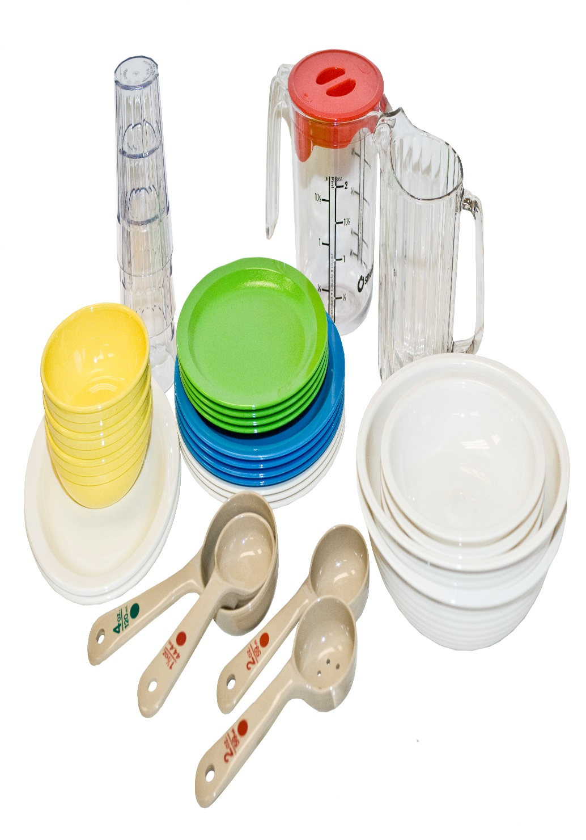
Benefits of FSMS
Promotes social, emotional, & motor skills
Encourages children to try new foods
Provides control over eating for children & adults
Notes:
SAY:
FSMS is highly encouraged in both child care and adult care settings for many reasons. For example, young children benefit from FSMS because it:
Promotes the development of social, emotional, and motor skills
Encourages children to try new foods
Provides children with control over their eating
Adults also benefit from meals served family style because it gives them more control over their serving sizes. Also, adults are generally accustomed to eating meals family style.

Slide 139

Meal Pattern Requirements & FSMS
Optional, but highly encouraged
Some children may need to develop necessary skills
  Example: passing, pouring, serving
  Allow time to practice each skill
Notes:
SAY:
Although FSMS is highly encouraged and offers many benefits to young children and adults, it may not be appropriate for some CACFP settings or age groups. For example, younger children, such as 1 year olds, may first need to develop the necessary skills for passing, pouring, and serving themselves before beginning FSMS.
Also, you may find that you may need to begin with allowing young children to serve themselves one meal component, followed by one meal or snack.
Therefore, the updated meal pattern requirements encourage, but do not require, meals to be served family style. If you should choose to serve meals family style, there are some key requirements outlined in the updated meal pattern.

Slide 140
FSMS Guidelines
Place enough food at each table to provide the required portions
  Children, adults, & supervising adults (optional)
Example: 3 children (3–5 years) & 1 supervising adult
  Minimum serving size is ¼ cup for sliced apples
  Place 1 cup of sliced apples in shared bowl
  Includes ¼ cup for supervising adult
Notes:
SAY:
First, enough food must be placed on each table to provide the minimum serving sizes for each meal component for children and adults, and to accommodate supervising adults that are eating with the participants.
For example, there are three children between the ages of 3–5 years old and 1 supervising adult seated at the table for lunch. The minimum serving size for fruit is ¼ cup for 3–5 year olds. In order for all children and the supervising adult to have the minimum serving size, place 1 cup of sliced apples in the serving bowl. In this example, each participant and the supervising adult would serve themselves ¼ cup to meet the minimum requirement for the fruit component.
This requirement also applies when you choose to serve only one or two meal component(s) family style to allow children to grow accustomed to FSMS. You must provide the minimum serving size.

Slide 141

Juice & Milk
Participants must be allowed to serve themselves meal components
Optional for children & adults to serve themselves juice or milk
Supervising adults must serve the required minimum serving size
Notes:
SAY:
Children and adults must be allowed to serve the meal components themselves, with milk or juice being the exception. Supervising adults may serve juice or milk to participating children and adults. If a CACFP facility chooses to have the supervising adult serve the beverages to the children and adults, they must serve the required minimum quantity to each child and adult.

Slide 142

Portion Amount
Children & adults may take smaller portions
Actively encourage participants to take the full serving
If the food is refused, do not force
  Meals are reimbursable if all meal components are offered
Notes:
SAY:
Children and adults may take smaller portions than required. In that situation, providers are responsible for actively encouraging children and adults to take the full serving size. Every child and adult should initially be offered and encouraged, but never forced to take the full serving size of each meal component required for his or her age group. If a child or adult does not take a component or the full serving size of a component, the meal is still reimbursable as long as all the meal components are offered.

Slide 143

Supervising Adults
&
FSMS
Supervising adult meals are not reimbursable
Cost of adult meals is an allowable expense
Notes:
SAY:
Eating meals with children is one of the most important ways of promoting healthy eating habits. When children see you eating a variety of nutritious foods, they are more likely to try them. Although meals for supervising adults are not reimbursable, the cost of adult meals is an allowable expense. Refer to your State agency for additional information on allowable meal costs for supervising adults.

Slide 144

SHOUT IT OUT!
FSMS
Notes:
DO:
(Large Group Discussion): Shout It Out: FSMS
Instructions:
ASK: For those of you using family style meal service, shout out some steps you have taken to implement family style meal service?
DO: Encourage participants to share their insight. Refer participants to the Discussion Highlights: Family Style Meal Service worksheet in their Participant’s Workbook to list any key points noted during the discussion. Then, recommend participants refer to the Support Family Style Meals handout in your Participant’s Workbook and the full version of this handout in the Nutrition and Wellness Tips for Young Children: Provider Handbook for the CACFP for additional ways to serve meals family style. They can find a link to this resource on the Training Resource handout.
FEEDBACK:
There are no right or wrong answers for this activity. However, some potential responses might include those noted in the following Answer Key: Family Style Meal Service.
NOTE TO INSTRUCTOR: Skip the next slides on offer versus serve if there are no participants from at-risk afterschool programs or adult day care programs.

Slide 145

Offer Versus Serve
Adult day care facilities & at-risk afterschool programs only
Not appropriate for young children
  Need time to explore flavors, textures, etc.
Notes:
SAY:
The next meal service we will discuss is Offer Versus Serve (OVS). This meal service is distinctly different from family style meal service. Specifically, it is only allowed in adult day care centers and at-risk afterschool programs.
Child care centers or homes may not serve meals through OVS. Reason being, young children are learning about new tastes and textures, and developing eating habits. They rely on those around them, including their providers, parents, and other children, to introduce them to new foods. OVS may limit their exposure to new foods. Therefore, this meal service is only allowed for adults and older children attending adult day care centers and at-risk afterschool programs.

Slide 146

Benefits of Using OVS
Operators may serve food
pre-portioned or directly
Participants may decline one or two of the meal components or items
May not be used for snacks
Notes:
SAY:
There several reasons to implement OVS in your adult day care center or at-risk afterschool program. Specifically, it allows participants to decline some food items offered in a reimbursable meal, while choosing those that appeal to them. Given adults and older children food choices, not only reduces food waste, but it also supports the idea that they are more likely to select and eat the foods they enjoy. In addition, you may serve meals pre-portioned or directly to the participant. Therefore, OVS is a great option for reducing food cost, while providing nutritious and reimbursable meals.

Slide 147
OVS Key Terms
Meal component: one of the five food categories that make up a reimbursable meal
Food item: a specific food offered within the meal components
Combination food: contains more than one food item from different meal components that cannot be separated
Notes:
SAY:
Before planning to incorporate OVS in your adult day care center or at-risk afterschool program, there are three key terms you should know to ensure your meals are reimbursable.
Meal component: A meal component is one of the five food categories that make up a reimbursable meal. All meals must contain the minimum meal components and in the minimum serving size for reimbursement.
Food item: A food item is a specific food offered within the meal components making up a reimbursable meal. For example, separate ½ cup servings of broccoli and carrots are two food items that make up the vegetables component.
Combination Food: A combination food contains more than one food item from different meal components that cannot be separated, such as soups, prepared sandwiches, burritos, and pizzas. For example, a vegetable pizza contains three food items from three different meal components: a serving of grains (crust), a serving of vegetables (vegetable toppings), and a serving of meat alternate (cheese).

Slide 148

Serving Meals OVS
Allowed at breakfast, lunch, & supper
OVS is not allowed at snack
  Two components
Notes:
SAY:
When serving OVS meals, you may only serve them at breakfast, lunch, and supper. It is not allowed at snack because there are only two required components.
Let’s review each meal to identify the basic requirements for OVS meals.

Slide 149
OVS at Breakfast
Offer four different food items, in the minimum serving sizes
  Milk
  Vegetable & fruit
  Grain
  One food item from the meats/meat alternates component or one additional item from the fruits & vegetables component or grains component
Notes:
SAY:
When using OVS at breakfast, you must offer four different food items, in the minimum serving sizes. These items must come from the following components:
Milk
Vegetable and fruit
Grain
One food item from the meats/meat alternates component or one additional item from the fruits and vegetables component or grains component

Slide 150
Reimbursable OVS Breakfast
Participants must take at least three different food items
Sample option
  ½ cup bananas
  ½ cup strawberries
  1 serving whole grain pancakes
  1 cup (8 oz) of fluid milk
Notes:
SAY:
Participants must take at least three different food items from any of those offered. For example, at breakfast you offered:
½ cup bananas
½ cup strawberries
1 serving whole grain pancakes
1 cup (8 oz) of fluid milk
The child or adult participant selects bananas, pancakes, and milk; or bananas, strawberries, and milk. These selections will credit as a reimbursable breakfast meal because they selected three different items in the minimum serving sizes.

Slide 151


OVS at Lunch & Supper
Offer at least one food item from each of the five meal components
  Milk
  Meats/meat alternates
  Vegetables
  Fruits
  Grains
Notes:
SAY:
When using OVS at lunch and supper, you must offer at least one food item, in the minimum serving sizes, from each of the five meal components:
Milk
Meats/meat alternates
Vegetables
Fruits
Grains

Slide 152
Reimbursable OVS Lunch or Supper
Participants must take at least three meal components
Sample option
  2 ounces Parmesan Chicken
  ½ cup fruit salad
  ¼ cup broccoli
  1 cup pasta
  1 cup (8 oz) of fluid milk
Notes:
SAY:
Participants must take at least three meal components in the minimum serving sizes for a reimbursable meal. For example, at lunch you offered:
2 ounces Parmesan Chicken
½ cup fruit salad
¼ cup broccoli
1 cup pasta
1 cup (8 oz) of fluid milk
The child or adult participant may take 2 ounces of parmesan chicken, ¼ cup of broccoli, and 1 cup of milk as a reimbursable meal. It is important to note that milk is optional for supper in adult day care centers, and it does not need to be offered when serving an OVS supper.
For additional information on OVS, refer to the policy memo, CACFP 05-2017 Offer Versus Serve and Family Style Meals in the Child and Adult Care Food Program. The link to this memo is included on the Training Resource handout in the reference section of your Participant’s Workbook.

Slide 153

Activity: OVS: Is It Reimbursable?
Notes:
DO:
(Activity): OVS: Is It Reimbursable?
The purpose of this activity is ensure participants understand the basic requirements of OVS at breakfast, lunch, and supper.
Materials Needed: Offer Versus Serve in the Child and Adult Care Food Program handout and the OVS in the CACFP Review worksheet, pen or pencil
Time: 5 minutes
Instructions:
SAY: Now that we have reviewed the basics for serving meals OVS, let’s complete an activity. Please turn to the Offer Versus Serve in the Child and Adult Care Food Program handout and the OVS in the CACFP Review worksheet in your Participant’s Workbook. Take a few minutes to read the scenario to determine if each meal or snack is reimbursable.
DO: Allow 3–5 minutes for participants to complete this activity. Then, review the answers using the following Answer Key: OVS in the CACFP Review.

Slide 154
Reward & Punishment
Negative effect on development & socialization
Rewards may lead to cavities & weight gain
Punishment may cause overeating
Not allowed in CACFP facilities
Notes:
OBJECTIVE 3: Participants will be able to identify at least three strategies for creating positive mealtime experiences.
SAY:
The last update for meal services focuses on rewarding and punishment. Using food as a reward for good behavior or punishment for less pleasing behaviors may have a negative effect on children’s development and socialization. For example, providing children sweet treats after they put away their toys may cause them to develop unhealthy eating habits, and these habits may cause cavities, weight gain, and other health problems.

Slide 155

Forcing Children to Eat
Causes children to eat more than they need
Fail to listen to hunger cues
Increases risk of being overweight
Not allowed in CACFP facilities
Notes:
SAY:
Another example is forcing children to eat all of their food before they can to leave the table. This method can cause children to eat more than they need and not listen to their hunger cues, increasing their risk of becoming overweight or obese. Therefore, the updated meal pattern requirements do not allow the use of food and beverage as a punishment or reward.

Slide 156

Activity: Meal Service Tips
Notes:
DO:
(Activity): Meal Service Tips
The purpose of this activity is to identify ways for creating positive mealtime experiences for all participants.
Materials Needed: Chart paper, markers, and pen or pencil
Time: 10 minutes
Instructions:
SAY: Think about mealtimes and the importance of positive mealtime experiences, free of rewarding and punishing participants. In small groups of three or four, create a list of tips for creating positive mealtimes for all participants.
DO: Allow 5–10 minutes for participants to complete this activity. Then, ask each group to share their responses.
FEEDBACK:
Some potential responses may include the following examples.
Serve meals family style so participants can choose the amount of food they want to eat.
Food and beverages are at the table at the start of each meal.
Supervising adults eat lunch with participants.
Supervising adults make positive remarks about the food and show enjoyment in eating.
Meal areas are away from major walkways to reduce distractions.

Slide 157

Lesson Review
Approved methods for preparing food
Meal services
  Family Style Meals
  Offer Versus Serve
Notes:
SAY:
In this lesson, we discussed some strategies for preparing and serving nutritious foods in CACFP settings. We focused on key ways for preparing nutritious foods and on strategies for serving meals through family style meal service and offer versus serve.
ASK:
At this time, are there any questions before we move to the last activity in this lesson?
DO:
Answer any questions, and then begin the next activity.
NOTE TO INSTRUCTOR: If there are questions that you are unable to answer, refer the participant(s) to their State agency or to the ICN Help Desk.

Slide 158
Activity: Apply in Three
Notes:
DO:
(Activity): Apply in Three
The purpose of this activity is to ensure participants identify an action plan for implementing meal service requirements for children and adults.
Materials Needed: Apply in Three worksheet and pen or pencil
Time: 5–10 minutes
Instructions:
SAY: Turn to the Apply in Three worksheet in your Participant’s Workbook. Write at least three things you learned about the latest requirements for meal services, how you will apply this information, and the estimated date in which you would like to have completed each action item. Once you have finished, stand up and find someone from a different group, and share your responses.
DO: Allow 3–5 minutes for participants to complete this activity. Then, request volunteers to share their responses.
FEEDBACK:
There are no right or wrong answers for this activity. However, some potential responses might include those noted in the following Answer Key: Apply in Three.
NOTE TO INSTRUCTOR: If this training is offered in the comprehensive 6-hour version, complete the comprehensive post-assessment. However, if this training is offered in individual lesson form, complete the lesson post-assessment.

Slide 159
Post-Assessment
Notes:
NOTE TO INSTRUCTOR: If this training is offered in the comprehensive 8-hour version, complete the comprehensive post-assessment. However, if this training is offered in individual lessons, complete the lesson post-assessment.
DO:
Post-Assessment
The purpose of the Post-Assessment is to determine what the participants learned throughout the training.
Materials Needed: Post-Assessment, Training Evaluation, and pen or pencil
Time: 5 minutes
Instructions:
DO: Distribute the Post-Assessment and the Training Evaluation.
SAY: The Post-Assessment is designed to assess what you have learned during this training. Begin by placing the non-name identifier, used for your Pre-Assessment, at the top of the page. Then, complete the Post-Assessment by reading each question carefully and selecting the best answer. Upon completion, please complete the training evaluation.
DO: Allow a minimum of 5 minutes for participants to complete the Post-Assessment. Remind them to list the identifier they used on the Pre-Assessment. Collect the Post-Assessments and the training evaluation. Then, dismiss the training.

Slide 160

Training Conclusion
Notes:
DO:
To begin this lesson, advance to the next slide.

Slide 161
Training Summary
CACFP Meal Pattern Updates
  Components
  Meal Service
Apply in Three: Action plans for implementation
Notes:
SAY:
In today’s training, we explored the updated CACFP meal pattern requirements. We focused on each of the meal component updates as well as the requirements for serving meals in CACFP settings. Most importantly, we identified ways to use this information when you return to your facility through a variety of different activities, such as the Apply in Three.
ASK:
Are there any questions that we have not covered on today?
DO:
Answer any posing questions and check the “bike rack” to confirm there are no posing questions.

Slide 162

Post-Assessments, Evaluations, & Certificates
Notes:
SAY:
I would like to thank you for attending this training and actively participating in the learning activities. Before we end today, the last activities involve the assessment, course evaluation, and training certificates.
DO:
Post-Assessment
The purpose of the Post-Assessment is to determine what the participants learned throughout the training.
Materials Needed: Post-Assessment, Training Evaluation, Training Certificates, and pen or pencil
Time: 10–15 minutes
Instructions:
DO: Distribute the Post-Assessment and the Training Evaluation.
SAY: The Post-Assessment is designed to assess what you have learned during this training. Begin by placing the same four-digit number used on the Pre-Assessment in the box at the top of your assessment. Then, complete the Post-Assessment by reading each question carefully and selecting the best answer. Upon completion, please complete the training evaluation.
DO: Allow a minimum of 10–15 minutes for participants to complete the Post-Assessment. Remind them to list the identifier they used on the Pre-Assessment. Following, collect the Post-Assessments and the Training Evaluations and set them aside to be returned to ICN. Distribute Training Certificates, and dismiss the participants from the training.
Image source: https://unsplash.com/photos/t48eHCSCnds

Slide 163




www.theicn.org 800-321-3054
Email: helpdesk@theicn.org
Follow ICN on Social Media!
facebook.com/ichildnutrition
@ichildnutrition
instagram.com/theicn
linkedin.com/company/theicn

